Slide 1
Broadcast Receivers
Broadcast Receivers are one of four components of an App (other three are Activity, Services and Content Providers).
Respond to system wide announcements. Announcements can be generated by the Android system or other apps.
Examples of system generated announcements: Screen turned off, battery is low, picture captured etc.
Apps can also generate custom broadcasts by calling Context.sendBroadcast() method and passing an intent as a parameter.
To listen to broadcasts we need to register a receiver. This can be done:
statically by declaring in the manifest file.
dynamically using method Context.registerReceiver() and passing an instance of class that extends BroadcastReceiver class.
BroadcastReceiver.onReceive() method is invoked whenever a broadcast with intent matches our receiver’s filter.

Slide 2
The app instantiates a class which extends BroadcastReciever class
private final BroadcastReceiver broadcastReceiver = new BroadcastReceiver() {
@Override
public void onReceive(Context context, Intent intent) {
//Code to execute when broadcast is received.
}
};
Register receiver in onResume() callback method.
IntentFilter intentFilterWiFi = new IntentFilter(); // Instantiate new IntentFilter Class
intentFilterWiFi.addAction(WifiManager.WIFI_STATE_CHANGED_ACTION); // Specify the type of broadcast to listen
registerReceiver(broadcastReceiverWiFi, intentFilterWiFi); // Register the receiver.
Unregister the receiver in onPause() callback method to conserve resources.
unregisterReceiver(broadcastReceiverWiFi);
Send custom broadcast in our app.
Intent intent = new Intent(); //Instantiate Intent Class
intent.setAction(getPackageName() + ".uniqueIntentCustom"); //Specify the intent action that other apps
//should use to receive this broadcast
sendBroadcast(intent); //Broadcast using sendBroadcast() method

Slide 3
The app also registers Power connected/disconnected receiver statically in the AndroidManifest.xml file. This allows the onReceive() method to be invoked automatically when ever power is connected or removed even when the app is not running.
<receiver android:name=".PowerConnBroadcastReceiver"> <intent-filter> <action android:name="android.intent.action.ACTION_POWER_DISCONNECTED"/> <action android:name="android.intent.action.ACTION_POWER_CONNECTED"/> </intent-filter> </receiver>
The onReceive() method of the receiver invokes the main activity. This has the effect that when ever power is connected or disconnected, the MainActivity.class is invoked.
public void onReceive(Context context, Intent intent) { Intent intentNewActivity = new Intent(context, MainActivity.class); intentNewActivity.setFlags(Intent.FLAG_ACTIVITY_NEW_TASK) .addFlags(intent.FLAG_ACTIVITY_SINGLE_TOP); context.startActivity(intentNewActivity); }

Slide 4
Flags used (in onReceive() callback method):
FLAG_ACTIVITY_NEW_TASK:
Start the activity in a new task. If task is already running with the activity, invoke this instance and pass intent to onNewIntent() callback method.
Same as setting launchMode attribute with value of singleTask in AndroidManifest.xml.
FLAG_ACTIVITY_SINGLE_TOP:
If activity is currently on top of back stack, it is invoked instead of creating new instances of activity. onNewIntent() callback method is invoked.
Same as setting launchMode attribute with value of singleTop in AndroidManifest.xml.
onNewIntent() callback method in invoked when the parent activity is relaunched if the "FLAG_ACTIVITY_SINGLE_TOP“ flag is set on the intent used to start new activity.
protected void onNewIntent(Intent intent) { super.onNewIntent(intent); // Code to execute once activity is re-launched }

Slide 5
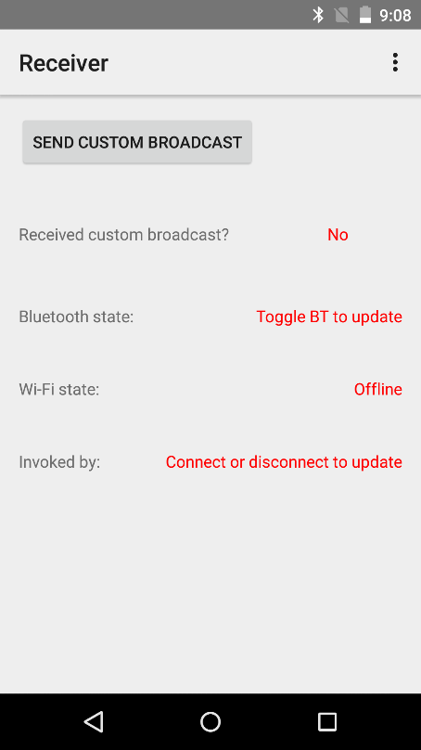
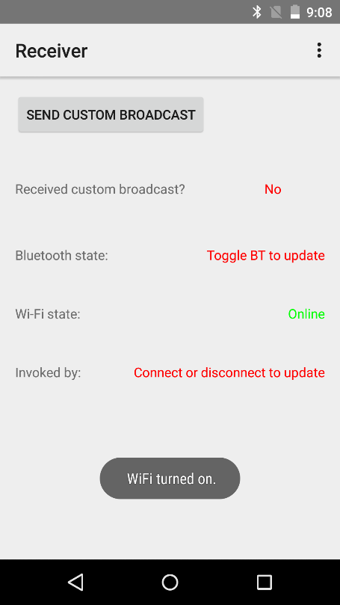
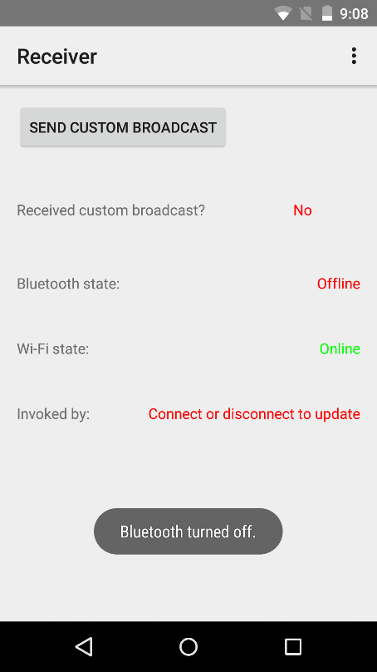
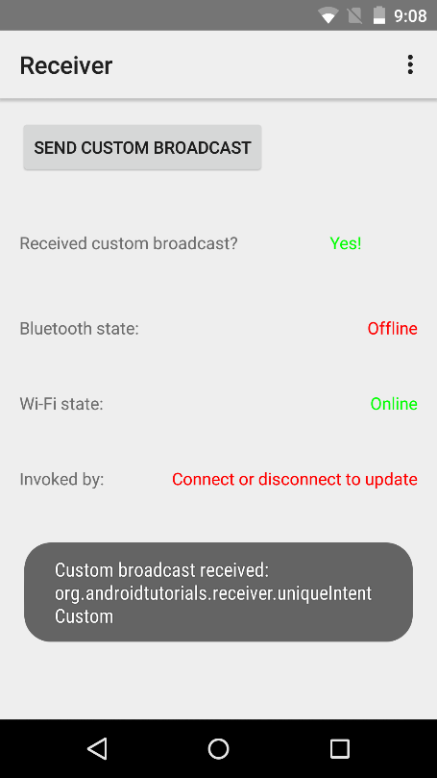
The app sends and receives one custom broadcast (click button) and receives two system broadcasts(BT and Wi-Fi).
After toggling Wi-Fi
After toggling Bluetooth
After sending custom broadcast
App start screen

Slide 6
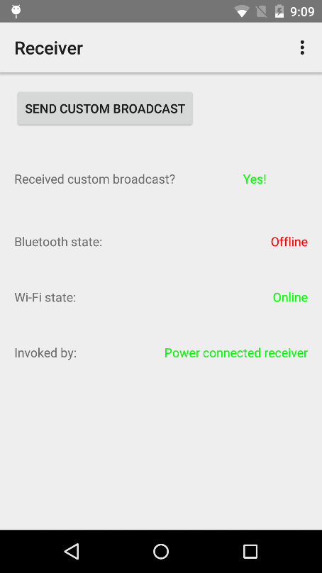
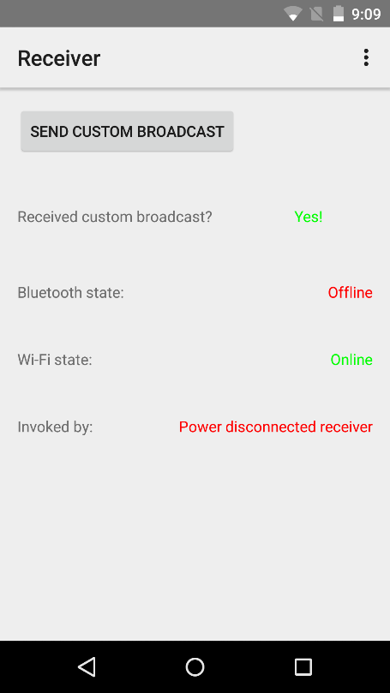
Activity started automatically after connecting power
Activity started automatically after disconnecting power

Slide 7
Two major classes of broadcasts.
Normal Broadcasts: use Context.sendBroadcast() method.
Asynchronous.
All the receivers of this broadcast are executed in undefined order.
Receivers cannot use result or abort the broadcast.
Advantages: Efficient, simple to use.
Ordered Broadcasts: use Context.sendOrderedBroadcast() method.
Broadcast are delivered one at a time based on priority.
Each receiver can propagate result to next receiver.
Receivers can abort the broadcast and prevent next receiver from receiving.
LocalBroadcastManager - Used to send intents to local objects within the app process.
We know the data we are sending within our app.
Other apps cannot broadcast to our app.
More efficient and secure compared to system wide broadcast.

Slide 8
References
BroadcastReceivers
Intents and Intent-Filters
LocalBroadcastManager
Task and Back Stack

Slide 9
Exercise:
Nothing to do!

