Slide 1
Android - Camera2
As of API level 21, Android has a new Camera API called Camera2.
The new API is a bit more complex but offers more functionally, flexibility, and control.
NOTE that not every phone can take full advantage of the camer2 API.
Guaranteed full support is on Nexus 5 and Nexus 6 Phones.
Other manufacturers could fully support this API, but it is done at their discretion.

Slide 2
Camera2 - Pipeline
The new pipeline for the camera2 API ( general sense / high-level ) :
Obtain a CameraDevice via a CameraManager
Create a CaptureRequest
CaptureRequests are sent to a CameraDevice via a CaptureSession
Multiple requests can be sent to a CameraDevice, and in this case requests are queued.
In order to setup a preview for a CameraDevice, you must build a CaptureRequest and add it to a CaptureSession with CaptureSession.setRepeatingRequest()
These quests are sent to the camera hardware where they can have two different destinations.
They go to preconfigured output Surfaces
Sent as CaptureResult where you can save a still images among other tasks.

Slide 3
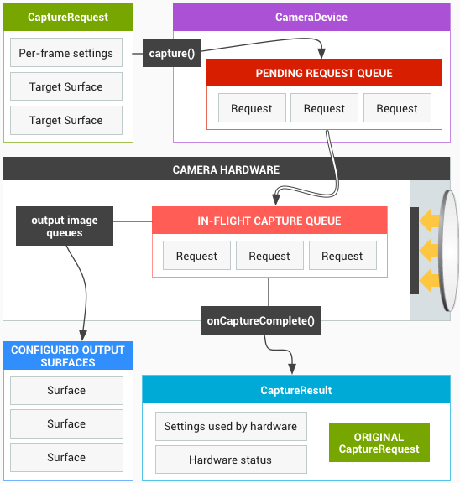
Camera2
https://source.android.com/devices/camera/camera3.html

Slide 4
Camera2 - Tutorial
In this tutorial, the app configures a preview session to be shown as a TextureView.
This tutorial is a compressed version of Camera2Basic from Google Samples GitHub:
Android-Camera2Basic
When the button is pressed a still image is captured and is saved the apps data folder.
Path on phone is /storage/emulated/legacy/Android/org.androidtutorials.sensor.camera2/data/files/pic.jpg

Slide 5
References
Camera2
CameraDevice
CameraManager
CameraCharacteristics
CameraCaptureSession
CaptureRequest
CaptureResult
CameraMetdata
TotalCaptureRequest
CameraDevice.StateCallback
CameraCaptureSession.CaptureCallback
CaptureRequest.Builder
Handler
HandlerThread
SurfaceTexture
TextureView
ImageReader
View.onClickListener
TextureView.SurfaceTextureListener

