Slide 1
Android - Conductor
Conductor is a view-handling framework which serves as an alternative to Fragments.
History
Developed by Square because of difficulty working with Fragments.
Square programmers complained that Fragments:
had complicated lifecycles.
were difficult to test and debug.
were error-prone due to asynchronous transactions.
Read Advocating Against Android Fragments, written by Square programmers.
In response, they developed Conductor, which includes features such as simpler lifecycles, easy integration, simple backstack handling, and built-in transition handling.

Slide 2
Conductor’s main components:
Controller: Their job is equivalent to that of Fragments, except they feature simpler lifecycles. They are View-wrapper classes that make a layout visible to the user.
Router: It is responsible for handling the Controller transactions, or in other words, it initiates the process that brings forward new Controllers so that the user can interact with new layouts. The Router also handles the backstack.
ControllerChangeHandler: This is responsible for the actual switching of Controllers. When a Router completes a transaction, it delegates the job of bringing the Controller to the foreground to the ControllerChangeHandler component. This component can be customized to have different animations during the transition.
ControllerTransaction: This defines data about the transaction.
For simple implementations, only a Router and a Controller are necessary to take advantage of this framework, which will be demonstrated in this tutorial.

Slide 3
How to use Conductor (as seen in the example)
The example code makes use of only a Router and two Controllers.
In install, insert the Conductor dependency in your app’s build.gradle file. Use the version specified on this page.
To initialize the router, we call Conductor.attachRouter(), in MainActivity’s onCreate() callback.
For each layout, we’ll need a subclass of Controller to expand that layout. In the example code, we use Layout1Controller and Layout2Controller to expand controller_1_layout.xml and controller_2_layout.xml respectively
We initialize the Router object and then call setRoot(), an instance method of Router, in MainActivity’s onCreate() callback to push the first Controller to the Router.
To push any sequential Controllers while adding onto the backstack, we call pushController(), an instance method of Router.
We override MainActivity’s onBackPressed() callback to ignore the default action when the back button is pressed if the Router object has a backstack available to it.

Slide 4
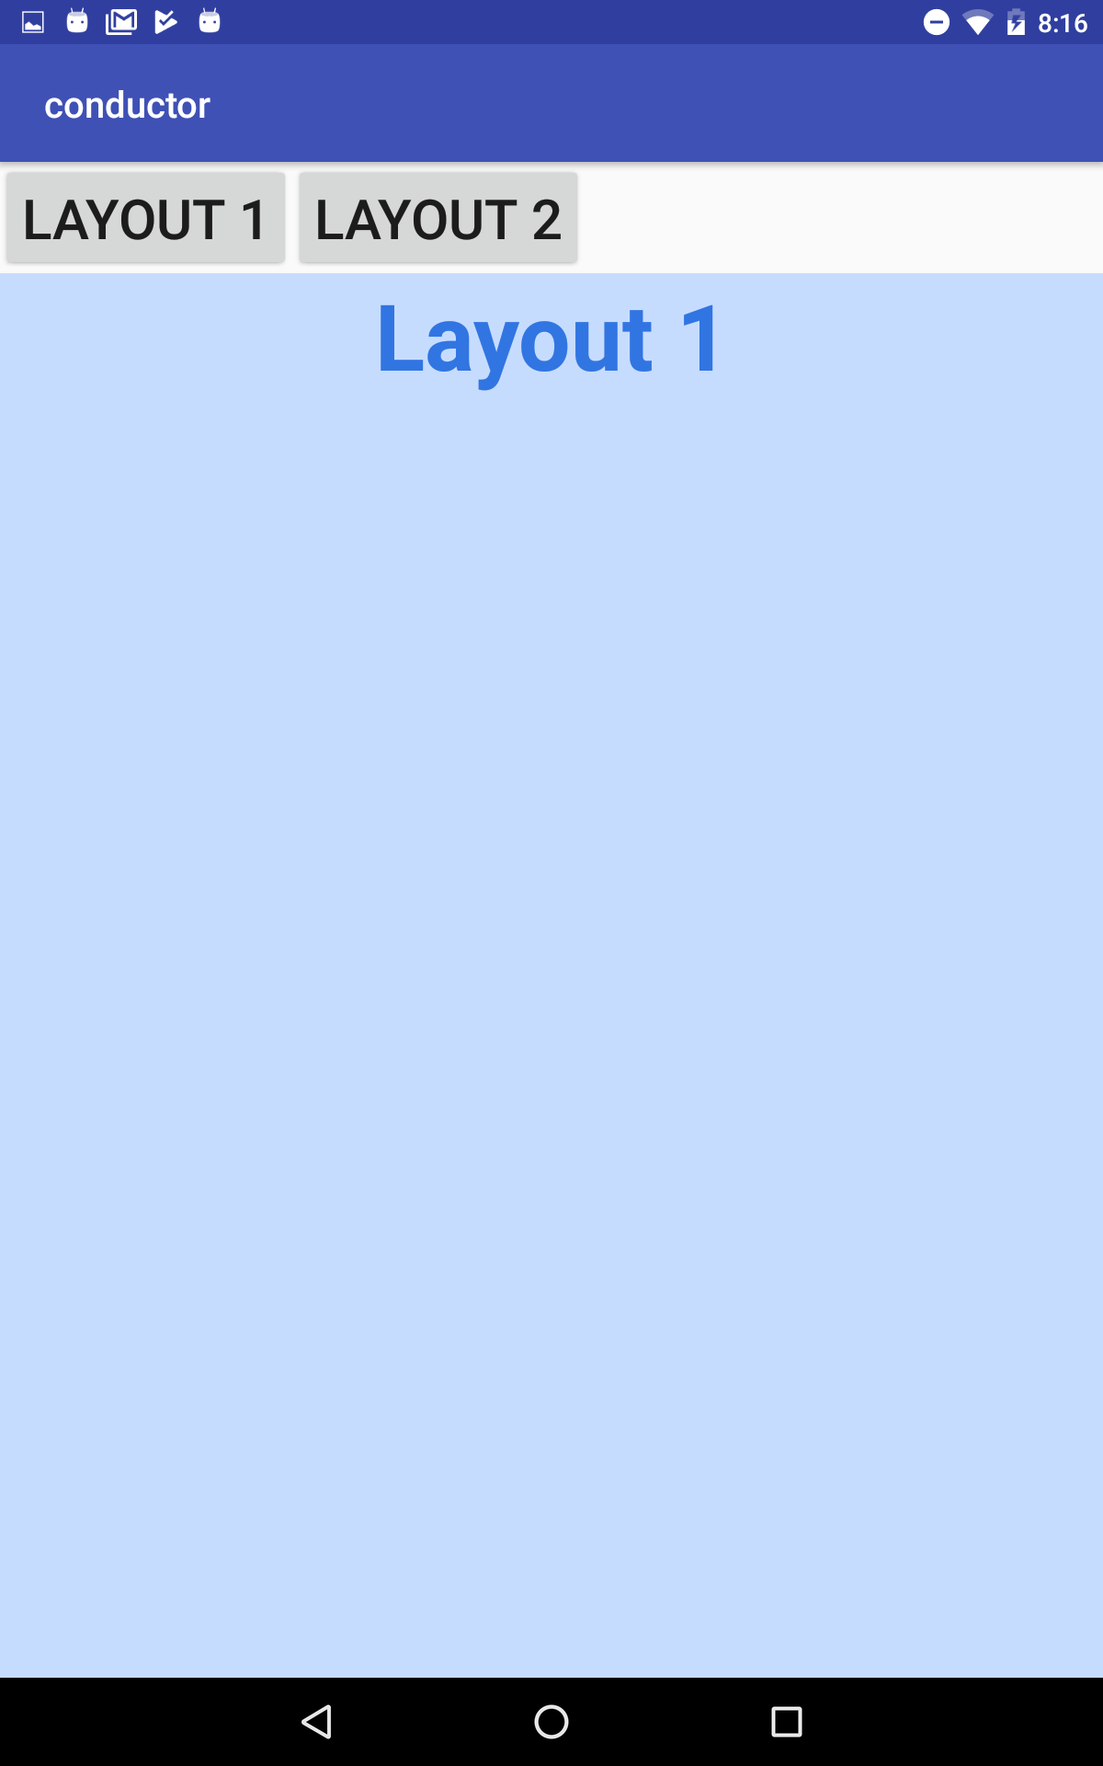
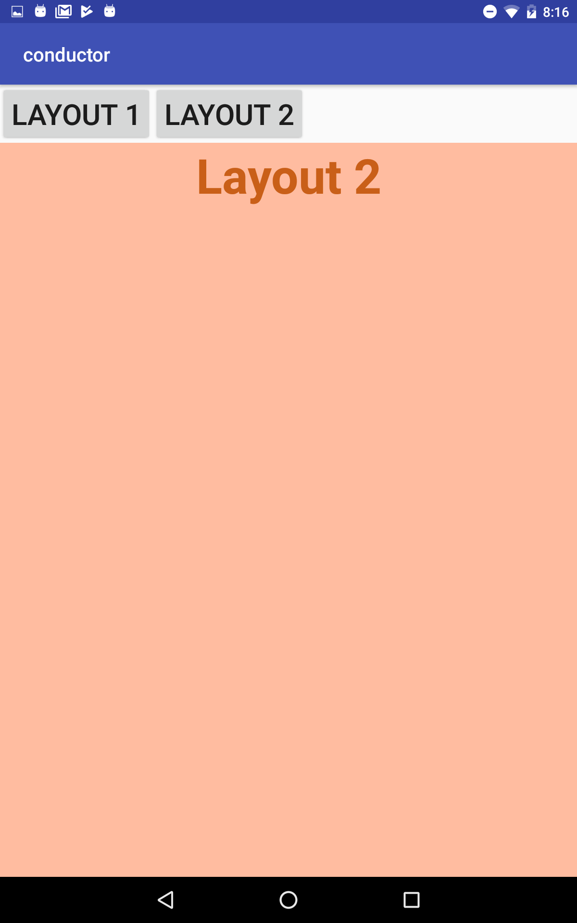
Pressing Layout 1 button pushes Layout1Controller to the router
Pressing Layout 2 button pushes Layout2Controller to the router

Slide 5
References
Advocating Against Android Fragments
Conductor github

Slide 6
Exercise
Add a button that makes a third layout appear.
Fill that layout with any content you would like.

