Slide 1
Rx Java Tutorial
Android

Slide 2
Introduction
RxJava – Reactive Extensions for the JVM – a library for composing asynchronous and event-based programs using observable sequences for the Java VM.
Source Code at https://github.com/ReactiveX/RxJava https://github.com/ReactiveX/RxAndroid
RxJava has become very important because of LiveData which is Android’s lifecycle aware version of RxJava.
RxAndroid is the Android version of RxJava. It provides additional API which is android specific

Slide 3
Implementation
Add the gradle dependency:- implementation "io.reactivex.rxjava2:rxjava:2.x.y" - x, y vary based on latest version implementation "io.reactivex.rxjava2:rxandroid:2.0.2"
We will be using a recycler view to demonstrate this tutorial.
In this tutorial, we will demonstrate the use of Observable.fromArray() API
The subscriber is on Android main/UI thread and the observable is on background thread.

Slide 4
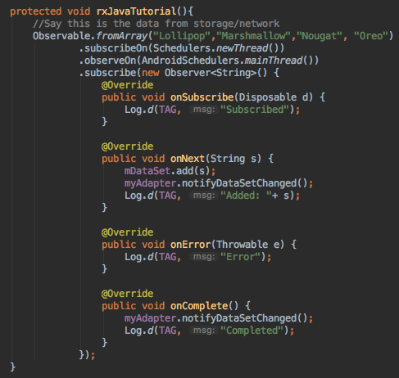
Code Snippet

Slide 5
Exercise
What happens if onStop() of MainActivity is called when the onNext was called.
Try LiveData
Try operators
Try other types of observables.

