Slide 1
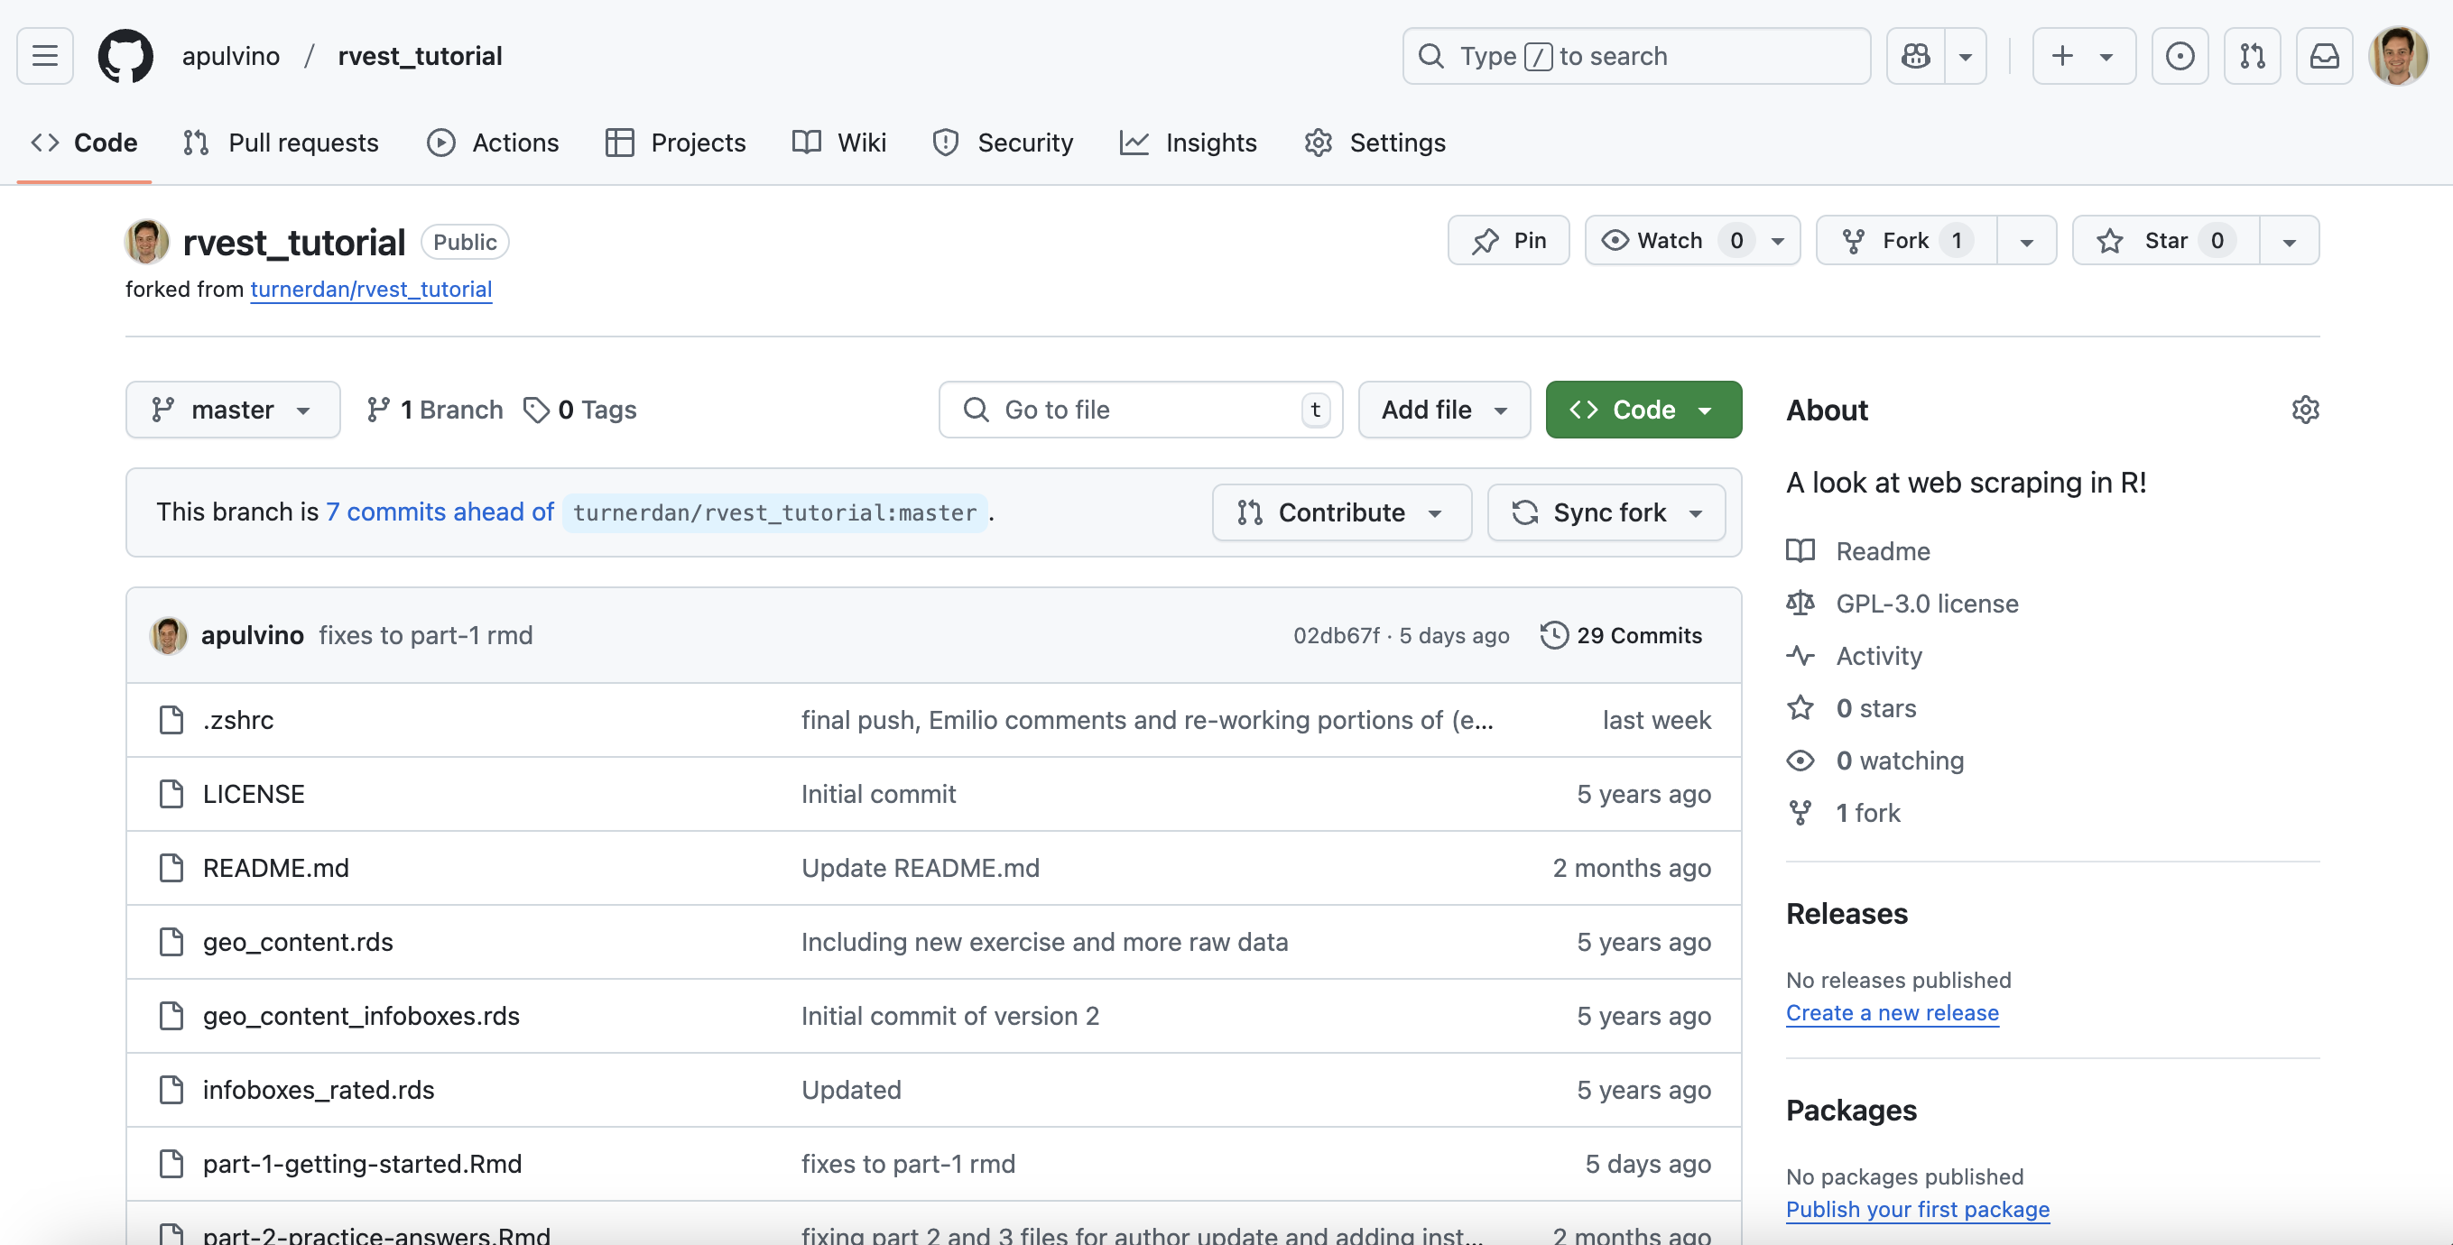
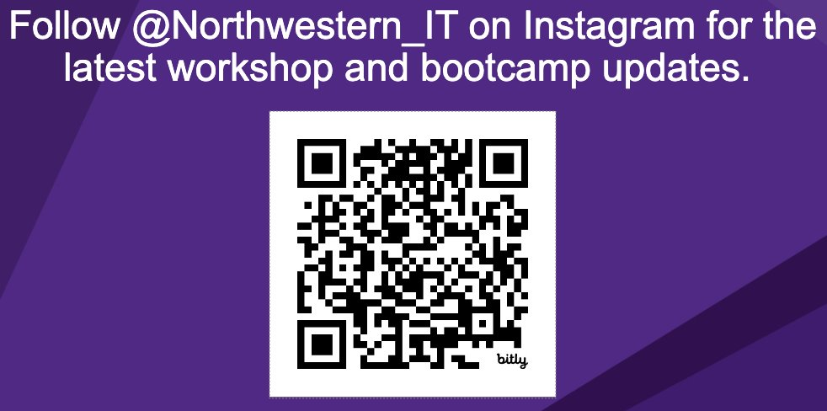
Next Steps in R
Workshop starts at 12:02
Materials for today
To work on your computer.
R and RStudio installed
https://github.com/apulvino/rvest_tutorial
Head to the link and click the green ‘Code’ box to download materials

Slide 2
Web Scraping Using Rvest
Anthony Pulvino
Emilio Lehoucq

Slide 3
This workshop is brought to you by:
Northwestern IT Research Computing and Data Services
Need help?
AI, Machine Learning, Data Science
Statistics
Visualization
Collecting web data (scraping, APIs), text analysis, extracting information from text
Cleaning, transforming, reformatting, and wrangling data
Automating repetitive research tasks
Research reproducibility and replicability
Programming, computing, data management, etc.
R, Python, SQL, MATLAB, Stata, SPSS, SAS, etc.
Request a FREE consultation at bit.ly/rcdsconsult.

Slide 4
Logistics
Ask Questions [in the zoom chat].
If you know the answer, feel free to respond (we may politely clarify if needed).
If my internet goes out.
Take a 5 minute break, and we will meet back in the same zoom room.

Slide 5
What’s next?
Tuesday, May the 6th: Introduction to Text Analysis

Slide 6
Web Scraping Using Rvest

