Slide 1
Simple Linux Shell
AMTOJ PUNIA - Henry Nguyen – EVAN WUSHKE

Slide 2
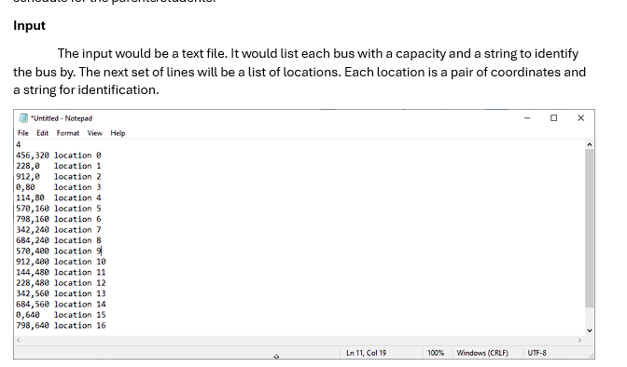
Welcome message and prompt format

Slide 3
Basic Functionality
Our shell can run `ls` all day long BABY

Slide 4
Background Jobs

Slide 5
I/O Redirection

Slide 6
The command pipeline

Slide 7
Search Paths

Slide 8
Signal Handeling

Slide 9
Project Breakdown
-> Populating the argument vector
-> Partition Nodes
-> Construct a Tree
-> Route Node
-> Matching/Balancing problem
-> Match Partitions Lengths with Bus Capacities
-> Rebalance Tree

Slide 10
Limitations
- Only attempted to solve subproblem
- Poor Project Management lead to incomplete solutions.
- Poor Group Governance lead to no cohesion in code between group members
- Imperative solution output not formatted and only tackles subproblem
- Functional solution is not complete.
- Lack of robust testing.

Slide 11
Design and Approach
- Break down my problem into smaller sub problems.
- Test as I go
- Lots of thought went into Data representation.
- Consider limitations of the language for development.

Slide 12
Debugging tools
Maybe we can put a screenshot of our print job function

Slide 13
Test Driver
Our shell made use of a test driver for:
- The custom string library
- Parsing input strings into the job pipeline
-

