Slide 1


NEXT GEN EMPLOYABILITY PROGRAM
CREATING A FUTURE-READY WORKFORCE
Student Name :
APURB RAJ
College Name :
Student ID :
GURU TEGH BAHADUR INTITUTE OF TECHNOLOGY
STU6084f5856a2bf1619326341

Slide 2
CAPSTONE PROJECT SHOWCASE
Project Title
MUSIC APPLICATION USING DJANGO
Abstract | Problem Statement | Project Overview | Proposed Solution | Technology Used | Modelling & Results | Conclusion | Q&A

Slide 3
Abstract
1
Problem Statement
2
Proposed Solution
3
Technology used
4
Modelling & Result

Slide 4


Problem Statement
Despite the abundance of music streaming platforms, many users still struggle to find a platform that offers a seamless and personalized music experience tailored to their tastes and preferences. Existing platforms often lack robust recommendation systems, user-friendly interfaces, and comprehensive social sharing features, leaving users feeling disconnected from the music community. Furthermore, many platforms are plagued by performance issues and security concerns, hindering the overall user experience.

Slide 5
Proposed Solution
Certainly! Here's a proposed solution for your music app project using Django:
Proposed Solution: Music App Using Django
Responsive Web Interface:
Develop a user-friendly and responsive web interface using HTML/CSS and JavaScript frameworks.
Ensure compatibility across various devices and screen sizes for seamless accessibility.
User Authentication and Authorization:
Implement secure user authentication and authorization mechanisms using Django's built-in authentication system.
Allow users to register, login, and manage their accounts securely.
Define roles and permissions to control access to different features and functionalities within the app.
Music Discovery and Recommendation:
Integrate advanced search algorithms and filtering options to facilitate music discovery based on genres, artists, albums, and playlists.
Implement recommendation systems to provide personalized music suggestions based on user preferences, listening history, and social interactions.

Slide 6
Technology used
In a Django project for your music app, you would utilize a variety of technologies to build a robust and feature-rich web application. Here are some key technologies commonly used in Django projects:
Django: Django itself is a high-level Python web framework that provides the foundation for your project. It includes features such as an ORM (Object-Relational Mapper) for interacting with databases, a URL routing system, a template engine for rendering HTML, and a built-in admin interface.
Python: Python is the primary programming language used in Django development. It offers simplicity, readability, and a vast ecosystem of libraries and frameworks that can be leveraged to extend Django's functionality.
HTML/CSS: HTML (Hypertext Markup Language) is used for structuring the content of web pages, while CSS (Cascading Style Sheets) is used for styling and layout. Django's template engine allows you to seamlessly integrate HTML and CSS into your project's frontend.
JavaScript: JavaScript is used for adding interactivity and dynamic behavior to web pages. You can use JavaScript frameworks and libraries such as jQuery, React.js, or Vue.js to enhance the user experience of your music app.
Bootstrap or other Frontend Frameworks: Bootstrap is a popular frontend framework that provides pre-designed CSS styles and JavaScript plugins for building responsive and mobile-friendly web interfaces. Alternatively, you can use other frameworks like Materialize CSS or Foundation for your project's frontend design.

Slide 7
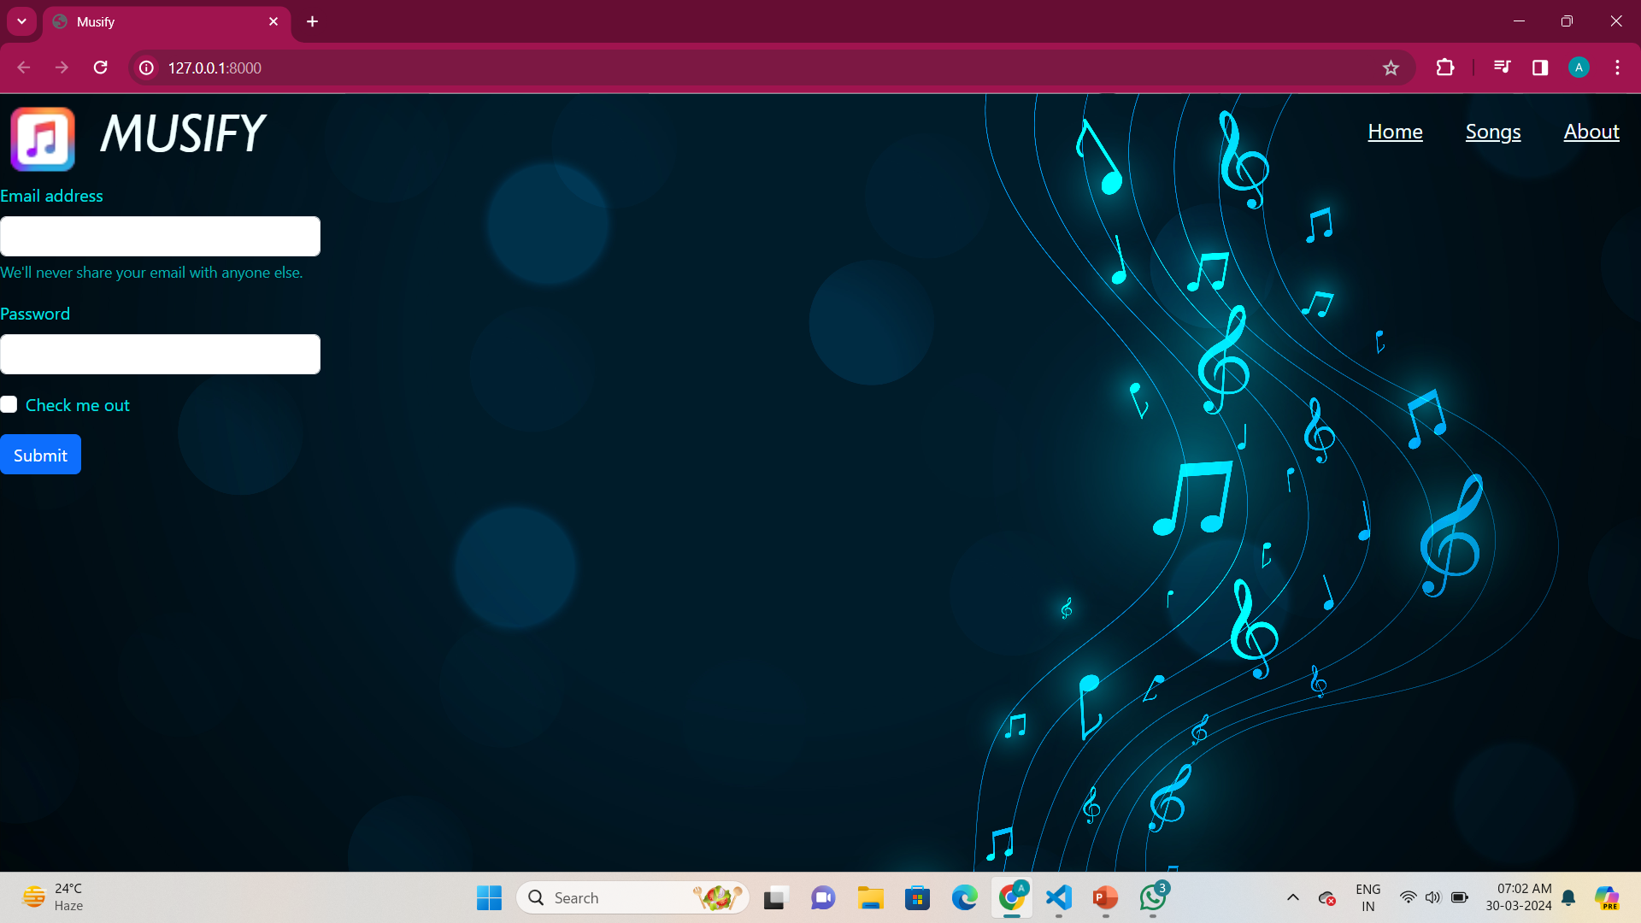
Modelling & Result

Slide 8
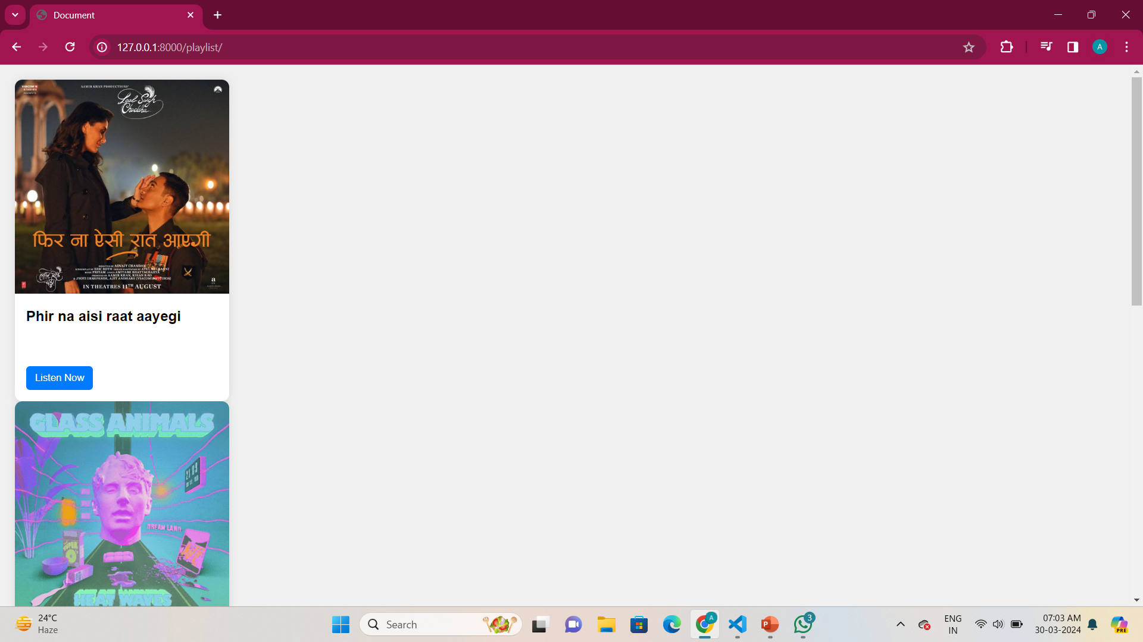
Modelling & Result

Slide 9

Conclusion
In conclusion, our music app project represents a culmination of innovative technology and user-centric design aimed at revolutionizing the digital music experience. Throughout this presentation, we have outlined the vision, objectives, and key features of our app, all powered by the Django framework. As we wrap up, let's recap the main points and reflect on the significance of our project.
Key Takeaways:
Addressing Industry Challenges: Our project addresses the existing challenges in the music streaming industry by providing a comprehensive platform for music discovery, streaming, and collaboration.
Enhanced User Experience: Through advanced search algorithms, personalized recommendations, and seamless audio streaming, our app offers users an immersive and tailored music listening experience.

Slide 10


Notes:
Thank You !!

