Slide 1
Data Pipeline and Quality Analysis
MSDS610
Notes:
Welcome to this presentation on data pipeline design and data quality for the MSDS610 project.

Slide 2
Data Pipeline Design
Pipeline Steps:
- Data Extraction from relational database.
- Data Transformations (e.g., cleaning, normalization, feature engineering).
- Final Storage Format: DB(postgres).
Notes:
This diagram illustrates the steps involved in the data pipeline, starting with data extraction from the relational database, applying transformations, and finally storing the data in an efficient format such as Parquet files.

Slide 3
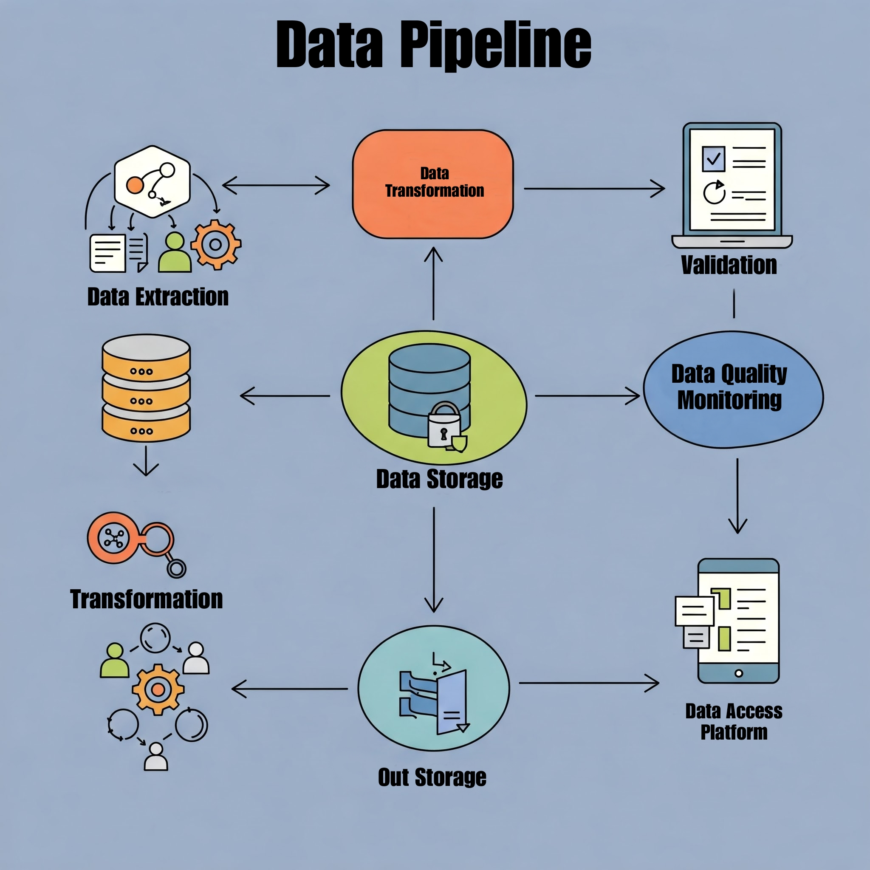

Slide 4
Pipeline Type
Chosen Type: Batch Processing
Justification: Data does not require real-time processing; batch processing is sufficient for behavioral analysis trends.
Notes:
The chosen pipeline type is batch processing. This is because the data use case focuses on behavioral trends over time, which do not require real-time processing.

Slide 5
Data Format
Input Format: CSV (relational data)
Output Format: csv files for efficient storage and processing.
Notes:
The input data format is CSV, which is common for relational data. The output format is Parquet files because it offers efficient storage and faster processing for analytics.

Slide 6
Data Quality Issues and Validation
1. Missing Values: Impute missing data using mean or median values.
2. Outliers: Apply interquartile range (IQR) to detect and handle outliers.
Notes:
Three key data quality issues are missing values, outliers, and categorical variables. To address these, we can impute missing data, apply outlier detection using IQR.

Slide 7
PostgreSQL Schema Creation
Schema Name: `cleaned`
Create the schema using pgAdmin4 UI or SQL query.
Notes:
A new schema named 'cleaned' will be created in the PostgreSQL database to store the transformed data. This step organizes the database and keeps the cleaned data separate from raw data.

Slide 8
Data Extraction and Transformation
1. Data Extraction: Query to retrieve data from the relational database.
2. Transformations:
- Handle missing values.
- Scale numerical features.
- Save the transformed data to a new table in the `cleaned` schema.
Notes:
Data extraction involves querying the relational database to retrieve the raw data. Transformations include handling missing values and scaling numerical features. The transformed data is then saved in the new 'cleaned' schema.

Slide 9
