Slide 1

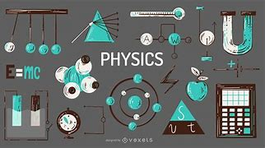
Physics-2 (Lab)
American International
University-Bangladesh
Section: B
Presented By:
Group:06

Slide 2
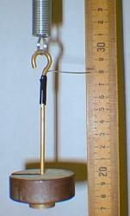
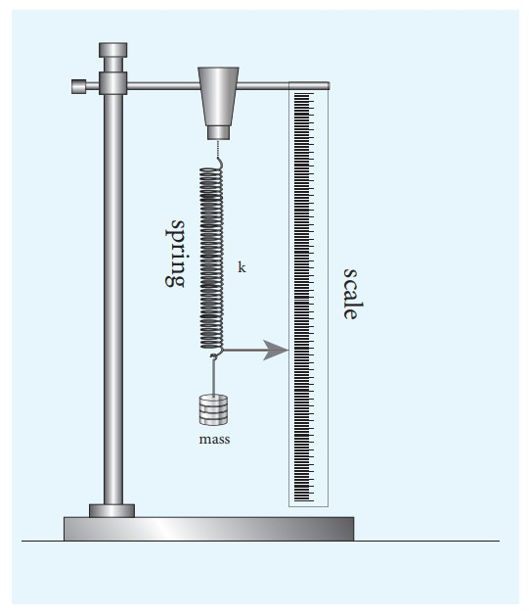
LAB REPORT – 3
Name of the experiment:
To determine the spring constant and effective mass of a given spiral
2

Slide 3
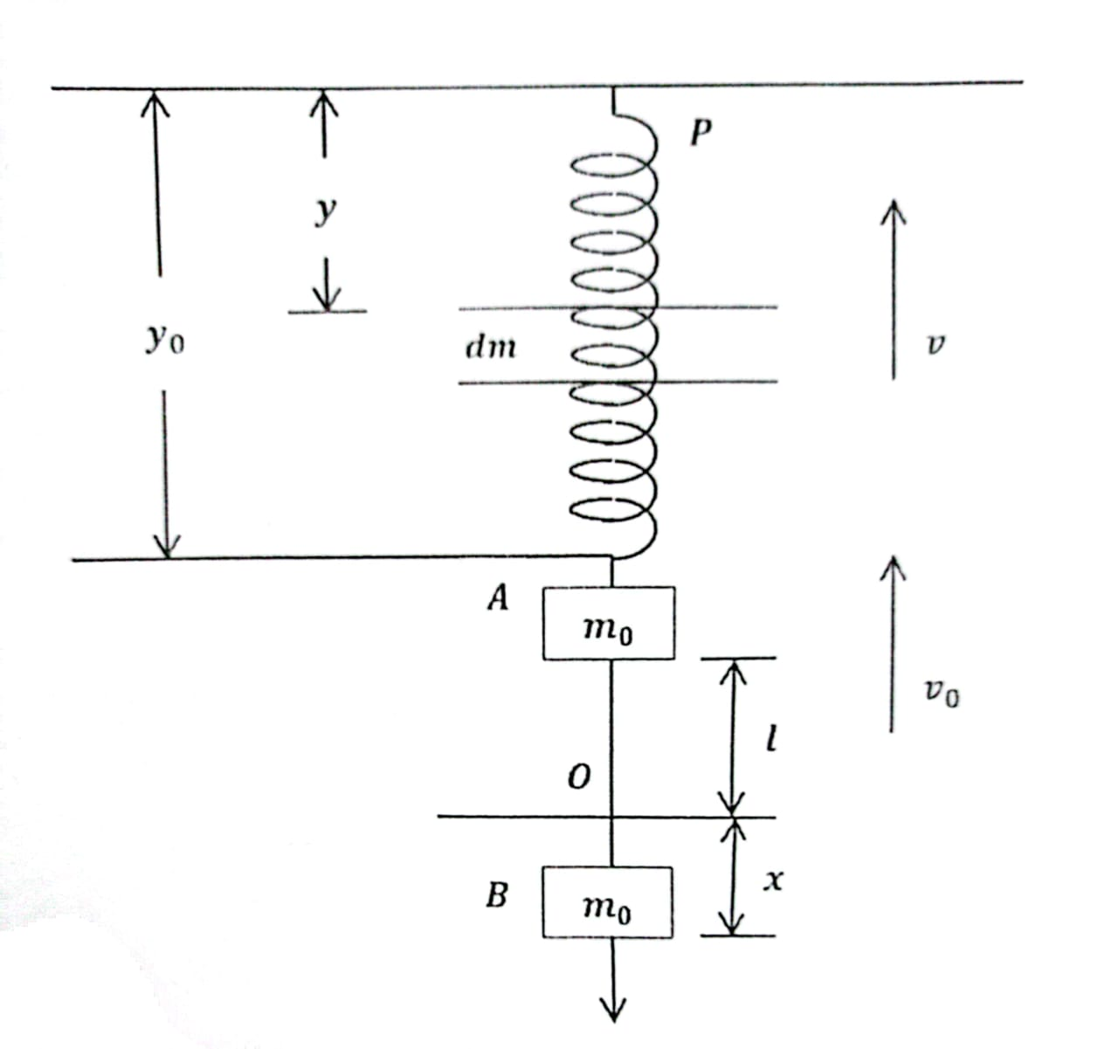
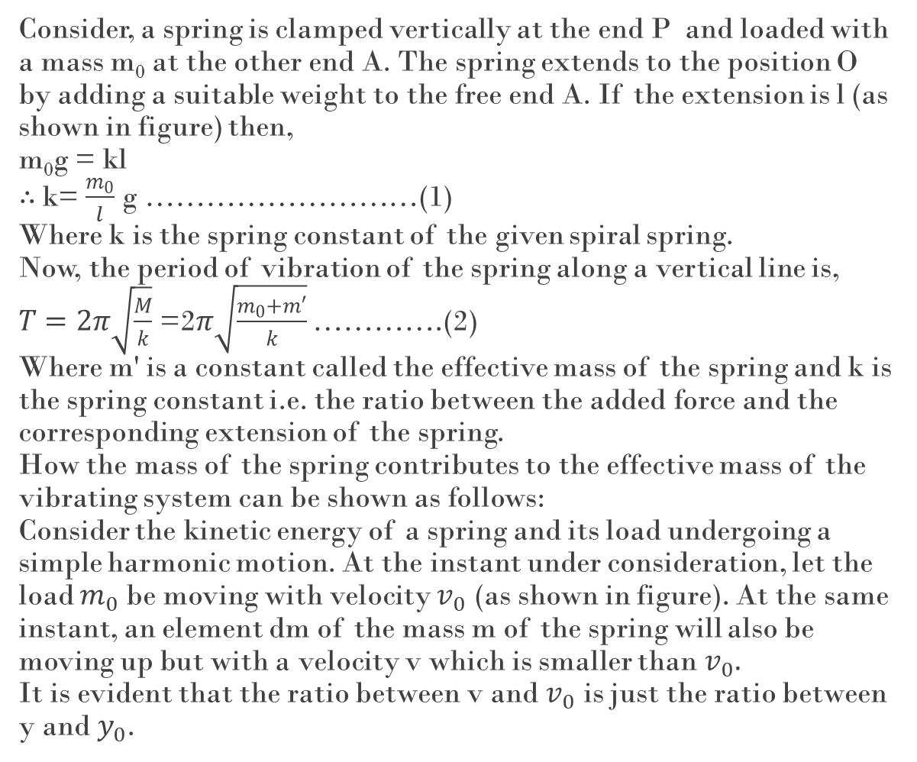
Consider, a spring is clamped vertically at the end P and loaded with a mass m₀ at the other end A. The spring extends to the position O by adding a suitable weight to the free end A. If the extension is l (as shown in figure) then, m₀g = kl $∴$k= $\frac{m_{0}}{l}$ g ………………………(1) Where k is the spring constant of the given spiral spring. Now, the period of vibration of the spring along a vertical line is, $T=2π\sqrt{\frac{M}{k}}$ =2$π\sqrt{\frac{m_{0}+m′}{k}}$ ………….(2) Where m' is a constant called the effective mass of the spring and k is the spring constant i.e. the ratio between the added force and the corresponding extension of the spring. How the mass of the spring contributes to the effective mass of the vibrating system can be shown as follows: Consider the kinetic energy of a spring and its load undergoing a simple harmonic motion. At the instant under consideration, let the load $m_{0}$ be moving with velocity $v_{0}$ (as shown in figure). At the same instant, an element dm of the mass m of the spring will also be moving up but with a velocity v which is smaller than $v_{0}.$ It is evident that the ratio between v and $v_{0}$ is just the ratio between y and $y_{0}$.
Theory
Figure: Measuring spring constant and effective mass
3

Slide 4


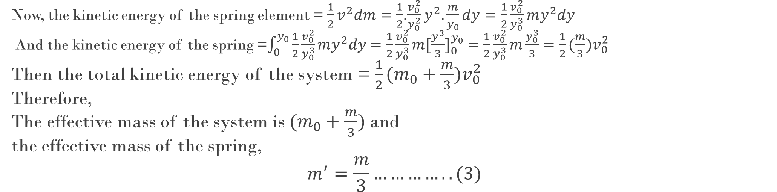


Hence,
$$\frac{v}{y}=\frac{v_{0}}{y_{0}}$$
$$or, v= \frac{v_{0}}{y_{0}}y$$
Similarly we have,
$$\frac{dm}{m}=\frac{dy}{y_{0}}$$
$$or, dm= \frac{m}{y_{0}}dy$$
Now, the kinetic energy of the spring element = $\frac{1}{2}v^{2}dm=\frac{1}{2}$.$\frac{v_{0}^{2}}{y_{0}^{2}}y^{2}.\frac{m}{y_{0}}dy=\frac{1}{2}\frac{v_{0}^{2}}{y_{0}^{3}}my^{2}dy$
And the kinetic energy of the spring =$\int_{0}^{y_{0}}{\frac{1}{2}\frac{v_{0}^{2}}{y_{0}^{3}}my^{2}dy}$ $=\frac{1}{2}\frac{v_{0}^{2}}{y_{0}^{3}}m[\frac{y^{3}}{3}]_{0}^{y_{0}}$ $=\frac{1}{2}\frac{v_{0}^{2}}{y_{0}^{3}}m\frac{y_{0}^{3}}{3}$ $=\frac{1}{2}(\frac{m}{3})v_{0}^{2}$
Then the total kinetic energy of the system = $\frac{1}{2}(m_{0}+\frac{m}{3})v_{0}^{2}$
Therefore,
The effective mass of the system is $(m_{0}+\frac{m}{3})$ and
the effective mass of the spring,
$$m^{′}=\frac{m}{3}…………..(3)$$
4

Slide 5
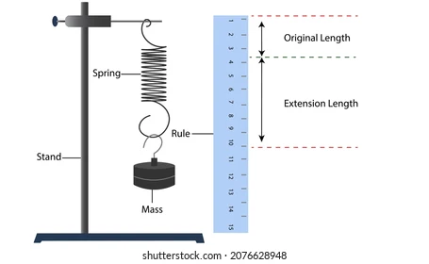
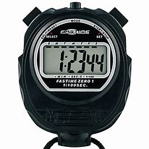
Apparatus
A spiral spring,
Convenient masses with hanging arrangement,
Clamp,
Stop clock,
Scale.
Scale-
Clamp
-Stop clock
5

Slide 6
Procedure 1. We suspended the spring by a hook attached to a rigid framework of heavy metal rods. 2. We measured the length of the spring with a meter scale. We placed a scale behind the spring to measure the extensions of the spring. 3. We added suitable weight to the free end of the spring so that it extends to the position O. On the reference frame we placed behind the spring, noted the position O and read the extension L. 4. We pulled the load from position O to a moderately low position B and then let it go. The spring then executed simple harmonic motion and vibrated up and down about the position 0.With a stop clock we measured the time for 20 vibrations and computed the time period T in sec per vibration. 5. We repeated operation (3) and (4) for at least 6 sets of loads. 6. We drew graphs with added loads m₀ in grams (abscissa) against the extensions of the spring 1 in cm (ordinate) and with T²as a function of m₀. We drew the best fitted lines through the points. 7. We calculated the spring constant by using the slope of the first graph. 8. The second graph did not passed through the origin owing to the mass of the spring which was not considered in drawing it. The intercept of the resulting line on the mass axis gave the effective mass of the spring. 9. We measured the mass m of the spring and showed the effective mass obtained from the graph is m' = m/3
6

Slide 7
Observations (A) Length of the spring, L = 32 cm Original mass of the spring, M=127 gm
7

Slide 8
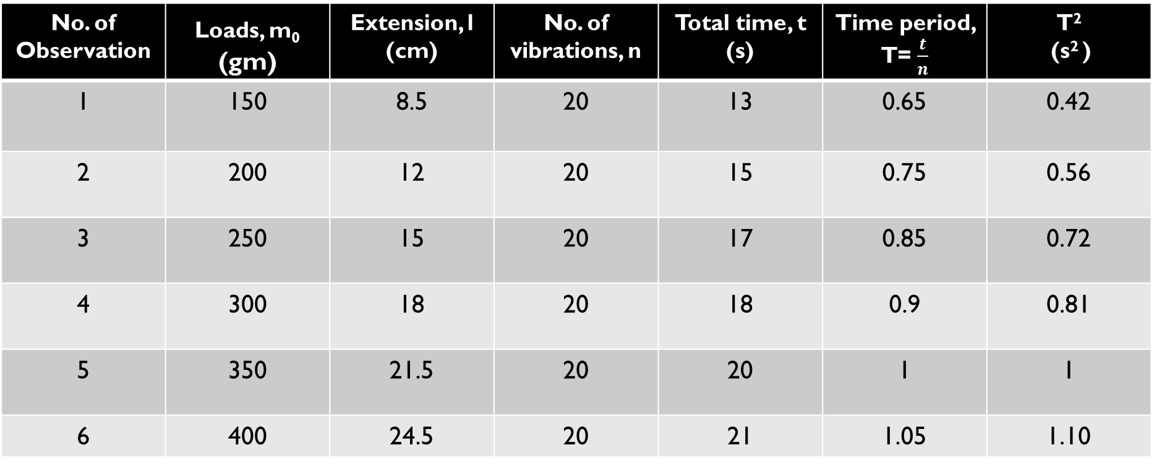
(B) Determination of extensions and time periods:
No. of Observation | Loads, m₀ (gm) | Extension, l (cm) | No. of vibrations, n | Total time, t (s) | Time period, T= $\frac{t}{n}$ | T² (s² )
1 | 150 | 8.5 | 20 | 13 | 0.65 | 0.42
2 | 200 | 12 | 20 | 15 | 0.75 | 0.56
3 | 250 | 15 | 20 | 17 | 0.85 | 0.72
4 | 300 | 18 | 20 | 18 | 0.9 | 0.81
5 | 350 | 21.5 | 20 | 20 | 1 | 1
6 | 400 | 24.5 | 20 | 21 | 1.05 | 1.10
8

Slide 9




Graph and Calculations
Graph - 1
Graph - 2
$$Slope=0.0606$$
$$m^{′}=26.9 gm$$
9

Slide 10



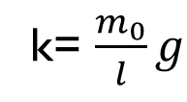
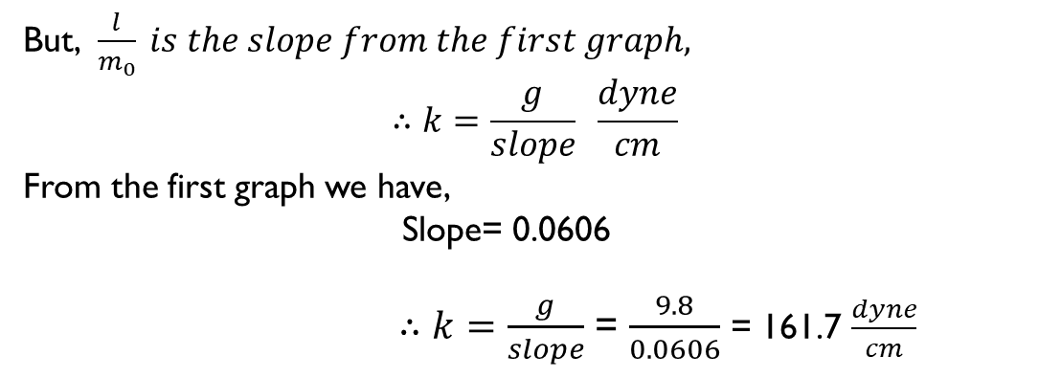
Analysis
We know,
k= $\frac{m_{0}}{l}g$
$$or, k=\frac{g}{(\frac{l}{m_{0}})}$$
But, $\frac{l}{m_{0}} is the slope from the first graph,$
$$∴k=\frac{g}{slope} \frac{dyne}{cm}$$
From the first graph we have,
Slope= 0.0606
$∴k=\frac{g}{slope}$ = $\frac{9.8}{0.0606}$ = 161.7 $\frac{dyne}{cm}$
10

Slide 11
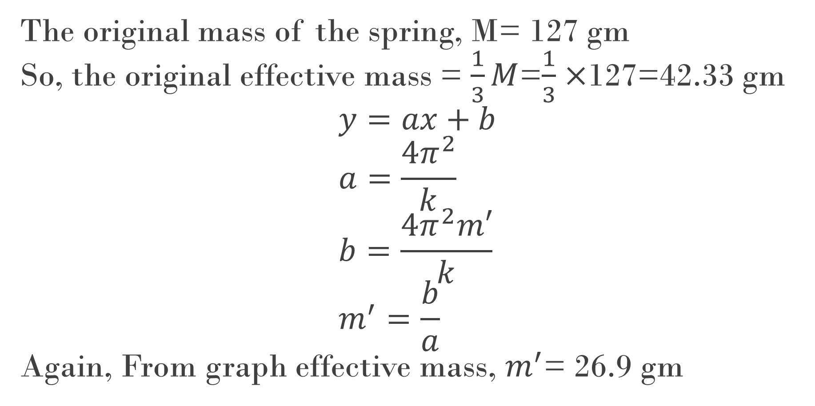
The original mass of the spring, M= 127 gm So, the original effective mass = $\frac{1}{3}M$=$\frac{1}{3}$ $×$127=42.33 gm $$y=ax+b \\ a=\frac{4π^{2}}{k} \\ b=\frac{{4π}^{2}m′}{k} \\ m^{′}=\frac{b}{a}$$ Again, From graph effective mass, $m^{′}$= 26.9 gm
11

Slide 12

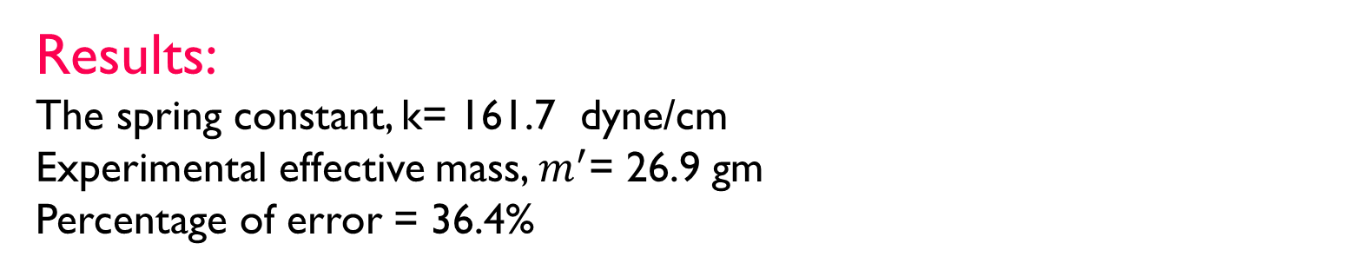

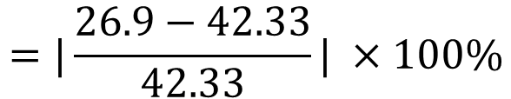
$$\frac{Expperiment value−Theoretical value }{Theoretical value}×100\%$$
$$Percentage of error=$$
$$=|\frac{26.9−42.33}{42.33}| ×100\%$$
$$=36.4\%$$
Results:
The spring constant, k= 161.7 dyne/cm
Experimental effective mass, $m^{′}$= 26.9 gm
Percentage of error = 36.4%
12

Slide 13

Discussions: Though we maintained lots of carefulness in measuring value, yet, some error would have been occurred in reading the extension of spring, calculating time during 20 vibrations, in measuring length or mass of spring etc. Again, resistance of air could have slightly damped the motion of the spring, leading to incorrect readings of vibrations. We were careful in dealing with the spring, so that the spring was not stretched beyond it’s elastic limit as this leads to incorrect results of spring constant. Sometimes due to the spring used in experiment, we may obtain errors. For example: over time the spring may lose elasticity due to repeated stretching and compression. So, error can occur. This experiment is considered to be the ideal process for determining the value of spring constant and effective mass of a spiral spring. So if we maintained more carefulness in the experiment, then we would have got accurate data.
13

Slide 14
Thank You
Group:06

