Slide 1




Project Title: An IoT-Based Real-Time Patient Health Monitoring System
Name:
Apurba Das (25BHI10010)
Abhishek Tandan (25bhi10097)
Gargi Khan (25BHI10112)
Lakshay Pareek (25Bhi10080)
Piyush (25BHI10028)

Slide 2












PROBLEM STATEMENT & OBJECTIVES
PROBLEM STATEMENT
OBJECTIVES
OBJECTIVES
OUR GOAL
OBJECTIVES
Many patients, especially the elderly, chronically ill, or those in remote areas, do not have continuous access to timely health monitoring. Traditional monitoring methods rely on periodic hospital visits or manual checks, which can lead to delayed detection of health issues and increased risk to patient well-being.
Our objective is to develop a smart, IoT-based health monitoring system that continuously collects, transmits, and analyzes patient vital signs, making real-time data accessible to caregivers and healthcare professionals.
To enable continuous, accessible, and reliable
patient health monitoring for a safer and healthier society.
Real-Time Monitoring
Limited Access to Continuous Monitoring
01
Measure vital parameters such as heart rate, SpO2, and body temperature continuously.
01
Patients need to be physically present in hospitals for regular checkups.
Wireless Data Transmission
BETTER INSIGHTS.
BRIGHTER LIVES.
Delayed Detection of Abnormal Conditions
02
Send the collected data to a cloud platform using Wi-Fi or Bluetooth.
02
Critical changes in vital signs may go unnoticed until it becomes serious.
03
Remote Accessibility
Burden on Healthcare System
Provide a web or mobile dashboard for real-time visualization of patient data.
03
Frequent hospital visits increase workload on healthcare professionals and infrastructure.
04
Automatic Alerts
04
Lack of Remote Accessibility
Generate instant notifications when readings cross predefined thresholds.
04
Difficult for caregivers to monitor patients who are at home or in remote areas.
05
Higher Healthcare Costs
05
Affordable & Scalable Solution
Regular hospital visits and late interventions can lead to higher treatment costs.
Design a low-cost, reliable, and scalable system that can be used in homes, clinics, and remote areas.

Slide 3





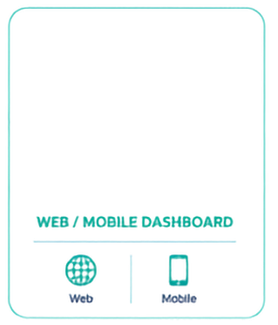



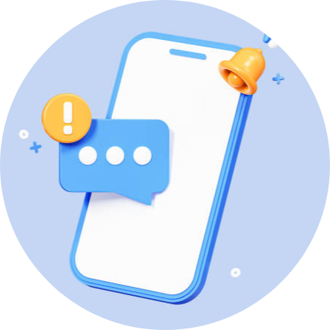
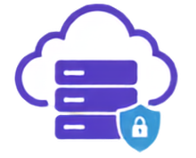
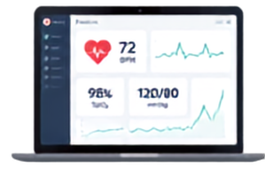

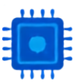











SYSTEM
OVERVIEW
An end-to-end IoT based health monitoring system
that collects, transmits and analyzes health data in real-time.
1. DATA COLLECTION
2. DATA TRANSMISSION
3. DATA PROCESSING
4. VISUALIZATION
5. ALERTS & NOTIFICATIONS
Body sensors collect
real-time health data.
Data is sent to the IoT
gateway via wireless.
Data is processed, analyzed
and stored securely.
Users can view real-time
data on dashboard.
Instant alerts for abnormal
health conditions.
Heart Rate
SPO2
Temperature
Blood
Pressure
IOT GATEWAY
CLOUD SERVER
Push Notifications
BODY SENSORS
Bluetooth
Wi-Fi
Storage
Analytics
AI Insights
KEY BENEFITS
Real-time
Monitoring
Early Detection &
Timely Alerts
Data-driven
Insights
Improved Patient Care
& Outcomes
Continuous
Health Tracking
Cost-effective
Healthcare

Slide 4

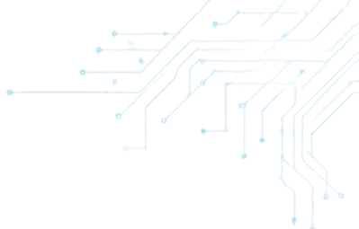









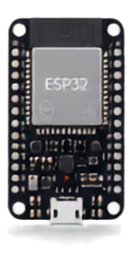
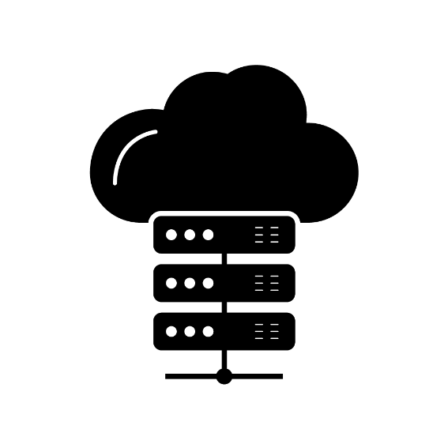
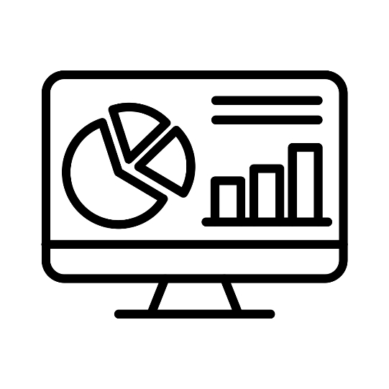
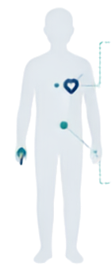















Methodology & Technical Strategy
A smart, connected approach to real-time patient health monitoring
2. EDGE PROCESSING
4. CLOUD LAYER
5. Visualization
1. SENSING
3. CONNECTIVITY LAYER
4. Cloud Platform
5. APPLICATION LAYER
Wearable/portable sensors continuously measure vital signs.
ESP32 acquires, filters & processes sensor data in real-time.
Secure transmission of data to the cloud.
Cloud platform stores, manages & analyzes data.
Real-time visualization & alerting for careegivers.
Heart Rate Sensor
Wi-Fi
Body Temperature Sensor
Bluetooth
Cloud Services (Firebase / Blynk / AWS)
Data Acquisition
Filtering & Validation
Local Processing
Data Storage
Analytics & Insights
DATA FLOW
TECHNICAL STRATEGY
Real-time Monitoring
Vital signs captured by sensors
Processed by ESP32
Sent via Wi-Fi / Bluetooth
Stored in the cloud
Analyzed & monitored
Alerts & insights to caregivers
Continuous acquisition and instant updates
Threshold-based Alerts
Rule engine detects anomalies & triggers alerts

Slide 5











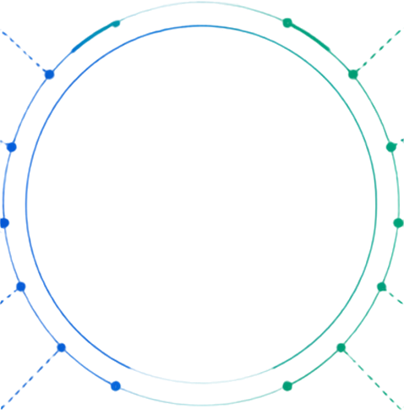


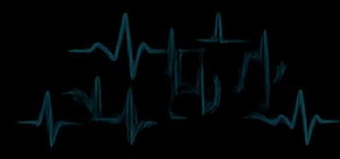
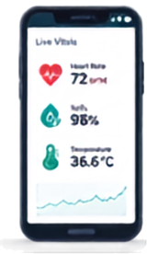

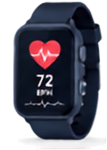










IMPACTS & BENEFITS
Transforming Patient Care with Real-time Insights
IMPACTS
BENEFITS
EARLY DETECTION OF EMERGENCIES
BETTER PATIENT OUTCOMES
Real-time monitoring and alerts help identify abnormal conditions early, enabling timely medical intervention.
Continuous care and timely alerts lead to improved recovery and better long-term outcomes.
IMPROVED PATIENT SAFETY
EMPOWERED CAREGIVERS
Continuous tracking of vital signs reduces risks and enhances overall patient well-being.
Caregivers can monitor patients remotely from anywhere, anytime with complete peace of mind.
REDUCED HOSPITAL VISITS
DATA-DRIVEN INSIGHTS
Remote monitoring minimizes the need for frequent hospital visits and allows care at home.
Historical data and analytics help identify trends and support better clinical decisions.
FASTER RESPONSE TIME
IOT-BASED HEALTH MONITORING SYSTEM
SCALABLE & FLEXIBLE
Instant alerts and remote access enable quicker decision-making during critical situations.
The system can be easily scaled to monitor multiple patients simultaneously.
LOWER HEALTHCARE COSTS
SECURE & RELIABLE
Early detection and continuous care help reduce complications and lower overall healthcare expenses.
Encrypted data transmission and secure cloud storage ensure privacy, reliability, and data protection.
OUR VISION
Building a smarter, healthier tomorrow through connected care and real-time monitoring.
Better Outcomes
Sustainable Healthcare
Healthier Patients
Smarter Care

Slide 6










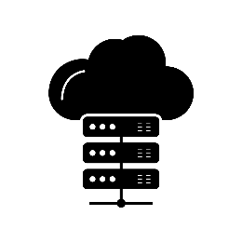
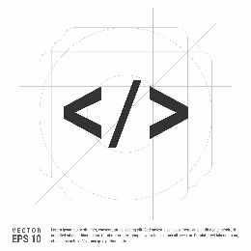












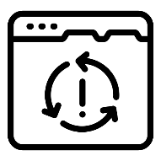



FEASIBILITY &
AVAILABILITY
Practical. Accessible. Scalable.
FEASIBILITY
AVAILABILITY
The system is technically, operationally and economically feasible using readily available technologies and resources.
All components and platforms used are easily available and widely supported.
TECHNICAL FEASIBILITY
HARDWARE COMPONENTS
SOFTWARE & PLATFORMS
DEVELOPMENT TOOLS
CONNECTIVITY
SUPPORT & COMMUNITY
Built using proven, low-power hardware (ESP32), MAx3000, 0D18B20 and reliable communication (Wi-Fi / Bluetooth).
Proven Technology
OPERATIONAL FEASIBILITY
Simple to use and maintain. Minimal training required for caregivers and healthcare staff.
Easy to Use & Maintain
ESP32, MAXX00100
DSH1B20, DHT22
and other modules are widely available online and in local markets.
Cloud platforms like FireBase / Blynk and other modules are reliable, scalable, and widely used.
Open-source IDGs (Arduino IDE, VVS Code) and libraries ensure easy development and support.
Wi-Fi and Bluetooth modules are commonly available and ensure reliable connectivity.
Large developer community and documentation ensure continuous support and updates.
ECONOMIC FEASIBILITY
Low-cost components and open-source platforms make the system affordable and cost-effective.
Affordable & Cost-Effective
WHY IT’S READY AVAILABLE
LEGAL & DATA FEASIBILITY
Complies with data privacy best practices. Secure transmission and storage of patient data.
Secure & Compliant
SCALABILITY FEASIBILITY
Components widely available online & offline
Affordable and easily replaceable
Low maintenance and long-term reliability
Cloud services with high uptime
Regular updates and community support
Cloud-based architecture allows easy scaling to monitor multiple patients simultaneously.
Scalable Architecture
Goal:
To deliver a feasible, accessible and reliable health monitoring solution that can be deployed widely and make a real impact on patient care.

Slide 7


















Background
RESEARCH & REFERENCES
Background
Background
Background
Building on Existing Research. Delivering Real-World Impact.
BACKGROUND RESEARCH
REFERENCES
Extensive research in IoT, wearable sensors, cloud computing, and health informatics has enabled the development of robust and scalable remote patient monitoring systems.
Internet of Things: A Survey on Enabling Technologies, Protocols, and Applications
Authors: Al-Fuqaha, Guizani, Mohammadi, Aledhari & Ayyash (2015)
https://www.researchgate.net/publication/279177017_Internet_of_Things_A_Survey_on_Enabling_Technologies_Protocols_and_Applications
1
IoT in Healthcare
IoT technologies enable continuous health monitoring and real-time data transmission, improving patient care and operational efficiency.
2
IoT-Based Healthcare-Monitoring System towards Improving Quality of Life
https://pmc.ncbi.nlm.nih.gov/articles/PMC9601552/
Wearable Sensors
Sensors like MAx30100 and DS18B2D provide accurate and non-invasive measurement of vital signs such as heart rate, SpO2, and body temperature.
3
The Internet of Things (IoT) in healthcare
https://www.sciencedirect.com/science/article/pii/S2542660523000446
Cloud Computing
3
Cloud platforms (Firebase/Blynk/AWS) ensure secure data storage, real-time synchronization, and seamless access from anywhere.
Alert Systems
Threshold-based alert mechanisms enhance patient safety by enabling instant notifications for abnormal health events.
Impact of RPM
Research shows Remote Patient Monitoring (RPM) reduces hospital readmissions, improves outcomes, and lowers healthcare costs.

