Slide 1

Driving Data-Driven Innovation: Honda's Journey in the Age of Industry 4.0
Team: -
Apuroop Kotha
Sai Suresh Reddy Challa

Slide 2

Introduction
Honda, a globally renowned automobile company with a rich history dating back to 1946, has long been a leader in the automotive industry. Known for its commitment to innovation and technological advancement, Honda has consistently produced high-quality vehicles and motorcycles that have captured the imaginations of consumers worldwide. As we delve into the role of data analytics and artificial intelligence (AI) in Honda's operations, it becomes clear that the company's commitment to innovation extends to its embrace of data-driven decision-making and cutting-edge technology.

Slide 3
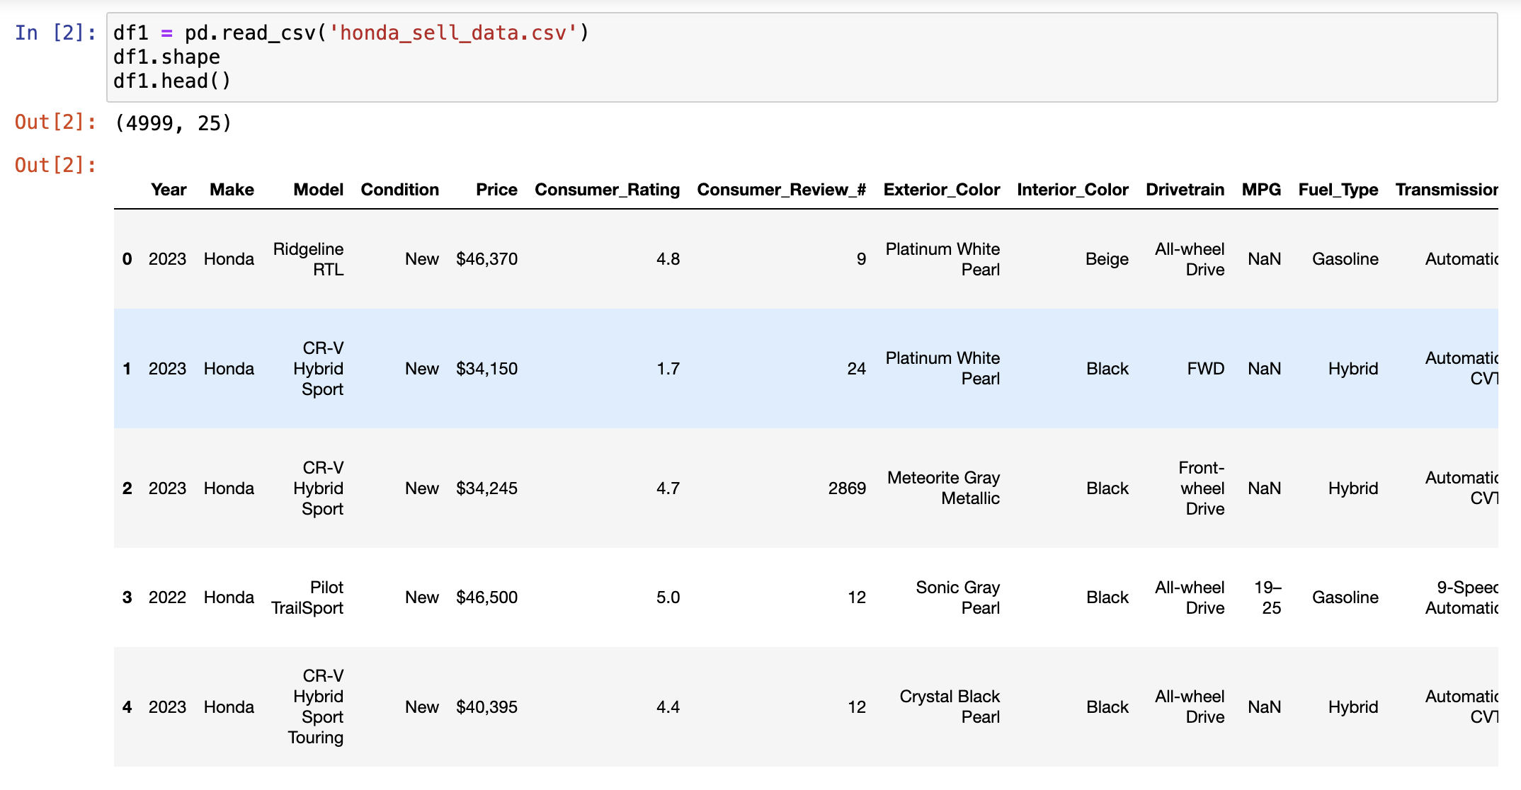
T. (2023, May 8). Car_Price_Prediction and EDA. Kaggle. https://www.kaggle.com/code/themeeemul/car-price-prediction-and-eda/input
Edmunds-Consumer Car Ratings and Reviews. (2018, October 1). Kaggle. https://www.kaggle.com/datasets/ankkur13/edmundsconsumer-car-ratings-and-reviews

Slide 4
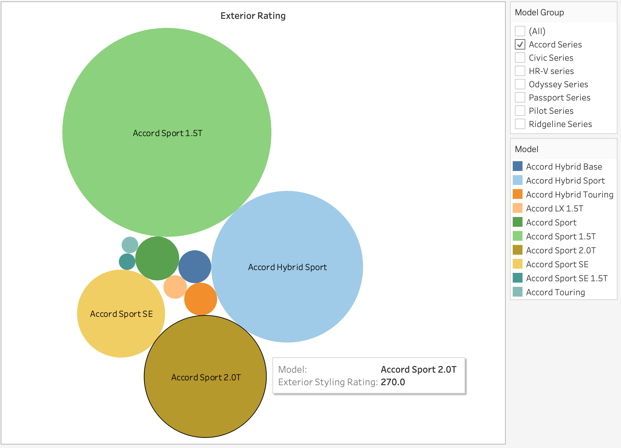
Exterior rating Analysis

Slide 5
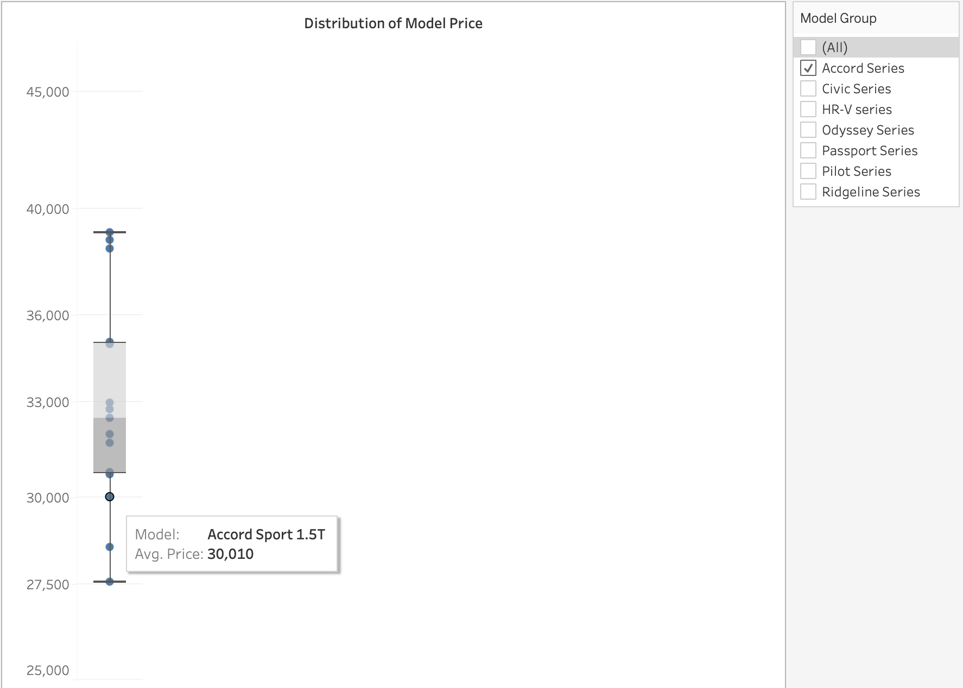
Model Price Distribution

Slide 6
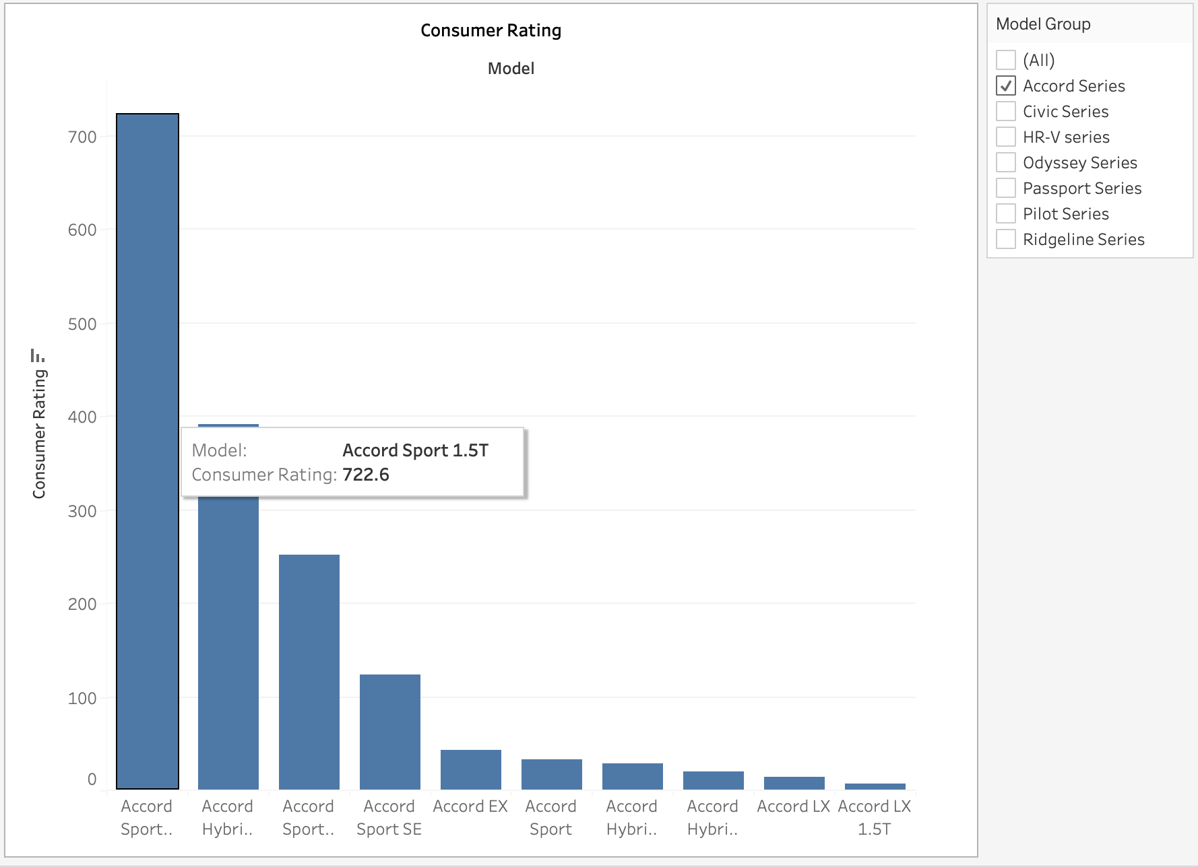
Overall Consumer Rating per Model

Slide 7
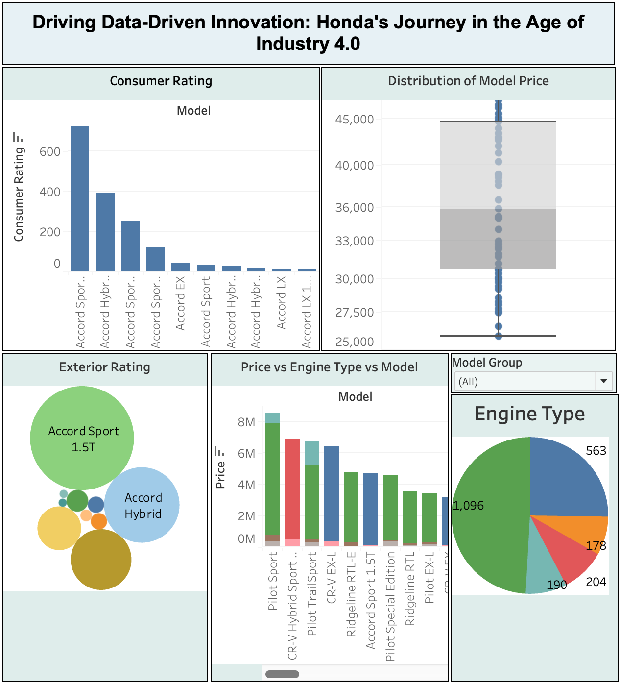
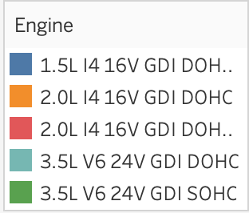
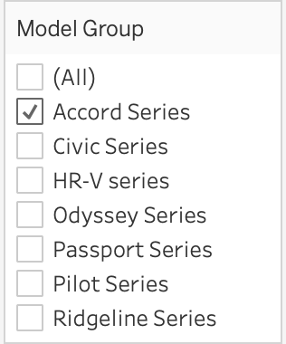
Dashboard

Slide 8
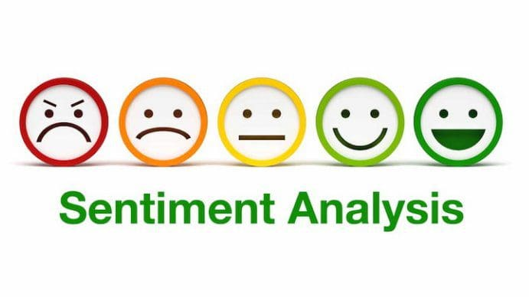

Slide 9
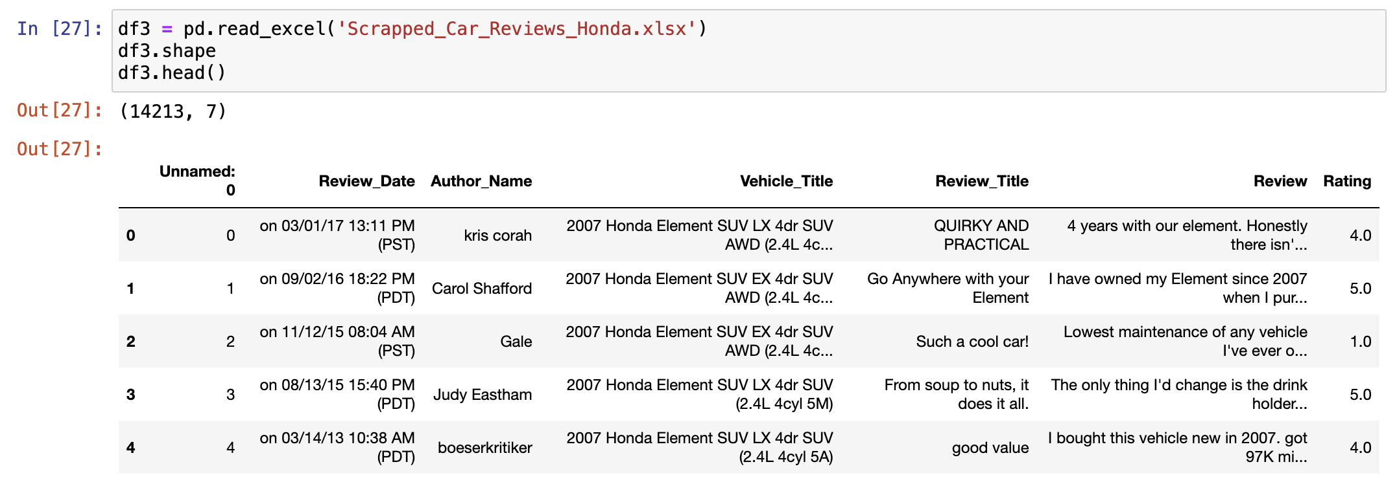
Edmunds-Consumer Car Ratings and Reviews. (2018, October 1). Kaggle. https://www.kaggle.com/datasets/ankkur13/edmundsconsumer-car-ratings-and-reviews

Slide 10
Steps Involved
NLTK: - Natural Language Processing Tool Kit
Sentiment analysis – Score, Positive / Negative reviews
Tokenize and count words
Understanding the context of the reviews
Get the most frequent bigrams / trigrams

Slide 11
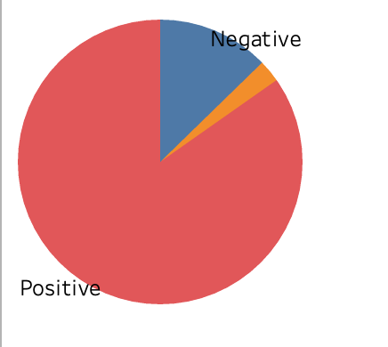
Sentiment Category: - Positive vs Negative

Slide 12
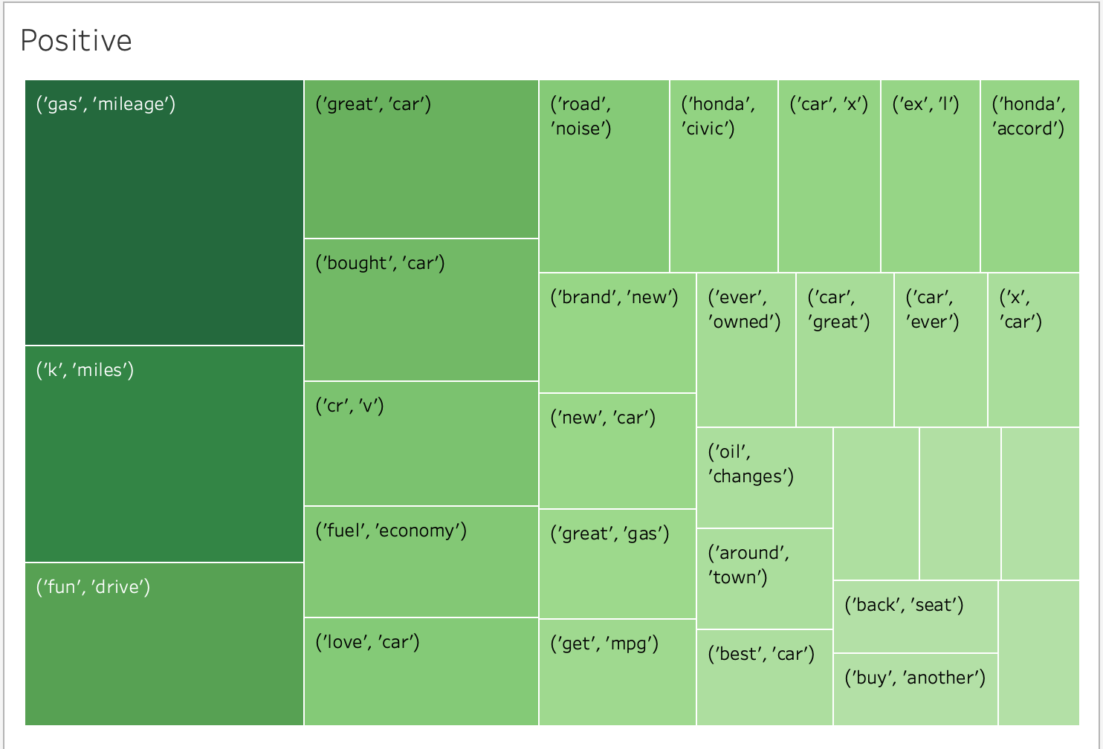
Positive Reviews

Slide 13
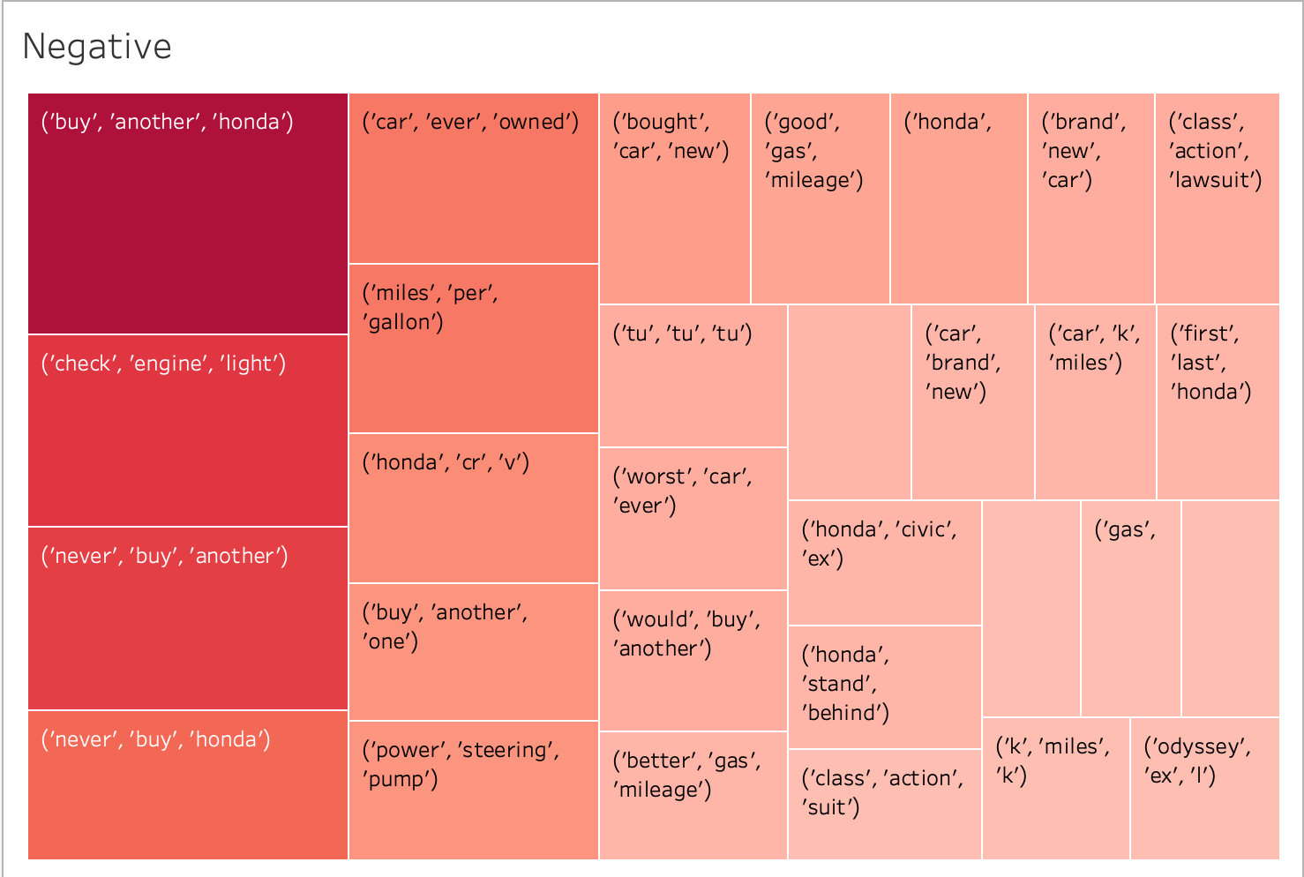
Negative Reviews

Slide 14
Conclusion
In the positive reviews the topic that most of the customers discussing are about miles, mileage, drive, brand.
In the negative reviews most of the customers discuss about engine, miles per gallon.
Honda can focus on the negative reviews and focus on the specific sectors where consumers expecting much more quality from the car models

Slide 15
Thank You
Q&A

