Slide 1
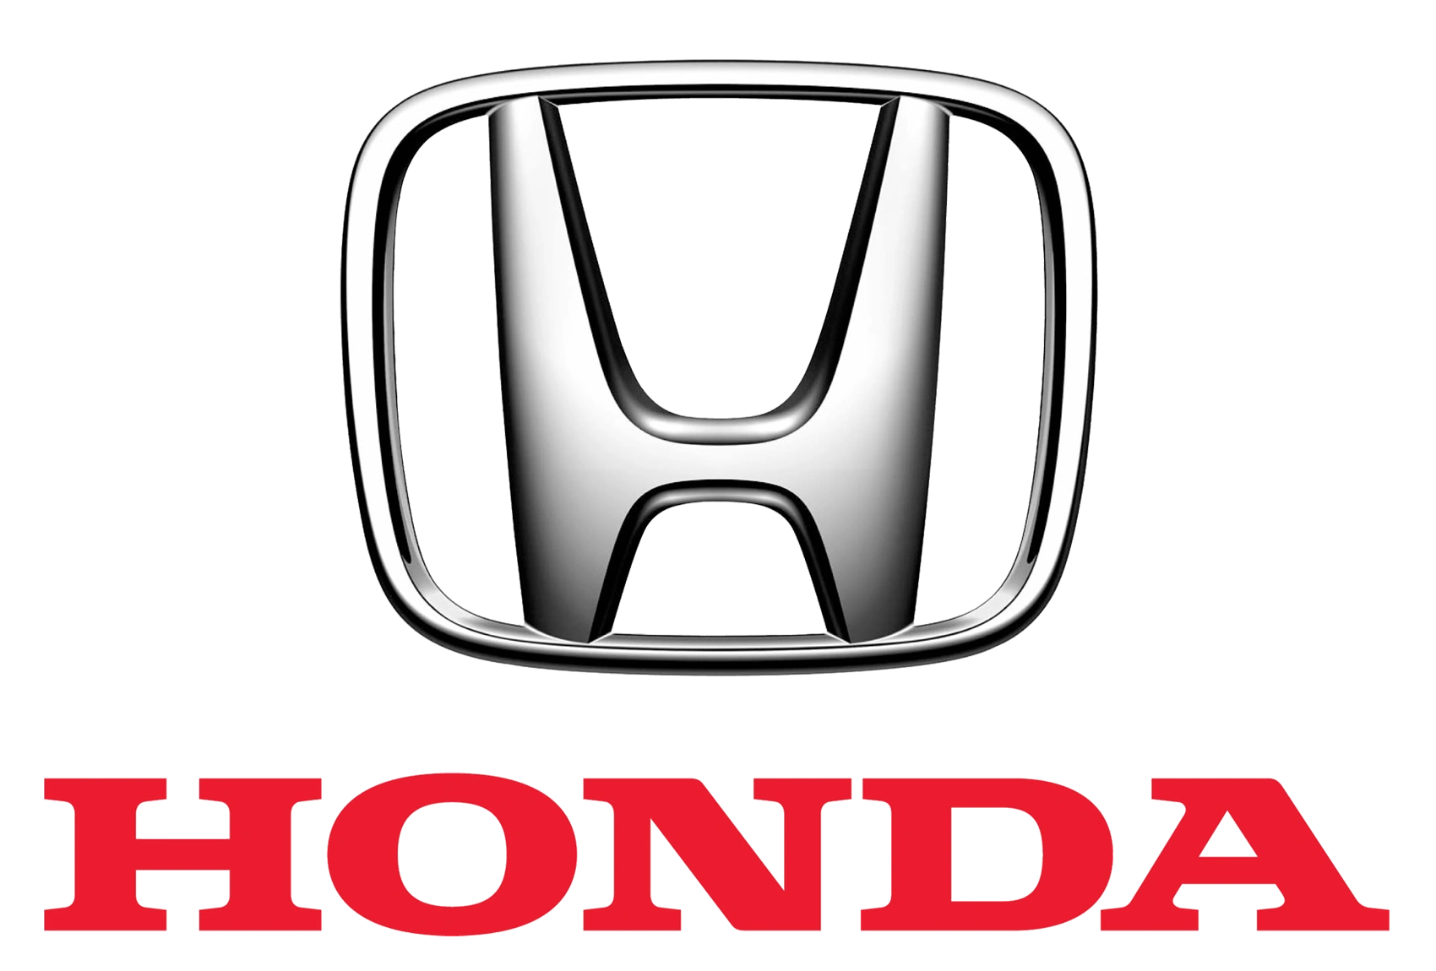
Driving Data-Driven Innovation: Honda's Journey in the Age of Industry 4.0
Group 8: -
Kotha Apuroop – 002967351 (kotha.a@northeastern.edu)
Sai Suresh Reddy Challa – 002651026 (challa.sai@northeastern.edu)

Slide 2

Introduction
Honda, a globally renowned automobile company with a rich history dating back to 1946, has long been a leader in the automotive industry. Known for its commitment to innovation and technological advancement, Honda has consistently produced high-quality vehicles and motorcycles that have captured the imaginations of consumers worldwide. As we delve into the role of data analytics and artificial intelligence (AI) in Honda's operations, it becomes clear that the company's commitment to innovation extends to its embrace of data-driven decision-making and cutting-edge technology.

Slide 3
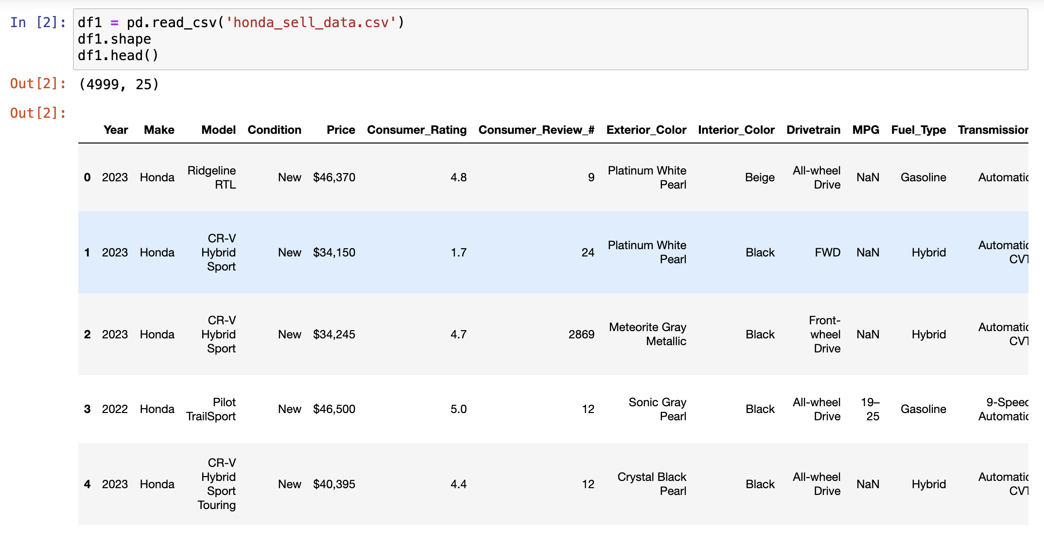
T. (2023, May 8). Car_Price_Prediction and EDA. Kaggle. https://www.kaggle.com/code/themeeemul/car-price-prediction-and-eda/input
Edmunds-Consumer Car Ratings and Reviews. (2018, October 1). Kaggle. https://www.kaggle.com/datasets/ankkur13/edmundsconsumer-car-ratings-and-reviews

Slide 4
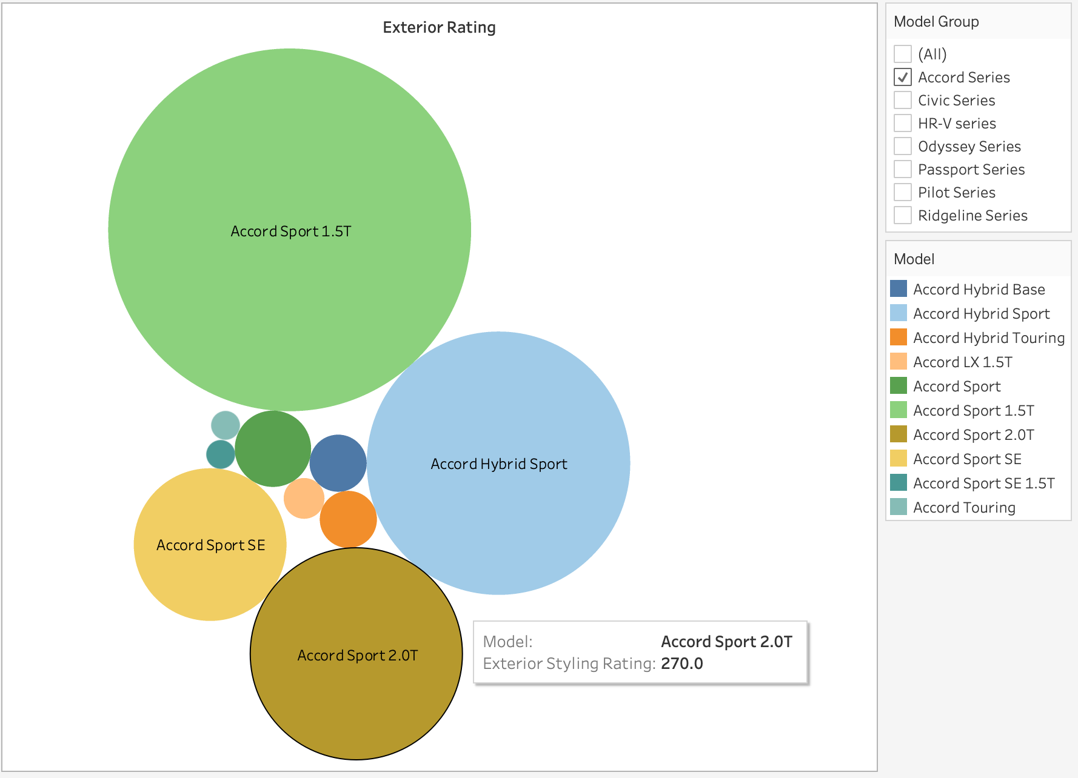
Exterior rating Analysis
The image describes the exterior ratings given by the consumers to the Honda, here the series filtered is Accord series. Among the Accord series Accord sport 1.5T has the best ratings for the exterior design.

Slide 5
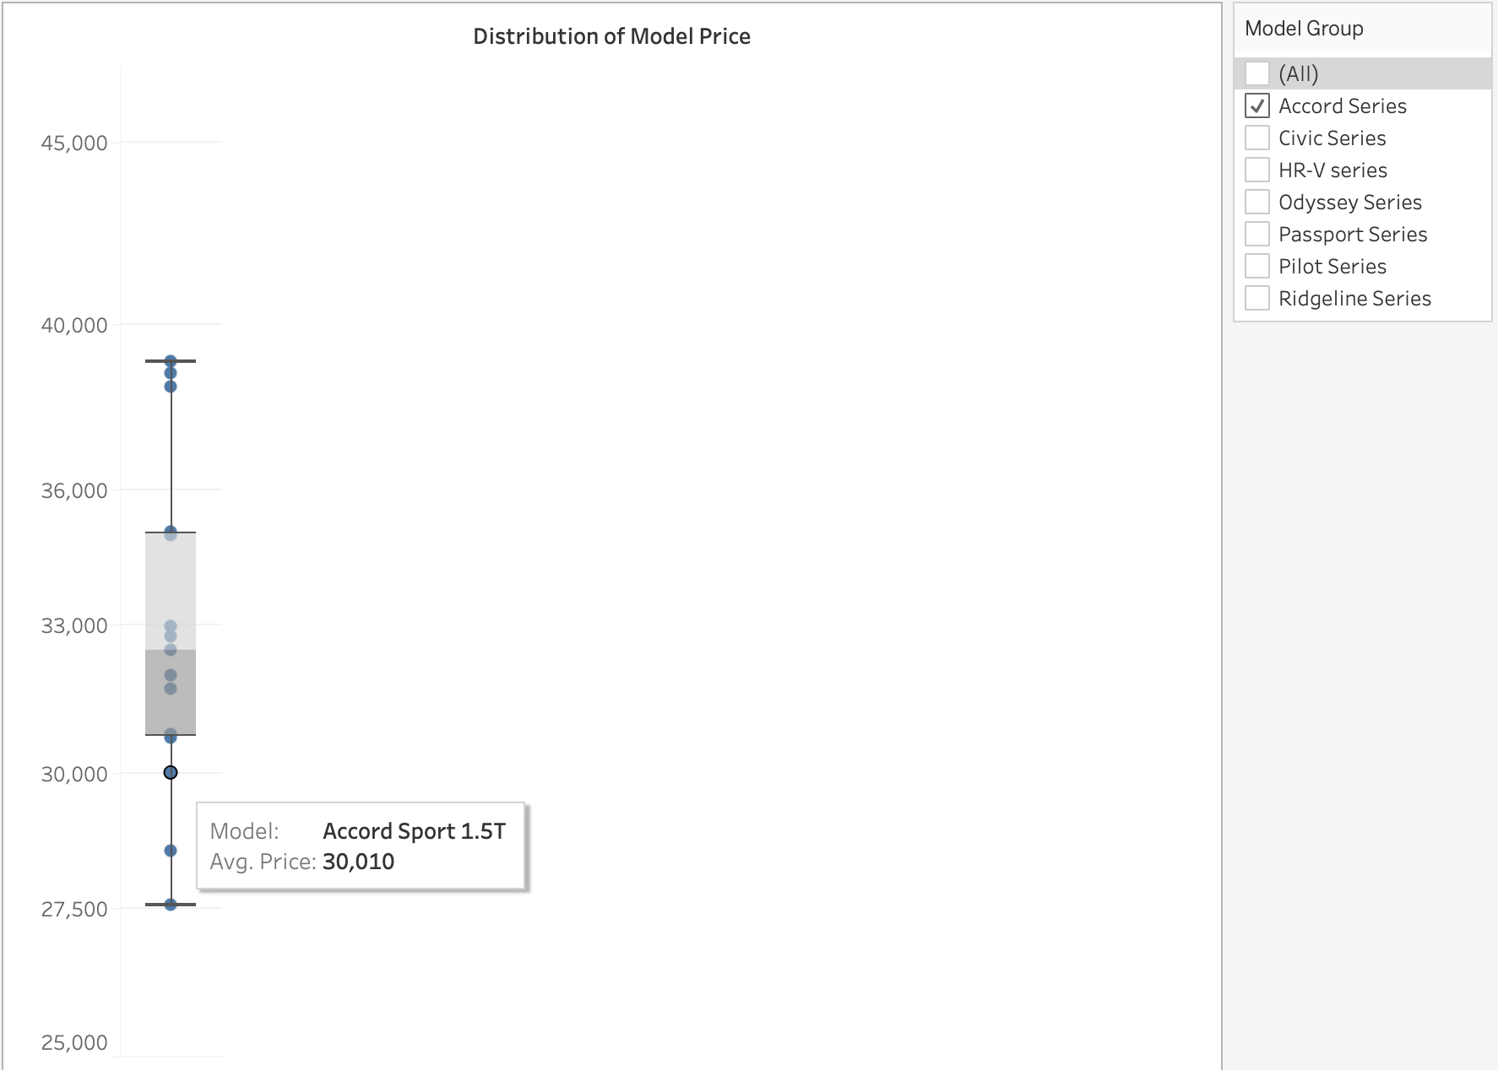
Model Price Distribution
The image describes the distribution of Model price of Honda, here the series filtered is Accord series. Among the Accord series, the average price of accord series is $30,010

Slide 6
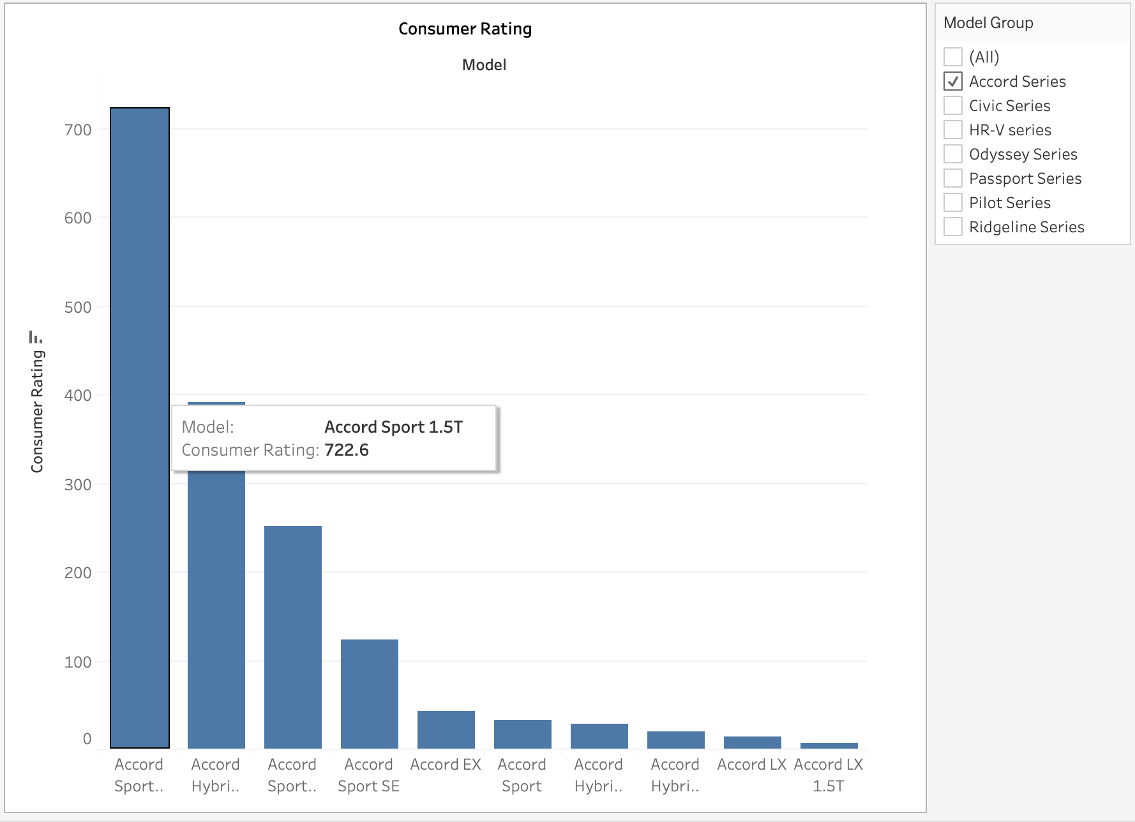
Overall Consumer Rating per Model
The image describes the distribution of consumer rating of Honda Accord series, here the series filtered is Accord series. Among the Accord series, Accord sport has the highest consumer rating.

Slide 7
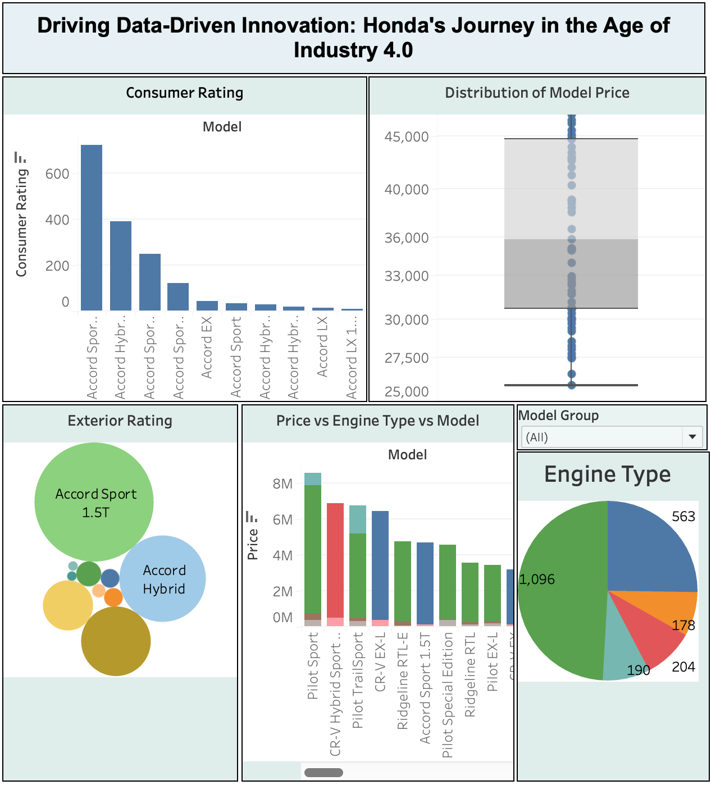
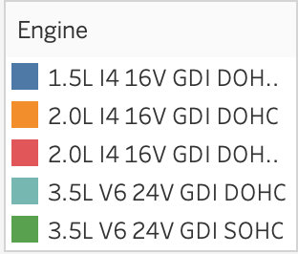
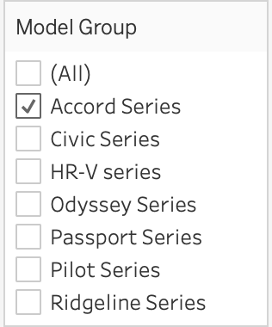
Dashboard 1
The dashboard has 5 charts, the consumer rating, distribution of model price, exterior rating, price vs engine vs model rating from the consumers and the pie chart describing the engine type.
The filter option has been applied on the model group, when the specific model has been selected the charts change as per the model series selected.

Slide 8
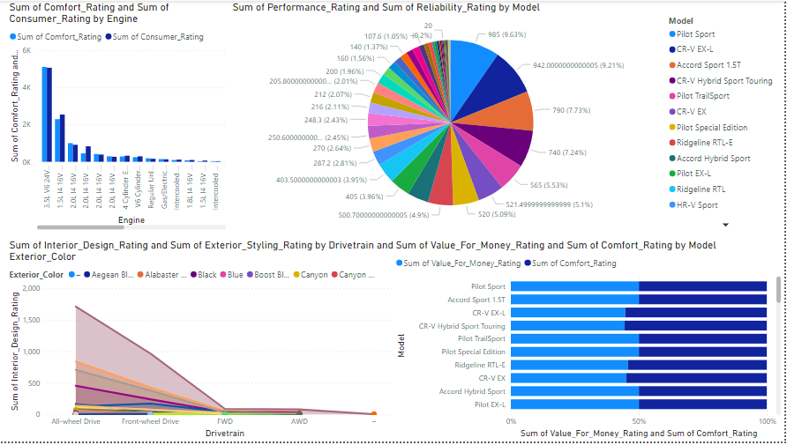
Dashboard 2:-
Pilot Sport had the highest Sum of Performance_Rating at 985, followed by CR-V EX-L and Accord Sport 1.5T. CR-V Hybrid EX-L had the lowest Sum of Performance_Rating at 4.50. Pilot Sport accounted for 9.63% of Sum of Performance_Rating. Sum of Comfort_Rating and total Sum of Consumer_Rating are positively correlated with each other. 3.5L V6 24V GDI SOHC accounted for 47.65% of Sum of Comfort_Rating. Sum of Consumer_Rating and Sum of Comfort_Rating diverged the most when the Engine was 2.0L I4 16V GDI DOHC, when Sum of Consumer_Rating were 378.20 higher than Sum of Comfort_Rating.

Slide 9
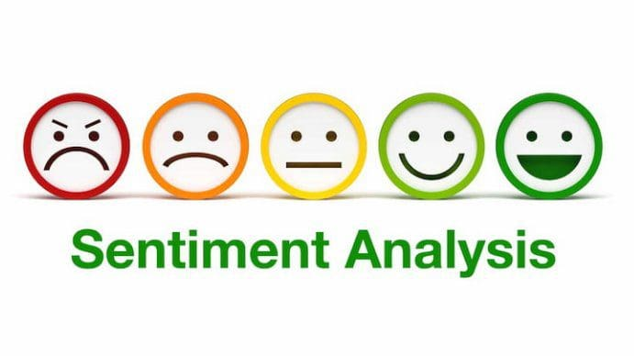

Slide 10
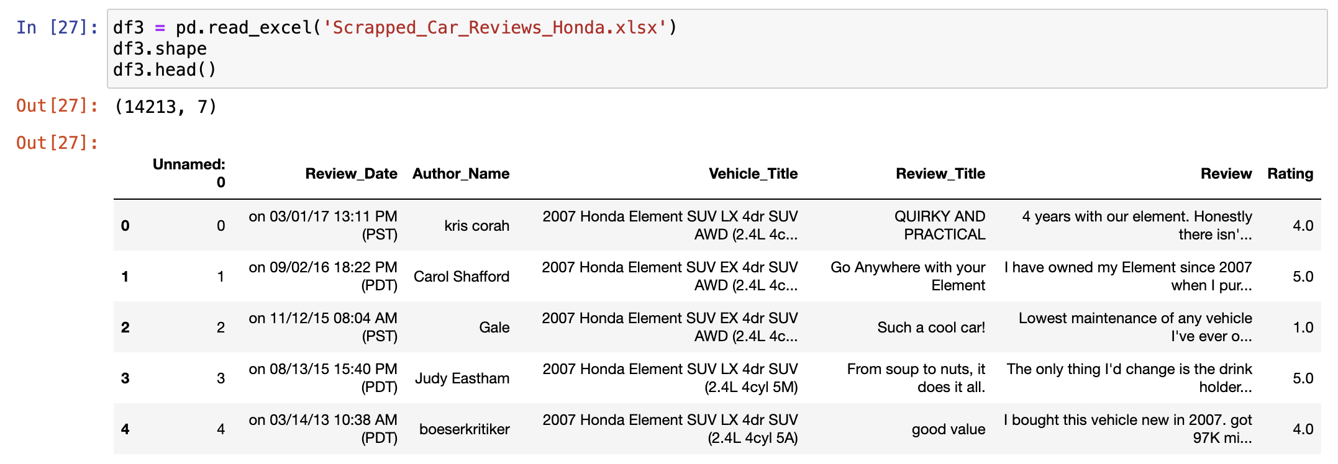
Edmunds-Consumer Car Ratings and Reviews. (2018, October 1). Kaggle. https://www.kaggle.com/datasets/ankkur13/edmundsconsumer-car-ratings-and-reviews

Slide 11
Steps Involved
NLTK: - Natural Language Processing Tool Kit
Sentiment analysis – Score, Positive / Negative reviews
Tokenize and count words
Understanding the context of the reviews
Get the most frequent bigrams / trigrams

Slide 12
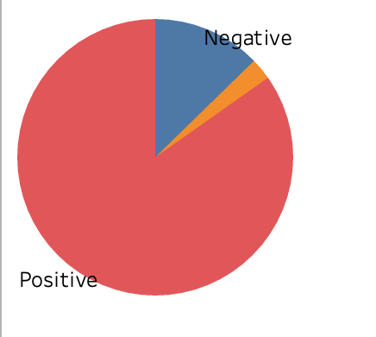
Sentiment Category: - Positive vs Negative
This pie chart describes the distribution of the reviews on the car engine. The engine types referred in the dataset are as follows,

Slide 13
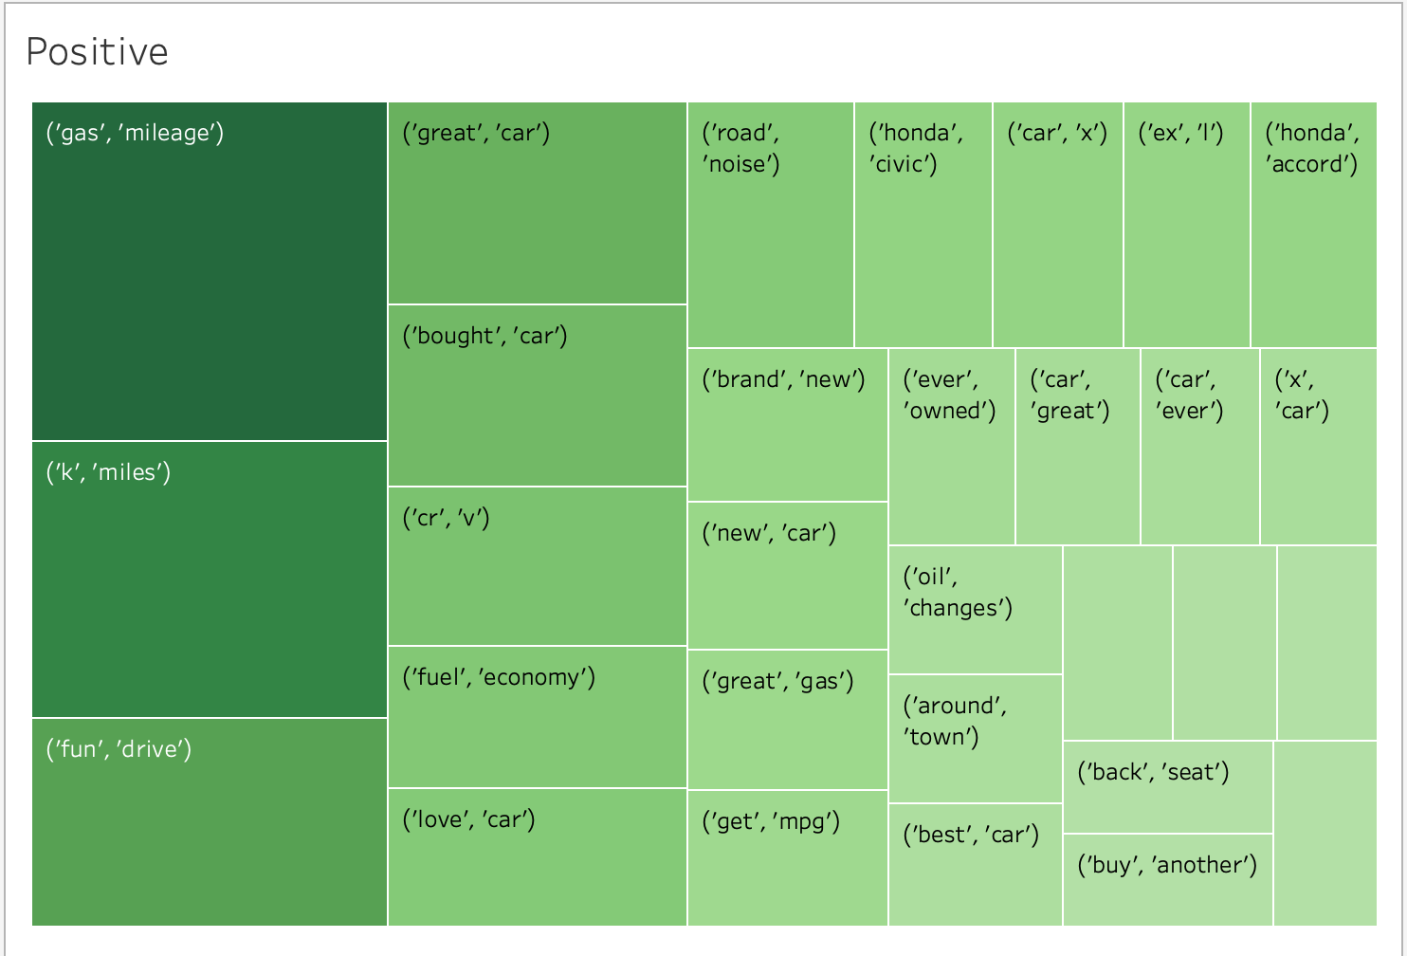
Positive Reviews
This Heat map describes the most frequently used positive words in the reviews these are the bigrams. Most of the consumers were discussing about the gas and mileage.

Slide 14
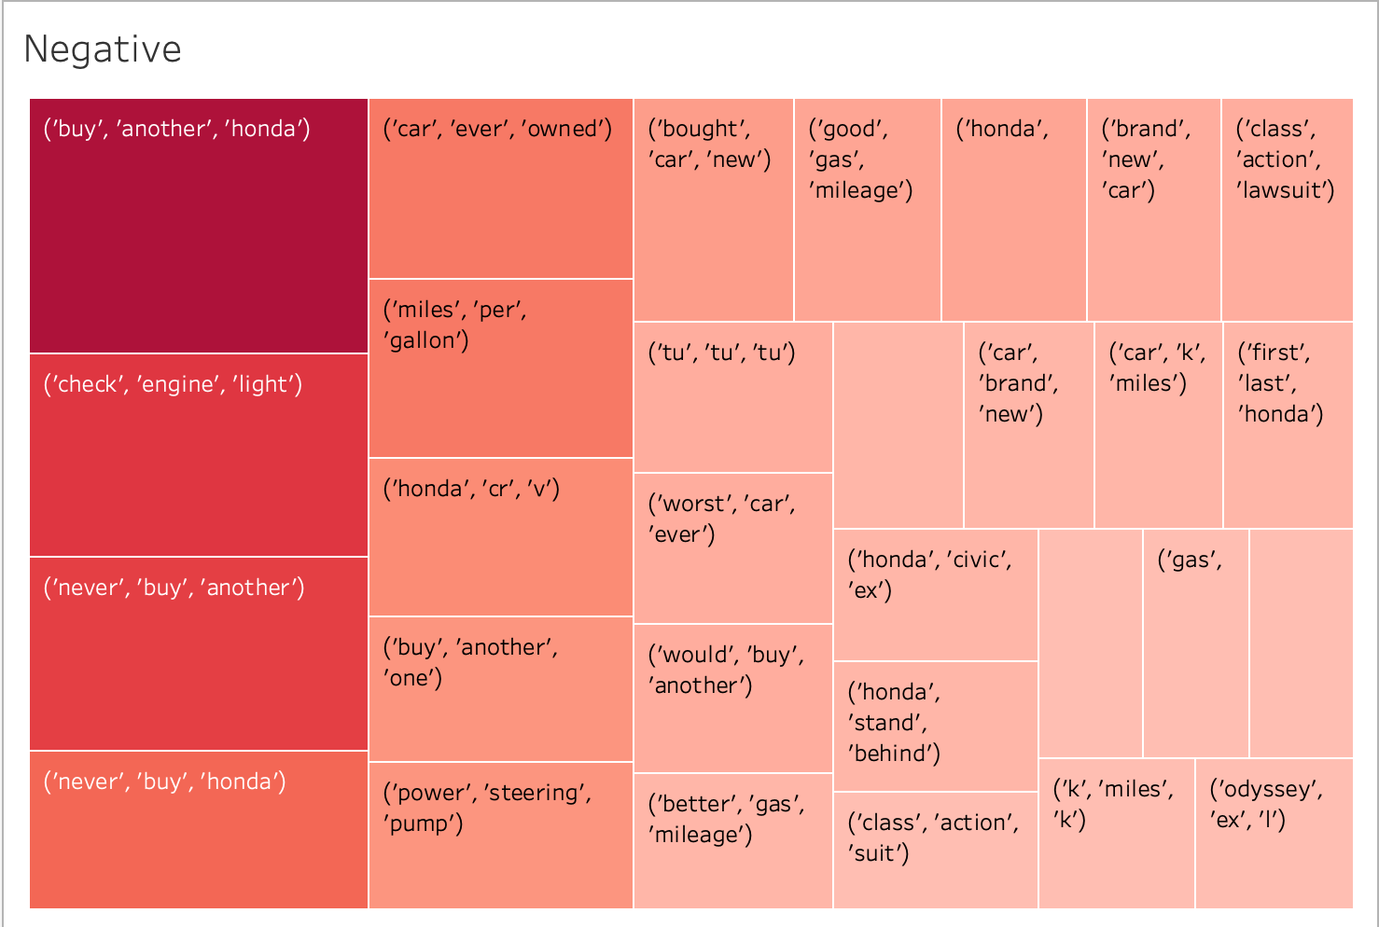
Negative Reviews
This Heat map describes the most frequently used negative words in the reviews these are the trigrams. Here the most frequently used negative reviews were buy another Honda, this might be because the consumers were referring to a specific model, so they might have reviewed as buy another Honda.

Slide 15
Conclusion
In the positive reviews the topic that most of the customers discussing are about miles, mileage, drive, brand.
In the negative reviews most of the customers discuss about engine, miles per gallon.
Honda can focus on the negative reviews and focus on the specific sectors where consumers expecting much more quality from the car models .
Sentiment analysis, when applied to Honda car reviews and similar consumer feedback, provides a data-driven foundation for enhancing product quality, customer satisfaction, and overall market performance. By embracing the insights offered by sentiment analysis, the manufacturing industry can continue to evolve its products to meet the ever-changing needs and expectations of its customer base, ensuring long-term success and brand loyalty in a highly competitive market.

Slide 16
References
Medhat, W., Hassan, A., & Korashy, H. (2014, December 1). Sentiment analysis algorithms and applications: A survey. Ain Shams Engineering Journal; Elsevier BV. https://doi.org/10.1016/j.asej.2014.04.011
Sentiment analysis of product reviews: A review. (2017, March 1). IEEE Conference Publication | IEEE Xplore. https://ieeexplore.ieee.org/abstract/document/7975207?casa_token=tioL8JgeyZEAAAAA:JRPAahZX9klnbxb9MX_SoDGbSAFkdUXCBrSNs4rgAQ1MmwbQ1URSr7XzqSoFNrWmmqIkz5SWVNk
Twitter sentiment analysis: A case study in the automotive industry. (2015, November 1). IEEE Conference Publication | IEEE Xplore. https://ieeexplore.ieee.org/abstract/document/7360594?casa_token=Z-XI-bA5QYkAAAAA:cWKyaJCjR_mD8n4YBDSii3Ro3wZ4pPYkE0p4exXjfgHsfD0GVJVNpVxxHUH97_Rl-TUA3UH2-Gw

Slide 17
Thank You
Q&A

