Slide 1

Micro Credit Loan- Project
Submitted By:
Apurv Saraf

Slide 2
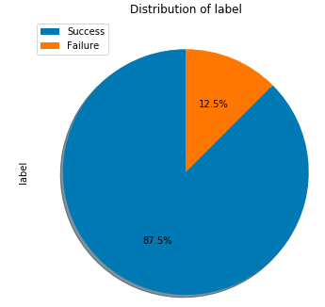
Business Problem Framing
Micro credit Loan Project is a real life project for a telecommunication network provider. The Telecommunication Network provider company collaborated with a Micro finance institution to provide micro-credit on mobile balances to be paid back in 5 days.
The Consumer is classified to be a defaulter if he/she do not pay back the loan amount within the time duration of 5 days. For the loan amount of 5 (in Indonesian Rupiah), payback amount should be 6 (in Indonesian Rupiah), while, for the loan amount of 10 (in Indonesian Rupiah), the payback amount should be 12 (in Indonesian Rupiah).
The client has approached for building a ML Algorithm to select the good customers who will pay back the loaned amount
Distribution of dataset

Slide 3
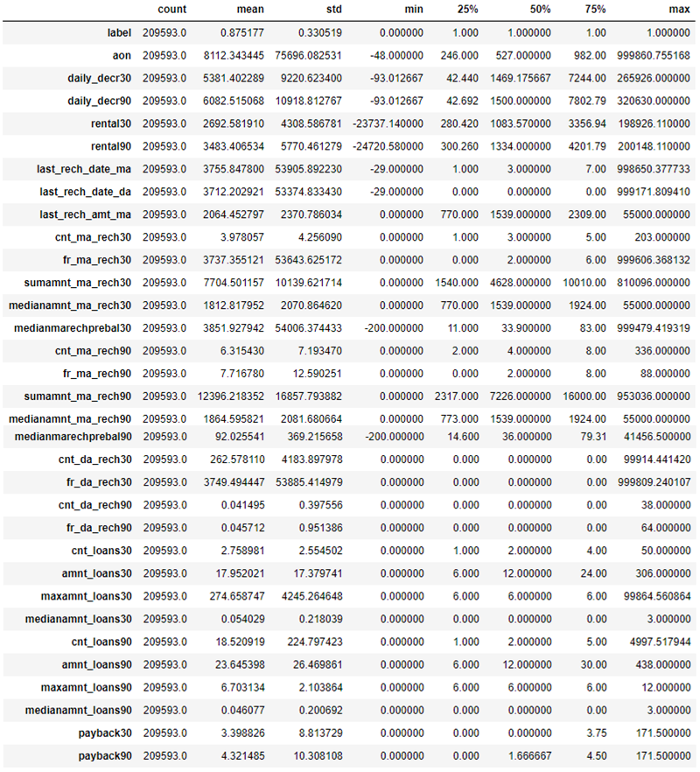
Exploratory Data Analysis
Under EDA using df.describe() we performed statistical analysis on the data set. Below are some conclusions drawn from it:
1) Maximum features contain continuous data
2) In some features Mean is greater than Median which gives us hint that there are outliers present in the dataset
3) Also some features are skewed
4) Also its evident that there are anomaly present as age on cellular network days, Daily amount spent from main account, averaged over last 30 days, Daily amount spent from main account, averaged over last 90 days, Average main account balance over last 30 days, Average main account balance over last 90 days, Number of days till last recharge of main account, Number of days till last recharge of data account are negative which can not be in any case
5) In maxamnt_loans30, medianamnt_loans30,maxamnt_loans90, medianamnt_loans90 seems some anomalies which needs to be corrected, that is if we go by definition of loan amount which could be 6 or 12 or zero for some customers.

Slide 4
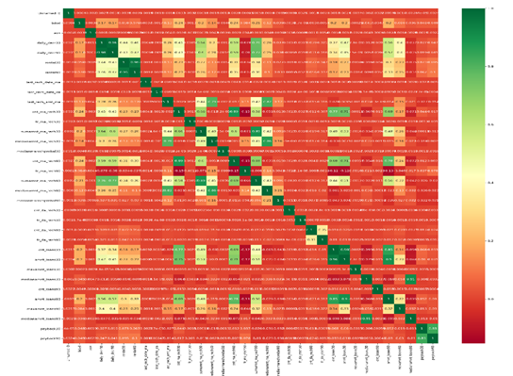
Correlation
Exploratory Data Analysis
We Also performed data cleaning by removing many irrelevant columns impacting our target variable like pcircle, unmapped etc.
Then we used df.corr() function and using sns.heatmap visualized the correlation.
From correlation we found many features to be highly correlated which we removed.
We also treated outliers present in the data set using zscore
Using PCA we cured the curse of dimensionality as well
Then using seaborn we performed uni-variate & bi-variate analysis

Slide 5
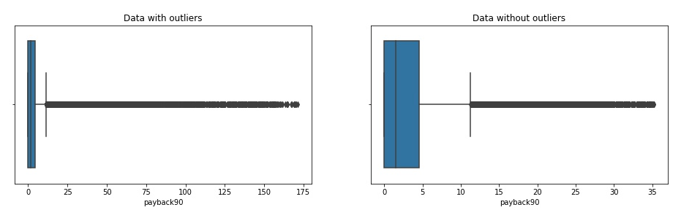
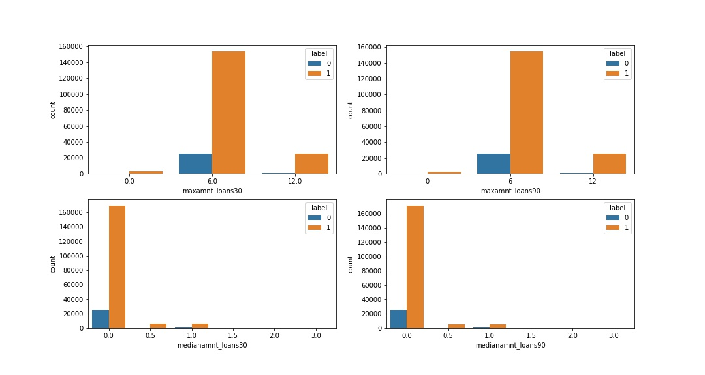
Data Visualization & Various Plots
Box Plot to check Outlier and after effects of Zscore
1
Count Plot to check distribution
2

Slide 6
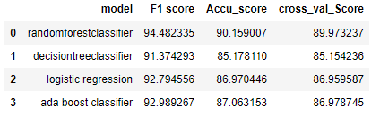
Model Performance
Model Building & Performance
It’s a classification problem and below models were used:
Logistic Regression
Decision Tree Classifier
Random Forest Classifier
AdaBoost Classifier
Evaluation being done using cross validation and various AUC and ROC Curve, accuracy score and classification matrices.

Slide 7
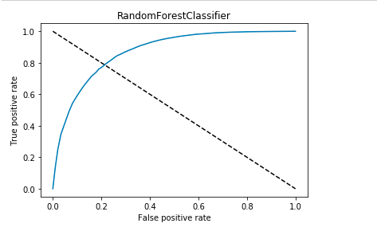
RFC Model Performance
Model finalization and conclusion
While evaluating the models found that Random Forest classifier is best fit model for the problem statement. Also would like to mention we can more fine tune the predictions by working more on feature tuning, and outlier management and also using smote for imbalanced data

Slide 8
Thank You

