Slide 1
Facial Emotion Recognition System
Jaypee University of Engineering and Technology
Project Mentor - Dr. Amit Kumar
Project number- AR3
Anisha Sharma: 231B047
Apurv Kumar: 231B060
Aryaman Singh Dhakad: 2310B65

Slide 2
Technology
The system leverages CNN-based deep learning with OpenCV-driven face detection to classify human facial emotions in real-time.
Core Programming Language :
Deep Learning Framework :
Technology | Purpose
Python | Core language for ML, computer vision
Tool | Role
TensorFlow | Backend engine, computation graph, GPU/CPU optimization
Keras | High-level API for CNN design and rapid prototyping

Slide 3
Technology
Machine Learning Model :
CNN Component | Function
Convolution + ReLU | Feature extraction
Pooling | Dimensionality reduction
Dropout | Overfitting prevention
Softmax | Class probability output
Training | Method
Loss Function | Categorical Cross-Entropy
Optimizer | Adam
Computer Vision Module:
OpenCV | Face detection, webcam input, image preprocessing

Slide 4
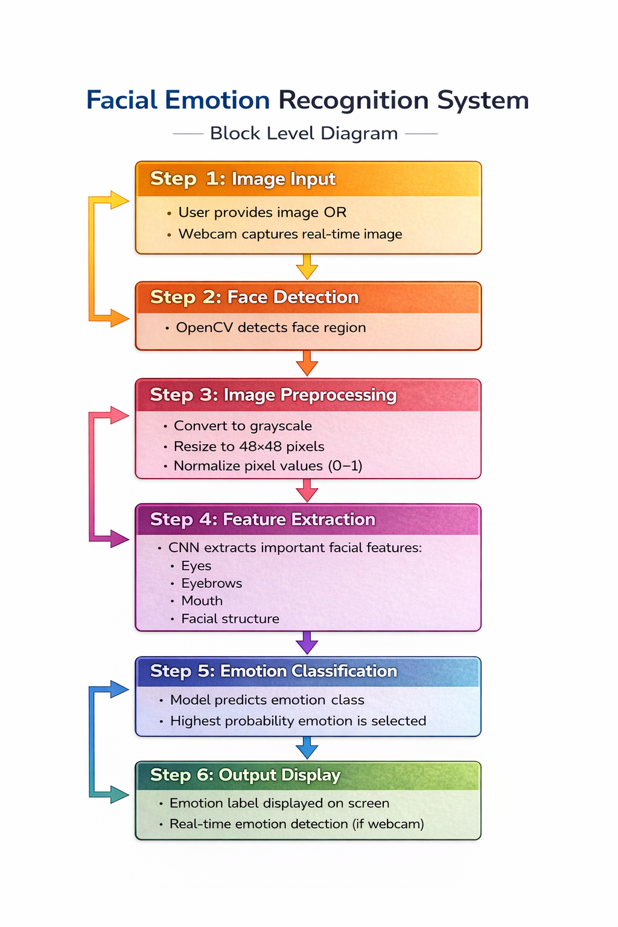
Methodology & Process-Flow

Slide 5
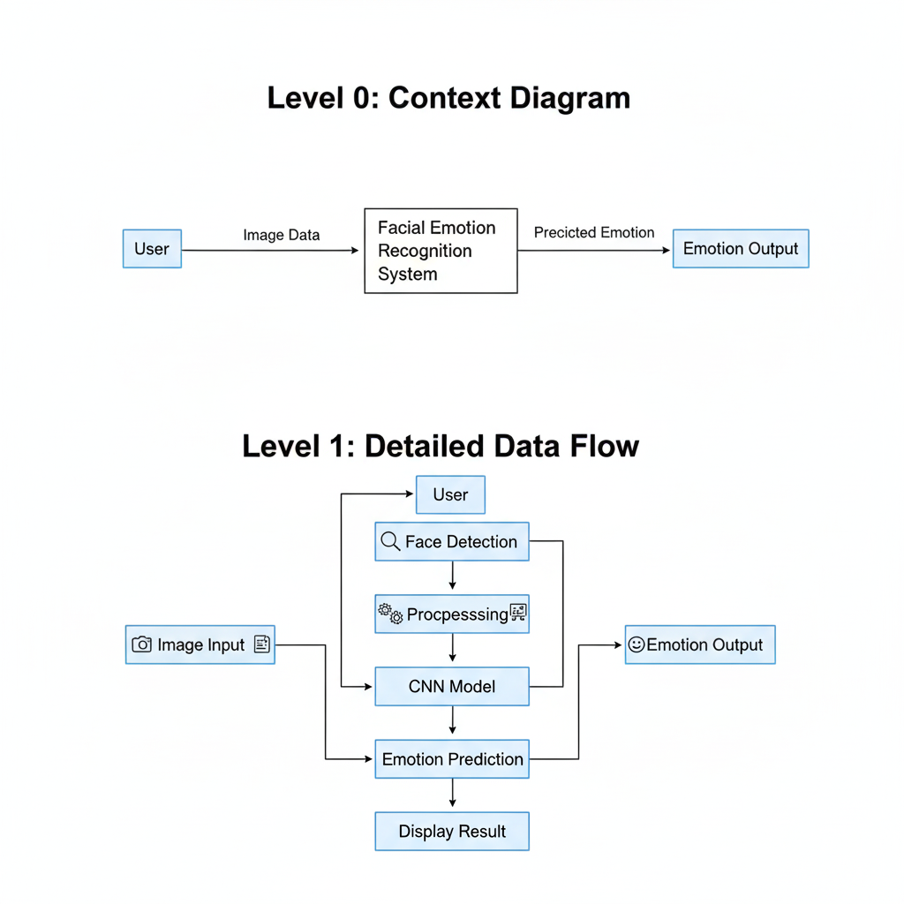
Data Flow Diagrams (DFDs)

Slide 6
Hardware & Dataset Overview
The data consists of 48x48 pixel images of faces. The task is to categorize each face based on the emotion shown in the facial expression into one of seven categories (0=Angry, 1=Disgust, 2=Fear, 3=Happy, 4=Sad, 5=Surprise, 6=Neutral).
The training set consists of 28,709 examples and the public test set consists of 3,589 examples.
FER2013 Dataset – Link to Kaggle Dataset
Component | Description
Processing Unit | CPU / GPU based training
Development Environment | Jupyter Notebook / Python IDE
Input Device | Webcam for real-time emotion detection

Slide 7
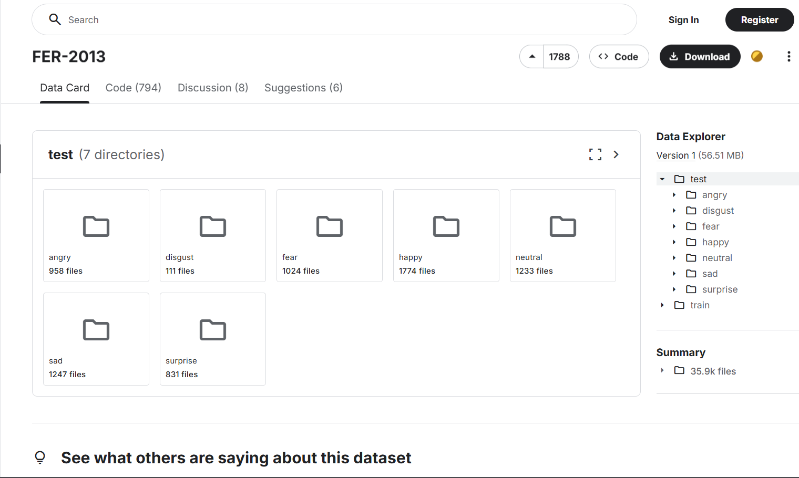

Slide 8
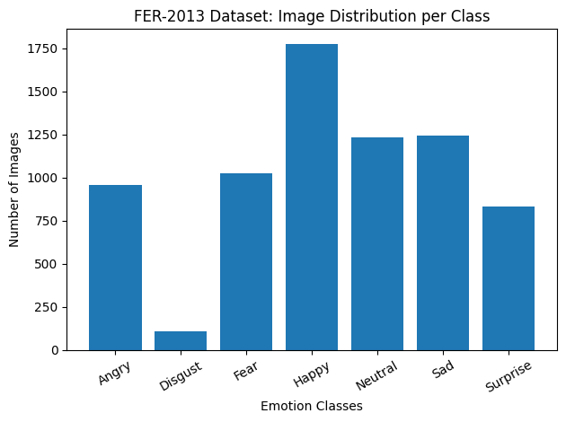
Visualizing Dataset (Number of Images/class)

Slide 9
Work Done (Current Progress)
WEEK-1: Studied the fundamentals of facial emotion recognition, its real-world applications, and the seven basic emotion categories.
WEEK-2: Researched and selected a suitable dataset, reviewed emotion classes, and analyzed the number and types of images.
WEEK-3: Learned about data preprocessing techniques such as resizing, noise reduction, grayscale conversion, and normalization.
WEEK-4: Applied preprocessing steps to clean and prepare the facial image dataset for better training performance.
WEEK-5: Studied deep learning approaches, understood CNN architecture (feature extraction and classification).

Slide 10
Future Work
1. Model Development:
- Build a CNN-based deep learning model.
- Experiment with custom CNN and transfer learning.
- Compare performance using accuracy and loss.
2. Model Training & Optimization:
- Train the model on the prepared dataset.
- Tune hyperparameters (learning rate, batch size, epochs).
- Apply dropout and data augmentation to reduce overfitting.
3. Model Evaluation:
- Evaluate using accuracy, precision, recall, F1-score, and confusion matrix.
- Test on unseen data for validation.

Slide 11
Future Work
4. Real-Time Emotion Detection:
- Integrate the trained model with webcam using OpenCV.
- Enable live face detection and emotion prediction.
5. Performance Improvement:
- Improve robustness against lighting changes and facial angles.
- Optimize speed for real-time prediction.
6. Deployment:
- Develop a simple GUI.
- Convert the model into deployable format (.h5 / .pt).
- Optionally deploy as a web application.

Slide 12
References
https://pmc.ncbi.nlm.nih.gov/articles/PMC7013584/
https://www.ijert.org/research/face-recognition-system-IJERTV8IS050150.pdf
https://ieeexplore.ieee.org/document/9145558
https://www.researchgate.net/publication/343118558_A_Review_of_Face_Recognition_Technology
https://francis-press.com/uploads/papers/qd2810eEIhPDLdXhBQjSWXVTJW4SrZ7iCUtQqZfs.pdf

