Slide 1

Facial Emotion Recognition System
Presented by:
Anisha Sharma: 231B047
Apurv Kumar: 231B060
Aryaman Singh Dhakad: 2310B65
Under the supervision of:
Dr. Amit Kumar
AR3
Jaypee University of Engineering & Technology, Guna

Slide 2
Introduction
This project focuses on building a system that can understand human emotions from facial expressions.
The main aim is to automatically detect emotions like happy, sad, angry, surprise, fear, disgust, or neutral from images or live video.
The focus is to make emotion recognition simple and useful for real-world applications like user interaction and behavior analysis.
The system leverages CNN-based deep learning with OpenCV-driven face detection to classify human facial emotions in real-time.

Slide 3
Problem Statement
The Indian Education landscape has been undergoing rapid changes for the past 10 years owing to the advancement of web-based learning services, specifically, e-Learning platforms.
In a physical classroom during a lecturing teacher can see the faces and assess the emotion of the class and tune their lecture accordingly, whether he is going fast or slow. He can identify students who need special attention.
Digital classrooms are conducted via a video telephony software program (ex- Zoom) where it’s not possible for medium-scale class (25-50) teacher to see all students and access the mood. Because of this drawback, students are not focusing on content due to a lack of surveillance.
While digital platforms have limitations in terms of physical surveillance, but it comes with the power of data and machines which can work for you. It’s data can be analyzed using machine learning algorithms which not only solves the surveillance issue, but it also removes the human bias from the system.
Moreover, it can be extended in mental health monitoring, real-time feedback systems. Thereby, improving human-computer interaction.

Slide 4
Literature Review
Summary of Existing Work
Earlier systems used manual features, while modern approaches rely on deep learning models for emotion recognition.
Key Findings
Standard datasets like FER-2013 and CK+ are widely used to classify emotions into seven categories.
Transfer learning with pre-trained models helps improve accuracy using large-scale facial data.
CNN layers learn basic features first and complex facial patterns like expressions in deeper layers.
Limitations / Gaps in Existing Solutions
Data augmentation improves model performance by handling variations in angles, lighting, and facial positions.
Neutral emotion plays an important role in preventing misclassification of other emotions.
Models perform well on controlled images but struggle with real-world conditions like lighting and head movement.
Existing systems fail to detect subtle or micro-expressions that indicate true emotions.
Bias in datasets affects performance across different age groups, skin tones, and facial variations.

Slide 5
Work Plan
Weak | Work | Status
Week 1 | Project Scope & Feasibility, Research paper & Article | Completed
Week 2 | Dataset Collection & Sample Pattern Recognition | Completed
Week 3 | Image Classification Techniques; Version Control Setup | Completed
Week 4 | Pre-processing (greyscale conversion/normalization) | Completed
Week 5 | One-Hot Encoding Standardization; 80-10-10 Splitting | Completed
Week 6 | Data Augmentation (using Keras imageDataGenerator) | Completed
Week 8 | Model Building Phase (Custom CNN architecture) | Completed
Week 9 | Model Training Phase ( Early Stopping Technique) | Completed
Week 10 | Accuracy/Loss Curve; Confusion Matrix Visualization | Completed
Week 11 | Fixing Class Imbalance; Optimizing the Model accuracy | Completed
Week 12 | Build real-time webcam emotion detection | Completed
Week 13 | Integrate Final model; Project Result/Report Documentation | Completed

Slide 6
Work Done
Developed and optimized a CNN model (filters reduced from 512 → 256) with BatchNorm and Dropout.
Implemented training strategies using EarlyStopping (patience=5) and ModelCheckpoint for adaptive learning.
Trained the model for 15 epochs, achieving 52% training accuracy and 53% validation accuracy with loss reduced from 4.0 to 1.45.
Evaluated model performance with 57.5% test accuracy and weighted F1-score of 0.553, with best performance on “Happy” (F1=0.794).
Analyzed confusion matrix to identify class imbalance and misclassification patterns (e.g., Fear and Neutral frequently confused with Anger).

Slide 7
Dataset Details
The data consists of 48x48 pixel images of faces. The task is to categorize each face based on the emotion shown in the facial expression into one of seven categories (0=Angry, 1=Disgust, 2=Fear, 3=Happy, 4=Sad, 5=Surprise, 6=Neutral).
The training set consists of 28,709 examples and the public test set consists of 3,589 examples.
FER2013 Dataset – Link to Kaggle Dataset

Slide 8
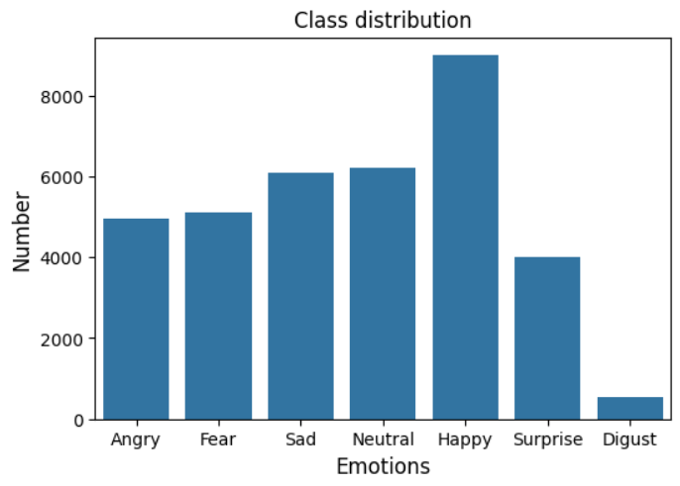
Visualizing Dataset

Slide 9
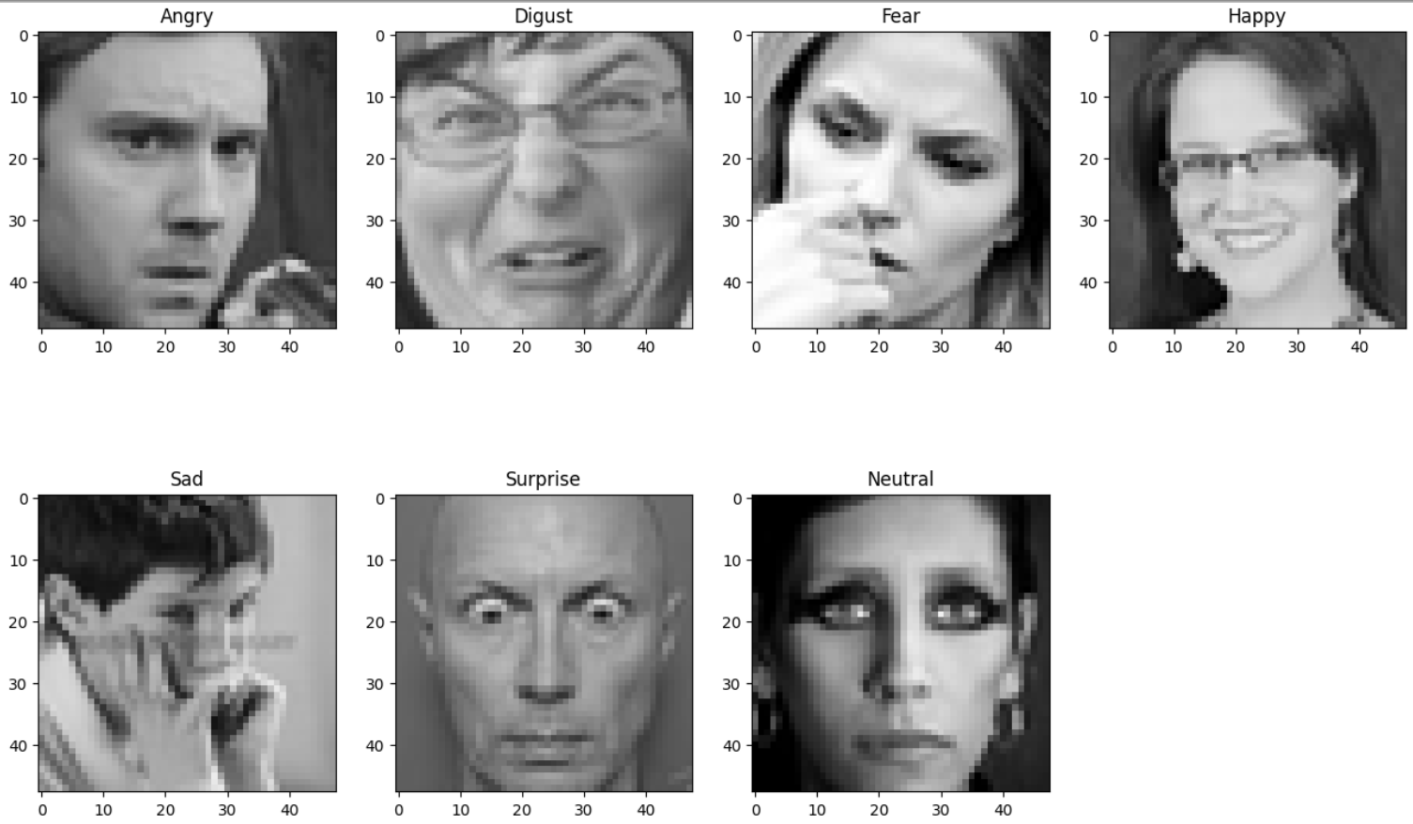
Visualizing Sample Images

Slide 10
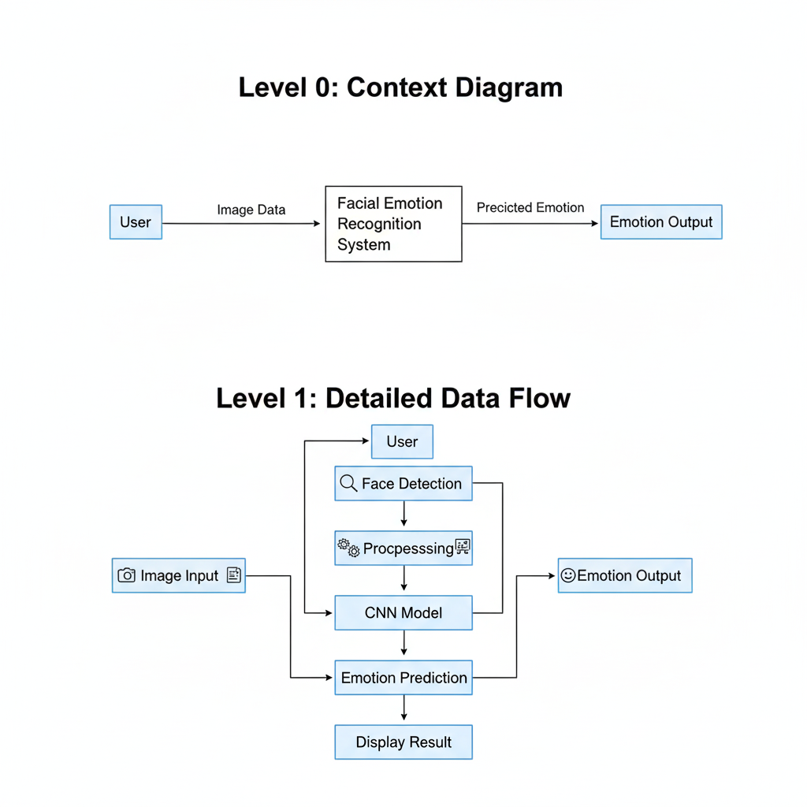
Data Flow Diagram (DFDs)

Slide 11
Process Methodology
Step 1: Data Input & Loading
Step 2: Face Detection
Step 3: Data Pre-processing
User provides Image, manually
OpenCV Detects Facial Region
Reshape images → (48, 48, 1)
Step 4: Data Augmentation & Generation
Uses ImageDataGenerator for: Rotation, zoom, horizontal flip.
Step 5: CNN Feature Extraction
Step 6: Training with Adaptive Learning
Step 7: Model Evaluation
Step 8: Emotion Prediction
Input → (48×48×1) image
Multiple Conv2D + BatchNorm + ReLU + MaxPooling layers
Apply Dropout & Flatten → Fully Connected Layers → Softmax (7 emotions)
Train using: Adam optimizer (lr=0.0001); Categorical Crossentropy loss
Use callbacks: EarlyStopping, ModelCheckpoint
Or Real-Time Image Detection using Webcam
Normalize pixel values → [0,1]range (/255)
Convert labels → one-hot encoding (7 classes)
Final predicted emotion, for static image
Real-time Emotion Identification
Evaluates on test/validation data
F1-score, Accuracy/Loss Curve, Confusion Matrix

Slide 12
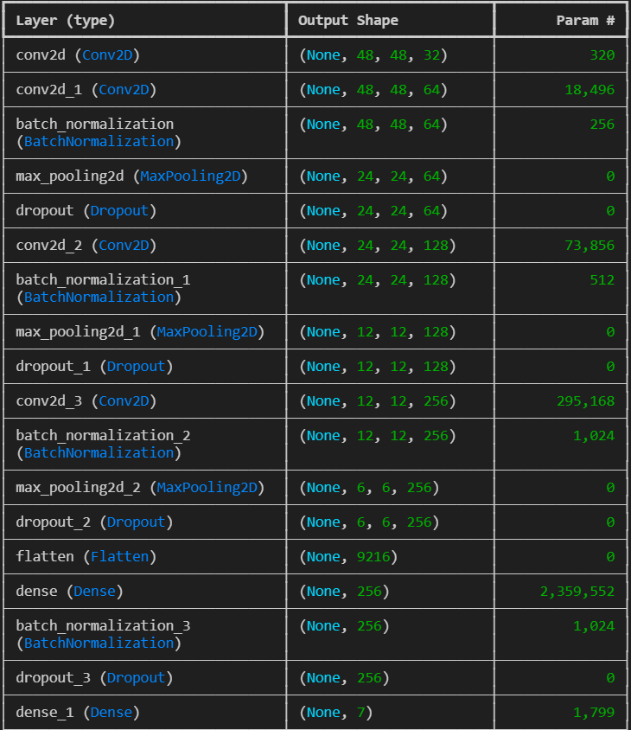
Model Architecture

Slide 13
Further Scope
Fixing Class Imbalance to improve minority class performance.
Increase training epochs & optimize hyperparameters(lr, dropout, batch size) to achieve better convergence and higher accuracy.
Improve real-time facial emotion detection using OpenCV for webcam-based input and live predictions.
Explore transfer learning (ResNet) to enhance feature extraction and boost overall model accuracy. (optional)

Slide 14
Conclusion
Model Training Performance
Trained for 15 epochs on FER dataset
Model Evaluation
Final Test Accuracy: 57.5%
Confusion Matrix Insights
Model performs well on: Happy (775 correct predictions); Surprise (332 correct)
Achieved:
Training Accuracy: 51–52%
Validation Accuracy: 52–53%
Loss reduced significantly:
4.0 → 1.45 (training loss)
3.5 → 1.45 (validation loss)
Weak classes identified: Fear: Recall = 0.167; Disgust: Recall = 0.192
Strong class performance: Happy: F1 = 0.794 (best); Sad: F1 = 0.715
Weighted F1-score: 0.553
Major misclassifications: Fear → Anger / Neutral; Neutral ↔ Anger confusion (169 cases)
Indicates class imbalance + feature similarity issues

Slide 15
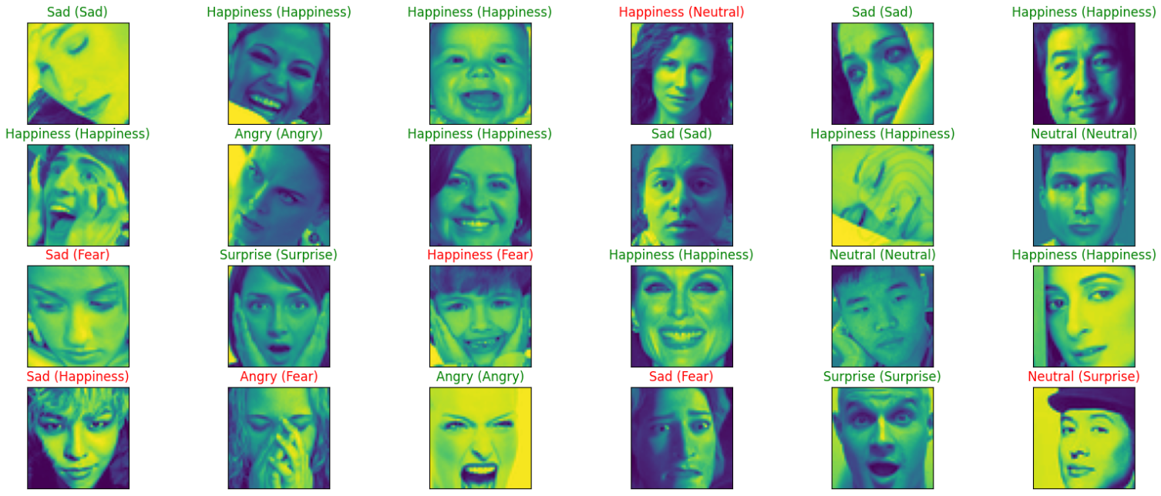
Image Classification

Slide 16
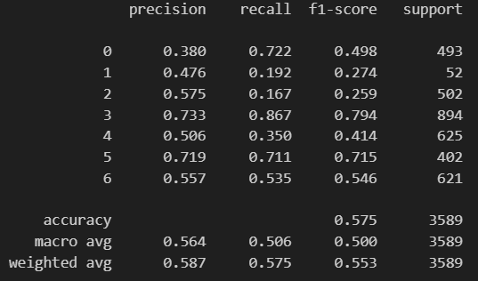
Classification Result

Slide 17
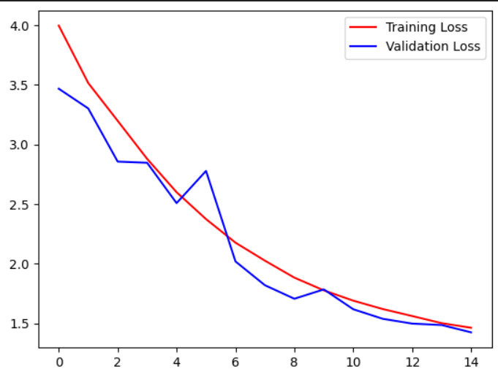
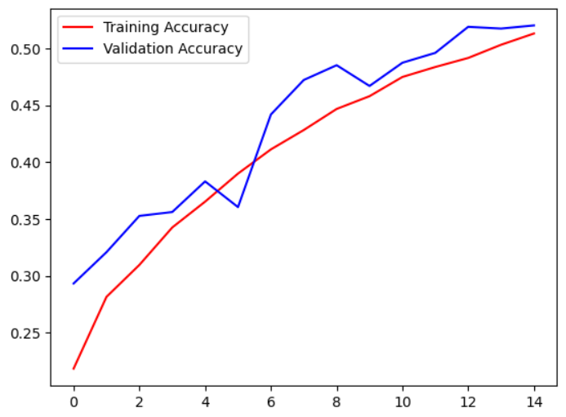
Accuracy/ Loss Curve

Slide 18
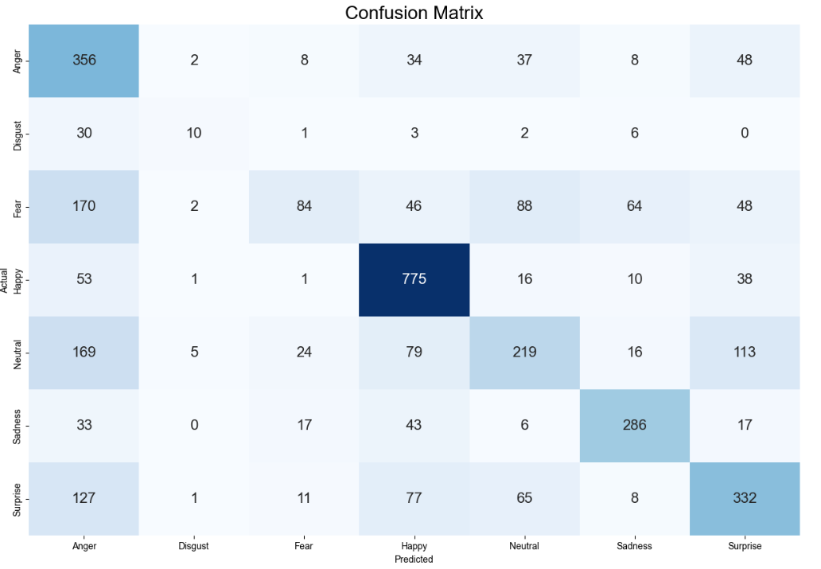
Confusion Matrix

Slide 19
References
[1] I. Goodfellow, Y. Bengio and A. Courville, Deep Learning, MIT Press, 2016.
[2] P. Ekman and W. V. Friesen, “Facial Action Coding System: A Technique for the Measurement of Facial Movement,” Consulting Psychologists Press, 1978.
[3] I. J. Goodfellow et al., “Challenges in Representation Learning: A Report on Three Machine Learning Contests,” Neural Information Processing, 2013.
[4] A. Mollahosseini, D. Chan and M. H. Mahoor, “Going Deeper in Facial Expression Recognition Using Deep Neural Networks,” IEEE Winter Conference on Applications of Computer Vision (WACV), 2016.
[5] S. Li and W. Deng, “Deep Facial Expression Recognition: A Survey,” IEEE Transactions on Affective Computing, vol. 13, no. 3, pp. 1195–1215, 2022.
[6] G. B. Huang et al., “Labeled Faces in the Wild: A Database for Studying Face Recognition,” University of Massachusetts, 2007.
[7] I. Goodfellow et al., “Facial Expression Recognition Challenge (FER-2013),” Kaggle Dataset, 2013.
[8] F. Chollet, “Keras: Deep Learning Library for Python,” 2015.
[9] G. Bradski, “The OpenCV Library,” Dr. Dobb’s Journal of Software Tools, 2000.
[10] K. He, X. Zhang, S. Ren and J. Sun, “Deep Residual Learning for Image Recognition,” IEEE CVPR, 2016.

Slide 20

Open for Questions & Feedback.
Thank You

