Slide 1

Infi-Hunt
Pockethon
IIT GOA
Apurv Varshney, Ashish Ekka, Shivam Kumar & Shreyash Tripathi

Slide 2

Hack Idea
A treasure hunt is a location based treasure hunt game where players get location based puzzles to solve and further clues are provided at the location solution of the current puzzle.
So we wanted to create a real-world interactive treasure hunt that users can play while sitting at home.

Slide 3

Why we chose this game?
Treasure hunts help exercise the mind by reinforcing problem-solving skills. Encourages creativity and thinking ‘outside the box’. So players can have fun while also learning these important life-skills.
So, for once parents cannot scold you for playing a game and they are also satisfied that there child is not wasting time. :)

Slide 4
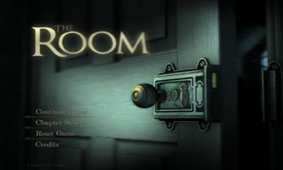
Problem?
Most of the treasure hunt games that you may have played have finite levels/have same timeline. So after the game is completed, there is no point in playing the game as we already know all the answers.
This is a major drawback of these games and discourage people from playing such games and hence these sort of games are generally less known.

Slide 5
Problem?
Another problem is that these type of games are not easy to scale and are a knightmare to the developers to create new levels to keep their fanbase busy and engaged.

Slide 6

Our Innovation/Solution
We take a cue from infinite runner games which are very popular.
The key to the solution is Randomness!!
We have implemented an algorithm such that it creates a new question every time even if the answer we should get is limited.
So, in a sense this treasure hunt is infinite and always remains interesting as now it depends on who score the highest points and not just completing the trail.
We have also used a real-world like so that player can relate to the game better.

Slide 7

Scalability & Saleability
Our solution is highly scalable and flexible as to create new questions we can just increase our database.
( Android play store has many such good games but they don’t receive the no.of downloads and income they deserve )
As we know infinite runner games are highly popular.
We just made Treasure Hunt INFINITE & Popular!!
We will keep the game Free but will keep some hints as internal purchases for our revenue.
We can keep some extra premium characters with some superpowers.

Slide 8
Framework
Game starts and player gets first clue
Player solves the puzzle
Player goes to the correct location and gets his new clue
Game Over and Score is displayed
All lives are over
Player goes to wrong location and loses a life

Slide 9
Future Work Ideas
scale to include any location from google maps, so we would have infinite maps also.
We can use different techniques to create new questions eg: ciphers.
Integrate Multiplayer model.
We can make the game in 3D for a more real-life feel.

Slide 10


Thank You!!
+1 23 987 6554

