Slide 1
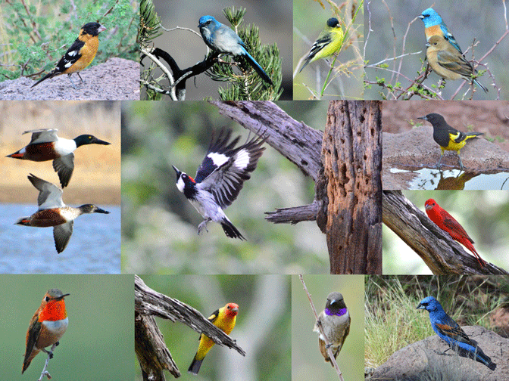
BIRD SPEECH RECOGNITION
Course Term Project Presentation
By -
Apurv Varshney
Gaurav Ganna
Pratyay Gaikwad

Slide 2
INTRODUCTION
Classification of birds by their sound has many potential applications in ecological surveillance, conservation monitoring, taxonomy and vocal communication studies.
Using audio recordings rather than pictures is justifiable since bird calls and songs have proven to be easier to collect and to discriminate better between species.
But for it to be useful for layman, it should be scalable, should work in noisy environments and on different lengths.

Slide 3
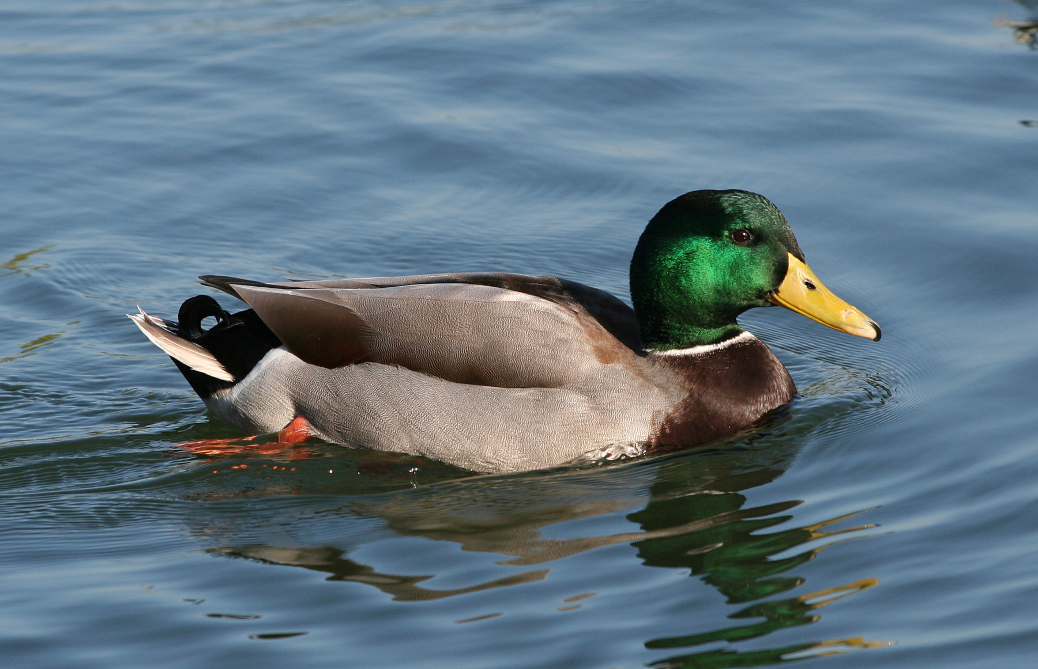
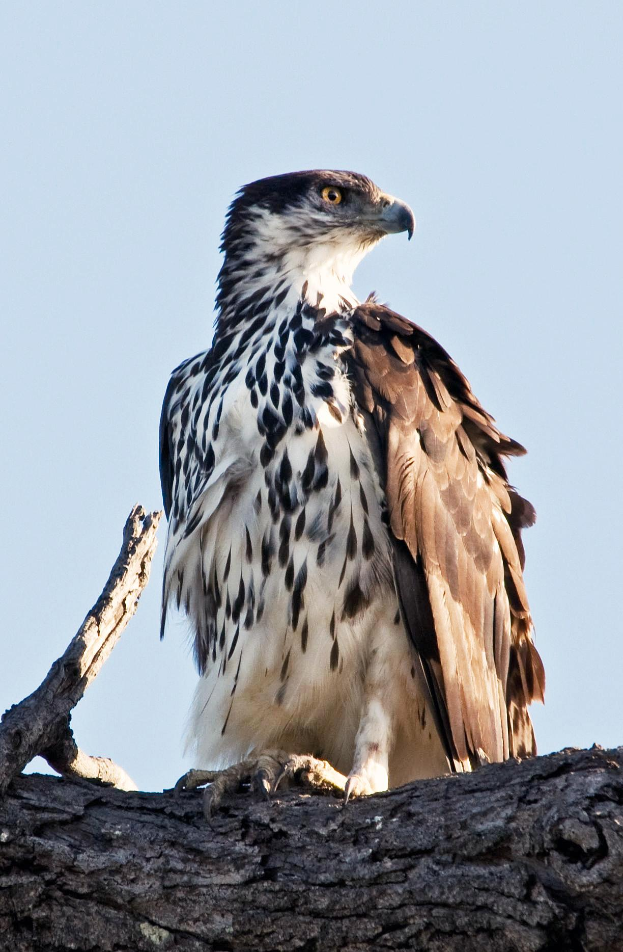
DATASET
Mallard
Dataset A - initially collected recordings of birds found in Goa.
Dataset B - collected quality ’A’ recordings of 7 species of variable length from xeno-canto website.
These recordings contains flight calls along with bird-songs. These were recorded in natural settings so it also includes long pauses, environmental noises along with actual bird audio.
Black Hawk-eagle

Slide 4
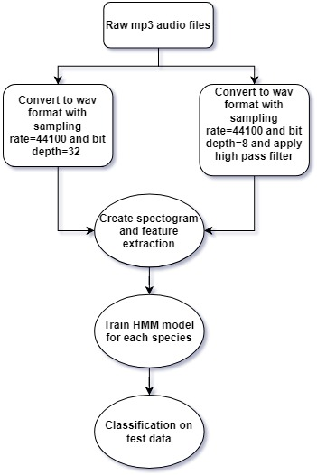
OVERVIEW

Slide 5
DATA PREPROCESSING
Raw mp3 files :
various sample rates,
mono/stereo
various bit depth
Wav files :
sample rates : 44100 Hz,
mono
bit depth - 8/32
High pass filter

Slide 6
SPECTROGRAM ANALYSIS
Cut signal into fixed-length segments
Apply a window function(hamming)
Take FFT of the segments
Arrange results by time sequence

Slide 7
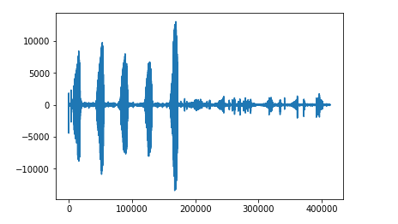
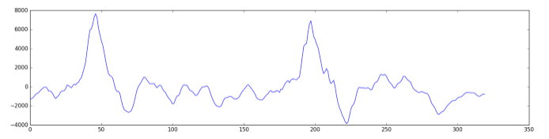
Basic plot of a Recording
FFT Plot of a window
Notes:
No . of samples=44100
No. of samples in a window = 4096
No. of windows=44100/4096

Slide 8
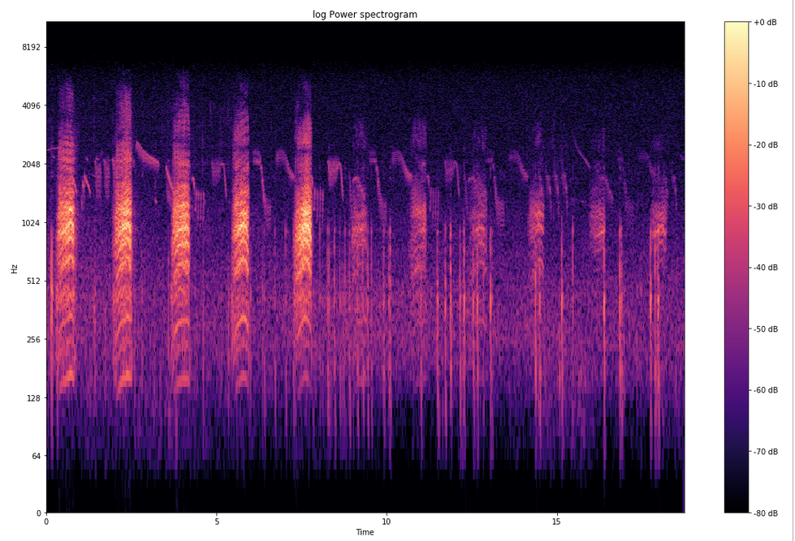
Spectrogram of a bird specie
Notes:
Different pitch pattern and notes can be seen

Slide 9
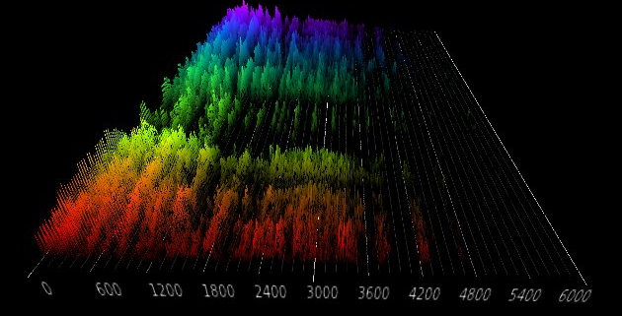
3D-View of A Spectrogram

Slide 10

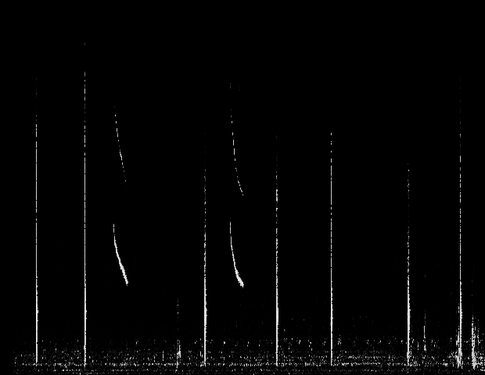
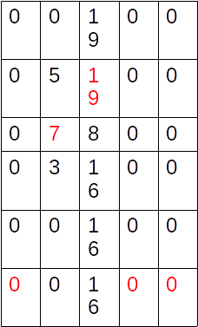


FEATURE EXTRACTION
The maximum amplitude in every column(time segment) and the corresponding frequency(row) are picked as desired feature

Slide 11
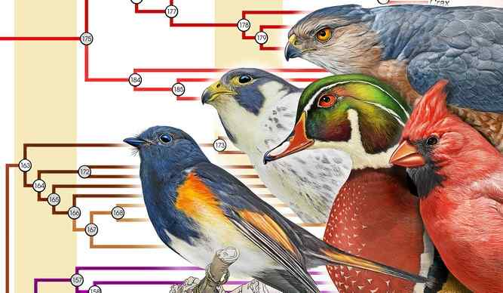
Hidden Markov Model(HMM)
Parameters(Ө) =
P(X_{t}|X_{t-1}), P(E_{t}|X_{t}) and initial state probability
Ө = arg max P( observation sequence | Ө)
Ө

Slide 12
HMM Model for each Sp
O₁
O₂
O₃
O_{t}

Slide 13
Classification/Testing
HMM fit to Species A
Result
Species Name + Image
Testing Data
HMM fit to Species B
HMM fit to Species C

Slide 14
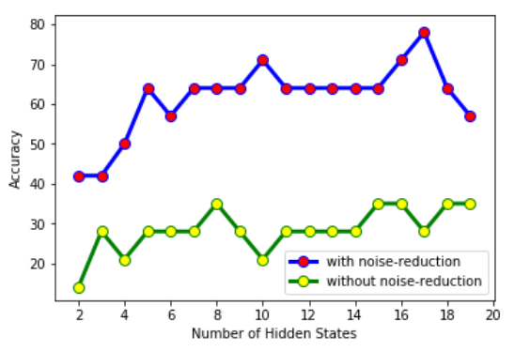
Accuracy vs Number of Hidden States

Slide 15
Thank You

