Slide 1

Concurrent Neural Signal Processing for EEG Spindle Detection
ECE / CS 5510: MULTIPROCESSOR PROGRAMMING
^{Final Project Presentation}
Presented by:
Apurv Sanjay Deshpande and Hari Makarand Summant
Under the guidance of Prof. Binoy Ravindran
Notes:
Apurv

Slide 2

Motivation
The area of parallelism for EEG spindle detection is largely unexplored, with minimal prior work addressing its potential.
We are inspired by Elon Musk's Neuralink idea, which highlights the importance of real-time neural signal processing.
To possibly explore more scalable solutions in sleep
and neurological research.
Notes:
Apurv

Slide 3
Why Sleep Spindle Detection?
Sleep spindles are critical for understanding cognitive functions like memory consolidation and sensory integration.
Detecting spindles helps diagnose sleep disorders and evaluate neurological health.
Challenges in current methods:
Long training times for neural networks, not good for real-time analysis.
Minimal exploration of parallel processing for neural network training.
Notes:
Apurv

Slide 4
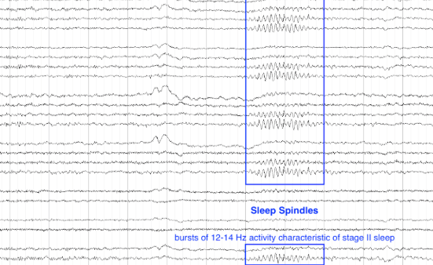
Spindle Activity Example:
Notes:
Sleep spindles are short bursts of oscillatory brain activity in the frequency range of 12-14 Hz. They are a hallmark of stage II non-REM sleep and are crucial for memory consolidation and brain plasticity.
What is EEG and EOG?
EEG (Electroencephalogram) measures electrical activity in the brain, helping to detect sleep-related patterns like spindles.
EOG (Electrooculogram) measures eye movements and complements EEG by capturing signals affected by rapid or slow eye movements during sleep.
When do spindles occur?
Spindles occur during non-rapid eye movement (NREM) sleep, particularly in stage II. This is a transitional phase between light and deep sleep.
Why identify spindles using EEG?
Detecting spindles can help understand sleep quality, cognitive functions, and diagnose sleep-related disorders such as insomnia or sleep apnea.
Why is this important?
Accurate detection of spindles is essential for research on brain health, neurological disorders, and improving therapeutic solutions for sleep-related issues.

Slide 5
Problem Statement:
“Improving the training and evaluation of neural networks (time-series Autoencoder) for EEG Spindle Detection using parallel programming to address limitations of sequential processing”
Notes:
hari

Slide 6
Related work:
Accuracy-Focused Approaches: Most studies prioritize improving detection accuracy through machine learning techniques, like neural networks for spindle identification.
Feature Engineering: Previous research emphasizes advanced feature extraction methods, such as wavelet Fourier analysis and statistical features, to enhance model performance.
Lack of Parallelism: Limited studies address computational efficiency, with almost no exploration of parallel processing for faster training or evaluation in EEG spindle detection.
Our Approach: We address this gap by introducing parallel training and evaluation techniques for a time-series autoencoder model, targeting both speed and accuracy.
Notes:
Existing Focus on Detection Accuracy: Most previous studies on EEG spindle detection have concentrated on improving detection accuracy through advanced neural networks like convolutional and recurrent architectures, without addressing the computational efficiency of training.
Limited Exploration of Parallelism: While parallel processing has been widely used in other domains to accelerate machine learning tasks, its application to EEG spindle detection is sparse, with minimal studies exploring parallel training or evaluation techniques.
Optimization of Feature Extraction: Some prior work has focused on optimizing feature extraction methods, such as using wavelet analysis and spectral properties, to enhance the performance of spindle detection models.
Gap in Computational Efficiency Research: Despite the advancements in model accuracy, there is a significant gap in research addressing the reduction of training and evaluation time for spindle detection models, particularly using parallel and distributed computing techniques.
Since this domain is relatively new, there has been limited research on the parallel programming aspect of the project.

Slide 7
Approach used in our Solution
Language and tools
Training
Evaluation and benchmarking
Implemented in Python using PyTorch.
Multiprocessing library provided.
Psutil library.
Implemented a time-series autoencoder.
Parallel processing with up to 8 CPU cores.
Split dataset among worker processes, each training independently.
Gradient synchronization to ensure consistent model updates.
Developed a parallel evaluation strategy to process batches concurrently across multiple cores.
Parallelism should not reduce the accuracy of the model.
Benchmarking was done against a sequential approach to find speedup.
Notes:
Hari

Slide 8
Solution Pipeline Overview:
EDA and Preprocessing
Training
Evaluation
Memory Testing
Components of the project
Notes:
EDA and Preprocessing: Load and preprocess datasets for analysis. Hari
Training (Sequential and Parallel): Neural network training with baseline and optimized approaches.
Evaluation: Benchmarks to compare sequential and parallel implementations.
Memory Management: Safe memory cleanup to optimize resource usage.

Slide 9
Properties of the Solution:
Correctness:
Maintained model accuracy across sequential and parallel approaches.
Progress:
Demonstrated significant reductions in training and evaluation times.
Efficiency:
Leveraged up to 8 CPU cores for parallel execution, achieving speedup and throughput gains.
Notes:
Apurv

Slide 10
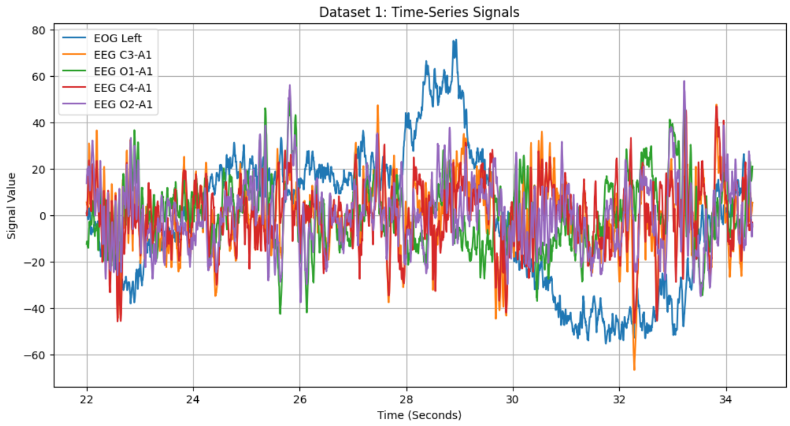
Exploratory Data Analysis and Preprocessing
Key steps:
Dataset Integration
Feature Selection
Find optimal features (PCA)
Normalization
Foundation for Modeling
Notes:
Dataset Integration: We combined two spindle datasets to create a unified and higher-quality dataset for analysis.
Feature Selection: Principal Component Analysis (PCA) was used to identify and extract the most optimal features for spindle detection.
Normalization: Data normalization was applied to ensure all features are scaled appropriately for the model.
Essential Preprocessing: These steps are crucial to prepare the data for effective training and evaluation.
Foundation for Modeling: Proper EDA and preprocessing lay the groundwork for robust and accurate neural network modeling.
This graph illustrates the time-series signals of EEG and EOG data across various electrodes. Each line represents the signal activity from specific channels, including "EOG Left" and EEG channels like "C3-A1" and "O1-A1," over time in seconds. The variability and overlapping patterns highlight the dynamic changes in brain and eye activity, which are crucial for spindle detection.

Slide 11
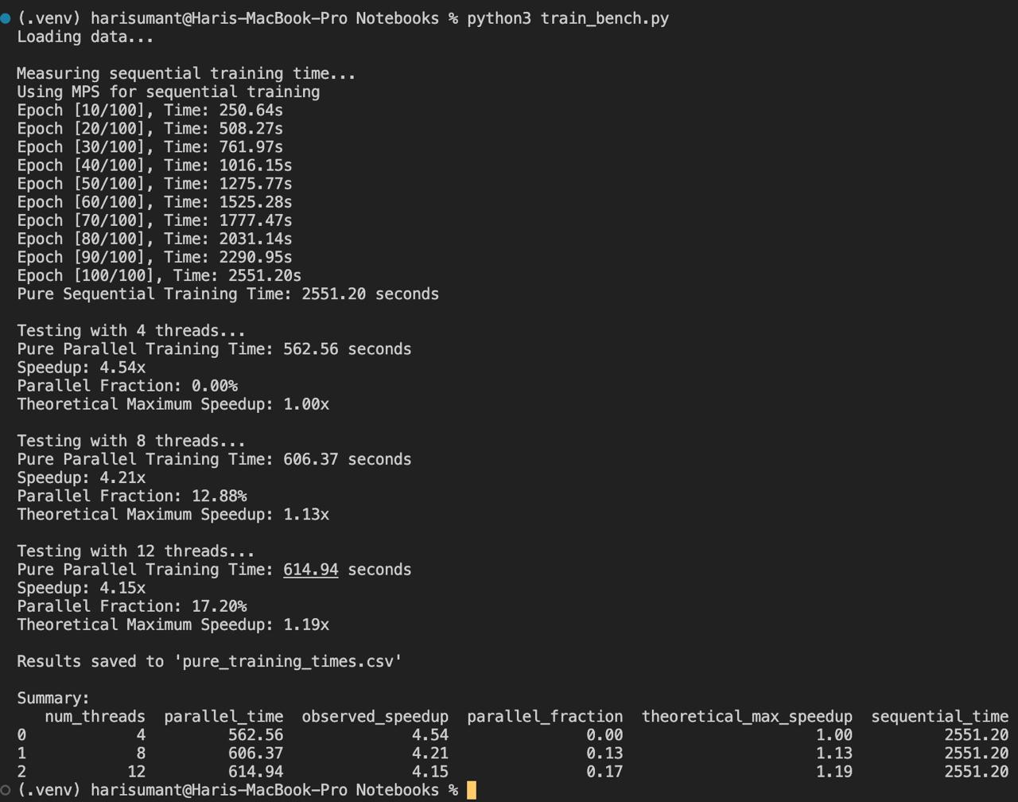
Insights from parallel training

Slide 12
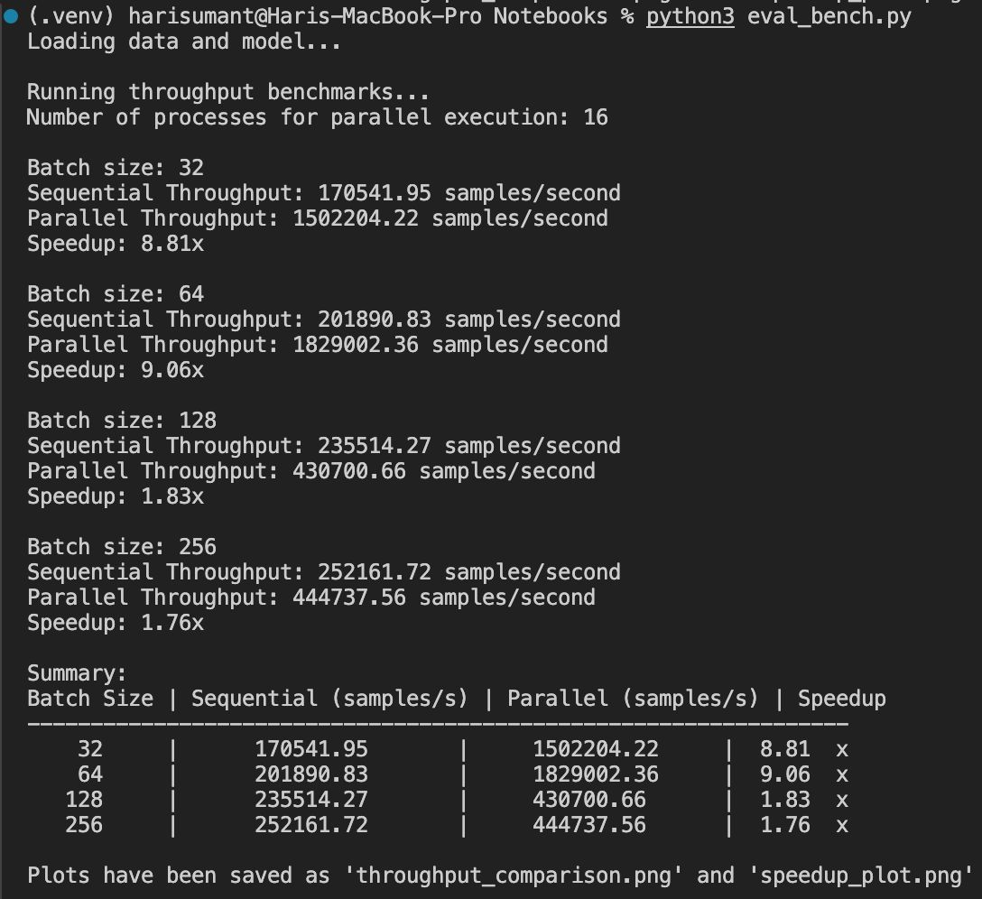
Insights from Parallel Evaluation

Slide 13
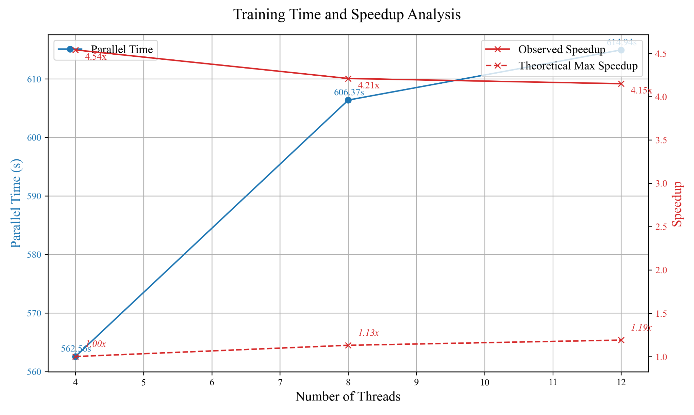
Experimental Results
Setup: Testing done on an 8-core macOS processor with batch sizes of 32, 64, 128, and 256.
Speedup: Up to 4.54x for training and 8.81x for evaluation.
Throughput: Significant improvements for smaller batch sizes.
Comparison shown using bar plots and line plots.
Notes:
This graph illustrates the training time and speedup achieved as we increase the number of threads used in parallel training.
The blue line represents the parallel training time in seconds for different thread counts. As the number of threads increases from 4 to 12, the training time slightly increases, indicating diminishing returns on parallelism.
The red line shows the observed speedup, which is the improvement in training time compared to sequential execution. With 4 threads, the speedup is around 4.54x, which is close to ideal. However, as the number of threads increases, the observed speedup decreases slightly, reaching 4.15x with 12 threads.
From this, I understand that parallel performance is effective at lower thread counts, achieving significant speedup. However, as more threads are added, factors like synchronization overhead and limited parallelizable tasks reduce efficiency, leading to diminishing speedup gains. This suggests that for our setup, 4 to 8 threads offer the best balance between speedup and efficiency.

Slide 14
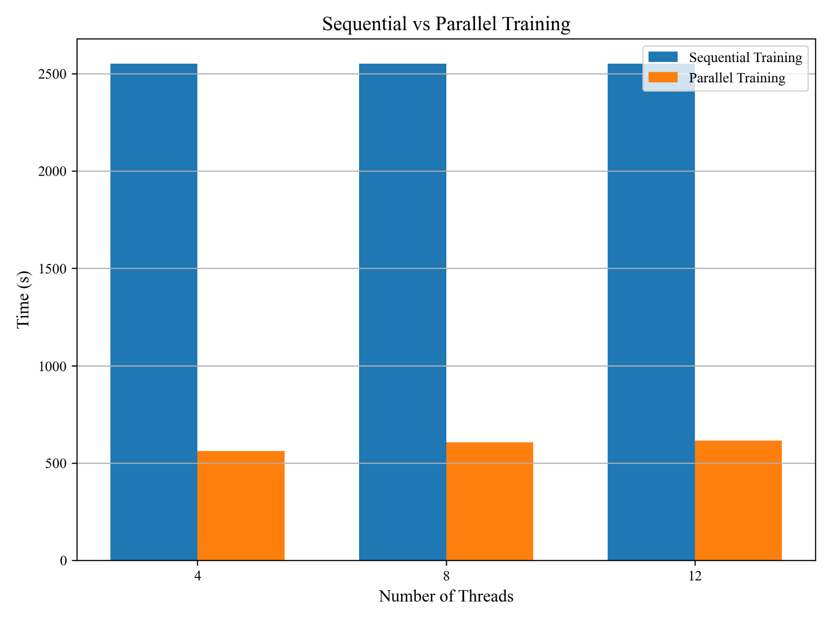
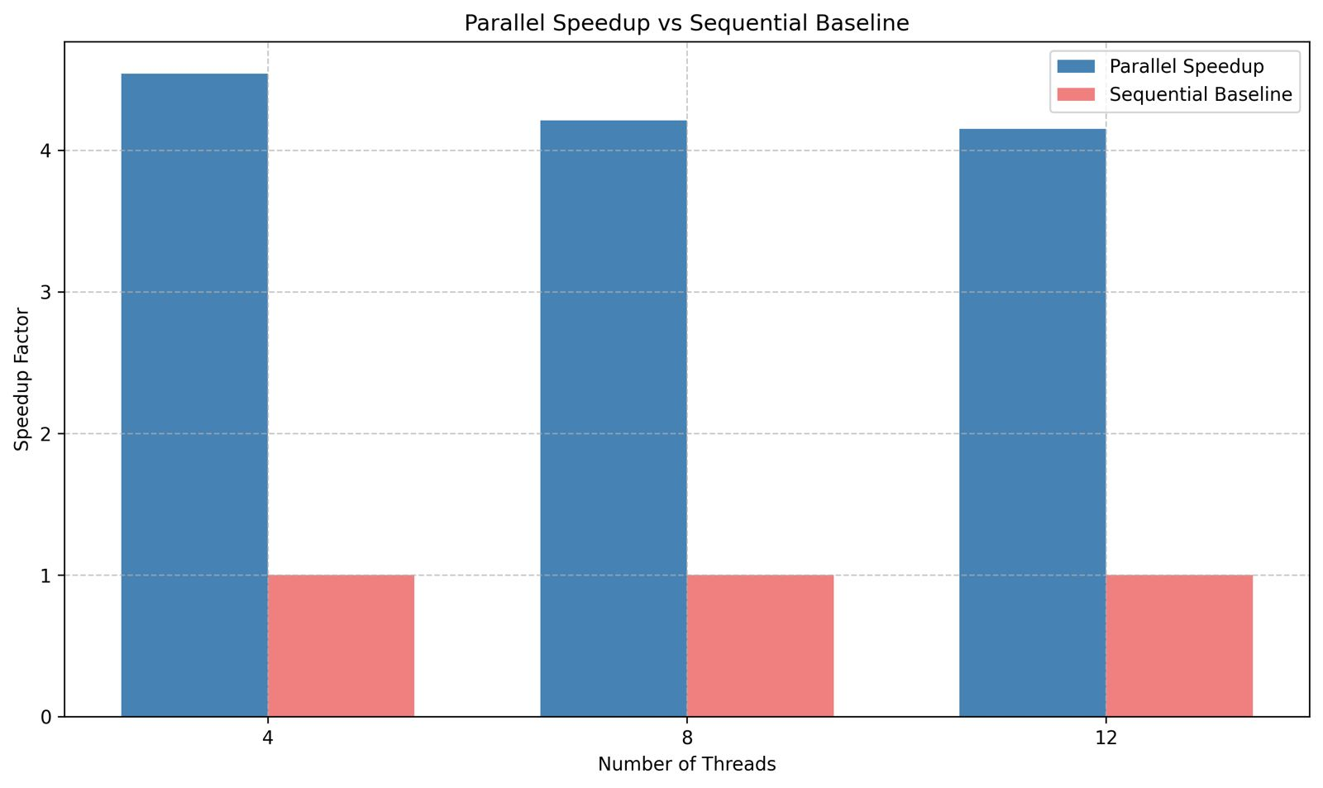
Comparison between Sequential and Parallel approaches

Slide 15
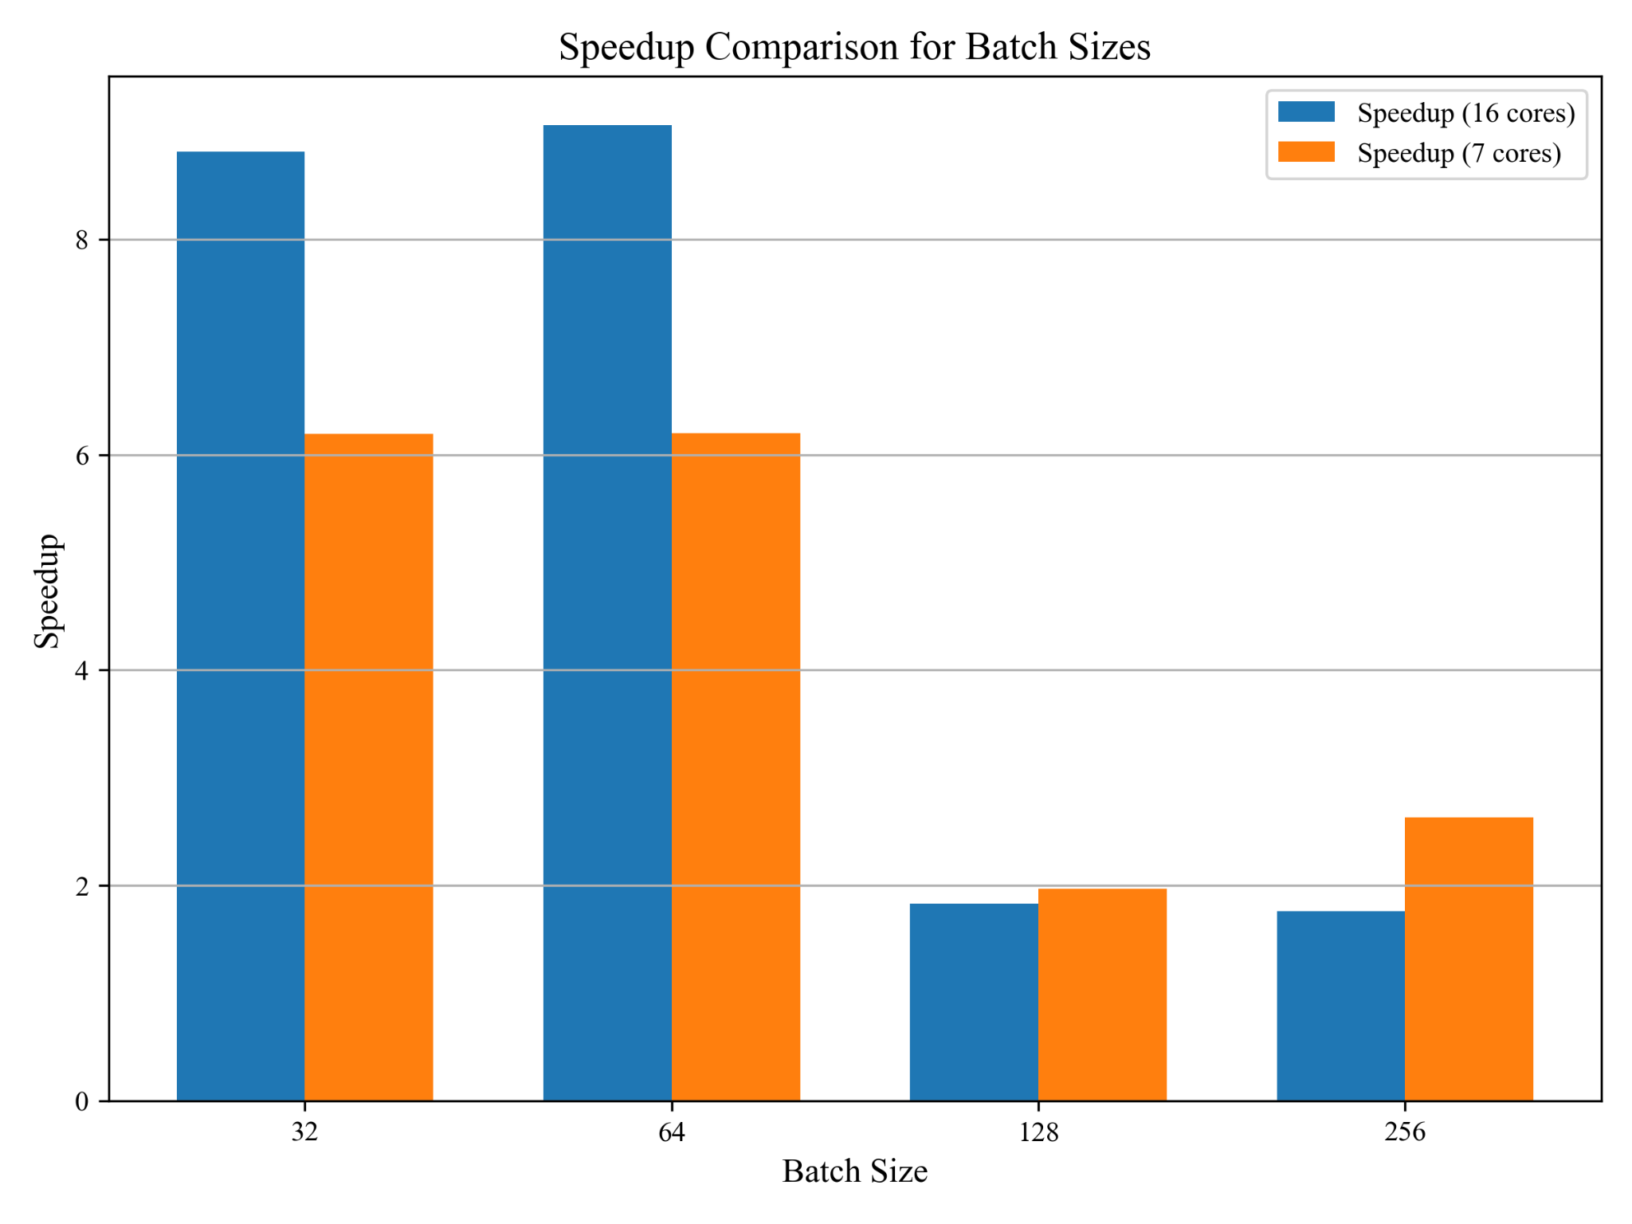
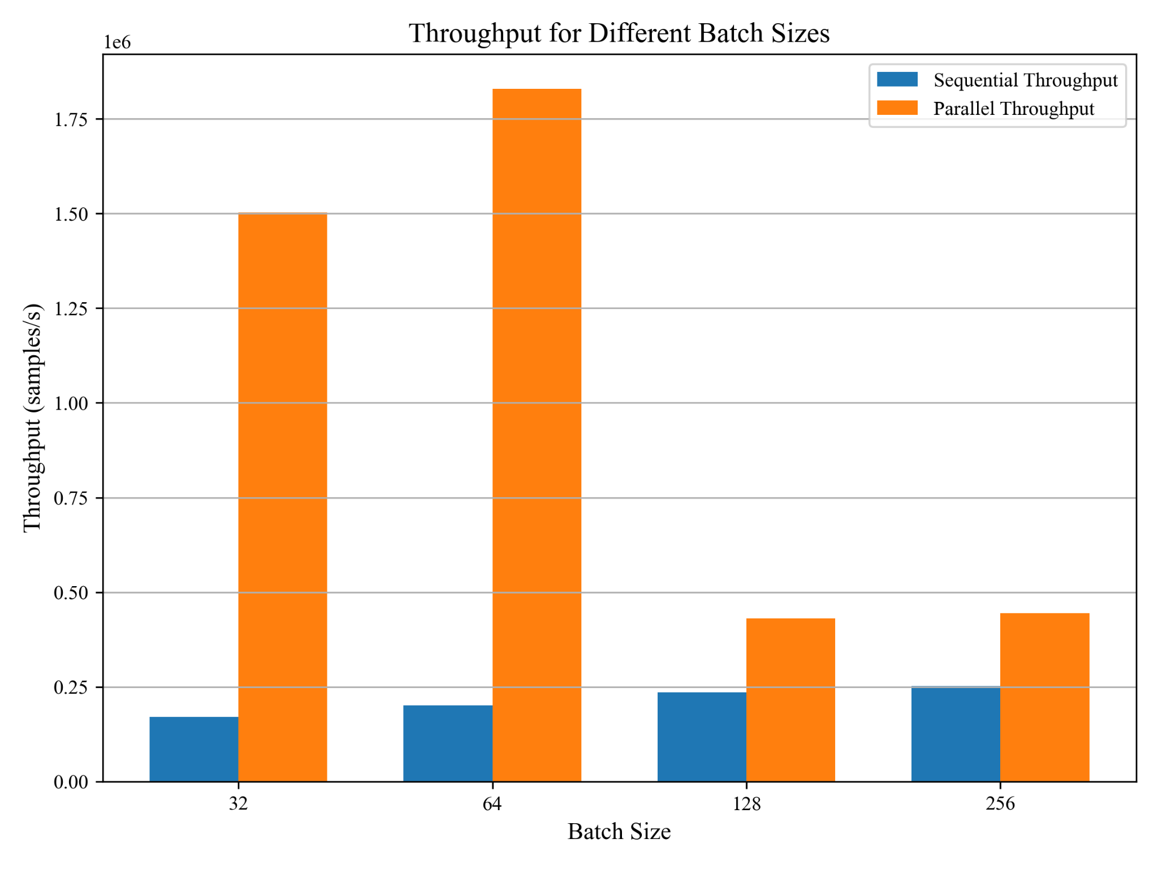
Speedup and throughput for different batch sizes

Slide 16
Memory Testing
Purpose:
Evaluating memory usage throughout training and evaluation phases.
Ensuring that memory is efficiently managed, particularly in parallel execution scenarios.
Perform Safe Cleanup:
Used garbage collection (gc.collect()) and release memory cache (torch.cuda.empty_cache()).
We monitored Set Size (RSS), Virtual Memory Size (VMS), and system memory usage at:
Startup: Initial memory usage before loading data.
After Initialization: Memory metrics post dataset loading and model initialization.
After Training/Evaluation: Memory impact after computational tasks.
Notes:
Apurv
Although memory management and gc is automatic, we have implemented manual tests to confirm that it is done properly

Slide 17
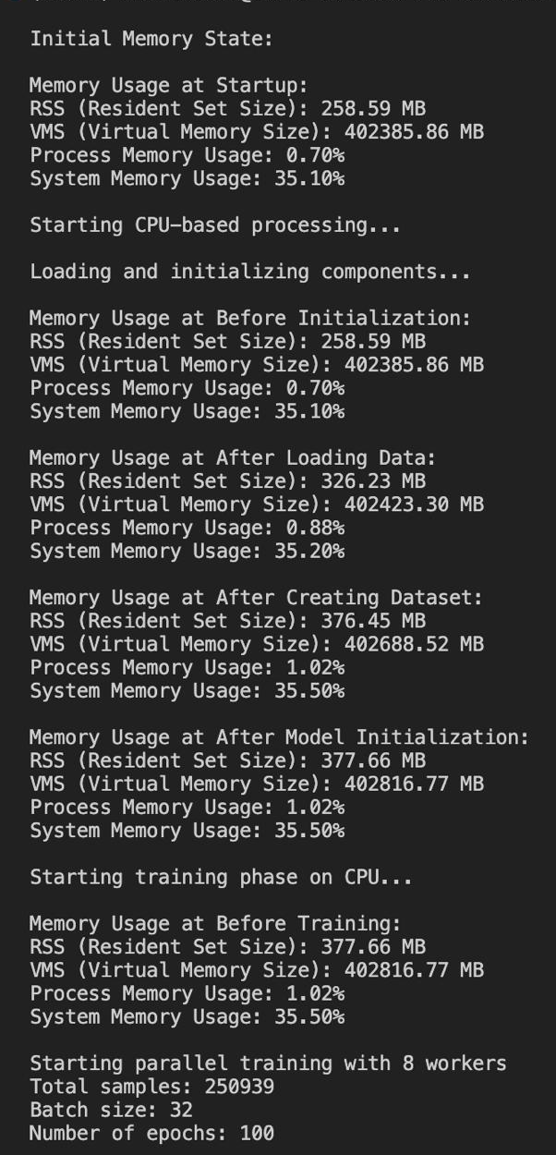
Insights from memory testing:
We see that memory usage gradually increases as components are initialized (data loading, dataset creation, and model setup), indicating efficient resource allocation for each step.
After initialization, the values are plateaued with no significant spikes, ensuring that the setup phase does not overburden the system.

Slide 18
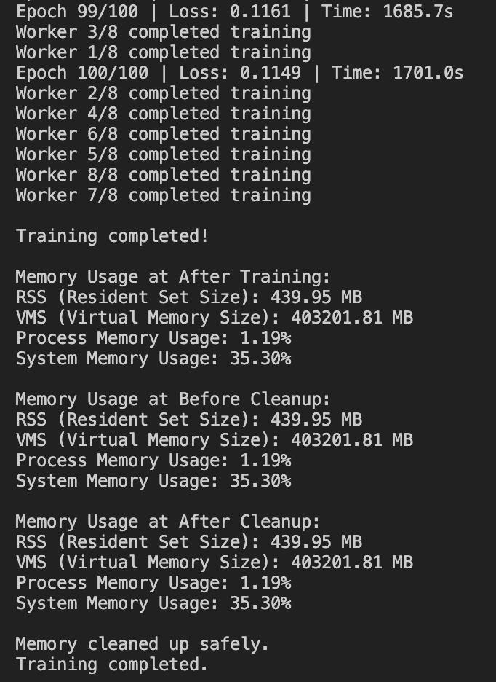
Insights from memory testing:
During parallel training, memory usage remains consistent across workers, showing efficient handling of shared resources.
The memory cleanup process effectively resets usage, ensuring no residual memory overhead after training completion.

Slide 19
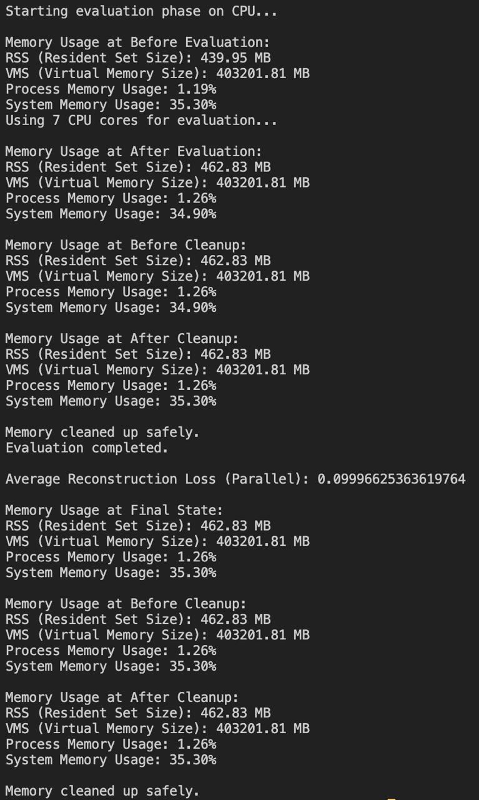
Insights from memory testing:
Memory increases slightly during evaluation, corresponding to the computational demands of multi-threaded processes.
Post-cleanup, memory usage returns to its pre-evaluation state, demonstrating the success of safe memory reclamation techniques.

Slide 20
What did we learn?
Were we successful?
Are we satisfied with the results?
Notes:
After completing the project, we learned that parallel processing significantly reduces training and evaluation times for neural networks without compromising accuracy. Additionally, proper synchronization and memory management are crucial for optimizing performance and ensuring system stability in large-scale computations.
Yes, we were successful in achieving our goal of reducing training and evaluation times through parallel processing, achieving a speedup of 4x.
We are satisfied with the results, as reducing training time from 46 minutes to just 12 minutes demonstrates a significant improvement, especially given the execution constraints.

Slide 21
Conclusion:
Parallel processing drastically reduces training and evaluation times without compromising accuracy.
Batch size configuration is critical for maximizing throughput.
Lock-free synchronization mechanisms can be explored further to improvise the parallelization.
Notes:
Apurv

Slide 22

Prof. Binoy Ravindran
Professor & Bradley Senior Faculty Fellow
Apurv Sanjay Deshpande
ECE Student at Virginia Tech
Hari Sumant
ECE Student at Virginia Tech

