Slide 1
Blockchain
The next big thing or hype?
Presnted By :
Apurva Modi (CS 432/532 A. Nwala)

Slide 2
What is Blockchain ?
Public database that keeps a permanent record of digital transactions.
Database doesn’t require any central authority to maintain it or to secure it.
It enables a more ‘trustful’ transactional system, a framework that allows people to make peer-to-peer transactions without needing to trust a third party.

Slide 3
Distributed and Decentralized
Consensus Mechanism
Irreversibility and Cryptosecurity
Features of Blockchain

Slide 4
How does this works ?
Step 1
Someone requests a transaction
Step 3
Nodes Validates the transactions and user’s status using Algorithm
Step 2
The requested transaction is broadcasted to a P2P network (nodes)
Step 4
The transaction is combined with other transaction to create a block of data called Ledger

Slide 5
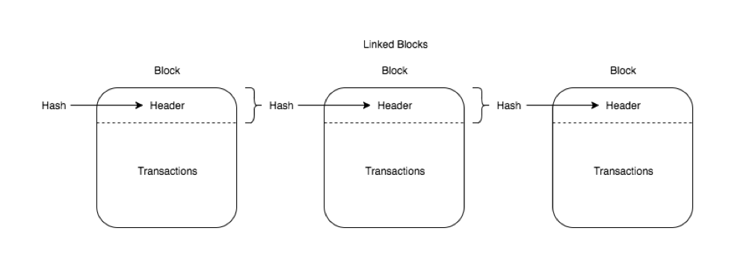
How does the chain looks ?

Slide 6
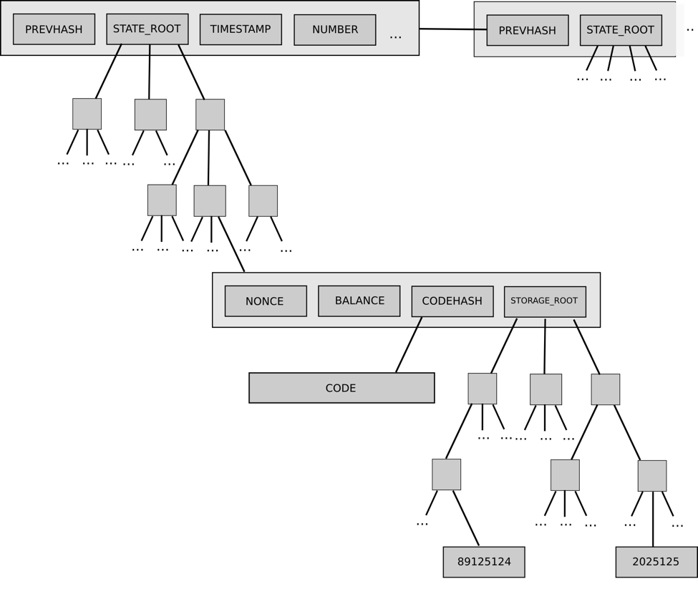

Slide 7
What is TRON ?
Decentralized platform that aims to allow for the creation of content, websites and applications. In sort TRON aims to facilitate the issuance of digital assets.
AIM of TRON
To cut out middleman in entertainment-based services.
Example
Cut Youtube as a middleman
TRON project aims to streamline the entertainmnet industry by bringing it on to a decentralized blockchain.

Slide 8

Advantages of Blockchain
Transparency
Reduced transaction costs
Faster transaction settlements
Decentralization
User-controlled networks

Slide 9


Disadvantages of Blockchain
Human error
Politics
Transaction costs, network speed
Network size
Complexity

Slide 10
Conclusion
Tron believe in decentralized internet and global free content entertainment system.
Blockchain has just started and is still a Blackbox for most of people.

Slide 13
