Slide 1
Predicting total sales volume of new customers

Slide 2
Data preperation
Group data by customer, beverage category, calorie description, and pack type
Aggregate median sales volume, cost of the product, and discount offered for each group
Calculate cost of individual products in each group by dividing total cost by physical volume

Slide 3
Models Considered
Linear Regression
Decision Tree
Random Forest

Slide 4
Target and predictors
Consider sales volume as the target variable for analysis
Use calorie category description, beverage category description, cost of the product sold, discount, and pack type descriptions as predictors

Slide 5
Evaluating model performance
Split the data into train and test
Train the model using training dataset
Evaluate the performance of the trained model using test dataset
Perform 3-fold cross-validation to evaluate the performance of the model

Slide 6
Model selection
Random Forest is considered as the best model
It has high accuracy of 91% and less error rate compared to other models
Random Forest has the ability to handle non-linearity, missing data, high-dimensional data, imbalanced classes, and can provide feature importance ranking

Slide 7
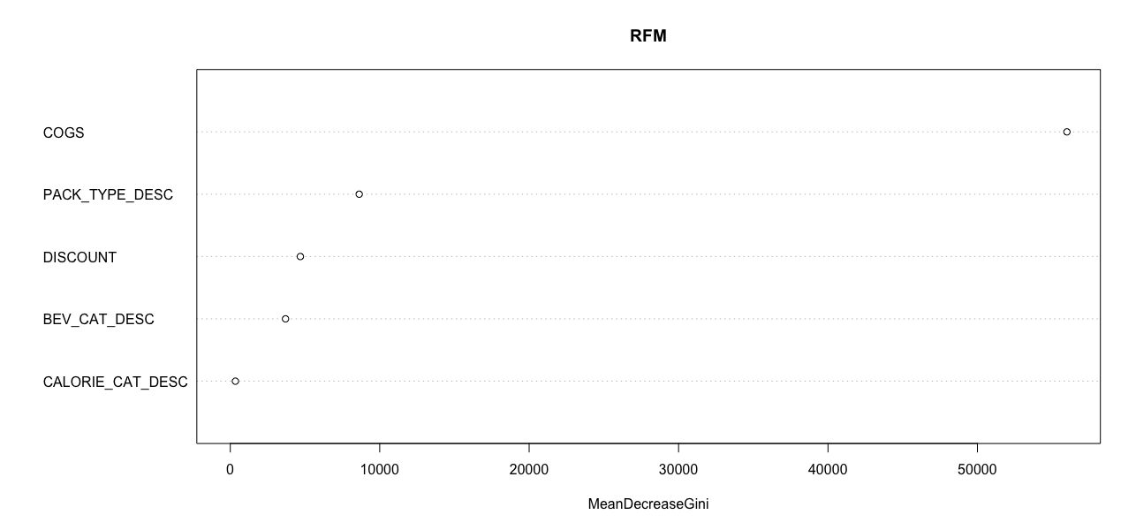
Factors effecting Sales volume

Slide 8
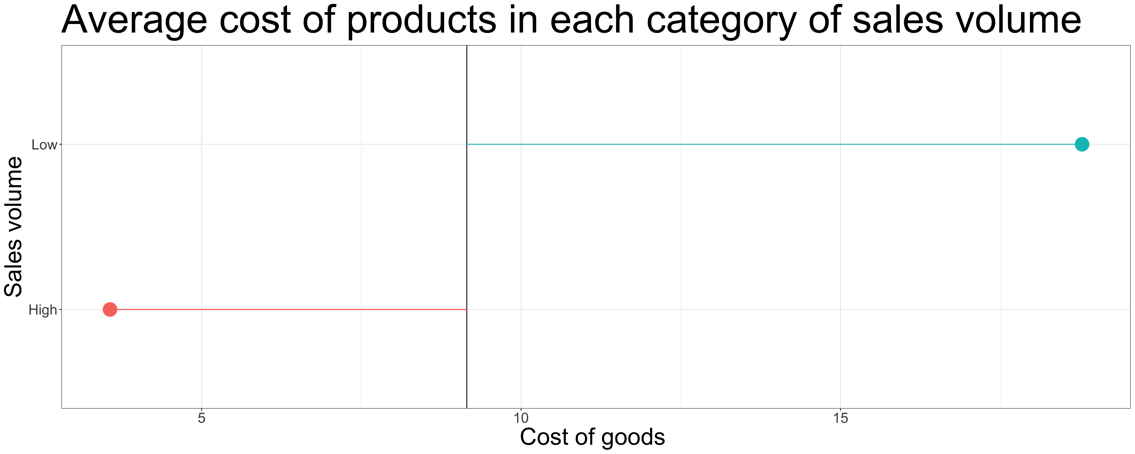
Model insight 1

Slide 9
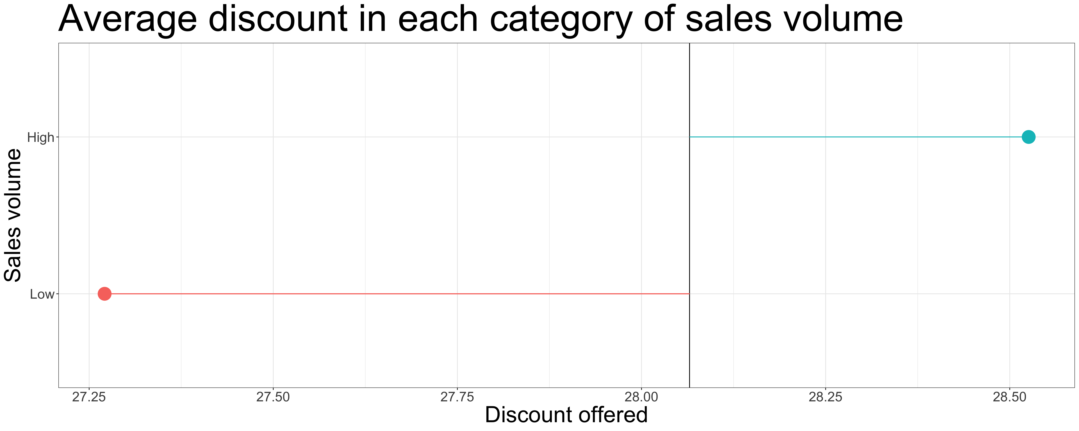
Model Insight 2

Slide 10
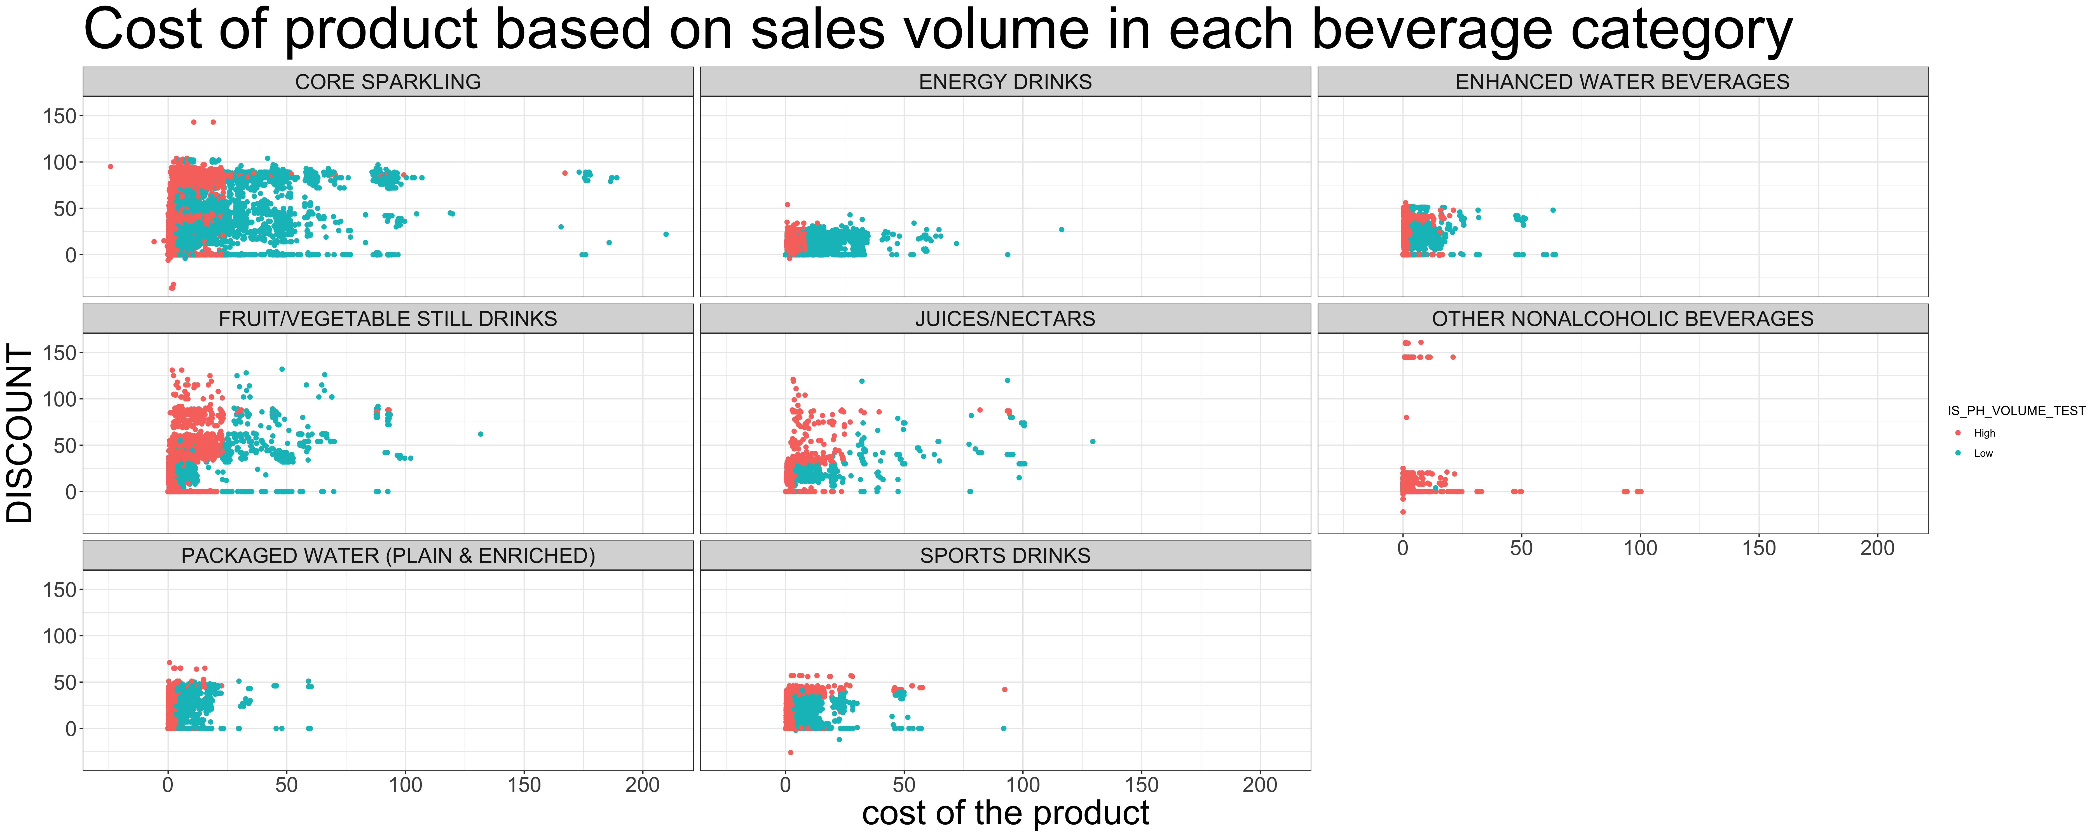
Model insight 3

Slide 11
Observations
Sales volume tends to be higher when the cost of the product is lower
When the cost is less than approximately 9 dollars, the sales volume is high. However, when the cost is higher than 9 dollars, the sales volume is low.
Discount offered does not have a significant effect on the sales volume.

Slide 12
Next Steps…
Gather customer reviews and ratings data to gain insights into the popularity of the product.
Conduct a detailed analysis to determine which pack types are more commonly sold and their impact on sales volume.

Slide 13
Conclusion
Implementing effective pricing strategies is crucial to drive up sales volume.
Lower product cost showed positive correlation with sales volume
Discount doesn’t have a significant effect on sales volume.
Findings align with Swire Coca-Cola's goal to improve sales volume predictions for new customers
Accurate sales volume prediction enables data-driven decisions on discounts and pricing, leading to increased profit and success.

