Slide 1
Licence Update
Team Members,
Asha Meka
Anupama vijay
Apurva Vyas
Bhadra Varma
Divya G kumar
Ajith M

Slide 2
Purpose
The purpose of the software is to provide the details of the software licence in the top of the each and every file. It helps you to get the licence details easily without searching in the file. It provides the details like Version number, created person name, created time and modified time.

Slide 3
Without our Tool
Previous whenever we want to know the licence details of the software we have to search for the software details which is somewhere in the file. And each and every time we want to make changes manually in the file. Incase the user forgets to update the file the newer details of the licence other users won’t know the present licence details.

Slide 4
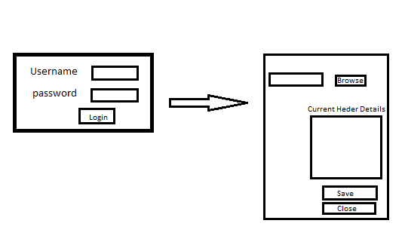
Prototype

Slide 5
Login Module
The Login Module contains two labels and two text boxes, one is to get the username of the user and the other one is to get the password from the user. The Authentication is done by the database.And also it contains one button called login which will direct you to the User Interface Page.

Slide 6
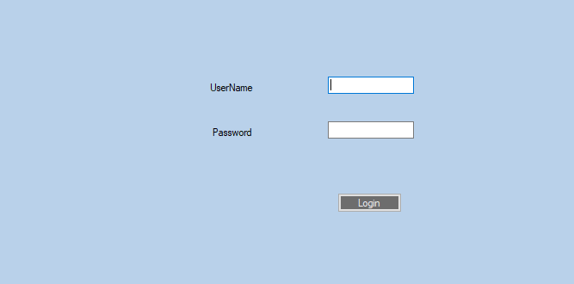
Screenshot of Login Module

Slide 7
User Interface Module
This module contains a browse button which will help you to select a directory and it also contains one richtextbox where you can edit the header details and save the changes with will be reflected as a header in the file.

Slide 8
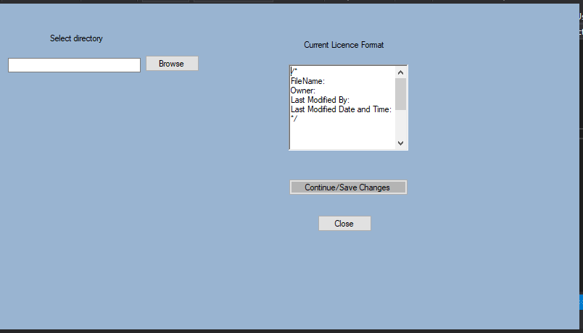
Screenshot of User Interface Module

Slide 9
Advantages
Reduces human Effort
Reduces Searching Time
Date and Time will be more accurate

Slide 10
Thank you

