Slide 1
Day Care Project
By:
Kratika Maheshwari
Pradheep Nagarajan
Venkateshwaran Palanikumar
Vikram Kannan Muralidharan
Apurva Mathur

Slide 2
Problem Statement:
The application intended to solve the problem of day care for children.
It assigns students to teachers and student and teachers to classrooms based on ClassroomRules.
Implements CRUD(Create, Read, Update, Delete) functionality for Students, Teachers and Vaccines. Does not add teachers or students to classroom if classroom is full of its maximum capacity according to state regulations.
Defines vaccines needed to be taken based on age groups.
Implements Annual Registration Renewal for students.
Tracks Immunization Records for a particular students.
Track Immunization Anniversaries for all students.
Track overdue of vaccines for all students.

Slide 3
Architecture:
Design Patterns Used:
Factory Design Pattern
Model View Controller
Lazy Singleton Pattern
Architecture
App
View
Controller
Csv Files(Model and DataBase)
MiddleWare

Slide 4
Architecture Explained
App.java
Contains the main method and is called first when we start an application.
It instantiates MainJFrame(View) and Controller(MainController).
View
Designed using Swing. Layout used is Card Layout.
Controller
Whenever an event is dispatched then controller is called. For example: a button is clicked. Validation are done in this part. Like if user want to see an student he/she should enter a valid id.
MiddleWare
Controller calls the middleware. It takes the action like to add an student to csv, delete a student and then write that data to csv file. Implemented using Factory Design Pattern and Lazy Singleton Design Pattern.
Model
Classes that represent data. This data is then added into csv files.

Slide 5
Model Classes
Person Class
Act as an abstract class for student and teacher.
Contains basic information like First Name, Last Name and Register Time and getter and setters methods of respective variables.
API includes getters and setters methods.
ClassRoom Class
Contains information of a particular classroom.
Contains class room name, min age, max age, capacity of students(size) and teachers(teachersSize) in a classroom, list of students and teachers assigned to that class room.
API includes getters and setters methods.

Slide 6
Immunization Class
It contains the information for a vaccine needed to be taken by student.
Contains variables like studentId(student for which is this vaccine), immunId(Primary key), immunName(Name of vaccine), status(whether the vaccine is taken or not), duration(for how much time this vaccine works), immunDate(Date when vaccine is taken).
API includes getters and setters method for all variables plus the overriden method toString() which gives the format in which data needs to be added into the csv file.

Slide 7
Rules Class
It contains the rules according to which students and teachers needed to be added into the classroom.
It contains minage, maxAge, groupSize(maximum students in a group), ratio, maxGroup(maximum groups possible in a class), size(Total students in a class).
API includes getters and setters method for all variables .
Student Class
It contains the information of a particular student.
Inherits from Person class.
It contains stuId(Primary key), age, fahterName, motherName and a list of immunizations taken.
API includes getters and setters method for all variables plus the overriden method toString() which gives the format in which data needs to be added into the csv file.

Slide 8
Teacher Class
It contains the basic information a teacher and list of students assigned to a teacher.
Variables includes teachId(Primary key), isAssigned(a boolean value to decide whether a teacher belongs to a class or not), classRoomName(name of the classroom to which the teacher is assigned and if the student is not assigned to a class it stores no class assigned).
Inherits from Person class.
API includes getters and setters method for all variables plus the overriden method toString() which gives the format in which data needs to be added into the csv file.

Slide 9
MiddleWare Classes(Interfaces)
MidlleWare is implemented using Factory Design Pattern and Lazy Singleton Design Pattern.
SuperClass (Data Management Class)
Students,Teachers and Immunizations needed to be read, created, updated and deleted.
So this class provides API to read all objects from csv file(getDataList), create a new object and add it(registerOneObject), update an object( updateOneObject),delete one object(deleteOneObject),to add the new data to csv file(rewriteData).
Also includes API to search based on primary key and other search criteria.
Implements Method OverLoading.

Slide 10
SubClasses
Student DataManagement Class
Inherits from data management class.
Create, read, update and delete objects of students.
Also do search based on student id,minimun and maximum age of a students.
Writes students object again into csv files.
Teacher DataManagement Class
Inherits from data management class.
Create, read, update and delete objects of teachers.
Also do search based on teacher id, classRoom names.
Writes students object again into csv files.

Slide 11
Immunization Data Management Class
Inherits from data management class.
Create, read, update and delete objects of vaccines.
Also do search based on immunization id and name.
Writes vaccines object again into csv files.
Factory Classes
AbstractDataManagementFactory Class
Abstract class to be implemented by factory classes.
API includes getObject that returns object of subclasses.

Slide 12
StudentDataManagementFactory Class
Inherits from AbstractDataManagementFactory class.
Implemented using lazySingleton design pattern.
API getObject returns StudentDataManagement object.
TeacherDataManagementFactory Class
Inherits from AbstractDataManagementFactory class.
Implemented using lazySingleton design pattern.
API getObject returns TeacherDataManagement object.

Slide 13
ImmunizationDataManagementFactory Class
Inherits from AbstractDataManagementFactory class.
Implemented using lazySingleton design pattern.
API getObject returns ImmunizationDataManagement object.
Data Class
Data Store Class
Class to give list of rules and classroom.
Implemented using Lazy Singleton Design Pattern.
API includes geeters and setters method to give list of rules and classroom.

Slide 14
Util Classes
File IO Class
Class to read a csv file, write to a csv file or append columns to the end of the csv file.
Controller Classes
Classes to handle events dispatched from the view.
Main Controller Class
Class invoked by the App.java. Invokes all other controllers based on condition.

Slide 15
ClassRoomController Class
To handle events dispatched from classRoom JPanels.
Will be invoked when we want students of a particular class or teachers of a particular class.
TeacherController Class
To handle events dispatched from teachers JPanels.
Will be invoked when we add a teacher, delete a teacher, update a teacher.

Slide 16
StudentController Class
To handle events dispatched from students JPanels and immunixzation JPanels.
Will be invoked when we add a student, delete a student, update a student.
Will be invoked when we add a vaccine, delete a vaccine, update a vaccine.
Renewal Controller Class
To handle students whose renewal need to be done.

Slide 17
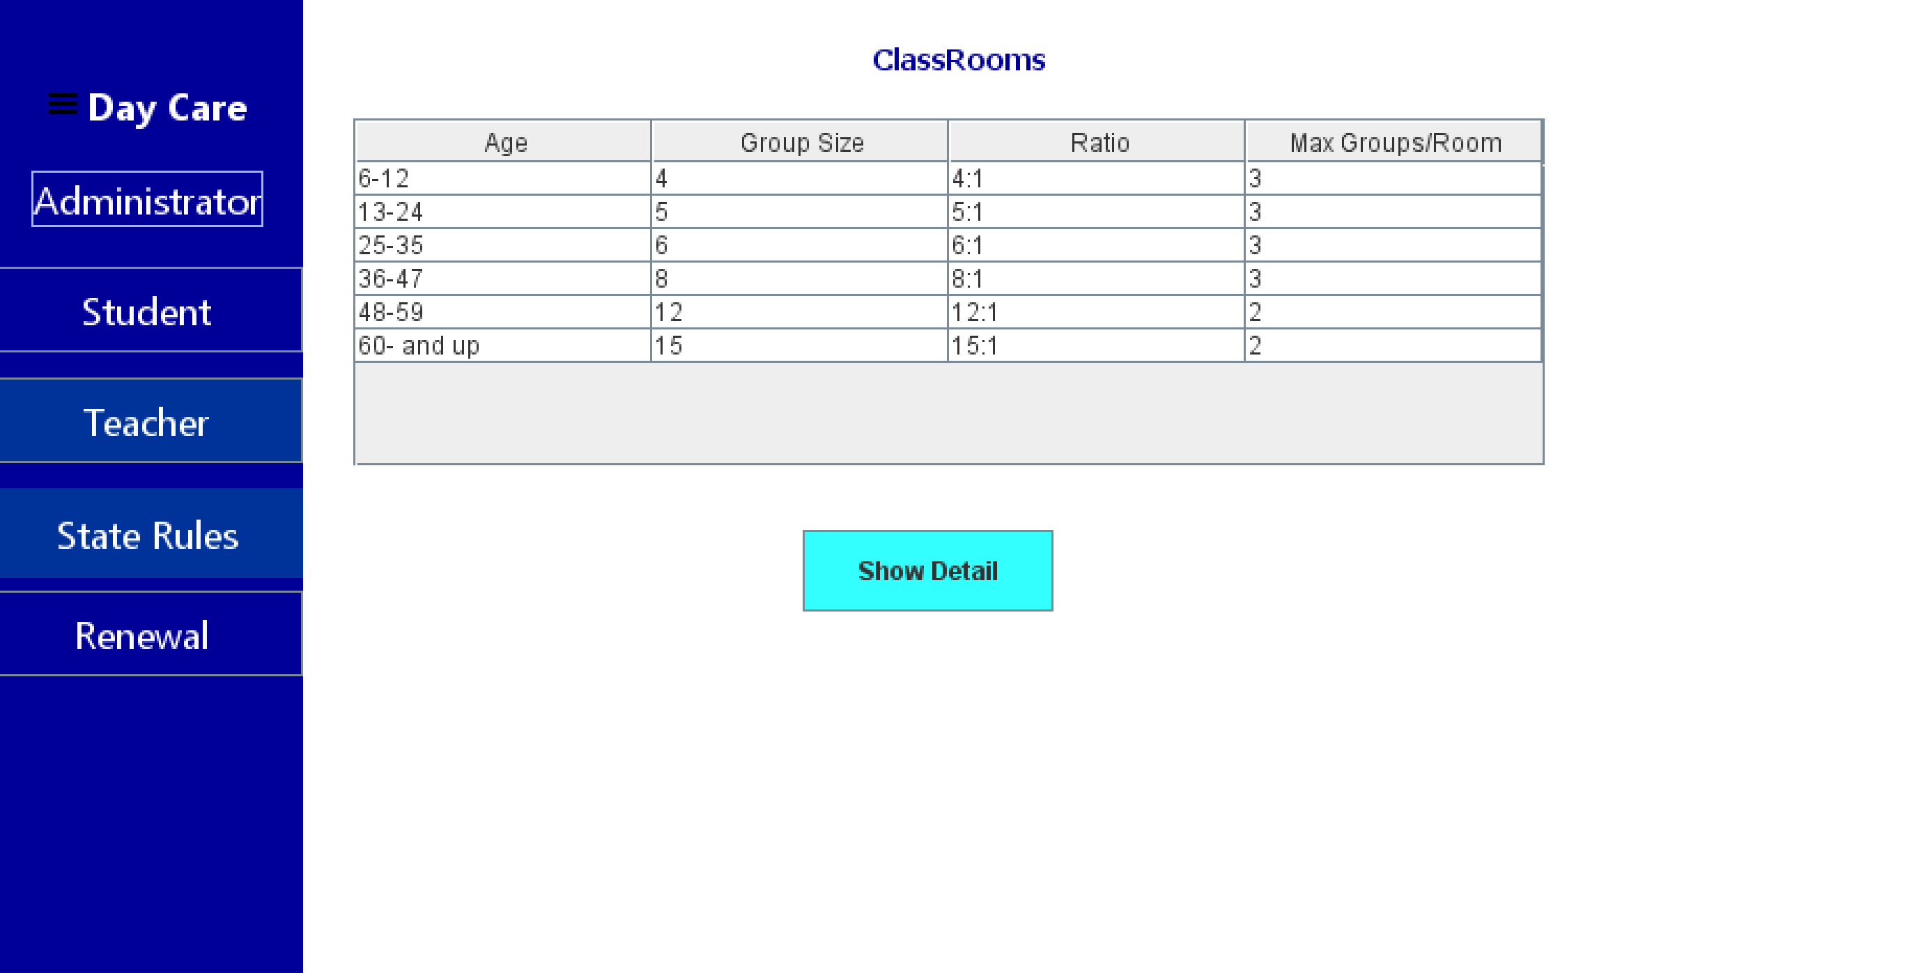
ScreenShots of Code

Slide 18
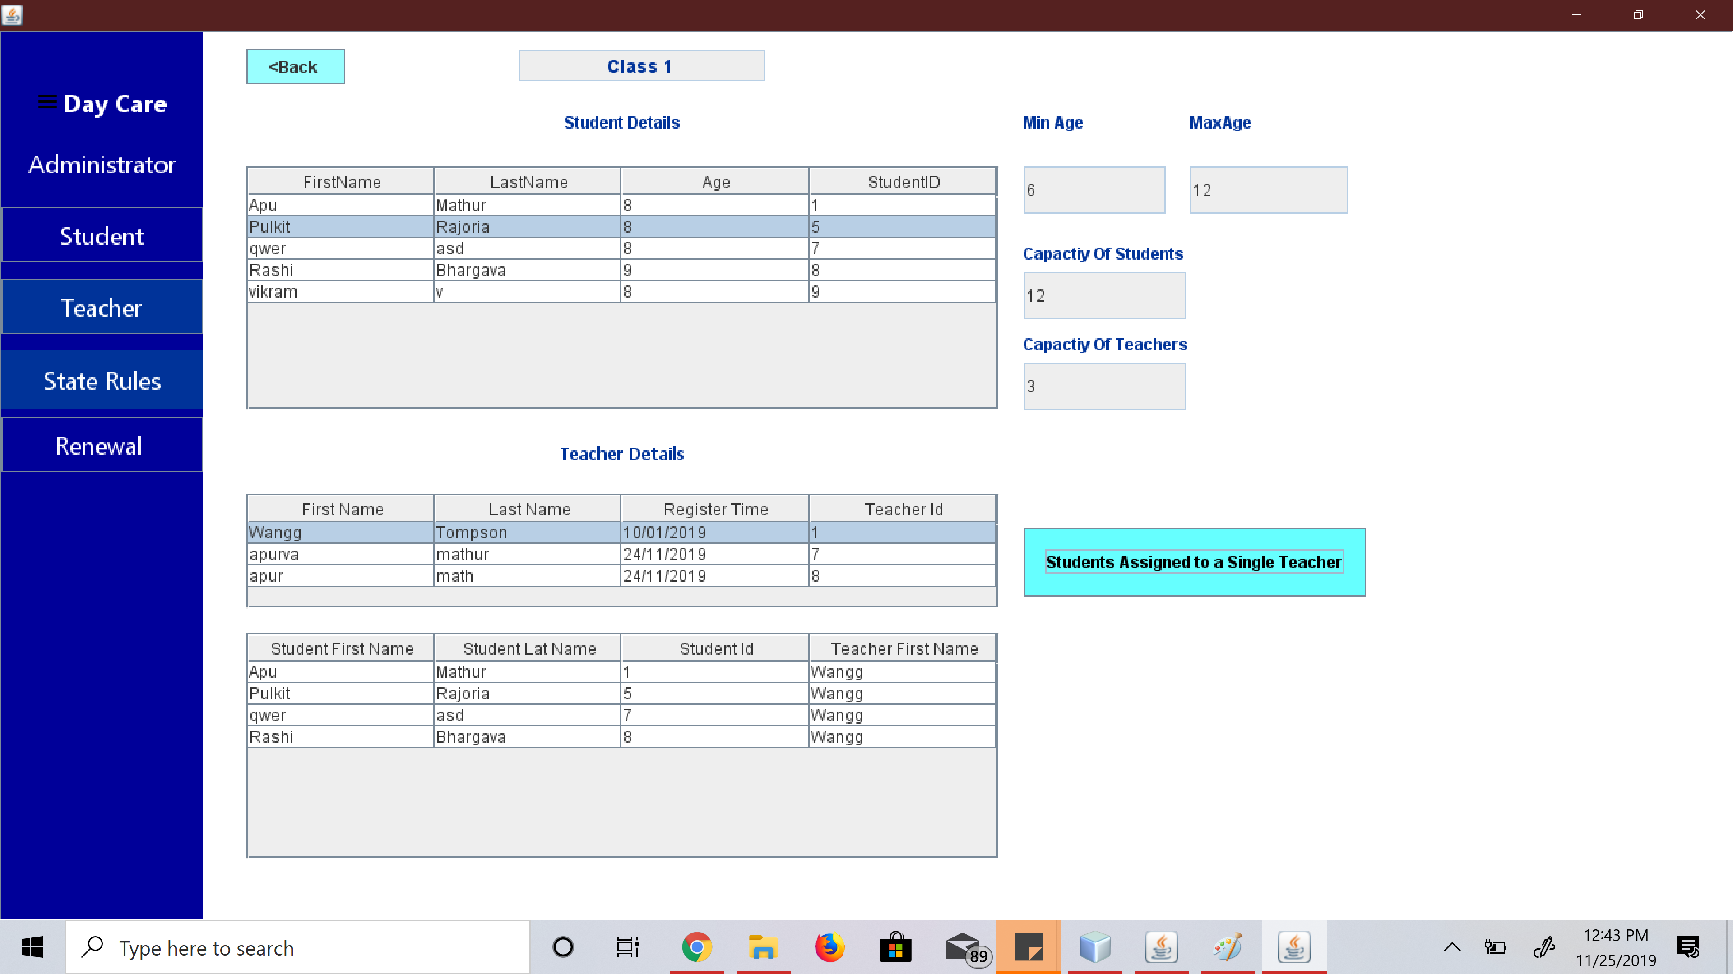

Slide 19
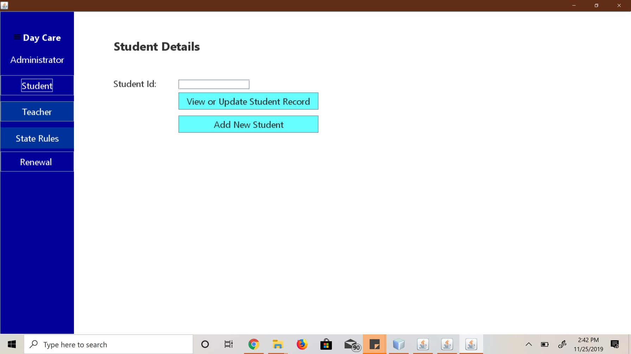

Slide 20
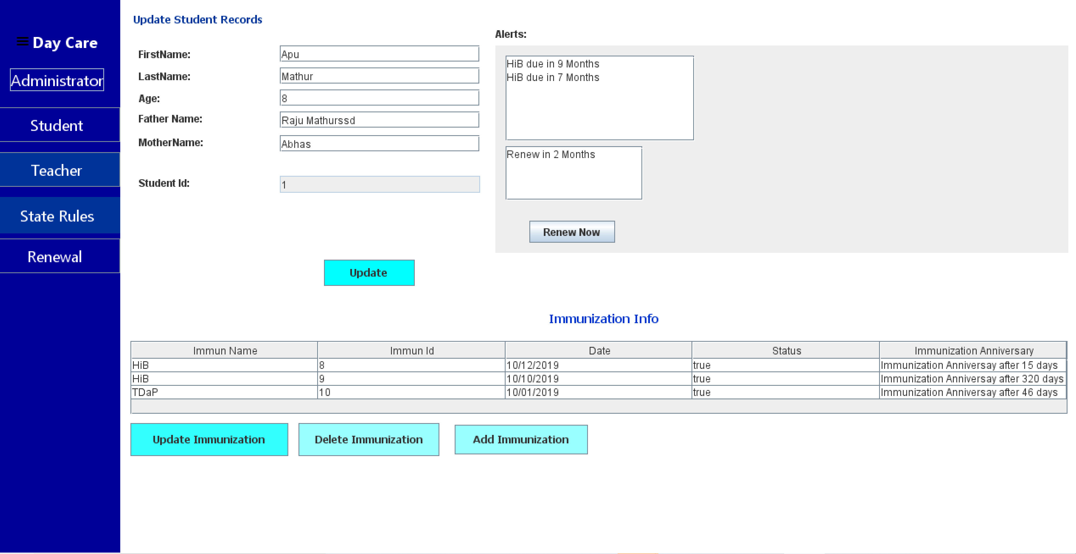

Slide 21
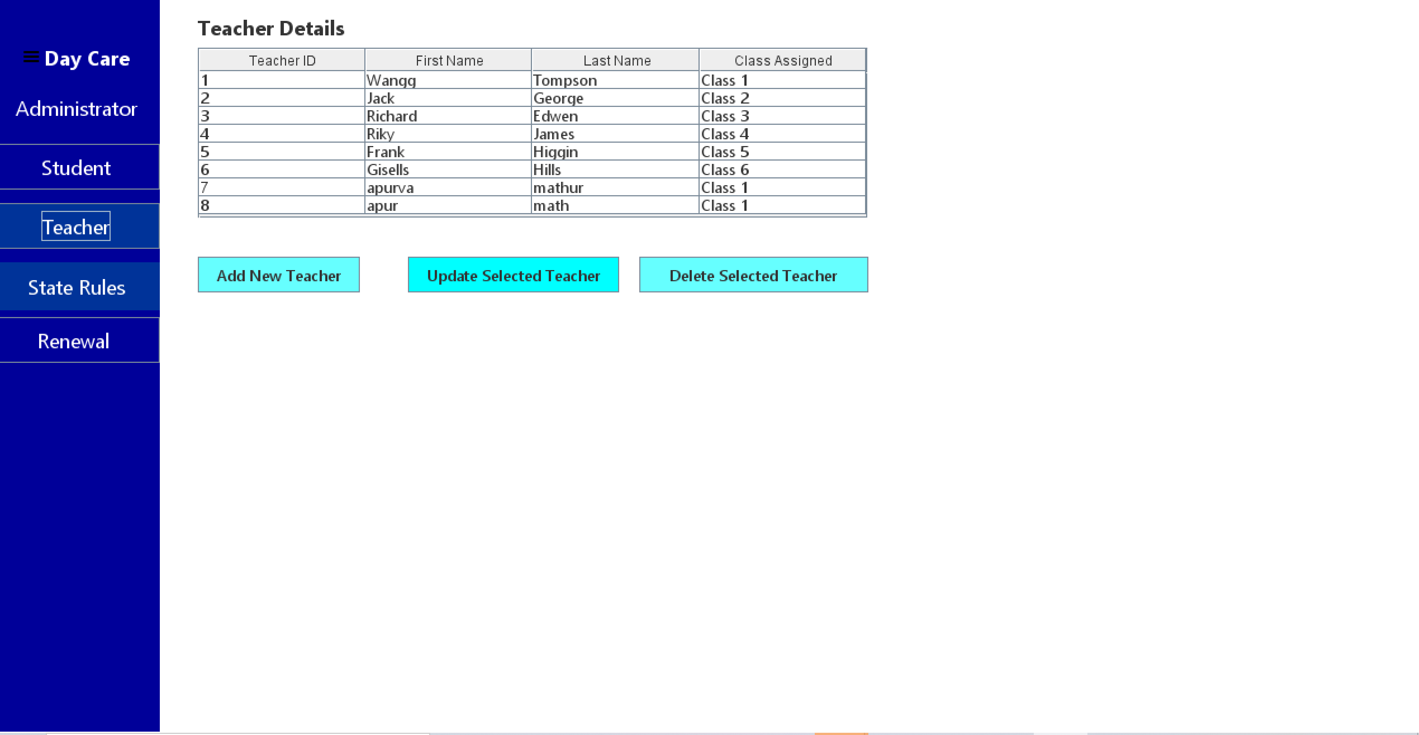

Slide 22
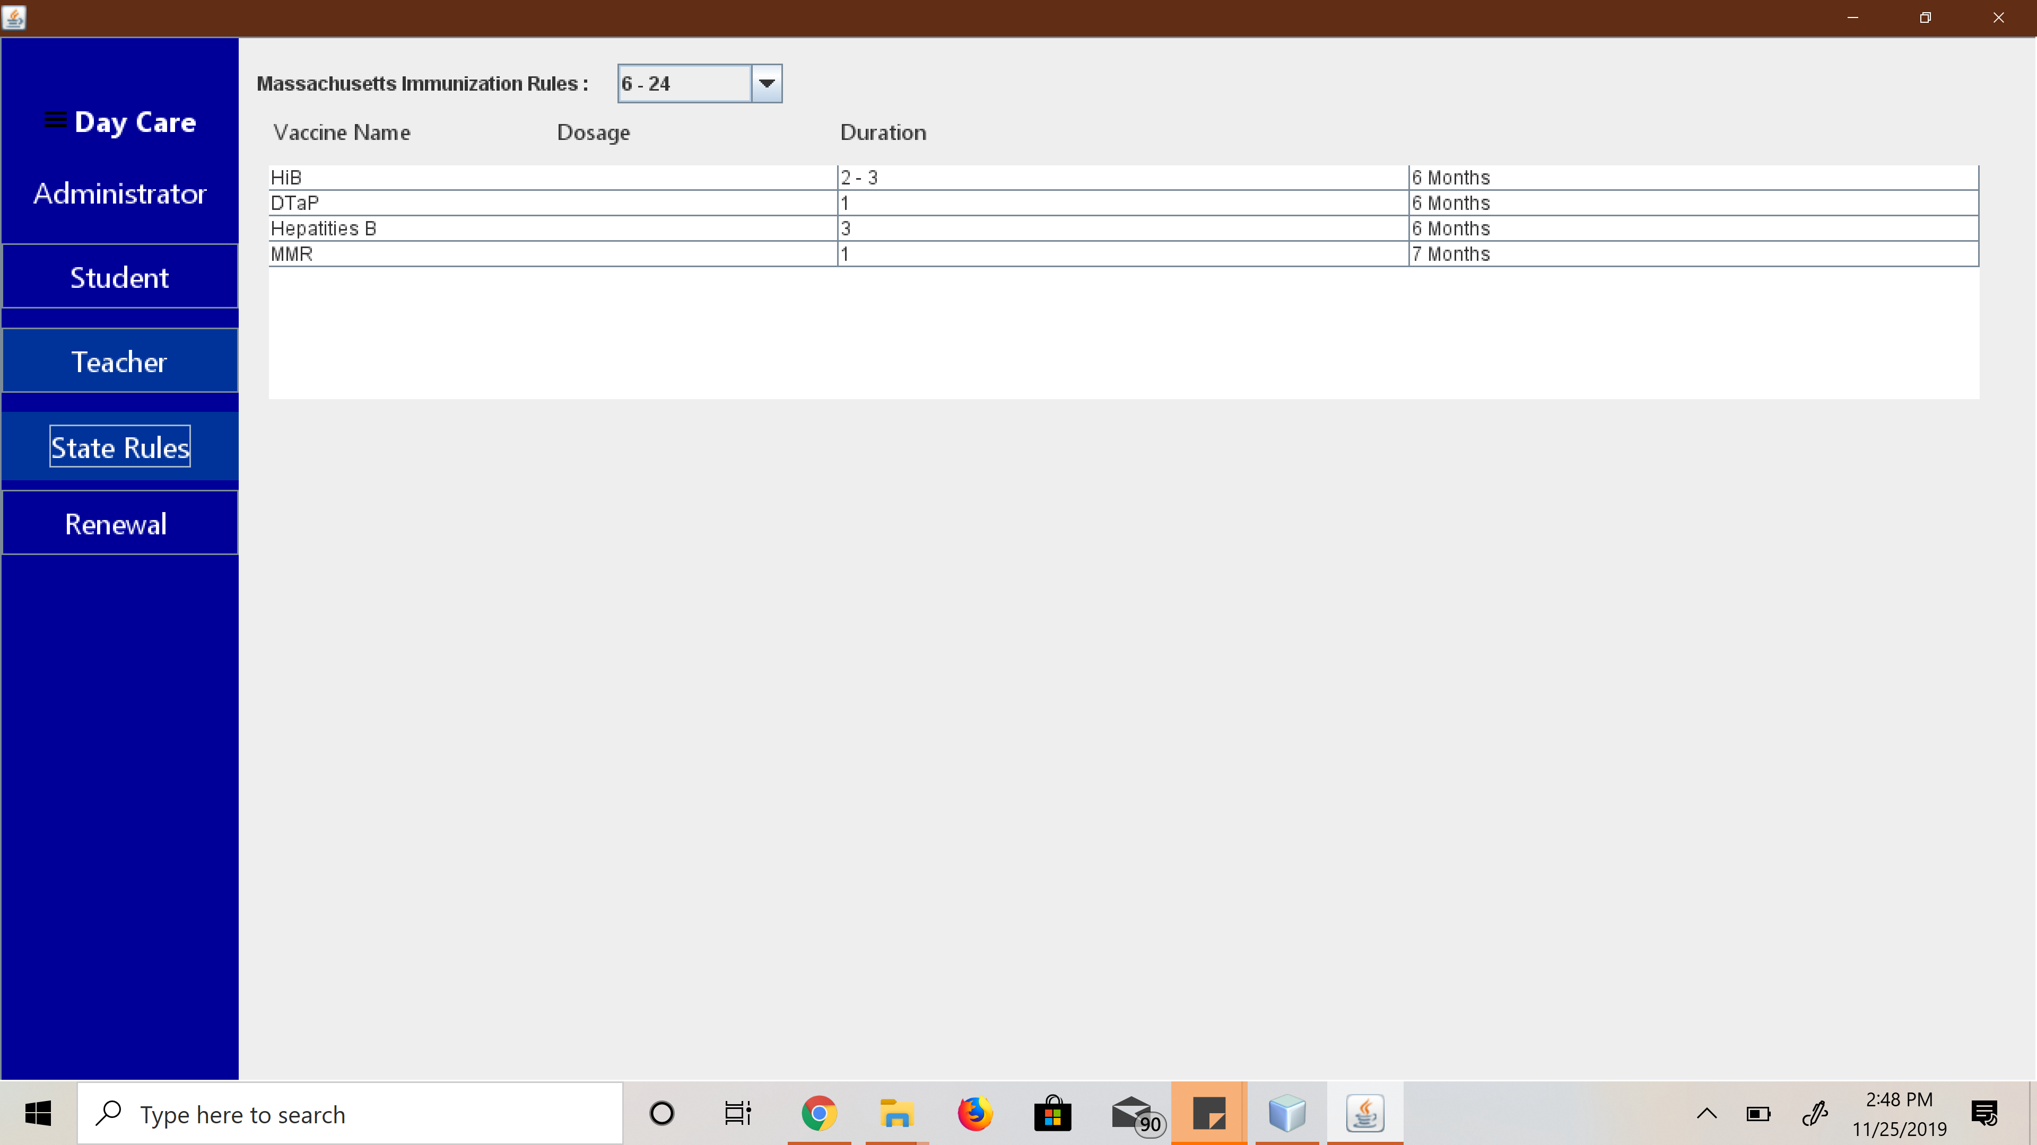

Slide 23
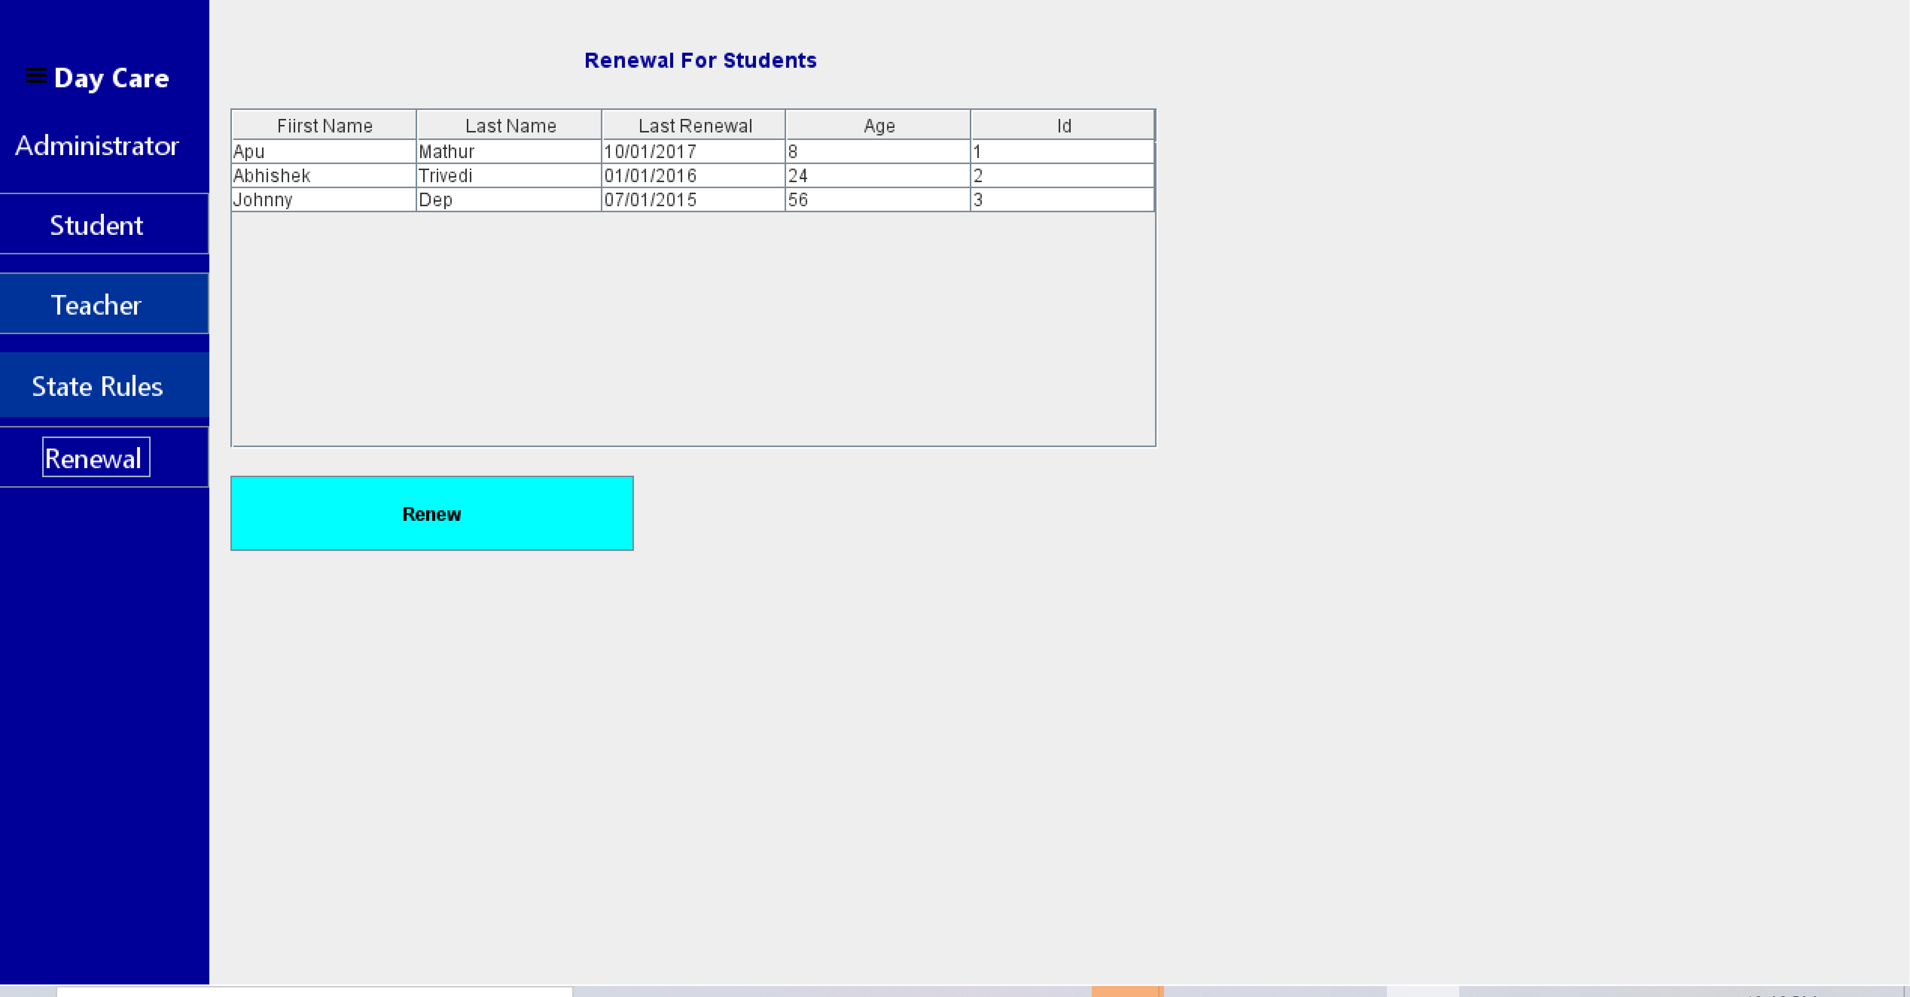

Slide 24
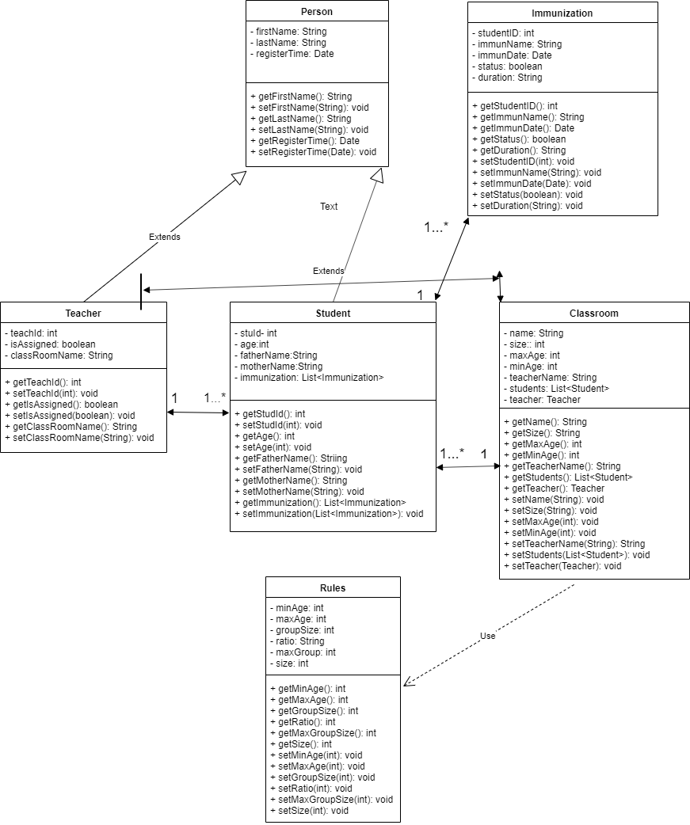

Slide 25
Who Did What??
Kratika Maheshwari
Designed all model classes
Designed Data Store
Added Immunization Anniversary Functionality
Designed RenewalJPanel and added students in Table in renewal controller.
Vikram Kannan Muralidharan
Designed state rulesJPanel and its functionality
Designed Alerts and renewal for vaccines.
Designed UI for Add,Update,Delete Student.
Deisgned UI for Add Immunization and the functionality to display vaccines based on vaccine id.
Designed FileIO class.

Slide 26
Pradheep Nagarajan
Designed UI for Add,Update,Delete Teacher.
Designed functionality of delete Teacher.
Designed MainJFrame.
Designed controller of Teacher.
Venkateswaran Palanikumar
Designed UI for Update and Delete Immunization.
Designed UI for MainJFrame.
Designed MainController.
In classRoomController designed functionality to display table of rules.

Slide 27
Apurva Mathur
Designed UI for ClassRoomJPanel and VIewStudentJPanel.
Implemented Factory Design Pattern and Lazy Singleton Design Pattern for MiddleWare
Designed DataManagement class and its subclasses like Student DataManagement, TeacherDataMangement, ImmunizationDataManagement.
Designed Factory Management classes like AbstractDataMAnagementFactory class and its subclasses like StudentDataMAnagementFactory, Teacher
DataManagementFactory and ImmunizationDataMangementFactory
Designed StudentController and ClassRoom Controller.

