Slide 1
MINI PROJECT SEMINAR ON MNEMONICIZER
PROJECT TEAM MEMBERS:
1.KESHOJU APURVA : 13H61A05M7
2.ESLAVATH VINOD : 13H61A05N4
3.MARUPAKA VENKATESH : 13H61A05L3
PROJECT GUIDE:
Mr.BALRAM
ASSISTANT PROFESSOR

Slide 2
ABSTRACT
Many applications that provide access to numerous words along with their definitions were created to help people build their vocabulary . These applications could not help people to remember difficult English words or more number of words . Our solution , in the form of an android application consists of words along with their definitions and memory aids.It is designed as a preparation tool to build effective vocabulary and help in preparing for various competitive examinations such as GRE, GMAT, SAT and TOEFL . This is an android application and uses SQLite as database manager . The application allows learners to access numerous words along with their meanings and mnemonics.The administrator can add and edit words , meanings and mnemonics so as to keep the user updated with new words.

Slide 3
PURPOSE
This application has been developed for Android users to
Access numerous words along with their meanings and mnemonics.
Memorize difficult English words easily.
Build effective vocabulary and help in preparing for various competitive examinations such as GRE, GMAT, SAT and TOEFL.

Slide 4
EXISTING SYSTEM
The user can access only words and their meanings making it difficult to memorize difficult words.
Lots of time consumed to search and learn words.
PROPOSED SYSTEM
The user can access words , meanings and their respective mnemonics.
Instead of searching each and every word , list of words are displayed in alphabetical order making it user-friendly.
An effective way to memorize more number of words in less time.

Slide 5
EXAMPLES
Word : cozen Meaning : trickery ; fraud Mnemonic : Instead of a dozen he took thirteen bananas and cheated the shopkeeper.
Word : condone
Meaning : forgive Mnemonic : paying condonation for less attendance.

Slide 6
SCOPE
The scope of the project is to provide list of words with mnemonics to build effective vocabulary using an Android device. The application shows the list of words , meanings and their respective mnemonics.

Slide 7
REQUIREMENT SPECIFICATIONS
SOFTWARE REQUIRED:
Windows OS(64-bit)
Android studio
Java JDK 1.7
SQLite database engine.
HARDWARE REQUIRED:
PC with Windows OS
4GB RAM or more
Intel processor(i3)
Android phone for testing

Slide 8
MODULES
Module 1:
The user is provided with a list of words arranged alphabetically
Module 2:
When the user clicks upon those words he is directed to the meaning and mnemonic of the selected word.

Slide 9
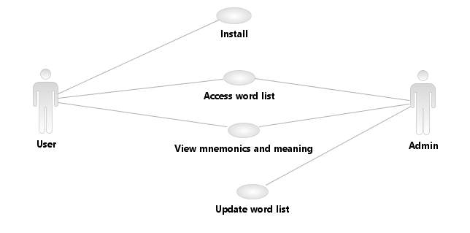
UML Diagrams

Slide 10
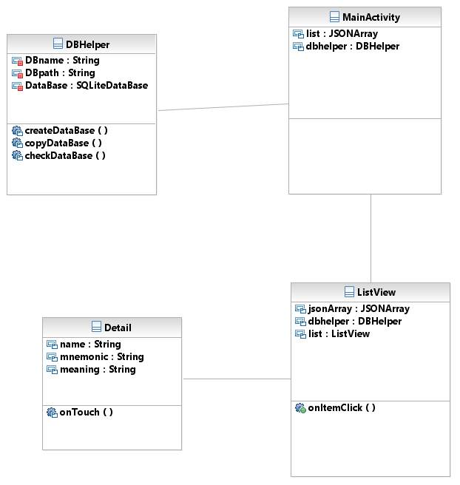

Slide 11
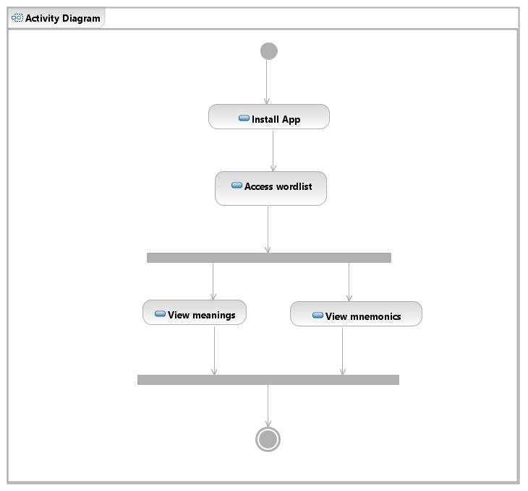

Slide 12
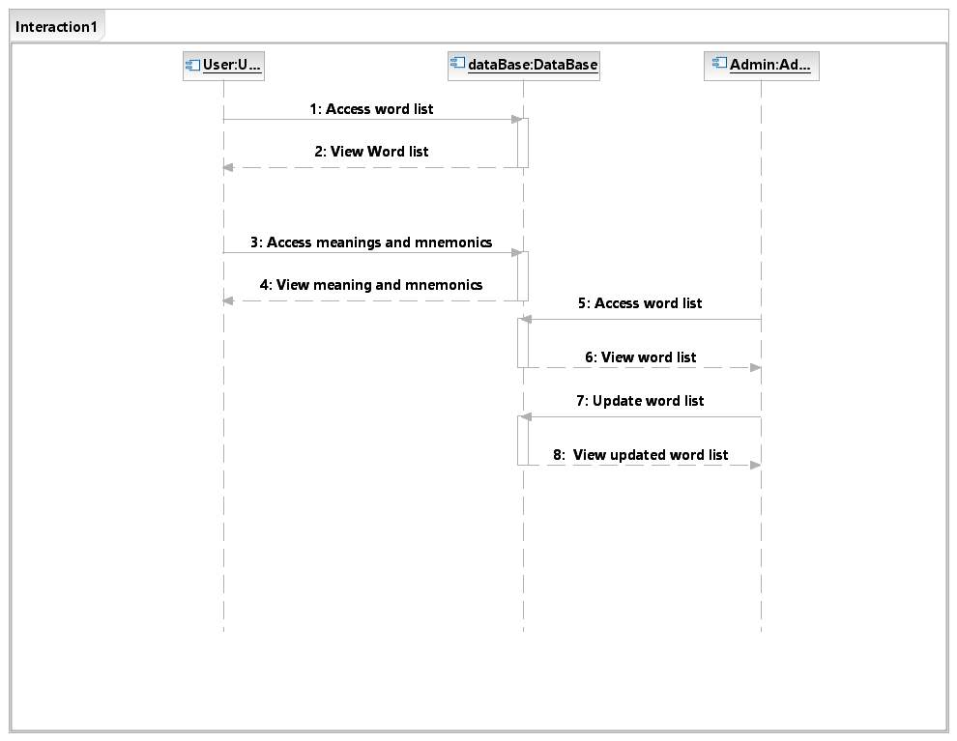

Slide 13
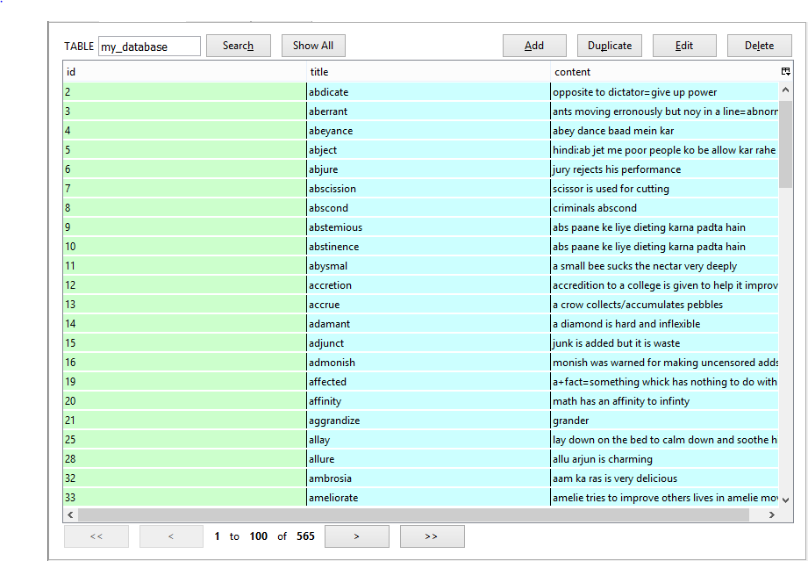
DATABASE WORDS TABLE

Slide 14
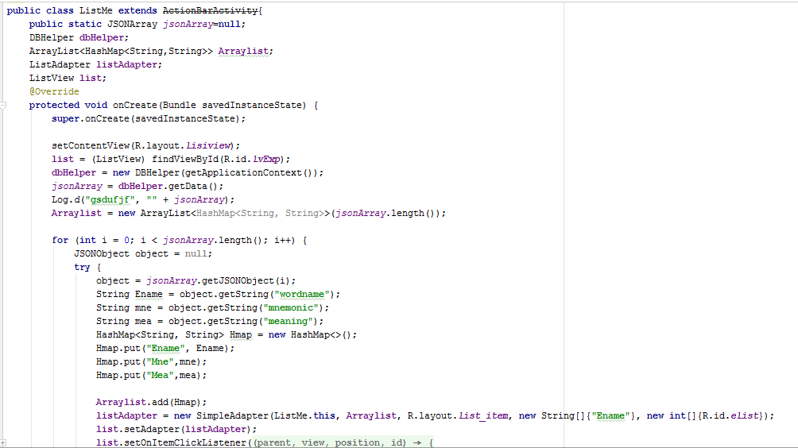
SAMPLE CODE

Slide 15
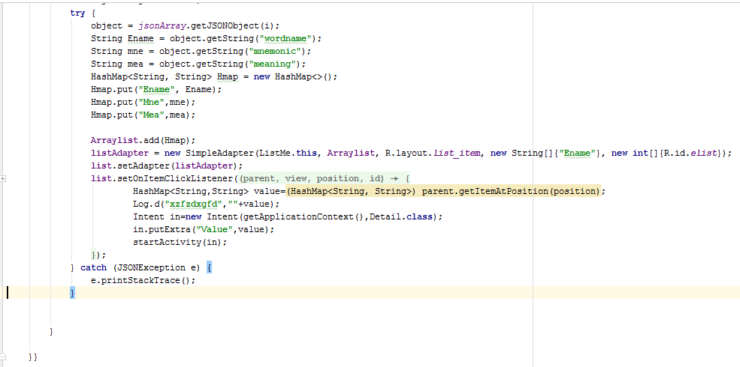

Slide 16
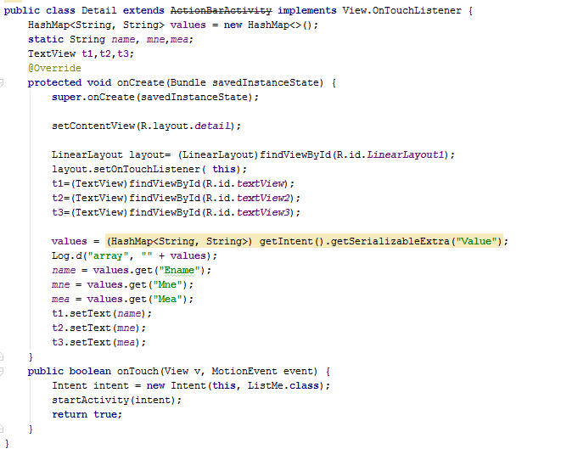

Slide 17
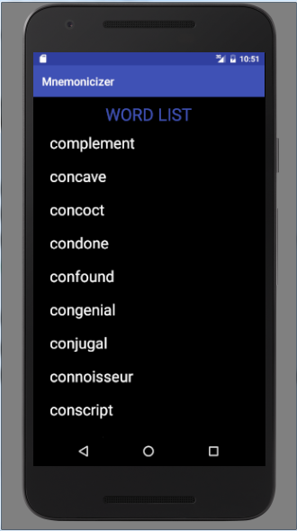
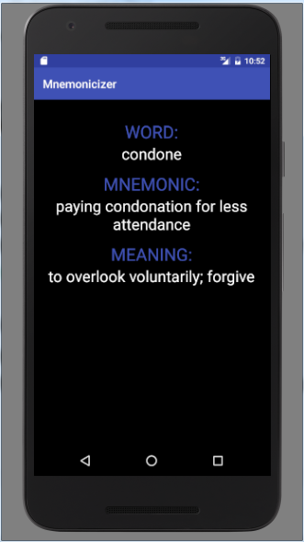
DESIGN WORD LIST SCREEN MEANINGS SCREEN

Slide 18
CONCLUSION
The “Mnemonicizer Application” for android helps a user to memorize difficult English words easily with the help of mnemonics or memory aids.
A user can access numerous words along with their meanings and mnemonics.
BENEFITS
Helps the users build effective vocabulary and prepare them for various competitive examinations using this simple and efficient mobile application.
User friendly interface that provides easy navigation.

Slide 19
References
https://developer.android.com/index.html
http://stackoverflow.com/
http://www.androidhive.info/

Slide 20
THANK YOU

