Slide 1
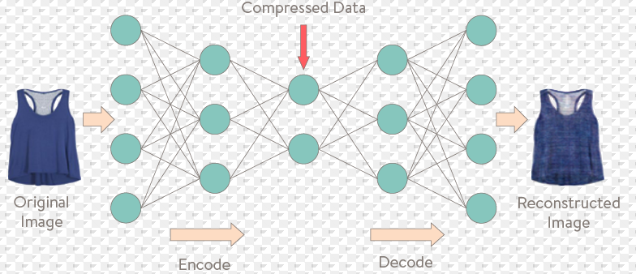
Denoising Autoencoders
Under the guidance of
Prof. Jin Tian
By Apurva and Anubhav
COMS-673

Slide 2
What AutoEncoders..?
"Auto-encoding" is a data compression algorithm where the compression and decompression functions are
Data-specific
Lossy
Learned automatically from examples rather than engineered by a human.
To build an AE, we need 3 functions:
Encoding function
Decoding function
Distance function

Slide 3
Applications of AE
Activity Recognition :
Data collected from sensors , One can learn automatic features from the data instead of extracting heuristic based features.
Upon learning the features, one can use a classifier to test the performance of it.
Pre-training a Deep Network:
Here we train a stacked AE in an unsupervised manner and obtain the weights.
This configuration will be used for the deep network which is better choice to randomly initialized weights. Studies have shows, this is a much better approach.
One-Class Classification (OCC) :
This problem arises when one have sufficient data for the positive class and very few or no data for the negative class.
We can train an AE on your positive data and learn features
Then compute reconstruction error on the training set to find a threshold.
During testing, one can use this threshold to reject those test instances whose values is greater than this threshold.

Slide 4
Types of AEs
Basic AE:
single fully-connected NL as encoder and decoder.
{768→32→768}
Deep AE:
use a stack of layers.
((768)→128→64→32—64→128→(768) )
Convolutional AE: if inputs are Images
Need use convnets as enc and Dec layer.
{Input→Conv2D→ MaxPooling2D→vector→ UpSampling2D→ Conv2D →reconstructed Output}
Sequence-to-sequence AE: If inputs are sequences.
Need to use a Model that encodes temporal structures E.g. LSTM cells.
{ input sequences→ LSTM encoder→ vector→ LSTM decoder→ target sequence}
Variational AE (VAE):
{input samples→ encoder network →latent space points→ decoder network → back to the original input data}
Notes:
MaxPooling2D layers (max pooling being used for spatial down-sampling)
→ vector containing information about the entire sequence

Slide 5
Our problem Statement:
Image denoising problem: we train the AE to map noisy images to clean images.
Use Convolutional neural networks
Apply Model on 2 Image datasets like MNIST, CiFAR10.

Slide 6
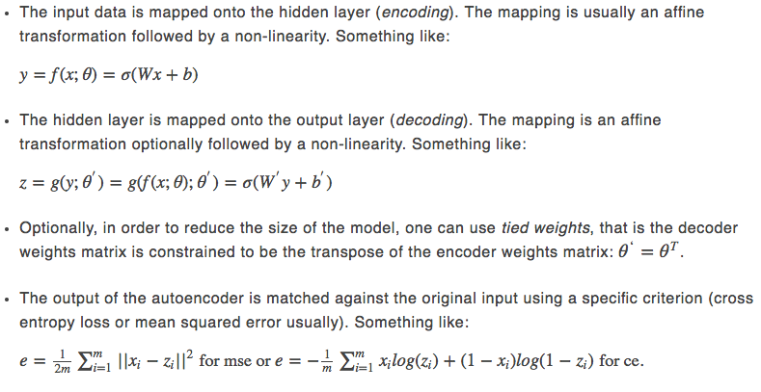

Algorithm For DEnoising AutoEncoders:
NOTATION FOLLOWED:
Using Backpropagation, small changes are made to the Model parameters to make the reconstructions more similar to the original input.

Slide 7
Model building and training and testing
Prepare our input data with noise(MNIST and CIFAR10)
Build you model
Configure the model:
( we used per-pixel binary crossentropy loss, and the Adadelta optimizer.)
Normalize if required.
Start training the model for “x” epochs.
When the Model reaches a stable train/test loss value (in our case 0.11), collect it.
Visualize the reconstructed inputs and the encoded representations.

Slide 8
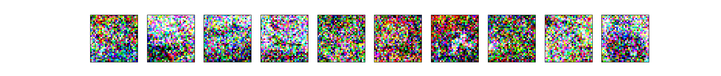
Preparing Input:
Add noise to the model :
Salt and pepper noise : a fraction of the input elements taken at random is set either to the maximum value or to the minimum.
NOTE:
The data corruption process has to be repeated each time the same input is presented to the AE. This will help the model to extract the underlying structure during the training.
If the training set is corrupted only once at the beginning of training, the model would recognize the distortions as valid data patterns, leading to OVERFITTING.

Slide 9
Build Model:
Output layer shape: (28*28*1)
Decode
Conv 2D shape: (28x28x32)
Upsampling shape: (28x28x32)
Conv 2D shape: (14x14x32)
Upsampling shape: (14x14x32)
Conv 2D shape: (7x7x32)
Encoded image
Max Pool 2x2 shape: (7x7x32)
encode
Conv 2D shape: (14x14x32)
Max Pool 2x2 shape: (14x14x32)
Conv 2d shape: (28x28x32)
Input layer shape: (28*28*1)

Slide 10
Configure Model:
AdaDelta optimizer:
The method dynamically adapts over time using only first order information and has minimal computational overhead beyond vanilla stochastic gradient descent.
The method requires no manual tuning of a learning rate and appears robust to noisy gradient information, different model architecture choices, various data modalities and selection of hyperparameters
Binary_crossentropy loss function:
It is a special case of multinomial cross-entropy loss for m=2
.
L(θ)=−1n∑i=1n[yilog(pi)+(1−yi)log(1−pi)]
=−1n∑i=1n∑j
=1myijlog(pij)

Slide 11
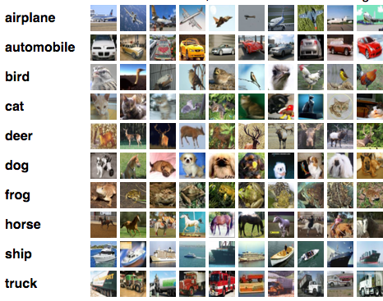
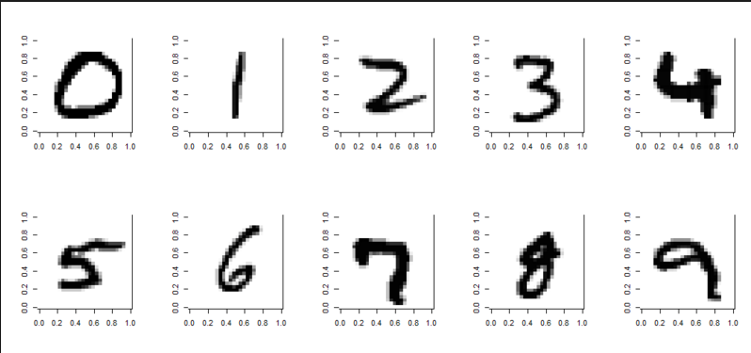
Datasets used:

Slide 12
Results
Dataset | Number of Epochs | Noise Factor | Number of Filters | Filter Size | Maxpool Size | Accuracy
Cifar10 | 5 | 0.2 | 50 | 3x3 | 2x2 | 0.12
Cifar10 | 5 | 0.5 | 50 | 3x3 | 3x3 | 0.1
Cifar10 | 5 | 0.5 | 50 | 3x3 | 2x2 | 0.2
Cifar10 | 10 | 0.2 | 100 | 3x3 | 2x2 | 0.38
Cifar10 | 10 | 0.5 | 100 | 5x5 | 3x3 | 0.32
Cifar10 | 50 | 0.5 | 100 | 3x3 | 2x2 | 0.48
Mnist | 5 | 0.5 | 50 | 3x3 | 2x2 | 0.81
mnist | 10 | 0.2 | 50 | 3x3 | 2x2 | 0.82
mnist | 50 | 0.2 | 30 | 3x3 | 2x2 | 0.88
mnist | 50 | 0.2 | 50 | 5x5 | 3x3 | 0.89
mnist | 50 | 0.5 | 30 | 3x3 | 2x2 | 0.92

Slide 13
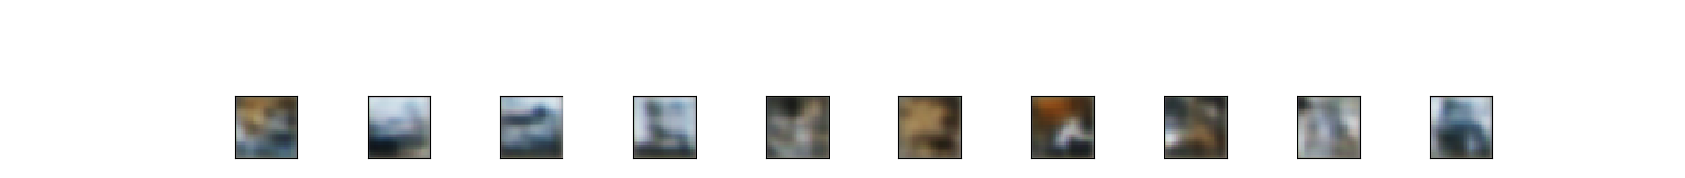
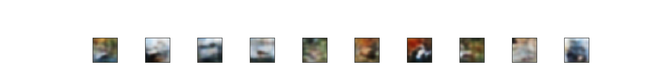

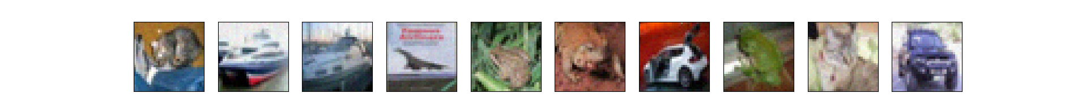
Result 1 with CIFAR-10
Noisy Data:
50epoch, 100 filters, 3x3 filtersize, 2x2 Maxpool size:

Slide 14
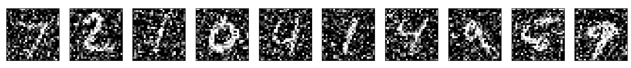
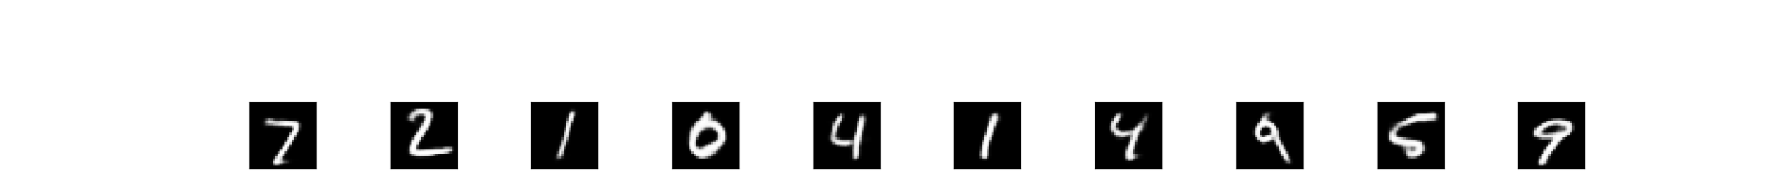
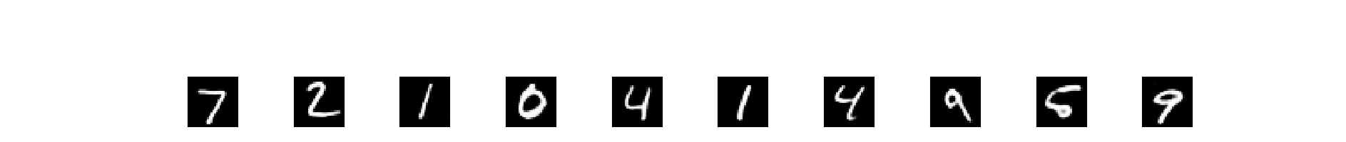
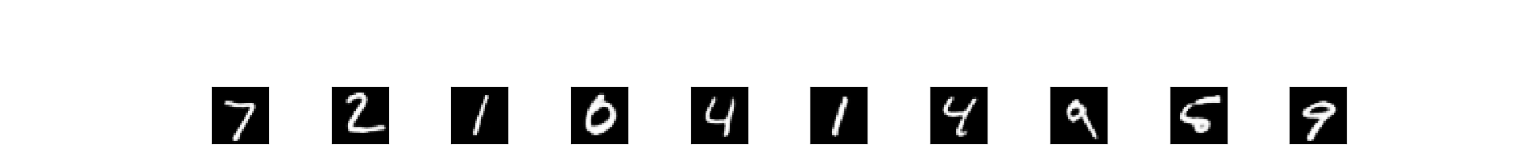

Result 1 with MNIST
Noisy Data:
50epoch, 30 filters, 3x3 filtersize, 2x2 Maxpool size:

Slide 15
References:
Stacked Denoising Autoencoders: Learning Useful Representations in a Deep Network with a Local Denoising Criterion.
Pascal Vincent, Hugo Larochelle, Isabelle Lajoie, Yoshua Bengio, Pierre-Antoine Manzagol, Dated: December, 2010
Image Restoration Using Convolutional Auto-encoders with Symmetric Skip Connections
Xiao-Jiao Mao, Chunhua Shen, Yu-Bin Yang, dated: August, 2016
Learning Deep Representations Using Convolutional Auto-encoders with Symmetric Skip Connections.
Jianfeng Dong† , Xiao-Jiao Mao† , Chunhua Shen? , Yu-Bin Yang† †. March 2017

Slide 16
Thank You

