Slide 1

World Explorer

Slide 2

Planning to travel?
.

Slide 3

Life is short and the world is wide!
This App is your one stop go to place to search and know all the countries you can be at within seconds.
All you need to do is Register!!

Slide 4
Webpage Overview

Slide 5
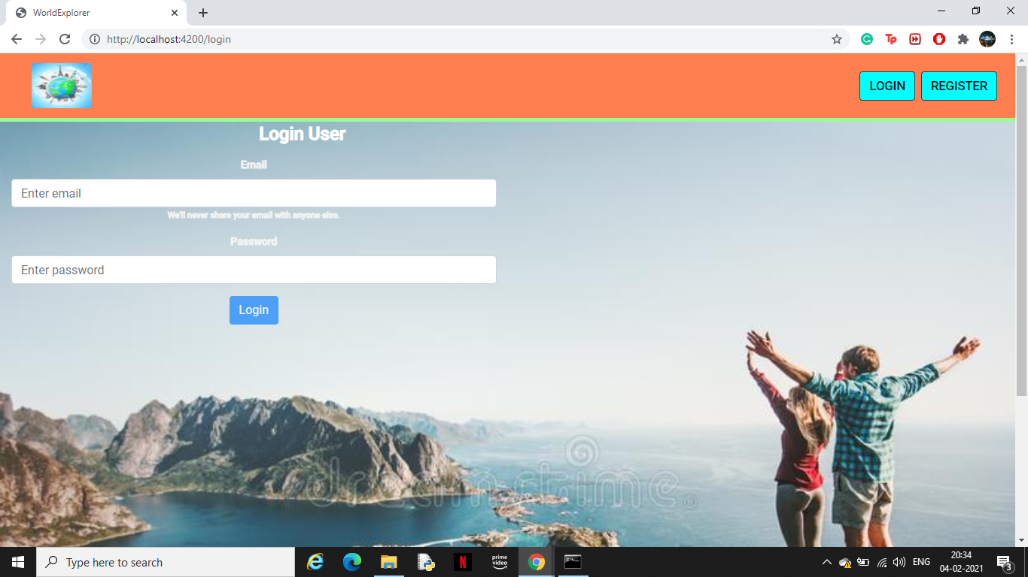

Slide 6
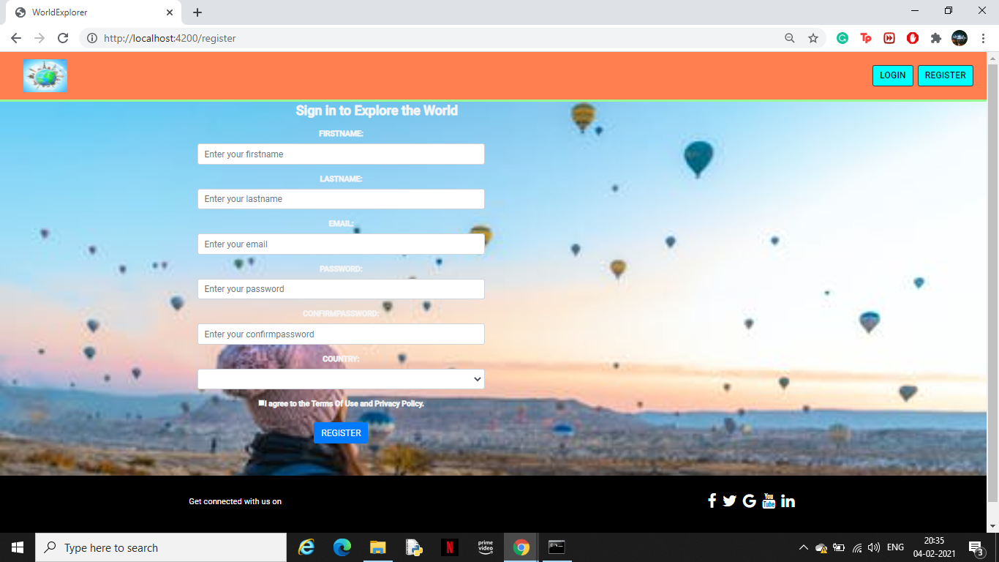

Slide 7
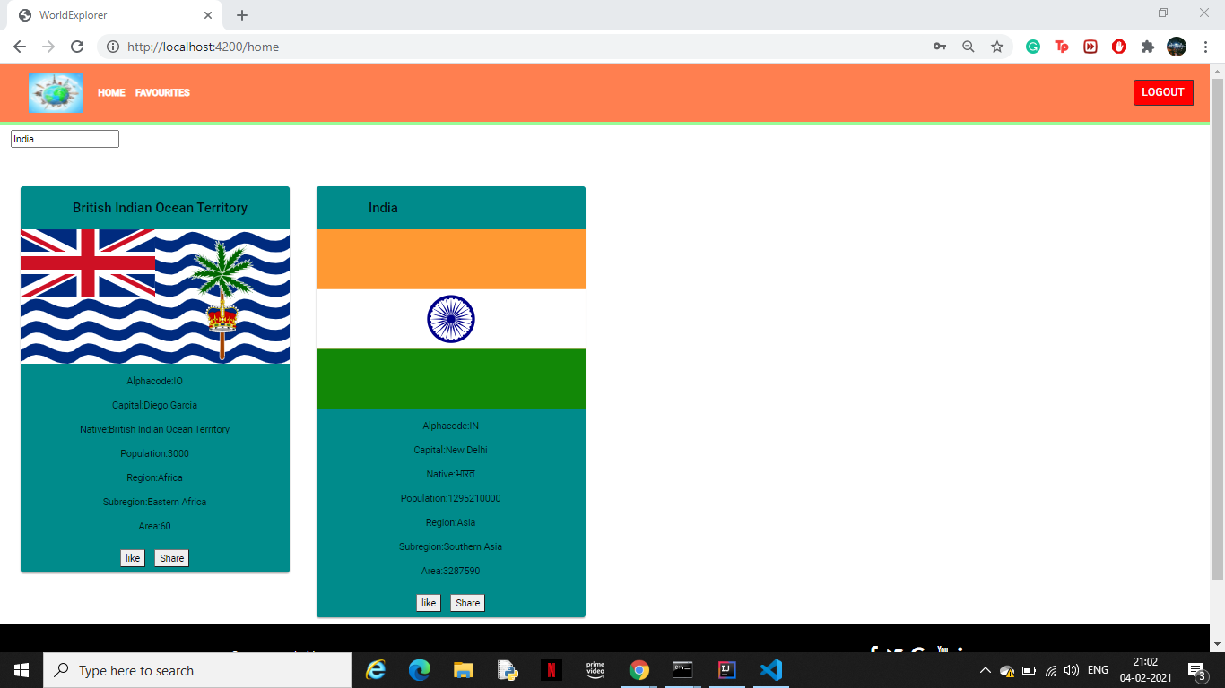

Slide 8

Front-end Overview

Slide 9
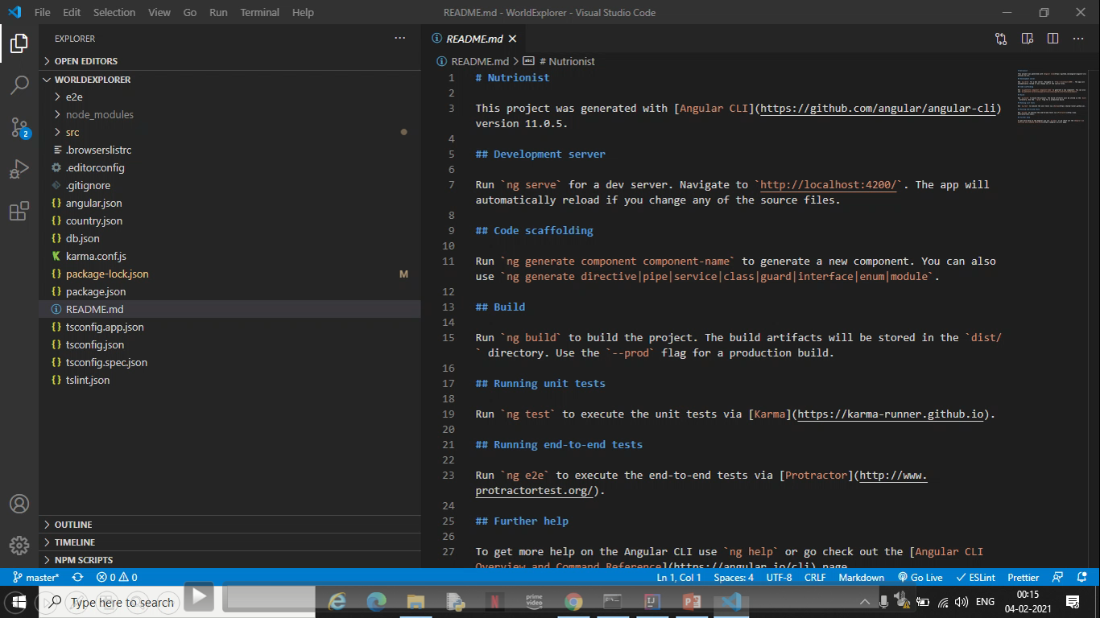

Slide 10


Back-end Overview

Slide 11
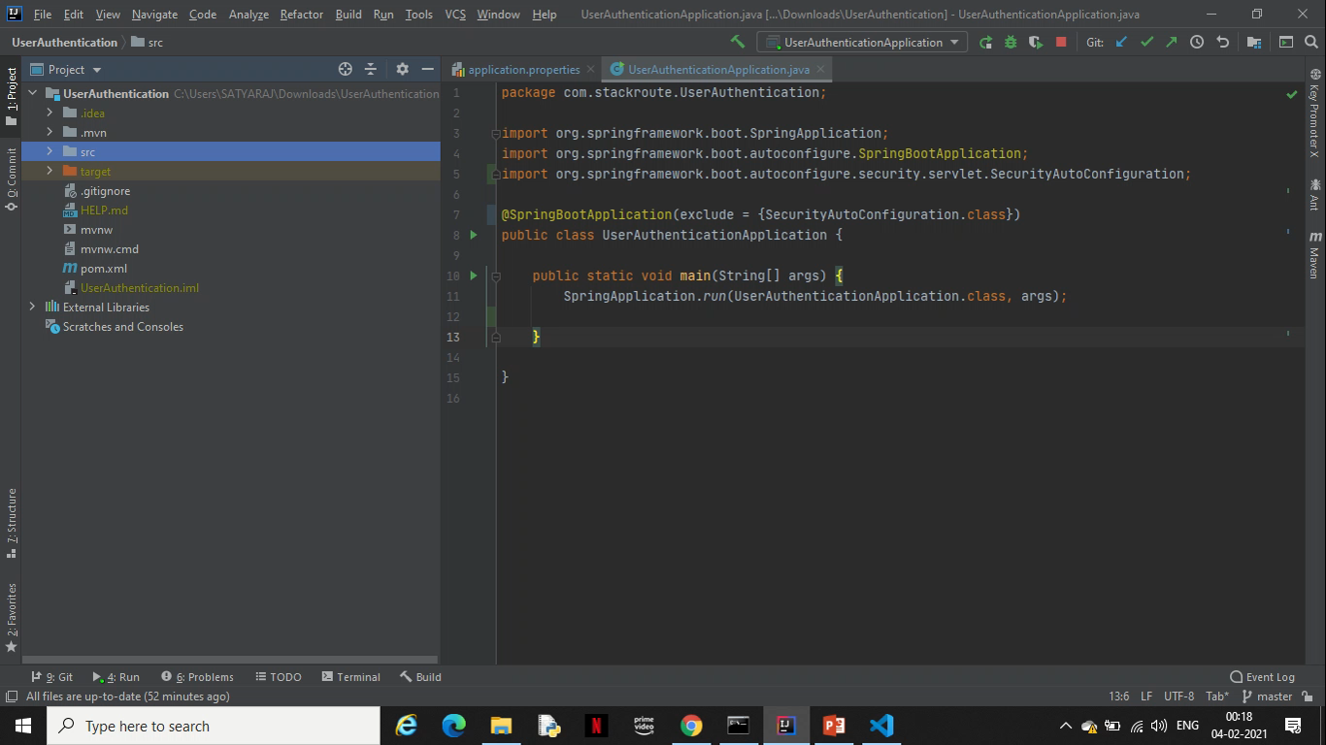

Slide 12
Tools Used:
Technologies:
References:
VCS : Gitlab
Middleware : Spring
Frond end : Angular
Data Store : MongoDB/MySQL
Testing : Karma, Jasmine, Junit, Mockito
Containerization: Docker
https://restcountries.eu/rest/v2/all
https://restcountries.eu/rest/v2/name/india

Slide 13

THANK YOU!

