Slide 1


SMART INDIA HACKATHON 2026
An offline workstation that turns
raw Bitcoin traffic into ranked,
explainable investigative leads.
Problem Statement ID SIH26146
Theme Cryptocurrency · Blockchain & Cybersecurity
PS Category Software
Organisation National Technical Research Organisation (NTRO)
NETRA
Network-Enhanced
Transaction Risk Analysis
AI-Powered Monitoring & Analysis
of Bitcoin Transaction Traffic
Team ID SH-2026-VORTEX · Team Name Team Vortex · 6 members
Prototype status working, offline, measured — not a mockup

Slide 2
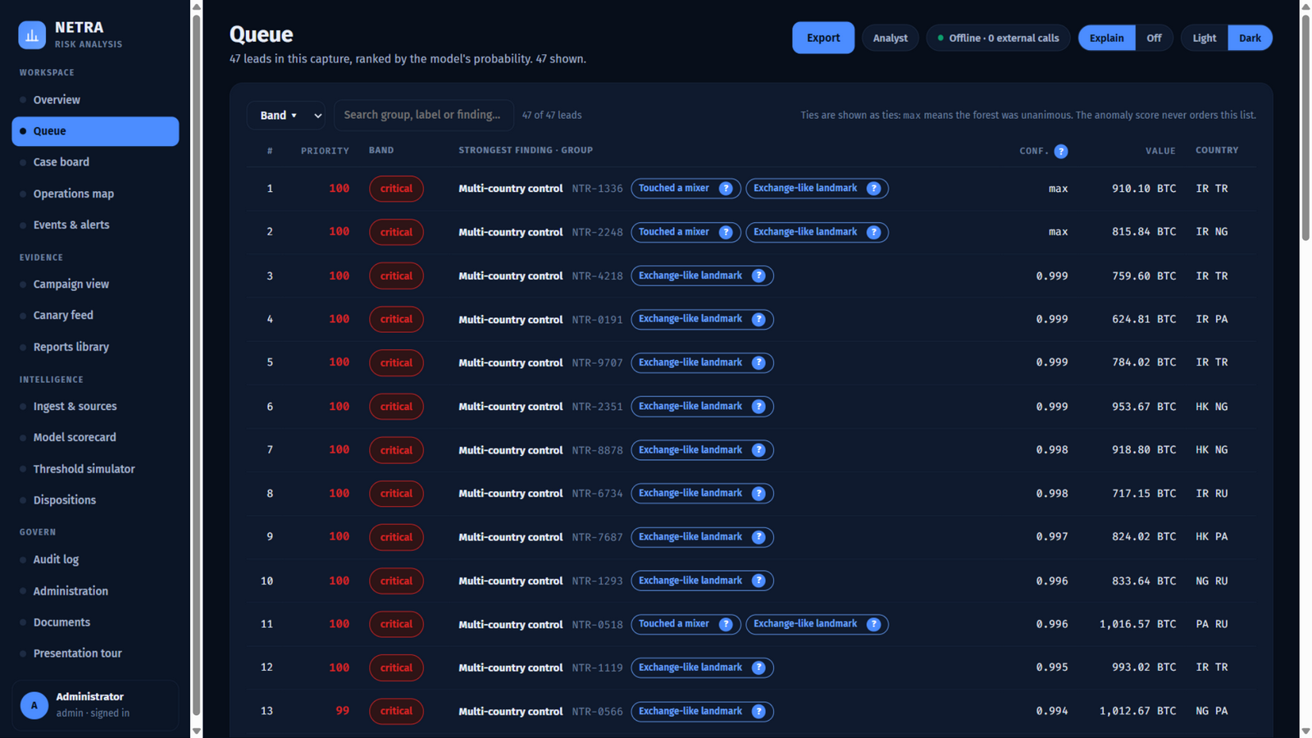
IDEA TITLE
TEAM VORTEX
One workstation. Two raw feeds in, ranked and explained leads out — and it never touches a network.
netra.local/app.html
WHAT MAKES NETRA DIFFERENT
Proposed Solution (Describe your Idea/Solution/Prototype)
Detailed explanation of the proposed solution
How it addresses the problem
Innovation and uniqueness of the solution
Correlates the two layers.
Most tools do blockchain OR network. NETRA fuses IP/port/timing with wallet/txid/amount, so a wallet group gets the country and hosting operator that sent it.
Explains every score.
Saabas decision-path attribution where base + listed + smaller factors equal the score shown, exactly — an investigator can check it.
Proves itself on planted ground truth.
98% ROC-AUC, 100% precision in the top-K, 86% recall — measured, not claimed.
Hunts campaigns, not just wallets.
Address poisoning and pool sweeps are cross-wallet patterns: one attacker, many victims.
Air-gapped by construction.
Zero external requests. Verified by reading every shipped file, not by promise.
Evidence-grade records.
Append-only audit log, cases, dispositions, model registry with rollback — chain of custody on the workstation.
The queue, on the demonstration capture: 47 leads ranked by the model's own probability, each with the finding that raised it.

Slide 3
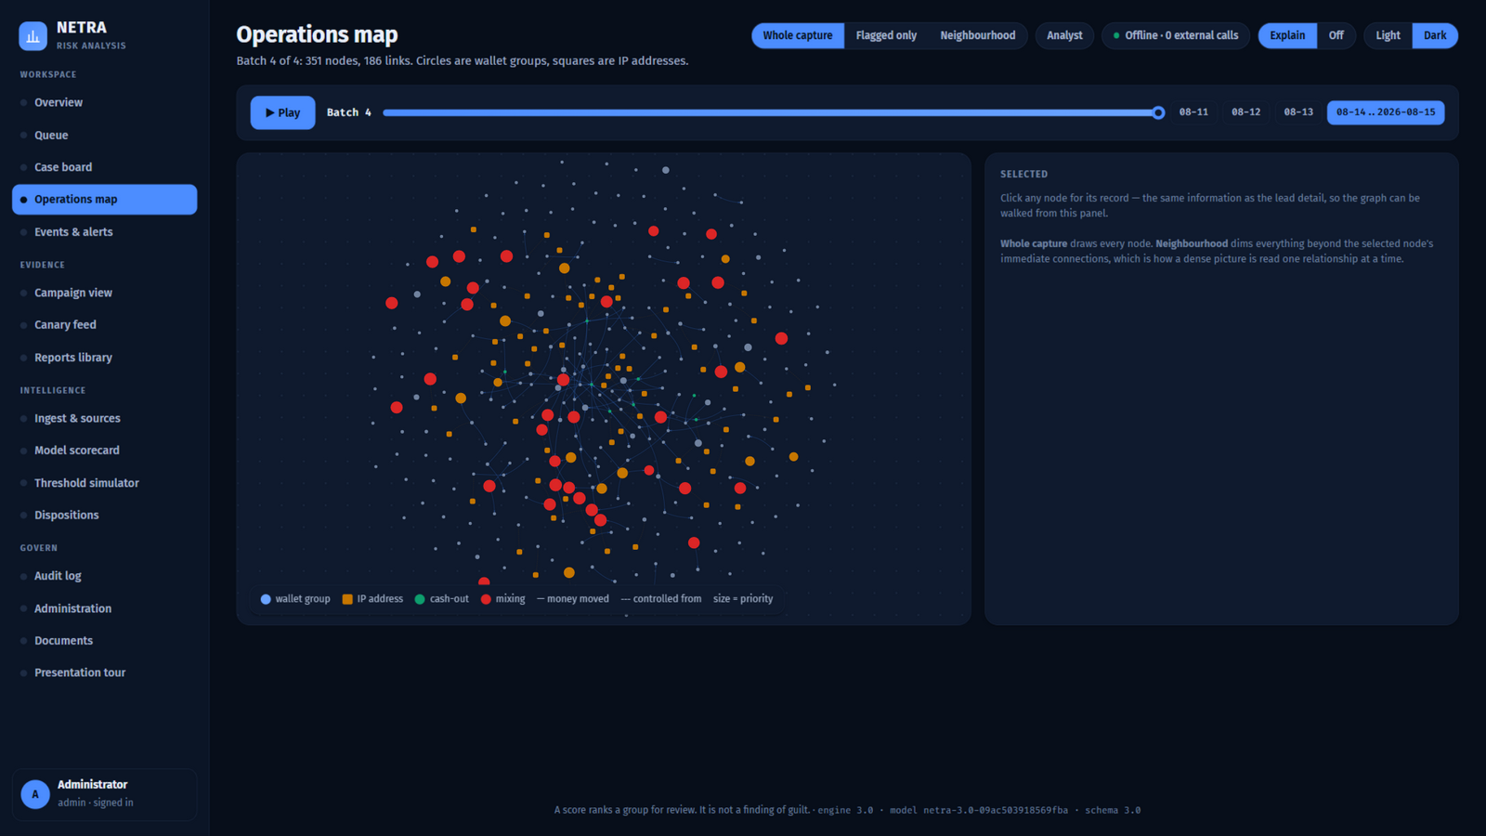
TECHNICAL APPROACH
TEAM VORTEX
Six stages, one process, no server to call: ingest → identify → correlate → features → models → leads.
netra.local/app.html — operations map
1. INGEST
2. IDENTIFY
3. CORRELATE
4. FEATURES
5. MODELS
6. LEADS
CSV · JSON · XML · SQLite
4 readers, ~90 header aliases,
quality gate with a reason
for every row set aside
NTR-#### wallet groups by
common-input clustering;
CoinJoin excluded so
innocent owners never merge
Network ⇄ chain fusion:
money-moved edges vs
controlled-by edges, with
country and operator
33 features per group:
volume, topology, graph
position (pagerank,
betweenness), campaigns
RandomForest risk +
IsolationForest anomaly,
calibrated; drift checked
against the training world
Ranked queue, per-lead
attribution, fund trails,
A4 report with engine,
model and capture hash
Technologies to be used (e.g. programming languages, frameworks, hardware)
Methodology and process for implementation (Flow Charts/Images/ working prototype)
STACK — AND WHY EACH PIECE IS THERE
Python 3.10 · FastAPI · uvicorn — one process serves the API, the workstation and the A4 reports
pandas · numpy · scikit-learn · networkx — no GPU, no cloud, no model server
SQLite for state and records — one file holds the analysis AND the audit trail; back it up whole
Vendored vis-network, Chart.js, 42 font files — the graph and charts render with the cable unplugged
pytest · smoke task · offline check — the working state is reproducible, not remembered
The map is the fusion made visible. 361 wallet groups and their network endpoints for one batch: 185 links, 55 of them control edges — an IP holding a wallet, which is a different fact from money moving.
Reproduce it: python tasks.py smoke generates a capture, trains from scratch, replays it and checks every endpoint. python tasks.py offline proves no shipped file reaches the network.

Slide 4
FEASIBILITY AND VIABILITY
TEAM VORTEX
Already running on the machine this was built on — the numbers below come from that run.
WHAT IS ALREADY FEASIBLE
RISKS, AND HOW THEY ARE HANDLED
MEASURED ON PLANTED TRUTH
Reads real exports.
A block-explorer style file with its own headers, satoshi amounts and junk rows is read and reported on in seconds.
A model that looks good offline and fails in use.
Trained on the scale it is served at; drift is measured per batch; the scorecard publishes the linear-model baseline beside it.
97.8%
ROC-AUC, 4-fold grouped by batch
Analysis of the feasibility of the idea
Potential challenges and risks
Strategies for overcoming these challenges
Runs on one laptop.
The whole pipeline processes the demonstration capture in about 15 seconds per batch on CPU only.
Garbage in, silent garbage out.
The gate reports what it set aside and why, before anything is scored.
89.3% / 85.9%
precision / recall at the review floor
100%
Offline deployment.
One command starts it; Docker bakes the capture, the models and the first administrator into the image.
A score read as a verdict.
Every screen, report and export carries 'a lead is not a finding of guilt', and the attribution reconciles to the number shown.
precision in the top-25 leads
0.99
Scales by batches, not by hope.
A capture is replayed window by window, so the work is bounded by the day, not by the file.
Network/chain mismatch: a file with no IP columns.
The analysis says so, drops the control edges, and reports what geography is lost.
clustering agreement with true owners
0.033
Brier score — the probabilities are calibrated
Every output is checkable.
The report names the engine, the model hash and the capture hash that produced it.
Someone edits the record afterwards.
The audit log is append-only by database trigger; a capture replay clears the analysis and never the records.
44 / 44
planted entities detected, 40 in the first batch

Slide 5
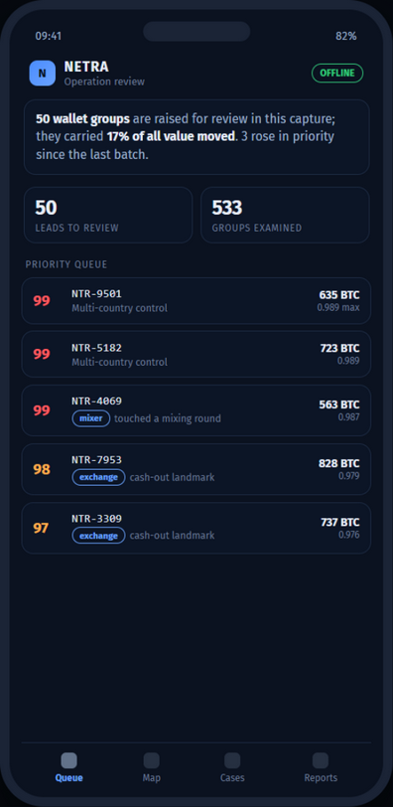
IMPACT AND BENEFITS
TEAM VORTEX
What a cybercrime unit gets on the first afternoon, and what it costs them.
25,240
361
47
183
transactions read
4 daily batches
wallet groups resolved
content-derived identity
leads raised
each with its reason
changes between batches
what moved, and from what to what
Potential impact on the target audience
Benefits of the solution (social, economic, environmental, etc.)
WHO BENEFITS, AND HOW
ECONOMIC AND OPERATIONAL CASE
NTRO analysts.
A ranked queue instead of a graph they have to read from scratch — with the reason attached to every entry.
No cloud bill, no GPU, no per-seat licence. It runs on the workstation the unit already owns, on Python 3.10 and a handful of pinned open-source libraries.
No data-protection exposure. Seized evidence and intelligence never leave the machine, because there is nowhere for them to go.
Recovered analyst time. Triage moves from reading a transaction graph to reading a ranked list of 47 entries out of 361 groups.
It keeps improving. Every decision an analyst records becomes a label; python tasks.py retrain trains a challenger that a human promotes — never one that promotes itself.
Law-enforcement officers.
An A4 lead report that names the evidence hash: something attachable to a file, not a screenshot.
Exchanges and banks.
Victim-notification sheets for poisoning campaigns, listing exactly who received a forged address.
Field teams.
The same queue on a phone, served by the local workstation, with no cloud account and no data leaving the room.
IN THE FIELD
The same queue, on a phone: the one-sentence answer, the two numbers that matter, and who to look at first — served locally, working offline.
The institution itself.
An append-only record of who looked at what, so the tool survives an audit and a change of staff.

Slide 6
RESEARCH AND REFERENCES
TEAM VORTEX
What this stands on, and where the claims in this deck can be checked.
Domain foundations
Method and tooling
Nakamoto, S. (2008). Bitcoin: A Peer-to-Peer Electronic Cash System.
Pedregosa et al. (2011). Scikit-learn: Machine Learning in Python. JMLR.
Meiklejohn et al. (2013). A Fistful of Bitcoins: Characterizing Payments Among Men with No Names. IMC — the common-input ownership heuristic, and its limits.
Breiman, L. (2001). Random Forests. Machine Learning 45(1).
Möser & Böhme (2015). Trends, Tips, Tolls: A Longitudinal Study of Bitcoin Transaction Fees. FC — value-flow tracing.
Liu, Ting & Zhou (2008). Isolation Forest. ICDM.
Saabas, T. (2014). Interpreting random forests — the decision-path attribution we use, chosen over SHAP because it reconciles exactly and runs in microseconds on an air-gapped host.
Details / Links of the reference and research work
Ron & Shamir (2013). Quantitative Analysis of the Full Bitcoin Transaction Graph. FC — peel chains and mixing.
Hagberg, Schult & Swart (2008). Exploring Network Structure with NetworkX.
FastAPI, uvicorn, SQLite, vis-network, Chart.js — official documentation.
Threat patterns used as detectors
FATF (2023). Targeted Update on Implementation of the FATF Standards on Virtual Assets and VASPs — typologies behind the risk features.
Standards and process
SIH 2026 Idea Submission template and evaluation criteria: novelty, complexity, clarity, feasibility, practicability, impact, UX (sih.gov.in).
Chainalysis (2023–24). Crypto Crime Report — address poisoning and dusting as observed attacker behaviour.
NTRO problem statement SIH26146: AI-Powered Monitoring & Analysis of Bitcoin Transaction Traffic.
Public exchange advisories on lookalike-address poisoning (prefix/suffix forgery) — the basis of our matched-character rule.
ISO/IEC 27037:2012 — handling of digital evidence; the reason the audit log is append-only and every output carries a hash.
Everything claimed here is reproducible on the machine that produced this deck. python tasks.py smoke rebuilds a capture, trains the models, replays the batches and checks every endpoint; python tasks.py accept <file> reports exactly what was read from any capture you supply.

