Slide 1

LET US ^{RISE} ABOVE THE REST MSP Mandal’s Deogiri Institute of Engineering and Management Studies Department of Computer Science & Engineering
CHATBOT
Team Members :- 1)Neha Kahate(36046)
2)Apurva Khadkikar(36057)
Class:- TE-I
Under the Guidance of:-
Prof. S.Nandedkar

Slide 2
Content:-
Introduction To Chatbot
Collected data.
Dialogflow API
Working of Dialogflow
Features Of Dialogflow

Slide 3
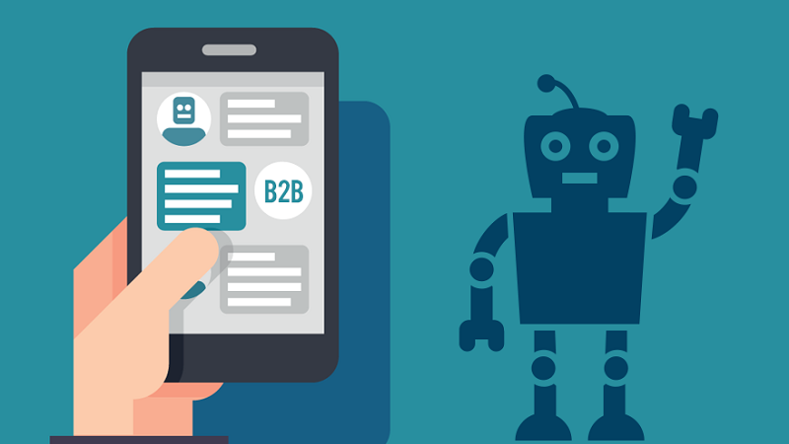
Introduction To Chatbot
A chatbot is a piece of technology that allows a computer program to communicate with people just like conversing through text messaging using a natural language, say English, to accomplish specific tasks.
A chatbot is also known as an artificial conversational entity (ACE), chat robot, talk bot, chatterbot or chatterbox.

Slide 4
Types of chatbots
Rule based chatbots (if you ask for phones the relevant phone pages open up in an e-commerce site that’s an example of a rule based chatbot).
A.I. based chat bots (learn over a period of time using Machine Learning techniques) — dialog flow is an example of that

Slide 5
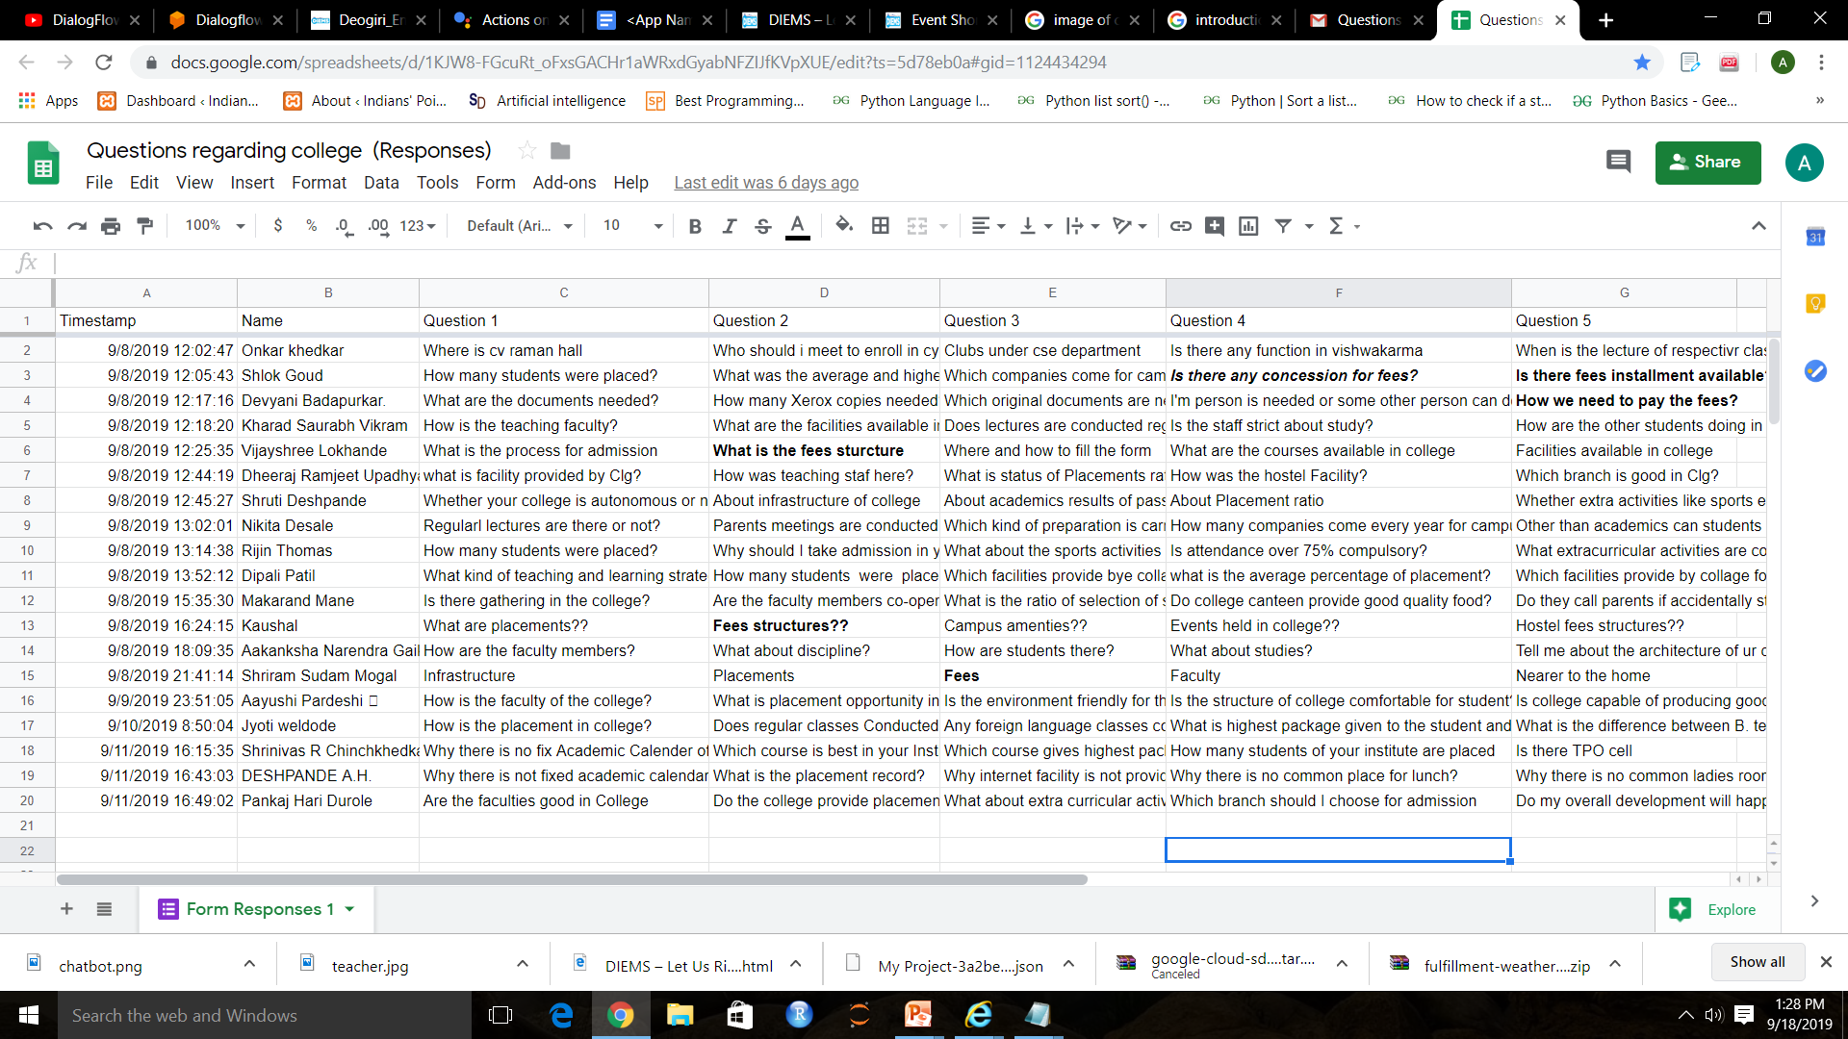
Dataset

Slide 6

Dialogflow API
Dialogflow (formerly Api.ai, Speaktoit) is a Google-owned developer of human–computer interaction technologies based on natural language conversations.
Supports 14+ languages in 16+
programming languages.
SDKs to work with web apps,
mobile app & wearables
Integrates with 14+ chat platforms
such as slack, messenger, Alexa,
Google Home.

Slide 7
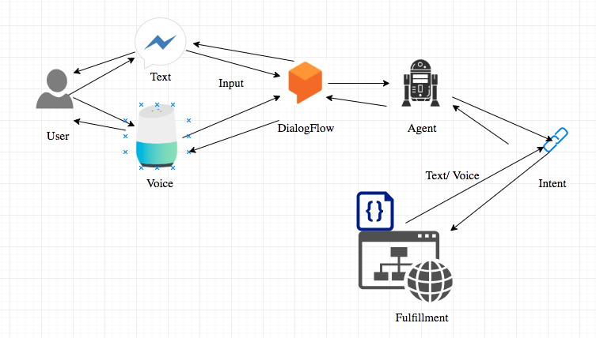
Working of Dialogflow

Slide 8
Thank you

