Slide 1
Phase 1 Vocabulary Analysis
Full report · 11 datasets · 3 variants · 32 runs · fold 0 · unthresholded

Slide 2
Scope & variants
Covers all 32 completed dataset×variant combinations
Excluded: ogbg-molhiv / all_fallback_bpe (not yet generated)
Blue = rbrics_old (* keys) · Red = rbrics ([*] keys) · Green = all_fallback_bpe
Regression (esol, Lipophilicity): vocabs + stats only; rules intentionally empty

Slide 3
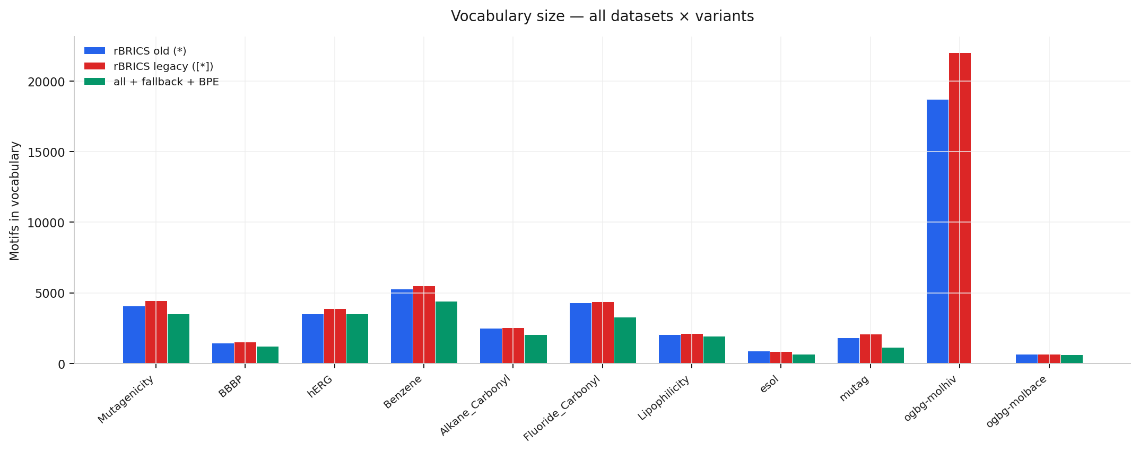
Vocabulary size — all datasets

Slide 4
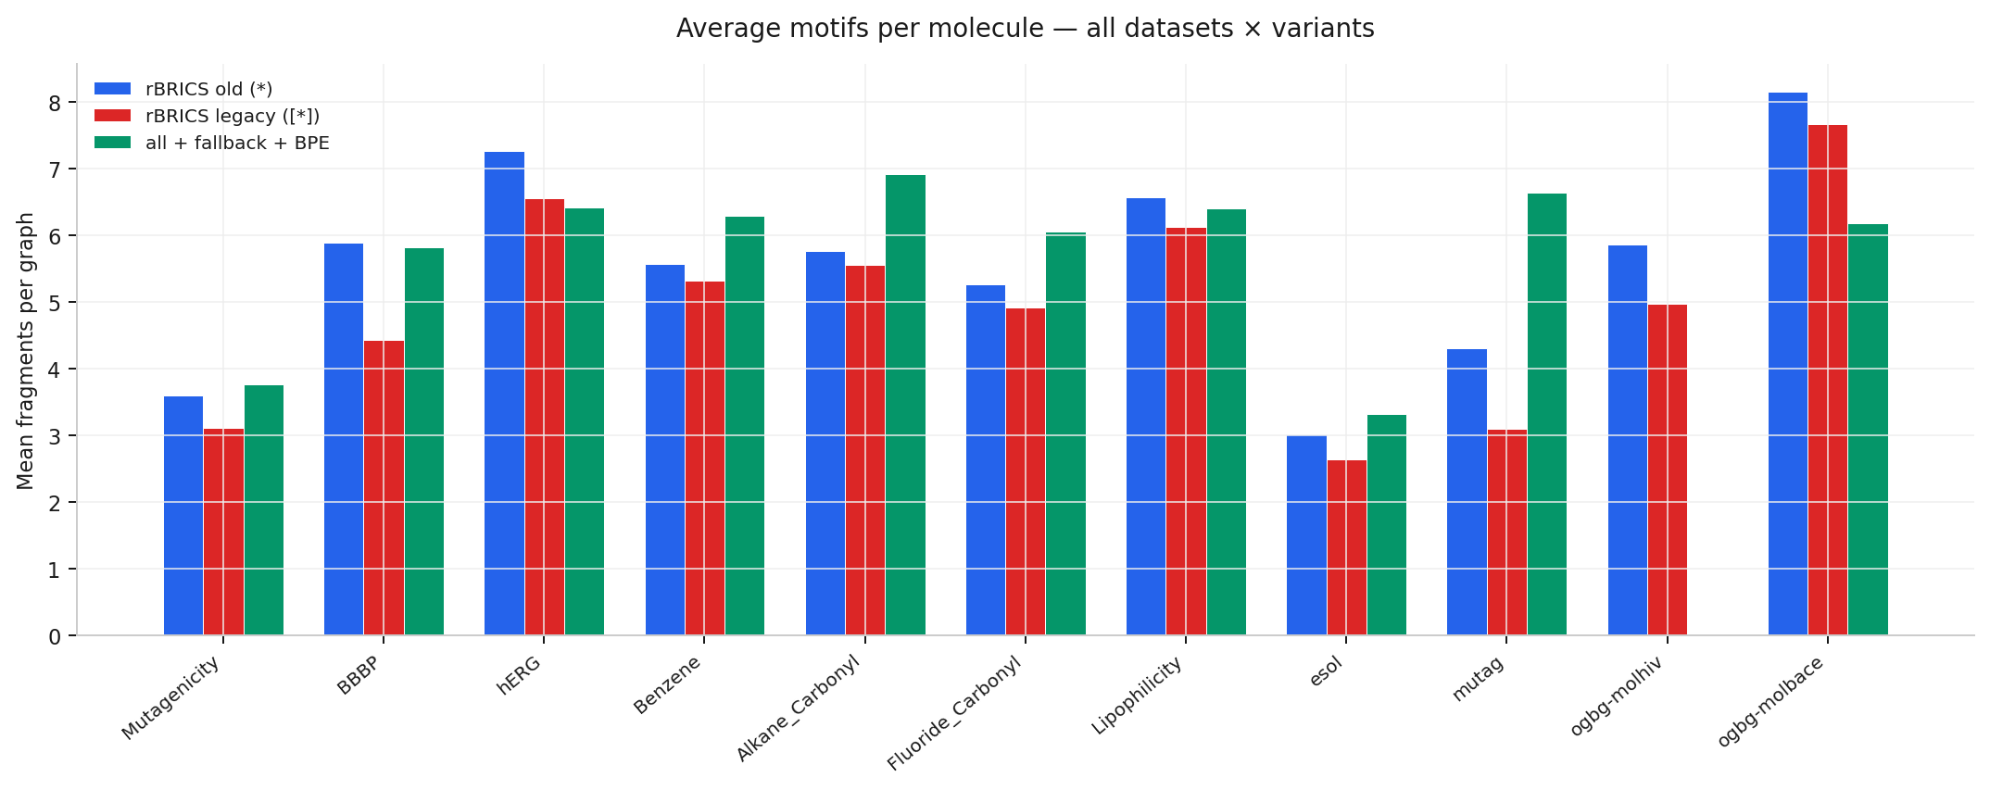
Mean fragments per graph — all datasets

Slide 5
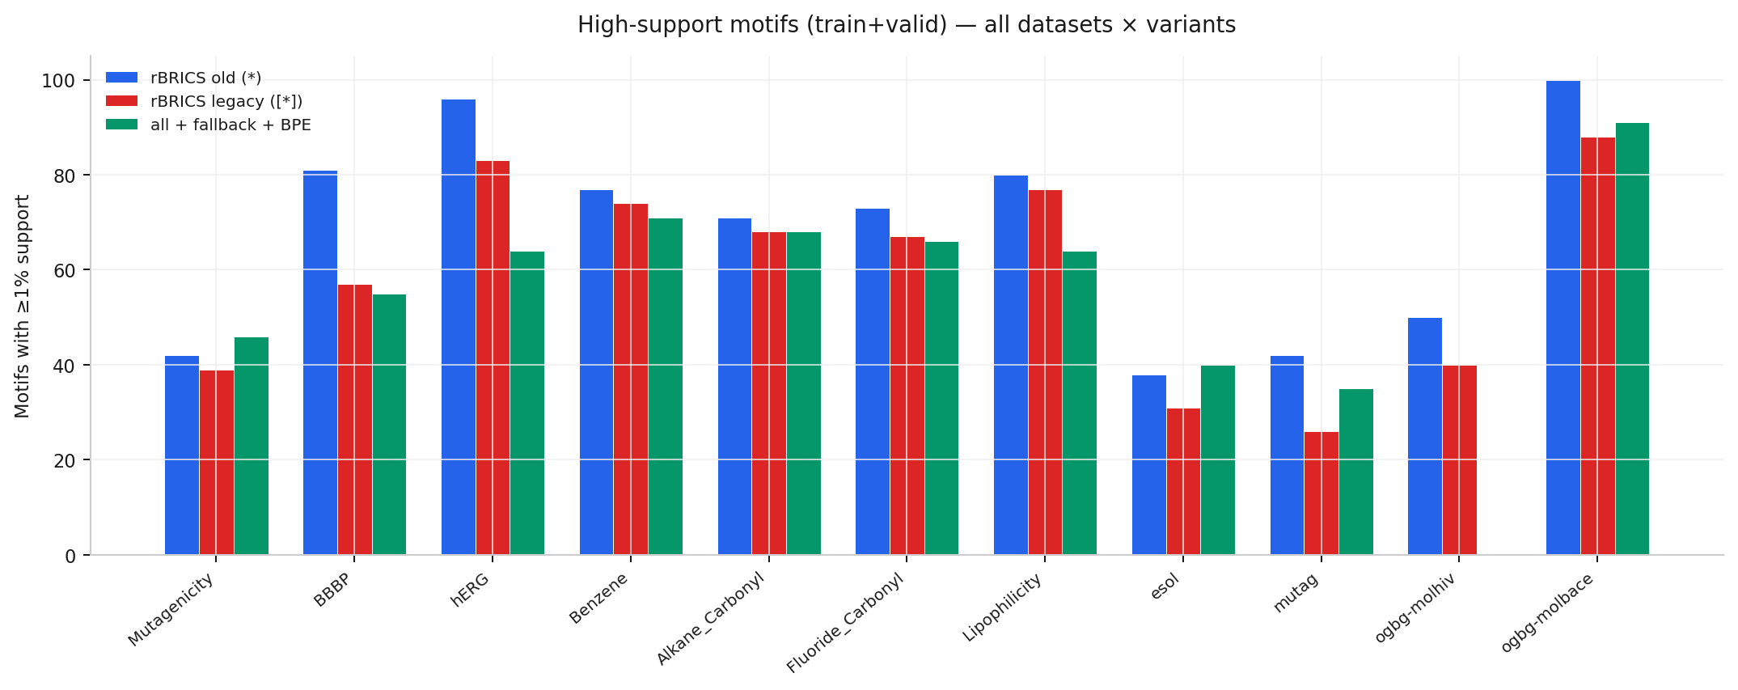
Motifs with ≥1% support — all datasets

Slide 6
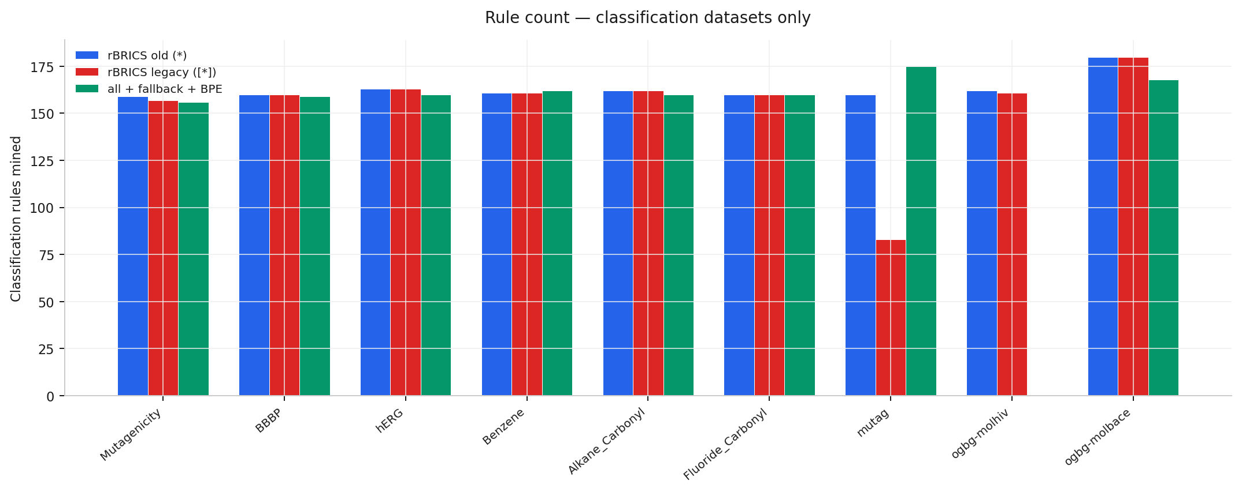
Classification rules mined — all classifiers

Slide 7
Mutagenicity
Task: Classification
Following slides: overview + per-variant motif statistics

Slide 8
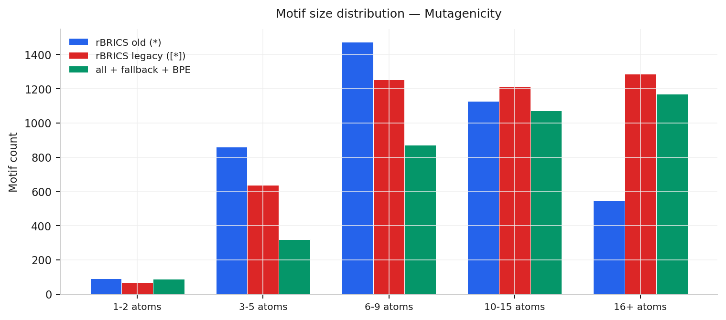
Mutagenicity · Classification
Variant | Graphs | Vocab | ≥1% | Mean frags | Med. | Min-Max | Rules
rBRICS old (*) | 7672 | 4102 | 42 | 3.60 | 3 | 1-19 | 159
rBRICS legacy ([*]) | 7672 | 4459 | 39 | 3.11 | 3 | 1-19 | 157
all + fallback + BPE | 7672 | 3518 | 46 | 3.76 | 3 | 1-36 | 156

Slide 9
Mutagenicity / rBRICS old (*)
Top frequent SMARTS | At. | Mols | Freq
*O* | 1 | 1150 | 15.0%
*[N+](=O)[O-] | 3 | 1115 | 14.5%
*N* | 1 | 791 | 10.3%
*C* | 1 | 785 | 10.2%
*C(*)=O | 2 | 717 | 9.3%
*c1ccccc1 | 6 | 646 | 8.4%
Class-skewed motif | Sup. | C0 | C1 | |Δ|
*c1ccc(C=*)o1 | 78 | 0% | 96% | 96
*C1CO1 | 172 | 8% | 97% | 89
*CCCC* | 126 | 114% | 29% | 86
*CCCl | 89 | 25% | 106% | 81
*[N+](=O)[O-] | 1115 | 16% | 95% | 79
*[NH+]([O-])O | 246 | 14% | 87% | 74
Best rule (159 total): (*[N+](=O)[O-]) ∨ (*c1ccccc1) ∨ (*OC) ∨ (*CC)

Slide 10
Mutagenicity / rBRICS legacy ([*])
Top frequent SMARTS | At. | Mols | Freq
[*][N+](=O)[O-] | 3 | 1115 | 14.5%
[*]O[*] | 1 | 899 | 11.7%
[*]N[*] | 1 | 763 | 9.9%
[*]c1ccccc1 | 6 | 646 | 8.4%
[*]OC | 2 | 643 | 8.4%
[*]C[*] | 1 | 626 | 8.2%
Class-skewed motif | Sup. | C0 | C1 | |Δ|
[*]CCCC[*] | 81 | 156% | 15% | 141
[*]c1ccc(C=[*])o1 | 78 | 0% | 96% | 96
[*]C1CO1 | 172 | 8% | 97% | 89
[*]C([*])[*] | 84 | 104% | 17% | 87
[*]CCCl | 89 | 25% | 106% | 81
[*][N+](=O)[O-] | 1115 | 16% | 95% | 79
Best rule (157 total): ([*][N+](=O)[O-]) ∨ ([*]c1ccccc1) ∨ ([*]OC) ∨ ([*]CC)

Slide 11
Mutagenicity / all + fallback + BPE
Top frequent SMARTS | At. | Mols | Freq
*O* | 1 | 1476 | 19.2%
*C* | 1 | 1451 | 18.9%
*C(*)=O | 2 | 1213 | 15.8%
*N* | 1 | 963 | 12.6%
*C | 1 | 862 | 11.2%
*[N+](=O)[O-] | 3 | 834 | 10.9%
Class-skewed motif | Sup. | C0 | C1 | |Δ|
*[N+](=O)[O-] | 834 | 20% | 94% | 74
*CCCl | 98 | 15% | 87% | 71
*C1CO1 | 104 | 11% | 81% | 70
*[NH+]([O-])O | 207 | 18% | 86% | 68
*N=O | 175 | 10% | 77% | 67
*N(*)N=O | 103 | 11% | 78% | 67
Best rule (156 total): (*C(*)=O) ∨ (*[N+](=O)[O-]) ∨ (*c1ccccc1) ∨ (*CC)

Slide 12
BBBP
Task: Classification
Following slides: overview + per-variant motif statistics

Slide 13
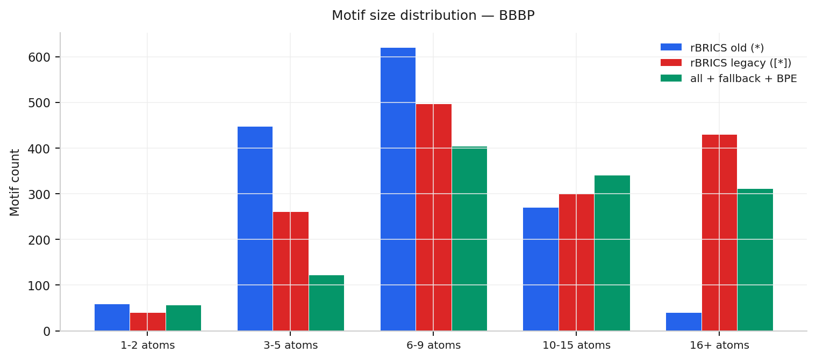
BBBP · Classification
Variant | Graphs | Vocab | ≥1% | Mean frags | Med. | Min-Max | Rules
rBRICS old (*) | 1859 | 1440 | 81 | 5.89 | 6 | 1-39 | 160
rBRICS legacy ([*]) | 1859 | 1531 | 57 | 4.43 | 4 | 1-27 | 160
all + fallback + BPE | 1859 | 1238 | 55 | 5.82 | 5 | 1-42 | 159

Slide 14
BBBP / rBRICS old (*)
Top frequent SMARTS | At. | Mols | Freq
*O* | 1 | 472 | 25.4%
*C* | 1 | 453 | 24.4%
*CC* | 2 | 361 | 19.4%
*N* | 1 | 357 | 19.2%
*c1ccccc1 | 6 | 324 | 17.4%
*C(*)=O | 2 | 292 | 15.7%
Class-skewed motif | Sup. | C0 | C1 | |Δ|
*c1ccc(F)cc1 | 65 | 3% | 102% | 98
*CC(*)F | 38 | 0% | 97% | 97
*c1ccccc1* | 246 | 7% | 104% | 97
*OC(C)(C)O* | 21 | 0% | 95% | 95
*C(=*)C(*)(C)C(*)(F) | 19 | 0% | 95% | 95
*c1ccc(*)c(*)c1* | 19 | 0% | 95% | 95
Best rule (160 total): (*CC*) ∨ (*c1ccccc1) ∨ (*C(*)=O) ∨ (*OC)

Slide 15
BBBP / rBRICS legacy ([*])
Top frequent SMARTS | At. | Mols | Freq
[*]O[*] | 1 | 415 | 22.3%
[*]N[*] | 1 | 351 | 18.9%
[*]c1ccccc1 | 6 | 324 | 17.4%
[*]C[*] | 1 | 314 | 16.9%
[*]C([*])=O | 2 | 250 | 13.4%
[*]CC | 2 | 233 | 12.5%
Class-skewed motif | Sup. | C0 | C1 | |Δ|
[*]c1ccc(F)cc1 | 65 | 3% | 102% | 98
[*]CCC=[*] | 20 | 0% | 90% | 90
[*]c1ccc2c(c1)N([*]) | 37 | 0% | 89% | 89
[*]C(F)(F)F | 39 | 5% | 92% | 87
[*]C(=O)CC | 33 | 12% | 97% | 85
[*]CCC[*] | 98 | 5% | 89% | 84
Best rule (160 total): ([*]c1ccccc1) ∨ ([*]CC) ∨ ([*]OC) ∨ ([*]CC([*])=O)

Slide 16
BBBP / all + fallback + BPE
Top frequent SMARTS | At. | Mols | Freq
*C* | 1 | 956 | 51.4%
*C(*)=O | 2 | 603 | 32.4%
*O* | 1 | 573 | 30.8%
*C | 1 | 519 | 27.9%
*N* | 1 | 384 | 20.7%
*CC | 2 | 375 | 20.2%
Class-skewed motif | Sup. | C0 | C1 | |Δ|
*C* | 956 | 34% | 154% | 119
*c1ccc(F)cc1 | 42 | 5% | 102% | 98
*CCCC(=O)c1ccc(F)cc1 | 29 | 0% | 93% | 93
*c1ccccc1F | 23 | 0% | 91% | 91
*c1ccc2c(c1)N(*)c1cc | 38 | 0% | 89% | 89
*N1CCC(*)(*)CC1 | 20 | 0% | 85% | 85
Best rule (159 total): (*C(*)=O) ∨ (*c1ccccc1) ∨ (*CO) ∨ (*CC ∧ *C(*)C)

Slide 17
hERG
Task: Classification
Following slides: overview + per-variant motif statistics

Slide 18
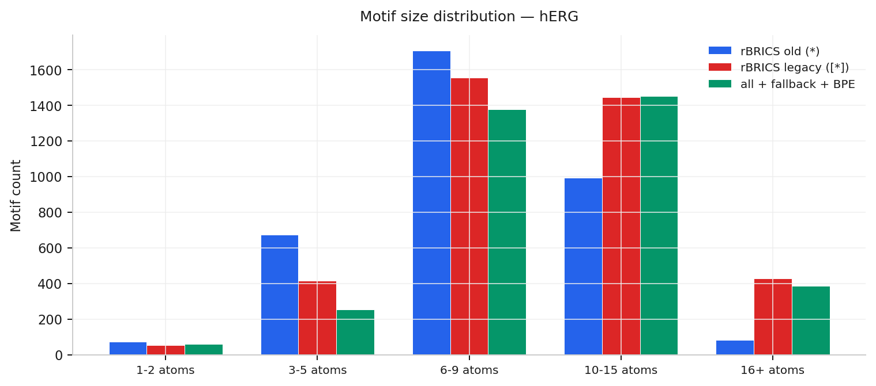
hERG · Classification
Variant | Graphs | Vocab | ≥1% | Mean frags | Med. | Min-Max | Rules
rBRICS old (*) | 9875 | 3528 | 96 | 7.26 | 7 | 1-18 | 163
rBRICS legacy ([*]) | 9875 | 3897 | 83 | 6.56 | 6 | 1-18 | 163
all + fallback + BPE | 9875 | 3529 | 64 | 6.41 | 6 | 1-22 | 160

Slide 19
hERG / rBRICS old (*)
Top frequent SMARTS | At. | Mols | Freq
*N* | 1 | 4052 | 41.0%
*C* | 1 | 3620 | 36.7%
*C(*)=O | 2 | 3086 | 31.3%
*O* | 1 | 2452 | 24.8%
*c1ccc(*)cc1 | 6 | 2010 | 20.4%
*OC | 2 | 1887 | 19.1%
Class-skewed motif | Sup. | C0 | C1 | |Δ|
*c1ocnc1C | 119 | 4% | 88% | 84
*c1nnc(*)n1C | 363 | 5% | 88% | 82
*S* | 497 | 17% | 76% | 59
*CCN(*)CC* | 184 | 16% | 73% | 57
*c1[nH]c2ccccc2c1* | 130 | 21% | 72% | 51
*NO | 105 | 71% | 21% | 50
Best rule (163 total): (*C(*)=O) ∨ (*OC) ∨ (*CCC*)

Slide 20
hERG / rBRICS legacy ([*])
Top frequent SMARTS | At. | Mols | Freq
[*]N[*] | 1 | 4037 | 40.9%
[*]C[*] | 1 | 3393 | 34.4%
[*]C([*])=O | 2 | 3047 | 30.9%
[*]O[*] | 1 | 2393 | 24.2%
[*]c1ccc([*])cc1 | 6 | 2007 | 20.3%
[*]OC | 2 | 1887 | 19.1%
Class-skewed motif | Sup. | C0 | C1 | |Δ|
[*]c1ocnc1C | 119 | 4% | 88% | 84
[*]c1nnc([*])n1C | 363 | 5% | 88% | 82
[*]S[*] | 464 | 17% | 77% | 60
[*]CCC[*] | 821 | 20% | 74% | 54
[*]CC(O)C[*] | 116 | 19% | 70% | 51
[*]NO | 105 | 71% | 21% | 50
Best rule (163 total): ([*]C([*])=O) ∨ ([*]CC[*]) ∨ ([*]CCC[*])

Slide 21
hERG / all + fallback + BPE
Top frequent SMARTS | At. | Mols | Freq
*C* | 1 | 4898 | 49.6%
*N* | 1 | 3823 | 38.7%
*C(*)=O | 2 | 3382 | 34.2%
*O* | 1 | 3134 | 31.7%
*C | 1 | 2097 | 21.2%
*c1ccc(*)cc1 | 6 | 1291 | 13.1%
Class-skewed motif | Sup. | C0 | C1 | |Δ|
*CCCSc1nnc(*)n1C | 111 | 3% | 90% | 87
*CCCSc1nnc(-c2ocnc2C | 109 | 3% | 89% | 86
*CC(O)C* | 116 | 19% | 70% | 51
*c1ccc(Cl)c(Cl)c1 | 150 | 23% | 70% | 47
*O | 363 | 68% | 22% | 47
*C12CCC(*)(CC1)OC2 | 159 | 23% | 67% | 45
Best rule (160 total): (*C(*)=O) ∨ (*c1ccccc1) ∨ (*C(F)(F)F) ∨ (*N(*)C)

Slide 22
Benzene
Task: Classification
Following slides: overview + per-variant motif statistics

Slide 23
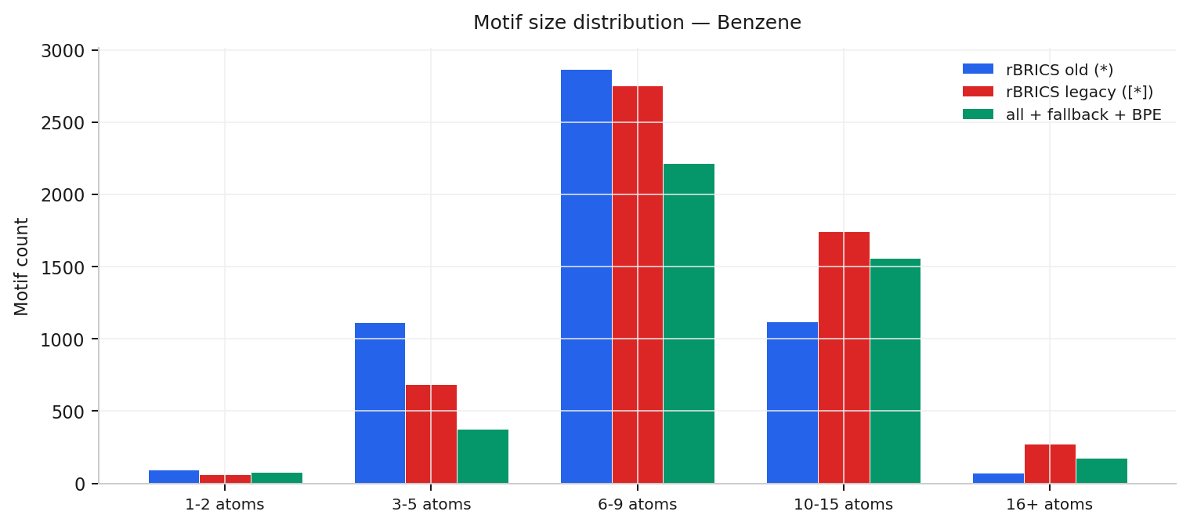
Benzene · Classification
Variant | Graphs | Vocab | ≥1% | Mean frags | Med. | Min-Max | Rules
rBRICS old (*) | 12000 | 5274 | 77 | 5.57 | 6 | 1-17 | 161
rBRICS legacy ([*]) | 12000 | 5519 | 74 | 5.32 | 5 | 1-12 | 161
all + fallback + BPE | 12000 | 4407 | 71 | 6.29 | 6 | 1-22 | 162

Slide 24
Benzene / rBRICS old (*)
Top frequent SMARTS | At. | Mols | Freq
*N* | 1 | 4632 | 38.6%
*C* | 1 | 4136 | 34.5%
*C(*)=O | 2 | 3881 | 32.3%
*O* | 1 | 2914 | 24.3%
*OC | 2 | 1759 | 14.7%
*CC | 2 | 1687 | 14.1%
Class-skewed motif | Sup. | C0 | C1 | |Δ|
*c1ccccc1 | 1655 | 0% | 94% | 94
*c1ccc(*)cc1 | 647 | 0% | 92% | 92
*c1ccccc1* | 441 | 0% | 91% | 91
*c1cccc2ccccc12 | 133 | 0% | 91% | 91
*c1ccc(*)c(*)c1 | 247 | 0% | 90% | 90
*c1ccc(F)cc1 | 382 | 0% | 90% | 90
Best rule (161 total): (*C(*)=O) ∨ (*CC) ∨ (*CC*) ∨ (*C(C)C)

Slide 25
Benzene / rBRICS legacy ([*])
Top frequent SMARTS | At. | Mols | Freq
[*]N[*] | 1 | 4621 | 38.5%
[*]C[*] | 1 | 4058 | 33.8%
[*]C([*])=O | 2 | 3875 | 32.3%
[*]O[*] | 1 | 2871 | 23.9%
[*]OC | 2 | 1759 | 14.7%
[*]CC | 2 | 1704 | 14.2%
Class-skewed motif | Sup. | C0 | C1 | |Δ|
[*]c1ccccc1 | 1655 | 0% | 94% | 94
[*]c1ccc([*])cc1 | 647 | 0% | 92% | 92
[*]c1cccc2ccccc12 | 133 | 0% | 91% | 91
[*]c1ccccc1[*] | 273 | 0% | 90% | 90
[*]c1ccc(F)cc1 | 382 | 0% | 90% | 90
[*]c1ccccc1F | 181 | 0% | 90% | 90
Best rule (161 total): ([*]C([*])=O) ∨ ([*]CC) ∨ ([*]CC[*]) ∨ ([*]C(C)C)

Slide 26
Benzene / all + fallback + BPE
Top frequent SMARTS | At. | Mols | Freq
*C* | 1 | 7385 | 61.5%
*C(*)=O | 2 | 5955 | 49.6%
*N* | 1 | 4947 | 41.2%
*O* | 1 | 3388 | 28.2%
*C | 1 | 1939 | 16.2%
*CC | 2 | 1712 | 14.3%
Class-skewed motif | Sup. | C0 | C1 | |Δ|
*c1ccccc1 | 1697 | 0% | 94% | 94
*c1ccc(*)cc1 | 632 | 0% | 92% | 92
*c1cccc(F)c1 | 126 | 0% | 92% | 92
*c1ccccc1* | 282 | 0% | 91% | 91
*c1cccc2ccccc12 | 140 | 0% | 91% | 91
*c1ccc(F)cc1 | 421 | 0% | 91% | 91
Best rule (162 total): (*C(*)=O)

Slide 27
Alkane_Carbonyl
Task: Classification
Following slides: overview + per-variant motif statistics

Slide 28
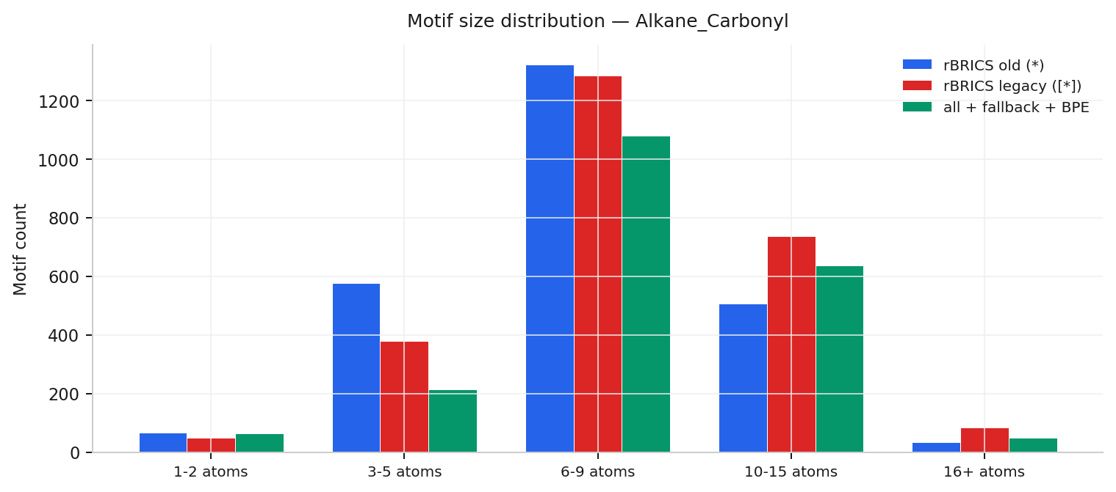
Alkane_Carbonyl · Classification
Variant | Graphs | Vocab | ≥1% | Mean frags | Med. | Min-Max | Rules
rBRICS old (*) | 4326 | 2510 | 71 | 5.76 | 6 | 1-15 | 162
rBRICS legacy ([*]) | 4326 | 2532 | 68 | 5.56 | 6 | 1-11 | 162
all + fallback + BPE | 4326 | 2042 | 68 | 6.92 | 7 | 1-21 | 160

Slide 29
Alkane_Carbonyl / rBRICS old (*)
Top frequent SMARTS | At. | Mols | Freq
*N* | 1 | 1771 | 40.9%
*C* | 1 | 1683 | 38.9%
*C(*)=O | 2 | 1084 | 25.1%
*O* | 1 | 1026 | 23.7%
*OC | 2 | 768 | 17.8%
*CC | 2 | 763 | 17.6%
Class-skewed motif | Sup. | C0 | C1 | |Δ|
*[NH2+]* | 274 | 85% | 6% | 79
*C(*)* | 75 | 105% | 28% | 77
*CC(O)C* | 55 | 82% | 7% | 75
*CO | 50 | 86% | 12% | 74
*C* | 1683 | 94% | 20% | 74
*S(*)(=O)=O | 346 | 80% | 11% | 68
Best rule (162 total): (*C(*)=O) ∨ (*CC*) ∨ (*c1ccccc1) ∨ (*S(*)(=O)=O)

Slide 30
Alkane_Carbonyl / rBRICS legacy ([*])
Top frequent SMARTS | At. | Mols | Freq
[*]N[*] | 1 | 1771 | 40.9%
[*]C[*] | 1 | 1665 | 38.5%
[*]C([*])=O | 2 | 1082 | 25.0%
[*]O[*] | 1 | 1021 | 23.6%
[*]CC | 2 | 770 | 17.8%
[*]OC | 2 | 768 | 17.8%
Class-skewed motif | Sup. | C0 | C1 | |Δ|
[*][NH2+][*] | 273 | 85% | 5% | 79
[*]CC(O)C[*] | 54 | 81% | 7% | 74
[*]CO | 50 | 86% | 12% | 74
[*]C[*] | 1665 | 91% | 21% | 70
[*]S([*])(=O)=O | 346 | 80% | 11% | 68
[*]c1noc([*])n1 | 92 | 80% | 12% | 68
Best rule (162 total): ([*]C([*])=O) ∨ ([*]OC) ∨ ([*]CC[*]) ∨ ([*]C([*])C)

Slide 31
Alkane_Carbonyl / all + fallback + BPE
Top frequent SMARTS | At. | Mols | Freq
*C* | 1 | 3138 | 72.5%
*N* | 1 | 1926 | 44.5%
*C(*)=O | 2 | 1778 | 41.1%
*O* | 1 | 1603 | 37.1%
*CC | 2 | 1151 | 26.6%
*C | 1 | 952 | 22.0%
Class-skewed motif | Sup. | C0 | C1 | |Δ|
*[NH2+]* | 276 | 85% | 5% | 80
*CC(O)C* | 54 | 81% | 7% | 74
*S(*)(=O)=O | 379 | 80% | 11% | 70
*c1noc(*)n1 | 93 | 81% | 12% | 69
*c1ccccc1F | 58 | 81% | 14% | 67
*C(F)F | 50 | 78% | 12% | 66
Best rule (160 total): (*C(*)=O) ∨ (*S(*)(=O)=O) ∨ (*N(*)C)

Slide 32
Fluoride_Carbonyl
Task: Classification
Following slides: overview + per-variant motif statistics

Slide 33
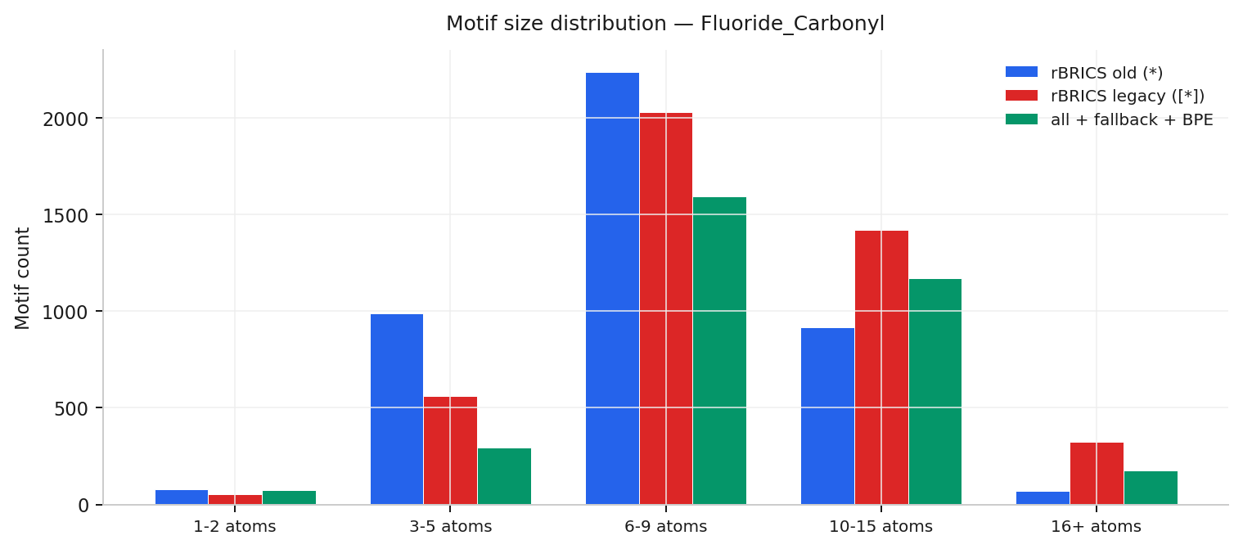
Fluoride_Carbonyl · Classification
Variant | Graphs | Vocab | ≥1% | Mean frags | Med. | Min-Max | Rules
rBRICS old (*) | 8671 | 4293 | 73 | 5.26 | 5 | 1-16 | 160
rBRICS legacy ([*]) | 8671 | 4383 | 67 | 4.92 | 5 | 1-12 | 160
all + fallback + BPE | 8671 | 3308 | 66 | 6.05 | 6 | 1-22 | 160

Slide 34
Fluoride_Carbonyl / rBRICS old (*)
Top frequent SMARTS | At. | Mols | Freq
*N* | 1 | 3094 | 35.7%
*C(*)=O | 2 | 2209 | 25.5%
*C* | 1 | 2183 | 25.2%
*O* | 1 | 1452 | 16.7%
*OC | 2 | 1296 | 14.9%
*CC | 2 | 867 | 10.0%
Class-skewed motif | Sup. | C0 | C1 | |Δ|
*C(*)* | 201 | 121% | 8% | 113
*CC=* | 138 | 97% | 0% | 97
*c1ccc(C=*)cc1 | 141 | 94% | 0% | 94
*CC=C | 555 | 93% | 0% | 93
*C=CC* | 127 | 93% | 0% | 93
*N1C(=O)C(=*)SC1=S | 88 | 92% | 0% | 92
Best rule (160 total): (*C(*)=O) ∨ (*OC) ∨ (*CC) ∨ (*c1ccc(F)cc1)

Slide 35
Fluoride_Carbonyl / rBRICS legacy ([*])
Top frequent SMARTS | At. | Mols | Freq
[*]N[*] | 1 | 3069 | 35.4%
[*]C([*])=O | 2 | 2205 | 25.4%
[*]C[*] | 1 | 2110 | 24.3%
[*]O[*] | 1 | 1420 | 16.4%
[*]OC | 2 | 1296 | 14.9%
[*]CC | 2 | 869 | 10.0%
Class-skewed motif | Sup. | C0 | C1 | |Δ|
[*]CC=[*] | 118 | 97% | 0% | 97
[*]c1ccc(C=[*])cc1 | 141 | 94% | 0% | 94
[*]CC=C | 555 | 93% | 0% | 93
[*]N1C(=O)C(=[*])SC1 | 88 | 92% | 0% | 92
[*]C(=O)C(=[*])C#N | 124 | 92% | 0% | 92
[*]=Cc1ccc(F)cc1 | 132 | 92% | 0% | 92
Best rule (160 total): ([*]C([*])=O) ∨ ([*]OC) ∨ ([*]CC) ∨ ([*]c1ccc(F)cc1)

Slide 36
Fluoride_Carbonyl / all + fallback + BPE
Top frequent SMARTS | At. | Mols | Freq
*C* | 1 | 4257 | 49.1%
*N* | 1 | 3405 | 39.3%
*C(*)=O | 2 | 3275 | 37.8%
*O* | 1 | 2358 | 27.2%
*C=* | 1 | 2097 | 24.2%
*C | 1 | 1368 | 15.8%
Class-skewed motif | Sup. | C0 | C1 | |Δ|
*C* | 4257 | 138% | 18% | 120
*C=* | 2097 | 106% | 0% | 106
*c1ccc(C=*)cc1 | 111 | 96% | 0% | 96
*=C | 798 | 94% | 0% | 94
*C(=O)C(=*)C#N | 144 | 92% | 0% | 92
*N1C(=O)C(=*)SC1=S | 98 | 92% | 0% | 92
Best rule (160 total): (*C(*)=O) ∨ (*C(F)(F)F) ∨ (*c1ccc(F)cc1)

Slide 37
Lipophilicity
Task: Regression
Following slides: overview + per-variant motif statistics

Slide 38
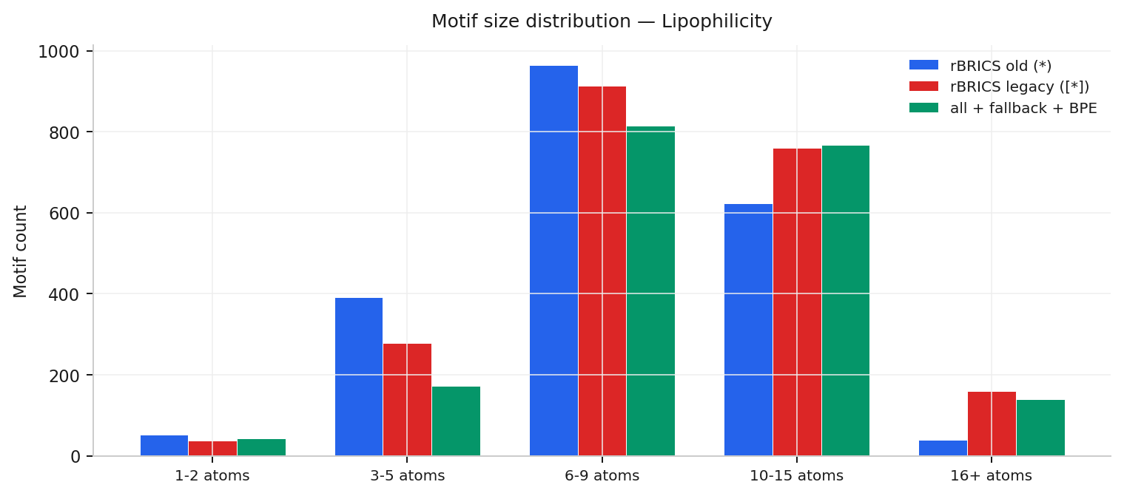
Lipophilicity · Regression
Variant | Graphs | Vocab | ≥1% | Mean frags | Med. | Min-Max | Rules
rBRICS old (*) | 4200 | 2073 | 80 | 6.56 | 7 | 1-25 | 0
rBRICS legacy ([*]) | 4200 | 2149 | 77 | 6.13 | 6 | 1-25 | 0
all + fallback + BPE | 4200 | 1935 | 64 | 6.40 | 6 | 1-40 | 0

Slide 39
Lipophilicity / rBRICS old (*)
Top frequent SMARTS | At. | Mols | Freq
*N* | 1 | 2189 | 52.1%
*C(*)=O | 2 | 1351 | 32.2%
*C* | 1 | 1322 | 31.5%
*O* | 1 | 1046 | 24.9%
*c1ccccc1 | 6 | 894 | 21.3%
*c1ccc(*)cc1 | 6 | 756 | 18.0%
Regression dataset No class-discriminative motifs (rules.json intentionally empty)

Slide 40
Lipophilicity / rBRICS legacy ([*])
Top frequent SMARTS | At. | Mols | Freq
[*]N[*] | 1 | 2184 | 52.0%
[*]C([*])=O | 2 | 1346 | 32.0%
[*]C[*] | 1 | 1267 | 30.2%
[*]O[*] | 1 | 1032 | 24.6%
[*]c1ccccc1 | 6 | 894 | 21.3%
[*]c1ccc([*])cc1 | 6 | 756 | 18.0%
Regression dataset No class-discriminative motifs (rules.json intentionally empty)

Slide 41
Lipophilicity / all + fallback + BPE
Top frequent SMARTS | At. | Mols | Freq
*C* | 1 | 2236 | 53.2%
*N* | 1 | 1901 | 45.3%
*C(*)=O | 2 | 1796 | 42.8%
*O* | 1 | 1263 | 30.1%
*c1ccccc1 | 6 | 895 | 21.3%
*C | 1 | 758 | 18.0%
Regression dataset No class-discriminative motifs (rules.json intentionally empty)

Slide 42
esol
Task: Regression
Following slides: overview + per-variant motif statistics

Slide 43
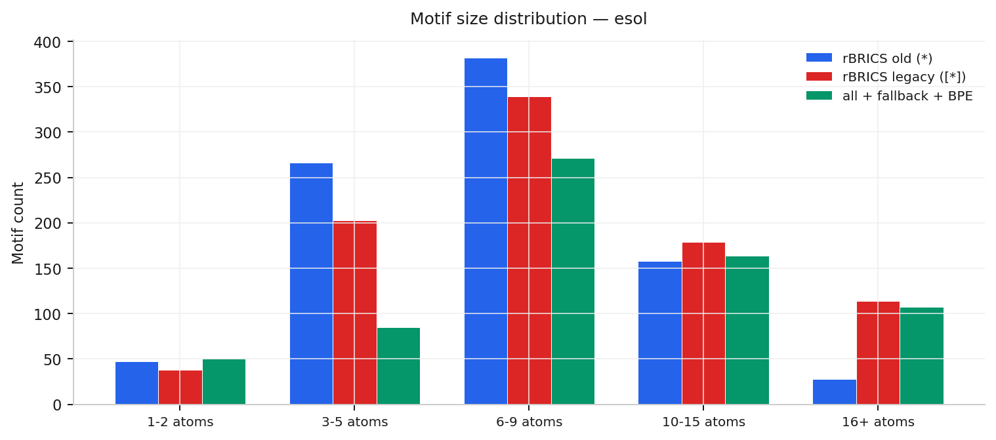
esol · Regression
Variant | Graphs | Vocab | ≥1% | Mean frags | Med. | Min-Max | Rules
rBRICS old (*) | 1128 | 881 | 38 | 3.01 | 2 | 1-13 | 0
rBRICS legacy ([*]) | 1128 | 873 | 31 | 2.64 | 2 | 1-13 | 0
all + fallback + BPE | 1128 | 677 | 40 | 3.31 | 3 | 1-15 | 0

Slide 44
esol / rBRICS old (*)
Top frequent SMARTS | At. | Mols | Freq
*CC | 2 | 179 | 15.9%
*O* | 1 | 135 | 12.0%
*c1ccccc1 | 6 | 116 | 10.3%
*C(*)=O | 2 | 103 | 9.1%
*CC* | 2 | 97 | 8.6%
*N* | 1 | 84 | 7.4%
Regression dataset No class-discriminative motifs (rules.json intentionally empty)

Slide 45
esol / rBRICS legacy ([*])
Top frequent SMARTS | At. | Mols | Freq
[*]CC | 2 | 180 | 16.0%
[*]O[*] | 1 | 127 | 11.3%
[*]c1ccccc1 | 6 | 116 | 10.3%
[*]C([*])=O | 2 | 99 | 8.8%
[*]N[*] | 1 | 84 | 7.4%
[*]C(C)C | 3 | 79 | 7.0%
Regression dataset No class-discriminative motifs (rules.json intentionally empty)

Slide 46
esol / all + fallback + BPE
Top frequent SMARTS | At. | Mols | Freq
*CC | 2 | 271 | 24.0%
*C* | 1 | 246 | 21.8%
*O* | 1 | 181 | 16.0%
*C(*)=O | 2 | 172 | 15.2%
*c1ccccc1 | 6 | 110 | 9.8%
*N* | 1 | 90 | 8.0%
Regression dataset No class-discriminative motifs (rules.json intentionally empty)

Slide 47
mutag
Task: Classification
Following slides: overview + per-variant motif statistics

Slide 48
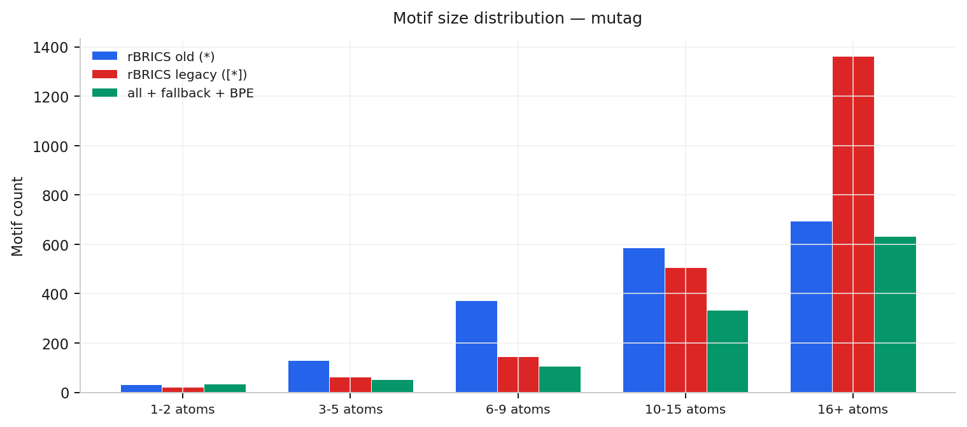
mutag · Classification
Variant | Graphs | Vocab | ≥1% | Mean frags | Med. | Min-Max | Rules
rBRICS old (*) | 2549 | 1817 | 42 | 4.30 | 3 | 1-94 | 160
rBRICS legacy ([*]) | 2549 | 2103 | 26 | 3.09 | 2 | 1-91 | 83
all + fallback + BPE | 2549 | 1160 | 35 | 6.64 | 5 | 1-98 | 175

Slide 49
mutag / rBRICS old (*)
Top frequent SMARTS | At. | Mols | Freq
*C(F)(F)F | 4 | 584 | 22.9%
*C(*)C(*)* | 2 | 447 | 17.5%
*N* | 1 | 395 | 15.5%
*C(F)C(F)C(F)C(*)F | 8 | 313 | 12.3%
*C(*)N | 2 | 187 | 7.3%
*NC(F)(F)F | 5 | 183 | 7.2%
Class-skewed motif | Sup. | C0 | C1 | |Δ|
*C(F)(F)F | 584 | 32% | 178% | 146
*C(*)(*)* | 82 | 2% | 132% | 129
*C(F)(F)C(F)(F)C(F)( | 43 | 5% | 123% | 119
*C(*)(*)F | 147 | 5% | 118% | 112
*C(F)C(F)C(*)P(N)N | 56 | 107% | 0% | 107
*C(*)* | 92 | 10% | 116% | 107
Best rule (160 total): (*C(F)(F)F) ∨ (*C(*)C(*)*) ∨ (*C1C(F)C(F)C(F)C(F)C1F) ∨ (*C(*)C(*)C(*)C(*)*)

Slide 50
mutag / rBRICS legacy ([*])
Top frequent SMARTS | At. | Mols | Freq
[*]C(F)(F)F | 4 | 584 | 22.9%
[*]N[*] | 1 | 348 | 13.7%
[*]NC(F)(F)F | 5 | 183 | 7.2%
[*]C1C(F)C(F)C(F)C(F)C | 11 | 165 | 6.5%
[*]C([*])N | 2 | 126 | 4.9%
[*]C([*])([*])F | 2 | 119 | 4.7%
Class-skewed motif | Sup. | C0 | C1 | |Δ|
[*]C(F)(F)F | 584 | 32% | 178% | 146
[*]C([*])([*])[*] | 69 | 3% | 133% | 130
[*]C(F)(F)C(F)(F)C(F | 43 | 5% | 123% | 119
[*]C([*])([*])F | 119 | 7% | 119% | 113
[*]C([*])[*] | 79 | 8% | 114% | 106
[*]C([*])N | 126 | 10% | 115% | 105
Best rule (83 total): ([*]C(F)(F)F) ∨ ([*]NC(F)(F)F) ∨ ([*]C1C(F)C(F)C(F)C(F)C1F) ∨ ([*]C(F)(F)F ∧ [*]NC(F)(F)F)

Slide 51
mutag / all + fallback + BPE
Top frequent SMARTS | At. | Mols | Freq
*C(F)(F)F | 4 | 1257 | 49.3%
*N* | 1 | 1185 | 46.5%
*C(*)(F)F | 3 | 798 | 31.3%
*F | 1 | 754 | 29.6%
*C(*)N | 2 | 630 | 24.7%
*P(F)F | 3 | 612 | 24.0%
Class-skewed motif | Sup. | C0 | C1 | |Δ|
*C(*)(F)F | 798 | 30% | 246% | 216
*C(C(F)(F)F)(C(F)(F) | 29 | 3% | 162% | 159
*C(F)(F)C(F)(F)C(F)( | 46 | 4% | 128% | 124
*N* | 1185 | 30% | 145% | 116
*C(F)(F)F | 1257 | 35% | 144% | 109
*F | 754 | 28% | 135% | 107
Best rule (175 total): (*C(F)(F)F)

Slide 52
ogbg-molhiv
Task: Classification
Following slides: overview + per-variant motif statistics

Slide 53
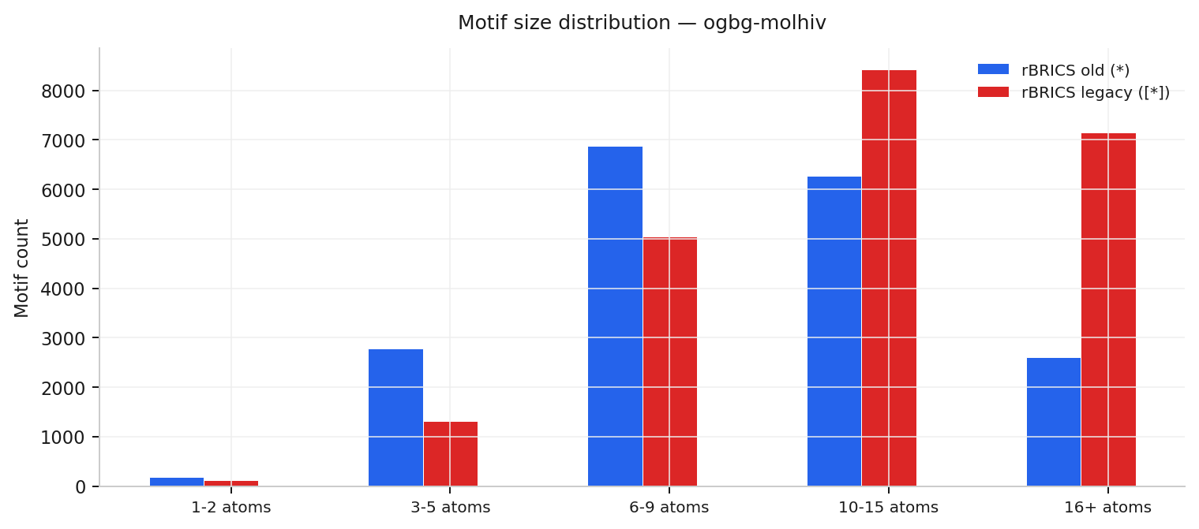
ogbg-molhiv · Classification
Variant | Graphs | Vocab | ≥1% | Mean frags | Med. | Min-Max | Rules
rBRICS old (*) | 41127 | 18716 | 50 | 5.86 | 5 | 1-84 | 162
rBRICS legacy ([*]) | 41127 | 22044 | 40 | 4.98 | 4 | 1-76 | 161
all + fallback + BPE | — | — | — | — | — | — | missing

Slide 54
ogbg-molhiv / rBRICS old (*)
Top frequent SMARTS | At. | Mols | Freq
*c1ccccc1 | 6 | 8919 | 21.7%
*N* | 1 | 8083 | 19.7%
*C(*)=O | 2 | 7904 | 19.2%
*OC | 2 | 7696 | 18.7%
*O* | 1 | 7669 | 18.6%
*C* | 1 | 7261 | 17.7%
Class-skewed motif | Sup. | C0 | C1 | |Δ|
*OC | 7696 | 152% | 5% | 147
*C(*)* | 1937 | 149% | 6% | 144
*C(C)=O | 2330 | 145% | 5% | 141
*CC(*)C(*)=O | 450 | 143% | 5% | 138
*O* | 7669 | 143% | 6% | 138
*C(F)(F)F | 594 | 135% | 1% | 134
Best rule (162 total): (*c1ccccc1) ∨ (*OC) ∨ (*CC) ∨ (*CC*)

Slide 55
ogbg-molhiv / rBRICS legacy ([*])
Top frequent SMARTS | At. | Mols | Freq
[*]c1ccccc1 | 6 | 8919 | 21.7%
[*]N[*] | 1 | 7873 | 19.1%
[*]OC | 2 | 7696 | 18.7%
[*]O[*] | 1 | 7104 | 17.3%
[*]C([*])=O | 2 | 7044 | 17.1%
[*]C[*] | 1 | 5820 | 14.2%
Class-skewed motif | Sup. | C0 | C1 | |Δ|
[*]CC[*] | 2560 | 154% | 5% | 149
[*]OC | 7696 | 152% | 5% | 147
[*]C(C)=O | 2330 | 145% | 5% | 141
[*]CCCC[*] | 630 | 162% | 22% | 140
[*]O[*] | 7104 | 144% | 5% | 138
[*]C(F)(F)F | 594 | 135% | 1% | 134
Best rule (161 total): ([*]c1ccccc1) ∨ ([*]OC) ∨ ([*]CC) ∨ ([*][N+](=O)[O-])

Slide 56
ogbg-molbace
Task: Classification
Following slides: overview + per-variant motif statistics

Slide 57
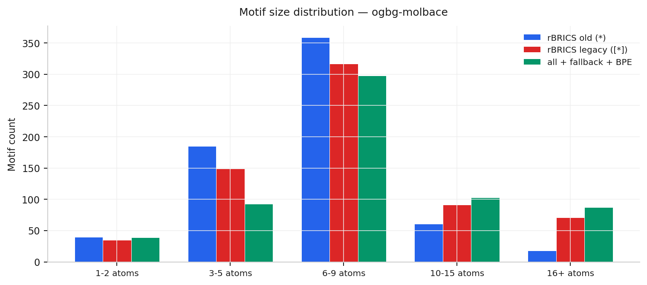
ogbg-molbace · Classification
Variant | Graphs | Vocab | ≥1% | Mean frags | Med. | Min-Max | Rules
rBRICS old (*) | 1513 | 663 | 100 | 8.16 | 8 | 1-25 | 180
rBRICS legacy ([*]) | 1513 | 663 | 88 | 7.66 | 7 | 1-25 | 180
all + fallback + BPE | 1513 | 620 | 91 | 6.18 | 6 | 1-22 | 168

Slide 58
ogbg-molbace / rBRICS old (*)
Top frequent SMARTS | At. | Mols | Freq
*N* | 1 | 788 | 52.1%
*c1cccc(*)c1 | 6 | 734 | 48.5%
*C* | 1 | 632 | 41.8%
*[NH2+]* | 1 | 515 | 34.0%
*CC(*)C(O)C* | 5 | 493 | 32.6%
*C(*)=O | 2 | 472 | 31.2%
Class-skewed motif | Sup. | C0 | C1 | |Δ|
*C(*)* | 16 | 212% | 25% | 188
*CC(C)(C)N=C(*)N* | 33 | 97% | 3% | 94
*n1c(N)nc2cc(Cl)ccc2 | 30 | 93% | 0% | 93
*c1cnc(*)c(*)c1 | 65 | 2% | 94% | 92
*C#C* | 25 | 4% | 96% | 92
*c1cc(=O)n(C)c(N)n1 | 35 | 91% | 0% | 91
Best rule (180 total): (*c1cccc(*)c1)

Slide 59
ogbg-molbace / rBRICS legacy ([*])
Top frequent SMARTS | At. | Mols | Freq
[*]N[*] | 1 | 788 | 52.1%
[*]c1cccc([*])c1 | 6 | 717 | 47.4%
[*]C[*] | 1 | 613 | 40.5%
[*][NH2+][*] | 1 | 515 | 34.0%
[*]CC([*])C(O)C[*] | 5 | 493 | 32.6%
[*]C([*])=O | 2 | 472 | 31.2%
Class-skewed motif | Sup. | C0 | C1 | |Δ|
[*]n1c(N)nc2cc(Cl)cc | 30 | 93% | 0% | 93
[*]NC1=NC(C)(C)Cc2cc | 30 | 97% | 3% | 93
[*][NH2+]C1CC2(CCC2) | 65 | 2% | 94% | 92
[*]C#C[*] | 25 | 4% | 96% | 92
[*]c1cc(=O)n(C)c(N)n | 35 | 91% | 0% | 91
[*]C1CC1[*] | 46 | 91% | 0% | 91
Best rule (180 total): ([*]c1cccc([*])c1)

Slide 60
ogbg-molbace / all + fallback + BPE
Top frequent SMARTS | At. | Mols | Freq
*C* | 1 | 540 | 35.7%
*c1cccc(*)c1 | 6 | 495 | 32.7%
*O* | 1 | 480 | 31.7%
*N* | 1 | 479 | 31.7%
*C | 1 | 398 | 26.3%
*C(*)=O | 2 | 319 | 21.1%
Class-skewed motif | Sup. | C0 | C1 | |Δ|
*C(=O)c1cc2c3c(c1)c( | 17 | 0% | 100% | 100
*[NH2+]C1CC2(CCC2)Oc | 37 | 0% | 97% | 97
*c1ccc(C2CC2c2cc(=O) | 26 | 96% | 0% | 96
*c1ccc2c(c1)C1(COC(N | 21 | 95% | 0% | 95
*NC(Cc1cccc(*)c1)C(O | 18 | 0% | 94% | 94
*n1c(N)nc2cc(Cl)ccc2 | 30 | 93% | 0% | 93
Best rule (168 total): (*c1cccc(*)c1) ∨ (*C(*)=O) ∨ (*c1cccc(*)c1 ∧ *C(C)(C)C)

Slide 61
Summary
all_fallback_bpe (green) consistently yields the smallest vocabulary
rbrics (red) often has the largest vocab; rbrics_old (blue) is similar in fragment counts
Class-skewed motifs overlap with top rules — aromatic, carbonyl, nitro groups on Mutagenicity/BBBP
ogbg-molhiv vocabs are 18–22k motifs unthresholded; phase 3 thresholding required
All 32 artifacts passed structural validation (matrix shapes, JSON syntax, SMARTS routing)

