Slide 1


Program Analysis https://www.cse.iitb.ac.in/~karkare/cs618/
Data Flow Analysis
Amey Karkare
Dept of Computer Science and Engg
IIT Kanpur
Visiting IIT Bombay
karkare@cse.iitk.ac.in
karkare@cse.iitb.ac.in

Slide 2
Recap
Optimizations
Machine Independent
Machine Dependent
Analysis
Intraprocedural
Local
Global
Interprocedural

Slide 3
Agenda
For the next few lectures
Intraprocedural Data Flow analysis
Components
Classical examples

Slide 4
Assumptions
Unless otherwise specified
Intraprocedural: Restrict to a single procedure
Input in 3–address code format

Slide 5
3 Address Code
Arrays, Pointers and
Procedures to be added
later when needed
Assignments
x = y op z
x = op y
x = y
Jump/Control statements
goto L
if x relop y goto L
Statements can have label(s)
L: …

Slide 6
Data Flow Analysis
Class of techniques to derive information about flow of data
along program execution paths
Used to answer questions such as:
whether two identical expressions evaluate to same value
used in common subexpression elimination
whether the result of an assignment is used later
used by dead code elimination

Slide 7
Data Flow Abstraction
Basic Blocks (BB)
sequence of 3-address code stmts
single entry at the first statement
single exit at the last statement
Typically we use “maximal” basic block (maximal sequence of such instructions)

Slide 8
Data Flow Abstraction
Leader: First statement of a basic block
First instruction of program (procedure)
Target of a branch (goto)
Instruction immediately following a branch

Slide 9
Special Basic Blocks
Two special BBs are added to simplify the analysis
empty (?) blocks!
Entry: Assumed to be the first block to be executed for the procedure analyzed
Exit: Assumed to be the last block to be executed

Slide 10
Data Flow Abstraction
Control Flow Graph (CFG)
A rooted directed graph G= (N, E)
N = set of BBs
including entry, exit
E = set of edges

Slide 11
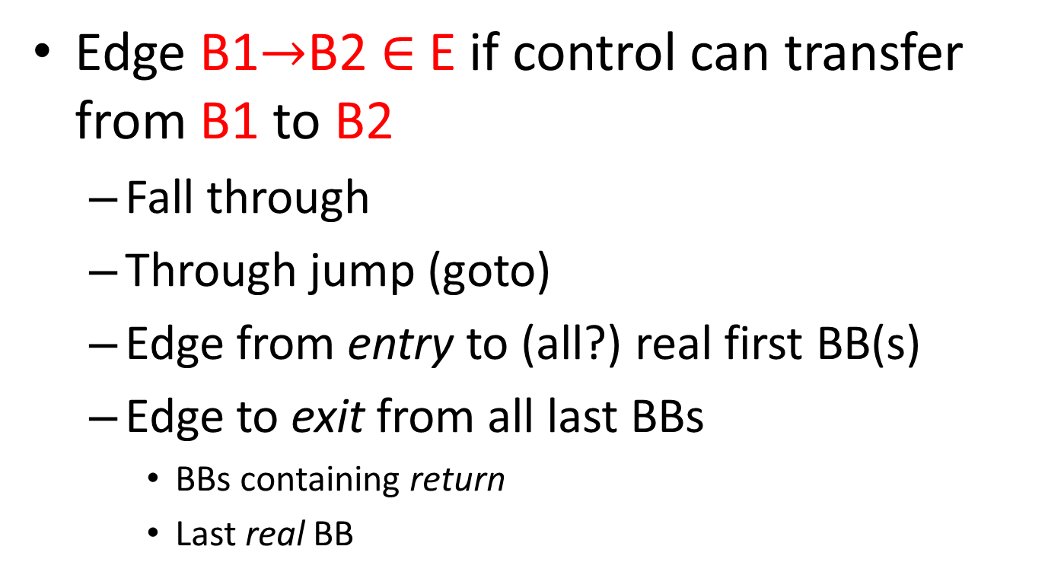
CFG Edges
Edge B1$→$B2$∈$ E if control can transfer from B1 to B2
Fall through
Through jump (goto)
Edge from entry to (all?) real first BB(s)
Edge to exit from all last BBs
BBs containing return
Last real BB

Slide 12
Data Flow Abstraction
Control Flow graph
Graph representation of paths that program may exercise during execution
Typically one graph per procedure
Graphs for separate procedures have to be combined/connected for interprocedural analysis
Later!
Single procedure, single flow graph for now.

Slide 13
Data Flow Abstraction
Input state/Output state for Stmt
Program point before/after a stmt
Denoted IN[s] and OUT[s]
Within a basic block:
Program point after a stmt is same as the program point before the next stmt

Slide 14
Data Flow Abstraction
Input state/Output state for BBs
Program point before/after a bb
Denoted IN[B] and OUT[B]
For B1 and B2:
if there is an edge from B1 to B2 in CFG, then the program point after the last stmt of B1 may be followed immediately by the program point before the first stmt of B2.

Slide 15
Data Flow Abstraction
Execution Path
p₁,p₂,…, p_{n}
p_{i} -> p_{i+1} are adjacent program points in the CFG
Infinite number of possible execution paths.
No finite upper bound on the length.
Need to Summarize the information at a program point with a finite set of facts.

Slide 16
Data Flow Schema
Data flow values associated with each program point
Summarize all possible states at that point
Domain: set of all possible data flow values
Different domains for different analysis/optimization

Slide 17
Data Flow Problem
Constraints on data flow values
Transfer constraints
Control flow constraints
AIM: To find a solution to the constraints
Multiple solutions possible
Trivial solutions,…, Exact solutions
We typically compute approximate solution, close to the exact solution
Why not exact solution?

Slide 18
Data Flow Constraints
Transfer functions
relationship between the data flow values before and after a stmt
forward functions
OUT[s] = f_{s}(IN[s])
backward functions
IN[s] = f_{s}(OUT[s])

Slide 19
Data Flow Constraints
Control flow constraints
relationship between the data flow values of two points that are related by program execution semantics
For a basic block having n statements:
IN[s_{i+1}] = OUT[s_{i}], i = 1,2,…,n-1
IN[s₁], OUT[s_{n}] to come later

Slide 20
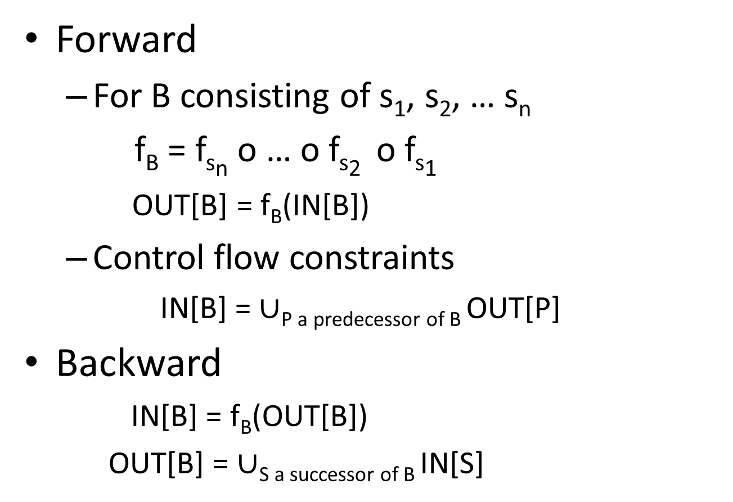
Data Flow Constraints: Basic Block
Forward
For B consisting of s₁, s₂, … s_{n}
f_{B} = f_{sn} o … o f_{s2} o f_{s1}
OUT[B] = f_{B}(IN[B])
Control flow constraints
IN[B] = $∪$_{P a predecessor of B} OUT[P]
Backward
IN[B] = f_{B}(OUT[B])
OUT[B] = $∪$_{S a successor of B} IN[S]

Slide 21
Data Flow Equations
Typical Equation
out[s] = in[s] – kill[s] U gen[s]
gen(s): information generated
kill(s) : information killed
For example:
a = b * c // generates expression b*c
c = 5 // kills expression b*c
d = b * c // is b*c redundant here?

Slide 22
Analysis of Structured Programs
Reaching Definitions Analysis
definition of a variable x :
x = …something…
Could be more complex (e.g. through pointers, references, implicit)
definition d reaches a point p if
there is a path from the point immediately following d to p
d is not “killed” along that path
“Kill” means redefinition of the left hand side (x in the above case)

Slide 23
Analysis of Structured Programs
d: x = y+z
s1
out(s1) = in(s1) - kill(s1) U gen(s1)
gen(s1) = {d}
kill(s1) = D_{x} – {d} // D_{x} : set of all defs of x
kill(s1) = D_{x} will also work here!
But may not work in general!

Slide 24
Analysis of Structured Programs
S
S1
S2
gen(s) = gen(s2) U (gen(s1) – kill(s2))
kill(s) = kill(s2) U (kill(s1) – gen(s2))
in(s1) = in(s)
in(s2) = out(s1)
out(s) = out(s2)

Slide 25
Analysis of Structured Programs
S
S1
S2
gen(s) = gen(s1) U gen(s2)
kill(s) = kill(s1) ∩ kill(s2)
in(s1) = in(s2) = in(s)
out(s) = out(s1) U out(s2)

Slide 26
Analysis of Structured Programs
S
S1
gen(s) = gen(s1)
kill(s) = kill(s1)
in(s1) = in(s) U gen(s1)
out(s) = out(s1)

Slide 27
Conservative Analysis
S
S1
S2
Assumption: All paths are feasible.
Consider: if (true) s1; else s2
s2 is never executed
gen(s) = gen(s1) ⊆ gen(s1) ∪ gen(s2)
kill(s) = kill(s1) ⊇ kill(s1) ∩ kill(s2)

Slide 28
Conservative Analysis
S
S1
S2
Thus: true gen (s) ⊆ analysis gen(s)
true kill (s) ⊇ analysis kill(s)
True is what is computed at run time
This is SAFE estimate
prevents optimization
but no wrong optimization

Slide 29
Recap : Reaching Definitions
Reaching Definitions Analysis
definition of a variable x :
x = …something…
Could be more complex (e.g. through pointers, references, implicit)
definition d reaches a point p if
there is a path from the point immediately following d to p
d is not “killed” along that path
“Kill” means redefinition of the left hand side (x in the above case)

Slide 30
Agenda
Intraprocedural Data Flow analysis
Classical examples
Reaching Defs
Available Expressions

Slide 31
Reaching Definitions
A definition d can reach the start of a block from any of its predecessor
it reaches the end of some predecessor
in(B) = ∪_{P is pred of B} out(P)
A definition d reaches end of a block
either it is generated in the block
or it reaches block and not killed
out(B) = in(B) – kill(B) ∪ gen(B)

Slide 32
Reaching Definitions
Kill & gen known for each block.
A program with N blocks has 2N equations with 2N unknowns
solution is possible.
iterative approach (on next slide)

Slide 33
for each block B {
out(B) = ϕ;
}
out(Entry) = ϕ; // note this for later discussion
change = true;
while (change) {
change = false;
for each block B other than Entry {
in(B) = ∪ _{P is pred of B} out(P);
oldOut = out(B);
out(B) = in(B) - kill(B) ∪ gen(B);
if (out(B) != oldOut) then {
change = true;
}
}
}

Slide 34
Reaching Definitions
ENTRY
BLOCK | GEN | KILL
B1 | {d1,d2,d3} | {d4,d7,d5,d6}
B2 | {d4,d5} | {d1,d7,d2}
B3 | {d6} | {d3}
B4 | {d7} | {d1,d4}
B1
d1: i = m – 1
d2: j = n
d3: a = u1
B2
d4: i = i - 1
d5: j = j - 1
B3
d6: a = u2
B4
d7: i = u3
EXIT

Slide 35
Reaching Definitions
 |  | B1 | B2 | B3 | B4
init | In | - | - | - | -
 | Out | ϕ | ϕ | ϕ | ϕ
pass1 | In
 | Out
pass2 | In
 | Out
pass3 | In
 | Out
ENTRY
B1
d1: i = m – 1
d2: j = n
d3: a = u1
B2
d4: i = i - 1
d5: j = j - 1
B3
d6: a = u2
B4
d7: i = u3
EXIT

Slide 36
Reaching Definitions
 |  | B1 | B2 | B3 | B4
init | In | - | - | - | -
 | Out | ϕ | ϕ | ϕ | ϕ
pass1 | In | ϕ
 | Out | d1,d2,d3
pass2 | In
 | Out
pass3 | In
 | Out
ENTRY
B1
d1: i = m – 1
d2: j = n
d3: a = u1
B2
d4: i = i - 1
d5: j = j - 1
B3
d6: a = u2
B4
d7: i = u3
EXIT

Slide 37
Reaching Definitions
 |  | B1 | B2 | B3 | B4
init | In | - | - | - | -
 | Out | ϕ | ϕ | ϕ | ϕ
pass1 | In | ϕ | d1,d2,d3
 | Out | d1,d2,d3 | d3,d4,d5
pass2 | In
 | Out
pass3 | In
 | Out
ENTRY
B1
d1: i = m – 1
d2: j = n
d3: a = u1
B2
d4: i = i - 1
d5: j = j - 1
B3
d6: a = u2
B4
d7: i = u3
EXIT

Slide 38
Reaching Definitions
 |  | B1 | B2 | B3 | B4
init | In | - | - | - | -
 | Out | ϕ | ϕ | ϕ | ϕ
pass1 | In | ϕ | d1,d2,d3 | d3,d4, d5 | d3,d4, d5,d6
 | Out | d1,d2,d3 | d3,d4,d5 | d4,d5, d6 | d3,d5, d6,d7
pass2 | In
 | Out
pass3 | In
 | Out
ENTRY
B1
d1: i = m – 1
d2: j = n
d3: a = u1
B2
d4: i = i - 1
d5: j = j - 1
B3
d6: a = u2
B4
d7: i = u3
EXIT

Slide 39
Reaching Definitions
 |  | B1 | B2 | B3 | B4
init | In | - | - | - | -
 | Out | ϕ | ϕ | ϕ | ϕ
pass1 | In | ϕ | d1,d2,d3 | d3,d4, d5 | d3,d4, d5,d6
 | Out | d1,d2,d3 | d3,d4,d5 | d4,d5, d6 | d3,d5, d6,d7
pass2 | In | ϕ | d1,d2,d3,d5, d6,d7 | d3,d4, d5,d6 | d3,d4, d5,d6
 | Out | d1,d2,d3 | d3,d4, d5,d6 | d4,d5, d6 | d3,d5, d6,d7
pass3 | In
 | Out
ENTRY
B1
d1: i = m – 1
d2: j = n
d3: a = u1
B2
d4: i = i - 1
d5: j = j - 1
B3
d6: a = u2
B4
d7: i = u3
EXIT

Slide 40
Reaching Definitions
 |  | B1 | B2 | B3 | B4
init | In | - | - | - | -
 | Out | ϕ | ϕ | ϕ | ϕ
pass1 | In | ϕ | d1,d2,d3 | d3,d4, d5 | d3,d4, d5,d6
 | Out | d1,d2,d3 | d3,d4,d5 | d4,d5, d6 | d3,d5, d6,d7
pass2 | In | ϕ | d1,d2,d3,d5, d6,d7 | d3,d4, d5,d6 | d3,d4, d5,d6
 | Out | d1,d2,d3 | d3,d4, d5,d6 | d4,d5, d6 | d3,d5, d6,d7
pass3 | In | ϕ | d1,d2,d3,d5, d6,d7 | d3,d4, d5,d6 | d3,d4, d5,d6
 | Out | d1,d2,d3 | d3,d4, d5,d6 | d4,d5, d6 | d3,d5, d6,d7
ENTRY
B1
d1: i = m – 1
d2: j = n
d3: a = u1
B2
d4: i = i - 1
d5: j = j - 1
B3
d6: a = u2
B4
d7: i = u3
EXIT

Slide 41
Reaching Definitions: Bitvectors
d1 | d2 | d3 | d4 | d5 | d6 | d7
bits for each definition
ENTRY
a |  | B1 | B2 | B3 | B4
init | In | - | - | - | -
 | Out | 0000000 | 0000000 | 0000000 | 0000000
pass1 | In | 0000000 | 1110000 | 0011100 | 0011110
 | Out | 1110000 | 0011100 | 0001110 | 0010111
pass2 | In | 0000000 | 1110111 | 0011110 | 0011110
 | Out | 1110000 | 0011110 | 0001110 | 0010111
pass3 | In | 0000000 | 1110111 | 0011110 | 0011110
 | Out | 1110000 | 0011110 | 0001110 | 0010111
B1
d1: i = m – 1
d2: j = n
d3: a = u1
B2
d4: i = i - 1
d5: j = j - 1
B3
d6: a = u2
B4
d7: i = u3
EXIT

Slide 42
Reaching Definitions: Bitvectors
in(B) = ∪_{P is pred of B} out(P)
out(B) = in(B) –kill(B) ∪ gen(B)
With bit vectors,
in(B) = ∨_{P is pred of B} out(P)
out(B) = (in(B) ∧ ¬kill(B)) ∨ gen(B)
Bitwise ∧, ∨, ¬ operations.

Slide 43
Reaching Definitions: Application
Constant Folding
While changes occur {
for all the stmts S of the program {
for each operand B of S {
if there is a unique definition of B
that reaches S and is a constant C {
replace B by C in S;
if all operands of S are constant {
replace rhs by eval(rhs);
mark definition as constant;
}}}}}

Slide 44
Reaching Definitions: Summary
For a basic block B:
gen = { d_{x} | d_{x} in B defines variable x and is not followed by another definition of x in B}
kill = { d_{x} | block contains some definition of x }
in(B) = ∪_{P is pred of B} out(P)
out(B) = in(B) –kill(B) ∪ gen(B)
meet ( Λ ) operator: The operator to combine information coming along different predecessors is ∪
What about ENTRY block?

Slide 45
Reaching Definitions: Summary
Entry block has to be initialized specially:
out(B_{entry}) = Entry Info
Entry Info = ϕ
A better entry info could be:
Entry Info = { x = undefined | x is a variable}
Why?

