Slide 1


Program Analysis https://www.cse.iitb.ac.in/~karkare/cs618/
Foundations of
Data Flow Analysis
Amey Karkare
Dept of Computer Science and Engg
IIT Kanpur
Visiting IIT Bombay
karkare@cse.iitk.ac.in
karkare@cse.iitb.ac.in

Slide 2
Taxonomy of Dataflow Problems
Categorized along several dimensions
the information they are designed to provide
the direction of flow
confluence operator
Four kinds of dataflow problems, distinguished by
the operator used for confluence or divergence
data flows backward or forward

Slide 3
Taxonomy of Dataflow Problems
Confluence→ Direction↓ | ∪ | ∩
Forward | Reaching Definition | Available Expressions
Backward | Live Variables | Very Busy Expressions

Slide 4
When does Data Flow Analysis Works?
Suitable initial values and boundary conditions
Suitable domain of values
Bounded, Finite
Suitable meet operator
Suitable flow functions
monotonic, closed under composition
But what is “SUITABLE” ?

Slide 5
Why Data Flow Analysis Works?
Suitable initial values and boundary conditions
Suitable domain of values
Bounded, Finite
Suitable meet operator
Suitable flow functions
monotonic, closed under composition
But what is “SUITABLE” ?
Lattice Theory

Slide 6
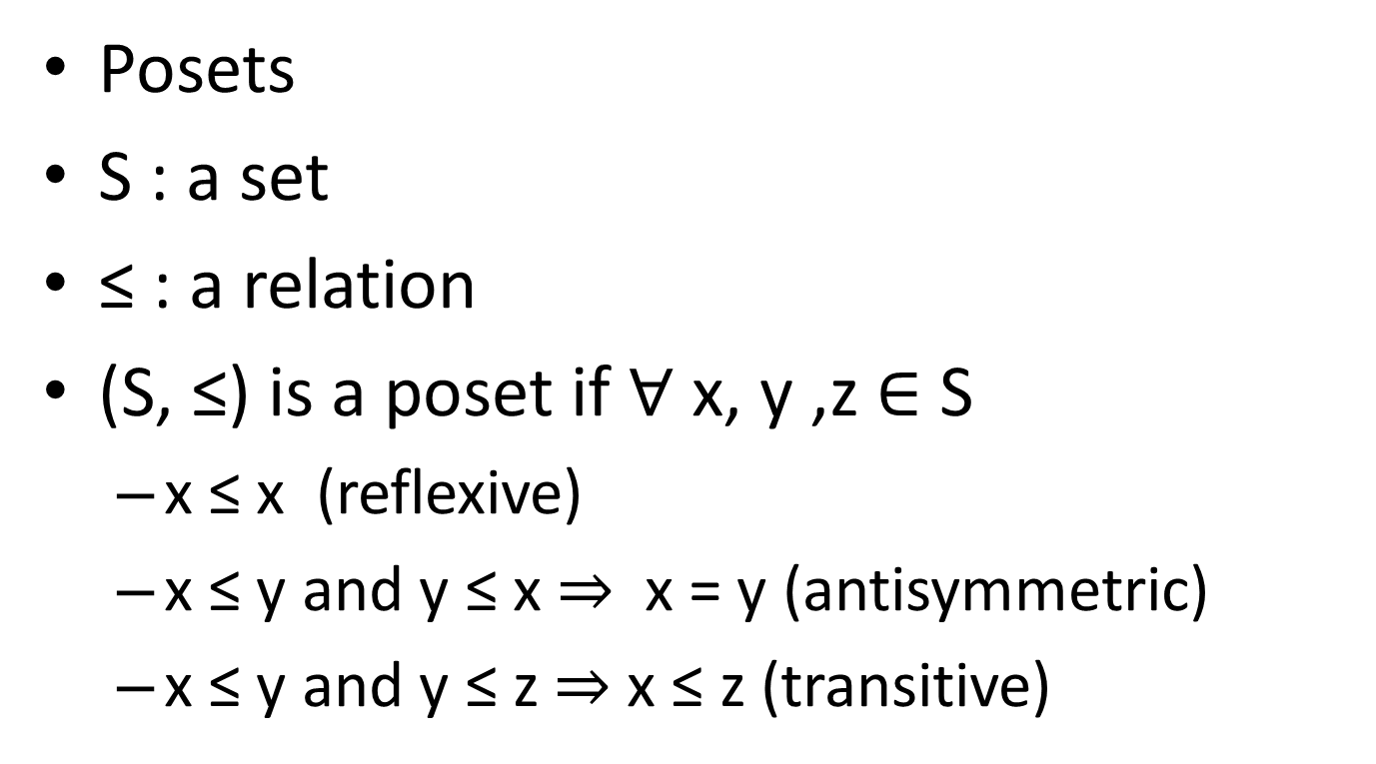
Partially Ordered Sets
Posets
S : a set
≤ : a relation
(S, ≤) is a poset if $∀$ x, y ,z $∈$ S
x ≤ x (reflexive)
x ≤ y and y ≤ x ⇒ x = y (antisymmetric)
x ≤ y and y ≤ z ⇒ x ≤ z (transitive)

Slide 7
Chain
Linear Ordering
Poset where every pair of elements is comparable
x1 ≤ x2 ≤ … ≤ xk is a chain of length k
We are interested in chains of finite length

Slide 8
Observation
Any finite nonempty subset of a poset has minimal and maximal elements
Any finite nonempty chain has unique minimum and maximum elements

Slide 9
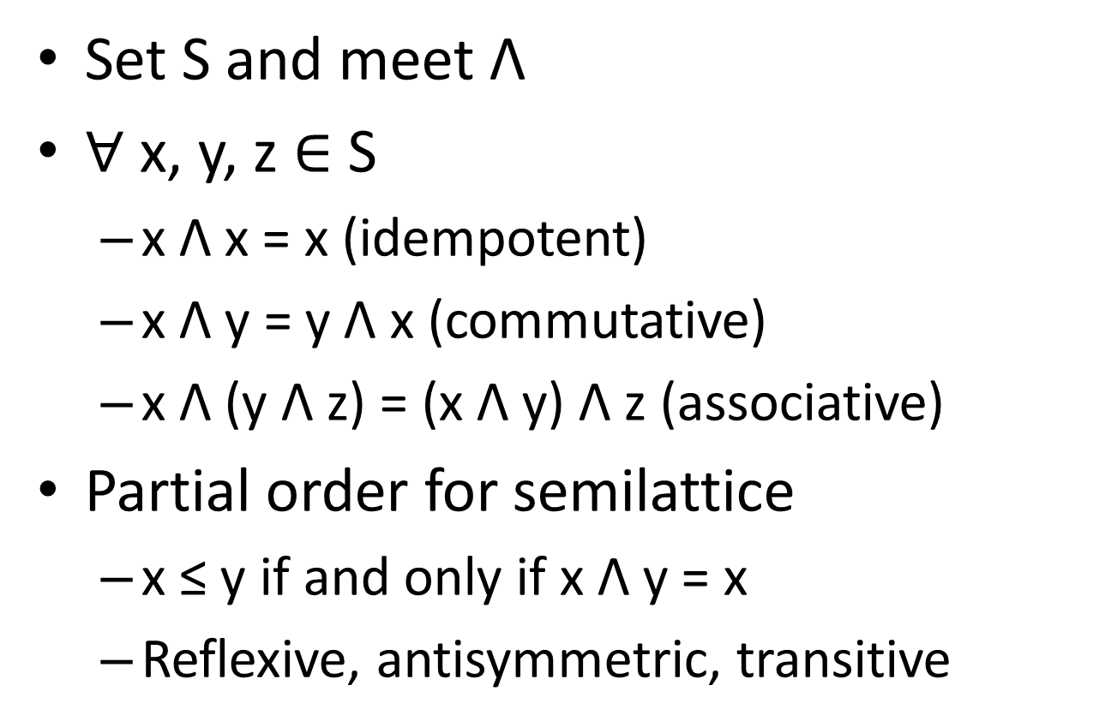
Semilattice
Set S and meet Λ
$∀$ x, y, z $∈$ S
x Λ x = x (idempotent)
x Λ y = y Λ x (commutative)
x Λ (y Λ z) = (x Λ y) Λ z (associative)
Partial order for semilattice
x ≤ y if and only if x Λ y = x
Reflexive, antisymmetric, transitive

Slide 10
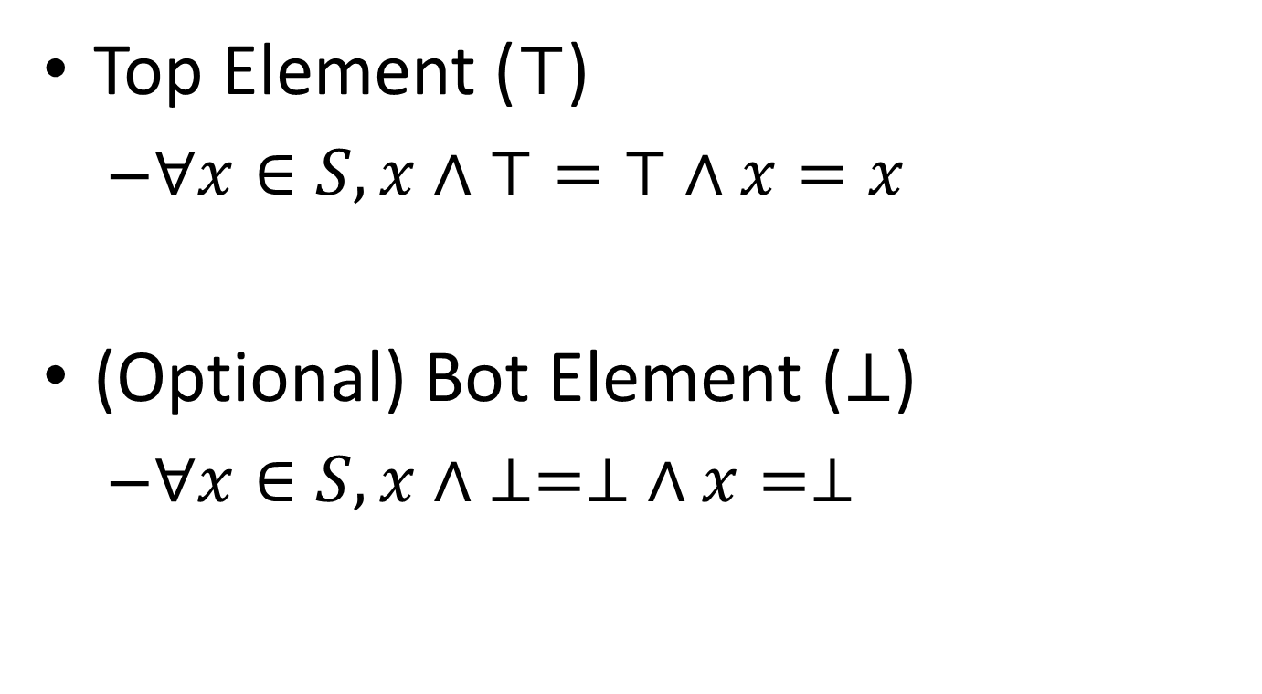
Border Element
Top Element ($⊤$)
$∀x∈S, x∧⊤=⊤∧x=x$
(Optional) Bot Element ($⊥$)
$∀x∈S, x∧ ⊥=⊥ ∧x=⊥$

Slide 11
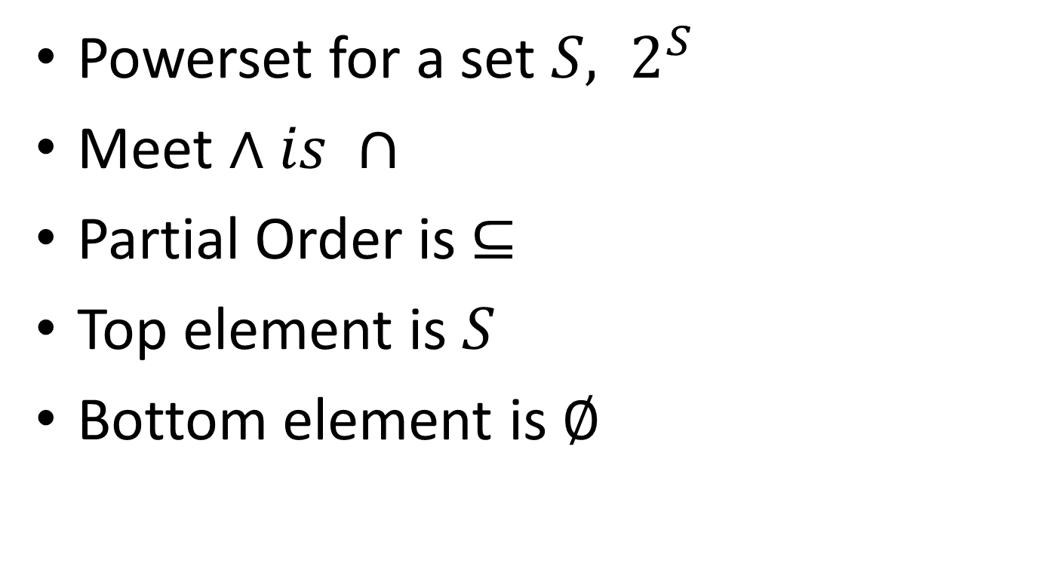
Familiar (semi)lattices
Powerset for a set ${S, 2}^{S}$
Meet $∧is ∩$
Partial Order is $⊆$
Top element is $S$
Bottom element is $∅$

Slide 12
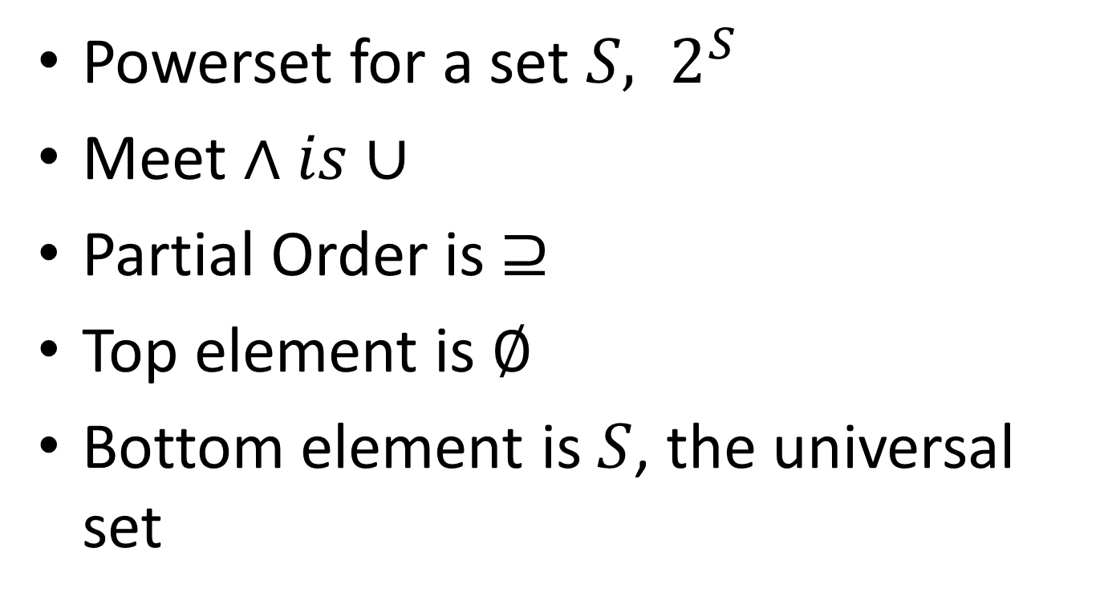
Familiar (semi)lattices
Powerset for a set ${S, 2}^{S}$
Meet $∧is∪$
Partial Order is $⊇$
Top element is $∅$
Bottom element is $S$, the universal set

Slide 13
Greatest Lower bound
glb of x and y is an element g s.t.
g ≤ x
g ≤ y
If z ≤ x and z ≤ y then z ≤ g
x Λ y is glb of x and y (Prove!)

Slide 14
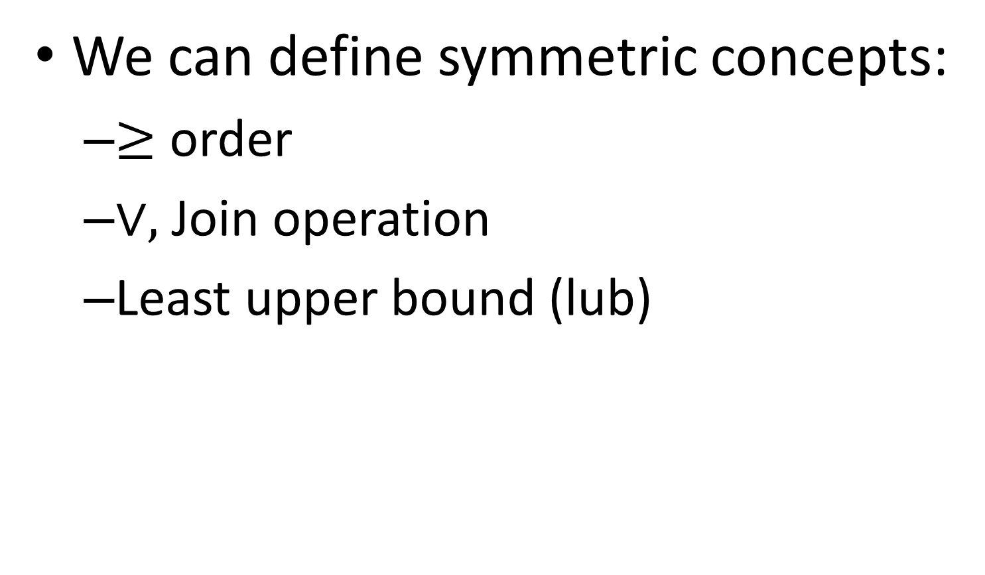
Semi (?)-Lattice
We can define symmetric concepts:
$≥$ order
$∨,$Join operation
Least upper bound (lub)

Slide 15
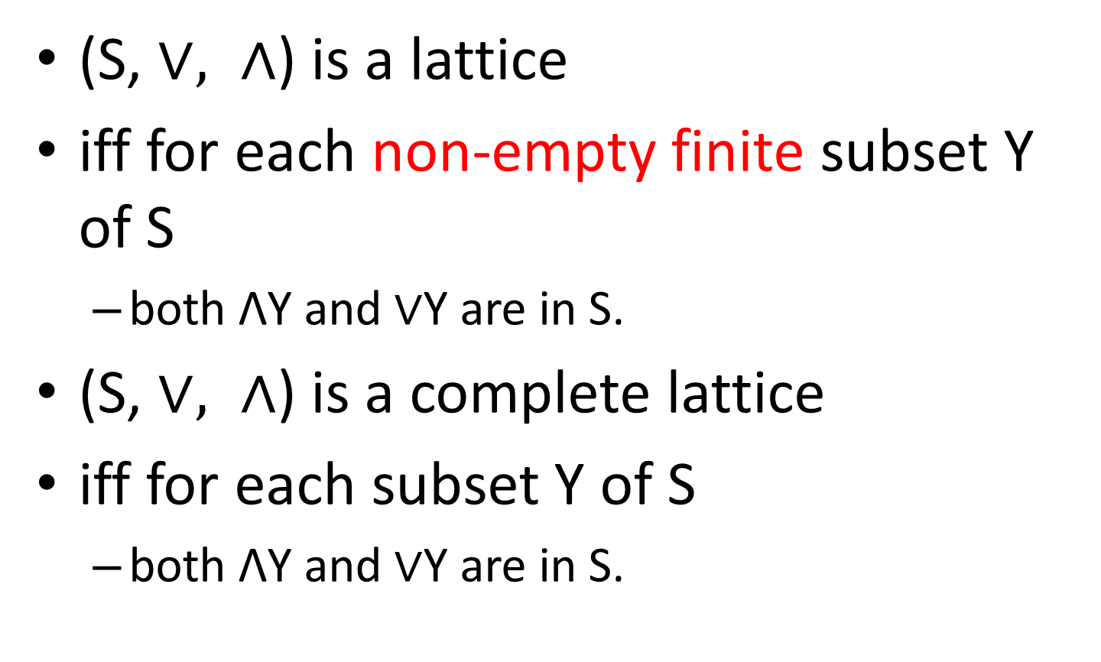
Lattice
(S, $∨, ∧$) is a lattice
iff for each non-empty finite subset Y of S
both ΛY and $∨$Y are in S.
(S, $∨, ∧$) is a complete lattice
iff for each subset Y of S
both ΛY and $∨$Y are in S.

Slide 16
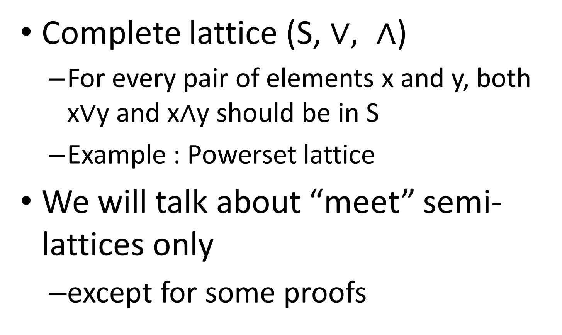
Lattice
Complete lattice (S, $∨, ∧$)
For every pair of elements x and y, both x$∨$y and x$∧$y should be in S
Example : Powerset lattice
We will talk about “meet” semi-lattices only
except for some proofs

Slide 17
Lattice Diagrams
Graphical view of posets
Elements = nodes in the graph
If x < y then x is depicted lower than y in the diagram
An edge between x and y (x lower than y) implies x < y and no other element z s.t. x < z < y (i.e. transitivity excluded)

Slide 18
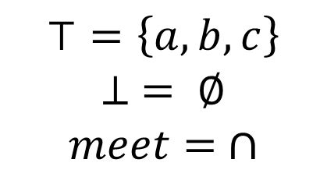
Lattice Diagram
$$⊤=\left\{a,b,c\right\}$$
$$⊥ = ∅$$
$$meet= ∩$$
{a,b,c}
{a,b}
{c,a}
{b,c}
{b}
{a}
{c}
{}
Lattice of superset relation
x Λ y (glb): the highest z for which there are paths downward from both x and y.

Slide 19
What if we have a large number of elements?
Combine simple lattices to build a complex one
Superset lattices for singletons
Combine to form superset lattice for multi-element sets
{a}
{b}
{c}
{}
{}
{}

Slide 20
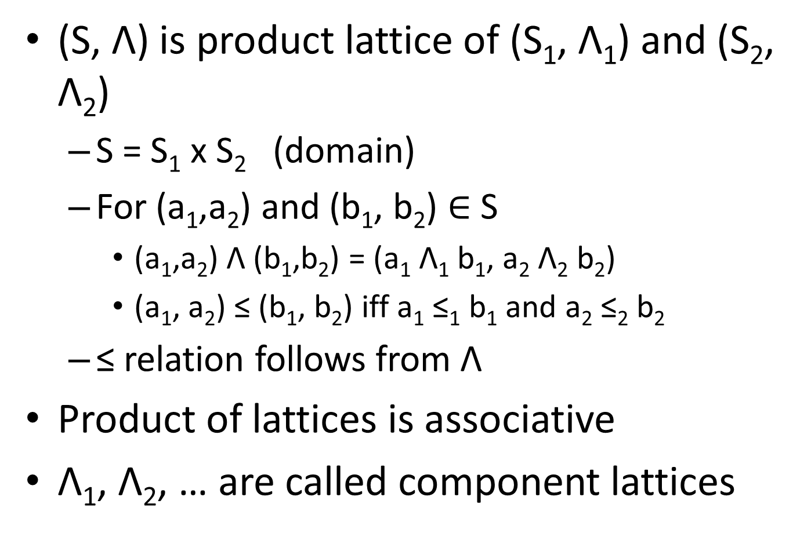
Product Lattice
(S, Λ) is product lattice of (S₁, Λ₁) and (S₂, Λ₂)
S = S₁ x S₂ (domain)
For (a₁,a₂) and (b₁, b₂) $∈$ S
(a₁,a₂) Λ (b₁,b₂) = (a₁ Λ₁ b₁, a₂ Λ₂ b₂)
(a₁, a₂) ≤ (b₁, b₂) iff a₁ ≤₁ b₁ and a₂ ≤₂ b₂
≤ relation follows from Λ
Product of lattices is associative
Λ₁, Λ₂, … are called component lattices

Slide 21
Product Lattice
{a}
{b}
{c}
{a,b,c}
{a,b}
{a,c}
{b,c}
{b}
{a}
{}
{}
{}
{c}
{}

Slide 22
Height of a Semilattice
Length of a chain x1 ≤ x2 ≤ … ≤ xk is k
K = max over length of all chains in the semilattice
Height of semilattice = K-1

Slide 23
Data Flow Analysis Framework
(D, S, Λ, F)
D: direction, Forward or Backward
(S, Λ): Semilattice Domain and meet
F: family of transfer functions, S->S

Slide 24
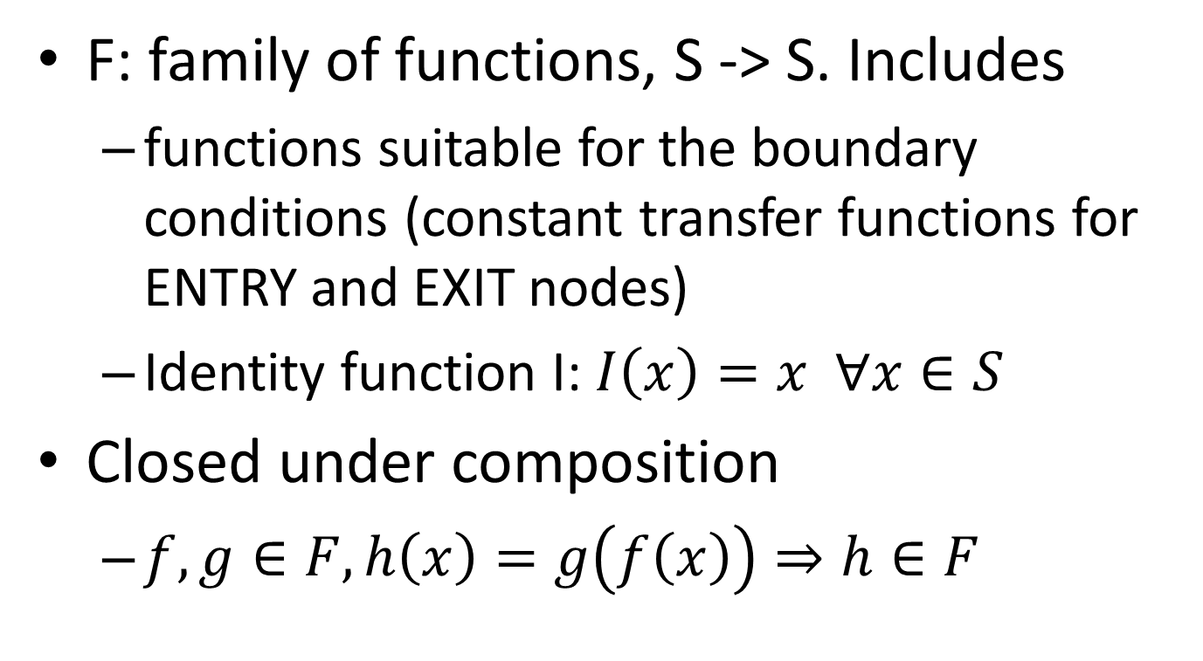
Transfer Functions
F: family of functions, S -> S. Includes
functions suitable for the boundary conditions (constant transfer functions for ENTRY and EXIT nodes)
Identity function I: $I\left(x\right)=x ∀x∈S$
Closed under composition
$f, g∈F, h\left(x\right)=g\left(f\left(x\right)\right)⇒h∈F$

Slide 25
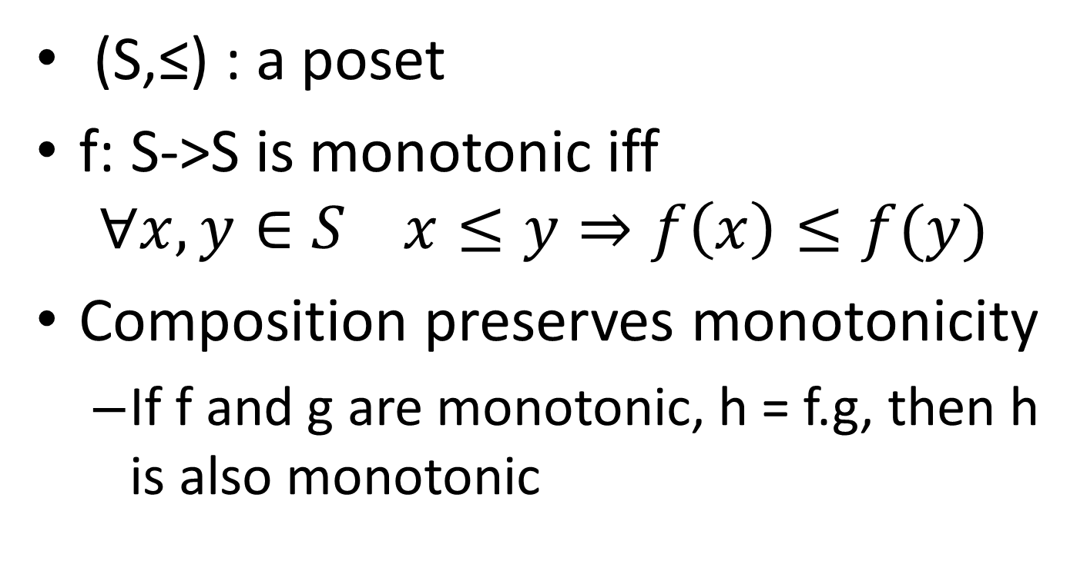
Monotonic Functions
(S,≤) : a poset
f: S->S is monotonic iff
$$∀x, y∈S x≤y⇒f\left(x\right)≤f(y)$$
Composition preserves monotonicity
If f and g are monotonic, h = f.g, then h is also monotonic

Slide 26
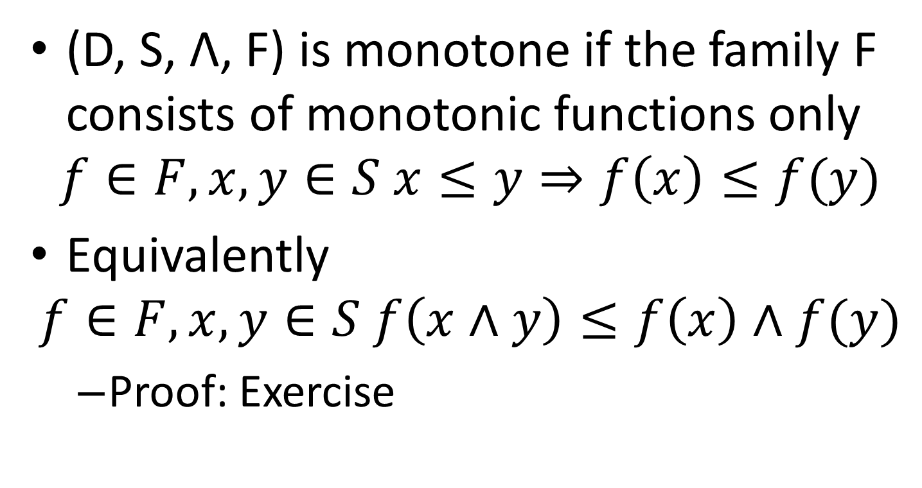
Monotone Frameworks
(D, S, Λ, F) is monotone if the family F consists of monotonic functions only
$$f∈F, x, y∈S x≤y⇒f\left(x\right)≤f(y)$$
Equivalently
$$f∈F, x, y∈S f\left(x∧y\right)≤f\left(x\right)∧f(y)$$
Proof: Exercise

Slide 27
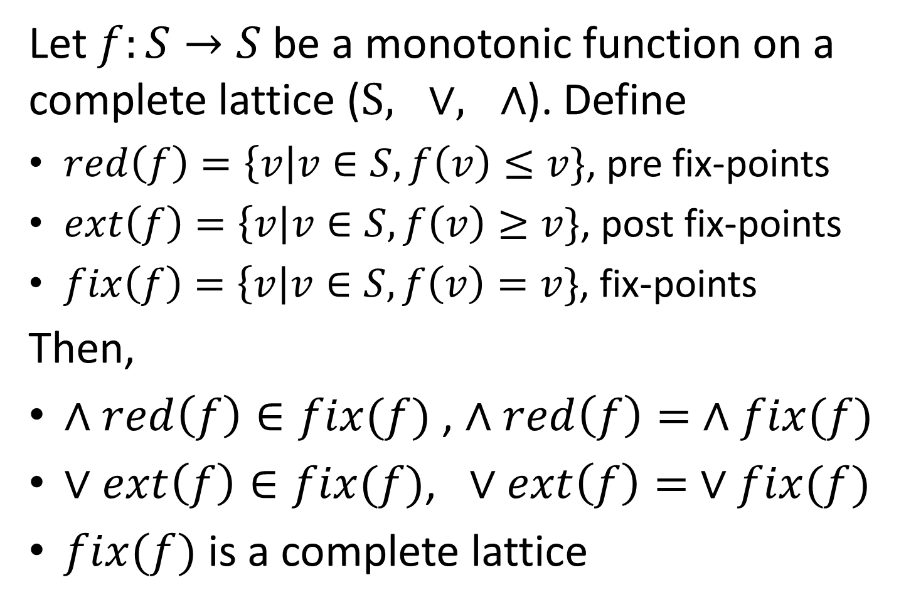
Knaster-Tarski Fixed Point Theorem
Let $f:S→S$be a monotonic function on a complete lattice ($S, ∨, ∧$). Define
$red\left(f\right)=\left\{v\right|v∈S, f\left(v\right)≤v\}$, pre fix-points
$ext\left(f\right)=\left\{v\right|v∈S, f\left(v\right)≥v\}$, post fix-points
$fix\left(f\right)=\left\{v\right|v∈S, f\left(v\right)=v\}$, fix-points
Then,
$∧red\left(f\right)∈fix(f)$ , $∧red\left(f\right)= ∧fix(f)$
$∨ext\left(f\right)∈fix(f)$, $∨ext\left(f\right)= ∨fix(f)$
$fix(f)$ is a complete lattice

Slide 28
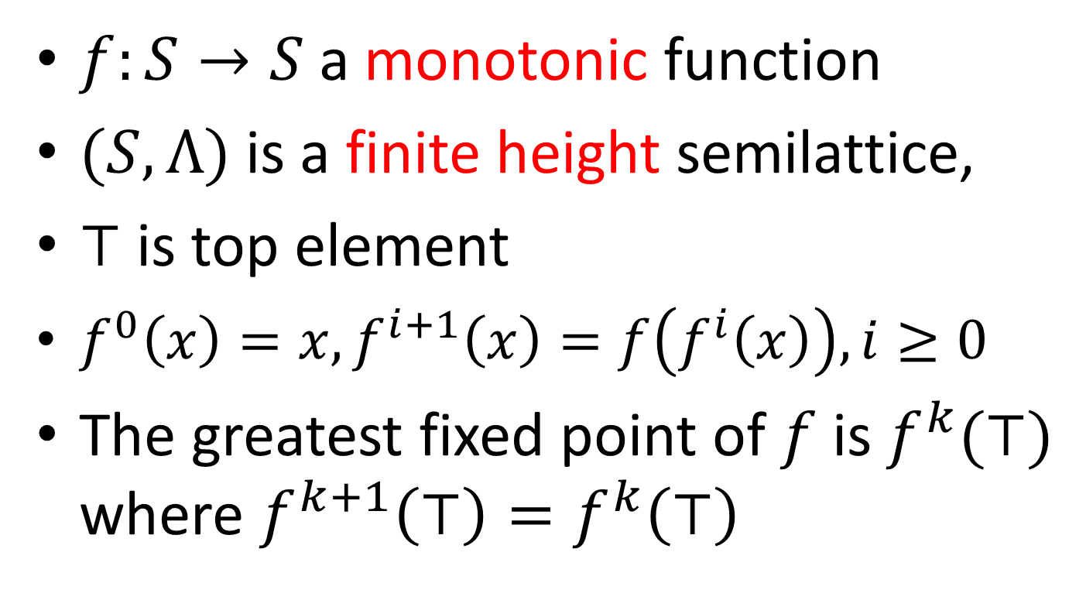
Application of Fixed Point Theorem
$f:S→S$ a monotonic function
$(S, Λ)$is a finite height semilattice,
$⊤$ is top element
$f^{0}\left(x\right)=x, f^{i+1}\left(x\right)=f\left(f^{i}\left(x\right)\right), i≥0$
The greatest fixed point of $f$ is $f^{k}(⊤)$ where $f^{k+1}\left(⊤\right)=f^{k}\left(⊤\right)$

Slide 29
Fixed Point Algorithm
// monotonic f on a meet semilattice
x := ⊤ ;
while (x != f(x)) x := f(x);
return x;

