Slide 1


Program Analysis https://www.cse.iitb.ac.in/~karkare/cs618/
Foundations of
Data Flow Analysis (contd …)
Amey Karkare
Dept of Computer Science and Engg
IIT Kanpur
Visiting IIT Bombay
karkare@cse.iitk.ac.in
karkare@cse.iitb.ac.in

Slide 2
Acknowledgement
Slides based on the material at http://infolab.stanford.edu/~ullman/dragon/w06/w06.html

Slide 3
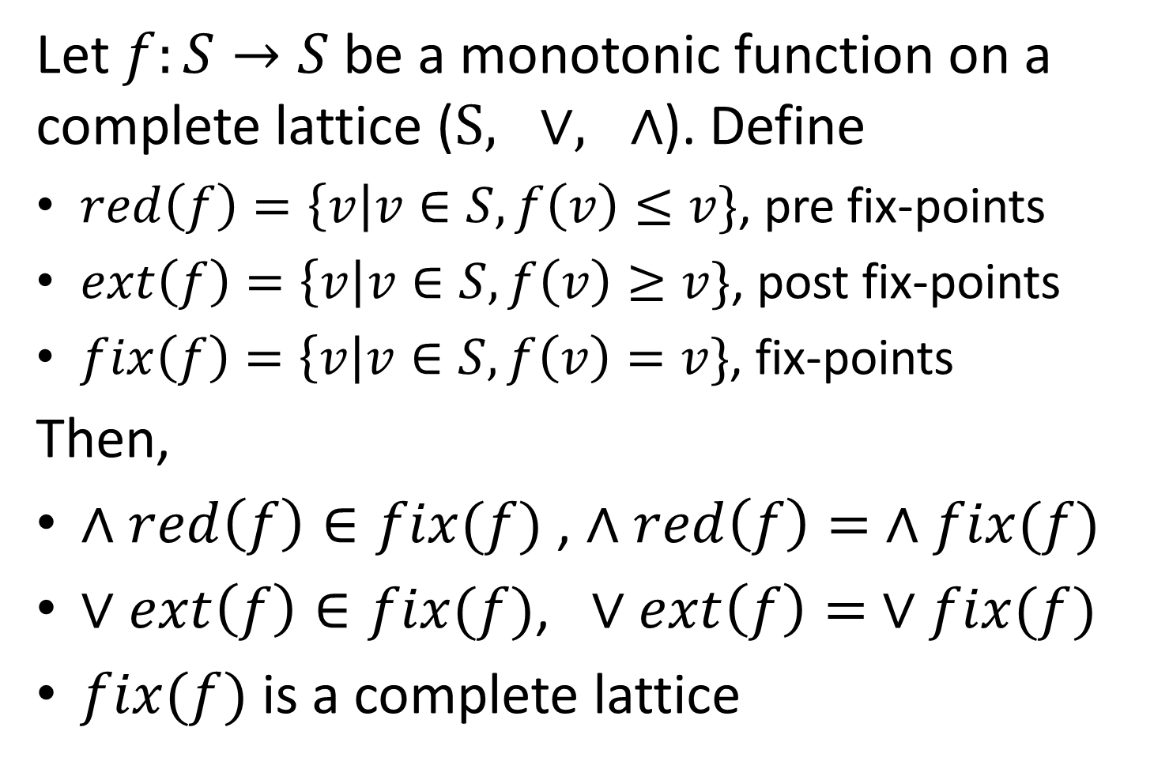
Knaster-Tarski Fixed Point Theorem
Let $f:S→S$be a monotonic function on a complete lattice ($S, ∨, ∧$). Define
$red\left(f\right)=\left\{v\right|v∈S, f\left(v\right)≤v\}$, pre fix-points
$ext\left(f\right)=\left\{v\right|v∈S, f\left(v\right)≥v\}$, post fix-points
$fix\left(f\right)=\left\{v\right|v∈S, f\left(v\right)=v\}$, fix-points
Then,
$∧red\left(f\right)∈fix(f)$ , $∧red\left(f\right)= ∧fix(f)$
$∨ext\left(f\right)∈fix(f)$, $∨ext\left(f\right)= ∨fix(f)$
$fix(f)$ is a complete lattice

Slide 4
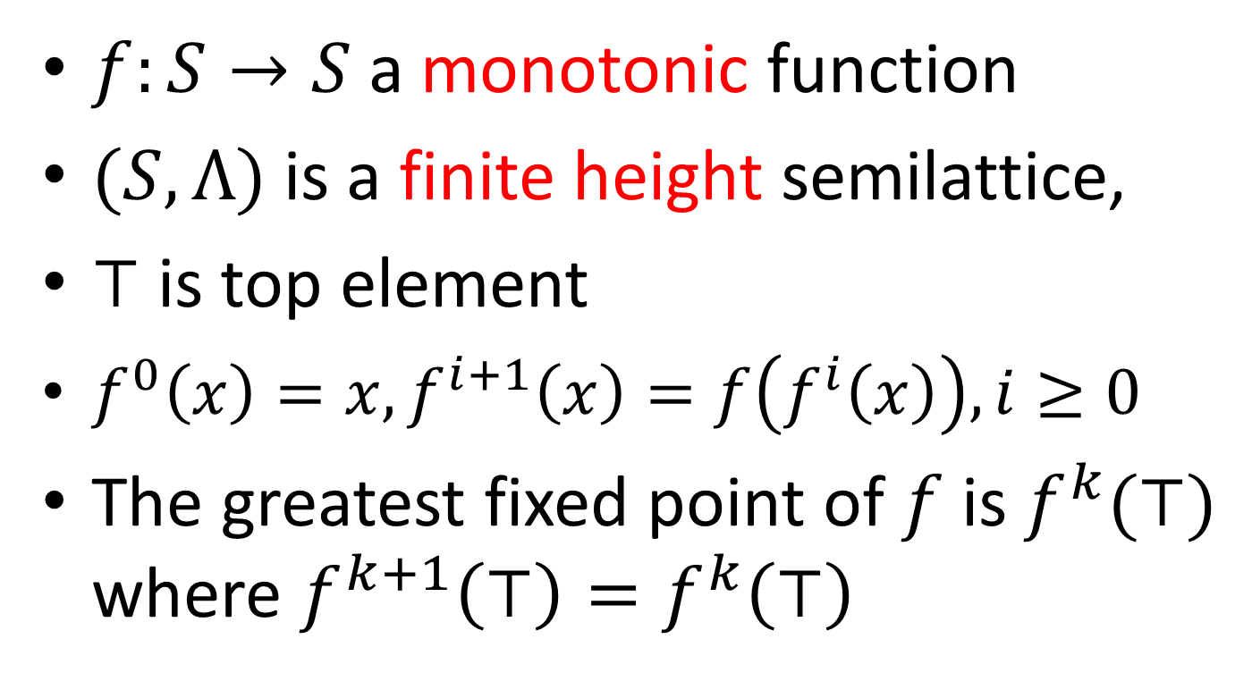
Application of Fixed Point Theorem
$f:S→S$ a monotonic function
$(S, Λ)$is a finite height semilattice,
$⊤$ is top element
$f^{0}\left(x\right)=x, f^{i+1}\left(x\right)=f\left(f^{i}\left(x\right)\right), i≥0$
The greatest fixed point of $f$ is $f^{k}(⊤)$ where $f^{k+1}\left(⊤\right)=f^{k}\left(⊤\right)$

Slide 5
Fixed Point Algorithm
// monotonic f on a meet semilattice
x := ⊤ ;
while (x != f(x)) x := f(x);
return x;

Slide 6
Resemblance to Iterative Algorithm (Forward)
OUT[entry] = Info_{ENTRY};
for (other blocks B) OUT[B] = ⊤;
while (changes to any OUT) {
for (each block B) {
IN(B) = ∧ _{predecessors P of B} OUT(P);
OUT(B) = f_{B}(IN(B));
}
}

Slide 7
Iterative Algorithm
f_{B}(x) = X – kill(B) ∪ gen(B)
BACKWARD:
Swap IN and OUT everywhere
Replace ENTRY by EXIT
Replace predecessors by successors
In other words
just “invert” the flow graph!!

Slide 8
Solutions
IDEAL solution = meet over all executable paths from entry to a point (ignore unrealizable paths)
MOP = meet over all paths from entry to a given point, of the transfer function along that path applied to Info_{ENTRY}.
MFP (maximal fixedpoint ) = result of iterative algorithm.

Slide 9
Maximum Fixedpoint
Fixedpoint = solution to the equations used in iteration:
IN(B) = ∧ _{predecessors P of B} OUT(P);
OUT(B) = f_{B}(IN(B));
Maximum = any other solution is ≤ the result of the iterative algorithm (MFP).

Slide 10
MOP and IDEAL
All solutions are really meets of the result of starting with Info_{ENTRY} and following some set of paths to the point in question.
If we don’t include at least the IDEAL paths, we have an error.
But try not to include too many more.
Less “ignorance,” but we “know too much.”

Slide 11
MOP Versus IDEAL
Any solution that is ≤ IDEAL accounts for all executable paths (and maybe more paths), and is therefore conservative (safe), even if not accurate.

Slide 12
MFP Versus MOP --- (1)
Is MFP ≤ MOP?
If so, then MFP ≤ MOP ≤ IDEAL, therefore MFP is safe.
Yes, but … requires two assumptions about the framework:
“Monotonicity.”
Finite height
no infinite chains … < x₂ < x₁ < x < …

Slide 13
MFP Versus MOP --- (2)
Intuition: If we computed the MOP directly, we would compose functions along all paths, then take a big meet.
But the MFP (iterative algorithm) alternates compositions and meets arbitrarily.

Slide 14
Good News!
The frameworks we’ve studied so far are all monotone.
Easy proof for functions in Gen-Kill form.
And they have finite height.
Only a finite number of defs, variables, etc. in any program.

Slide 15
Two Paths to B That Meet Early
In MFP, Values x and y
get combined too soon.
MOP considers paths
independently and combines at the last possible moment.
f(x)
OUT = x
OUT = f(x) ∧ f(y)
f
ENTRY
IN = x∧y
B
OUT = f(x∧y)
OUT = y
f(y)
Since f(x ∧ y) ≤ f(x) ∧ f(y), it is as if
we added nonexistent paths.

Slide 16
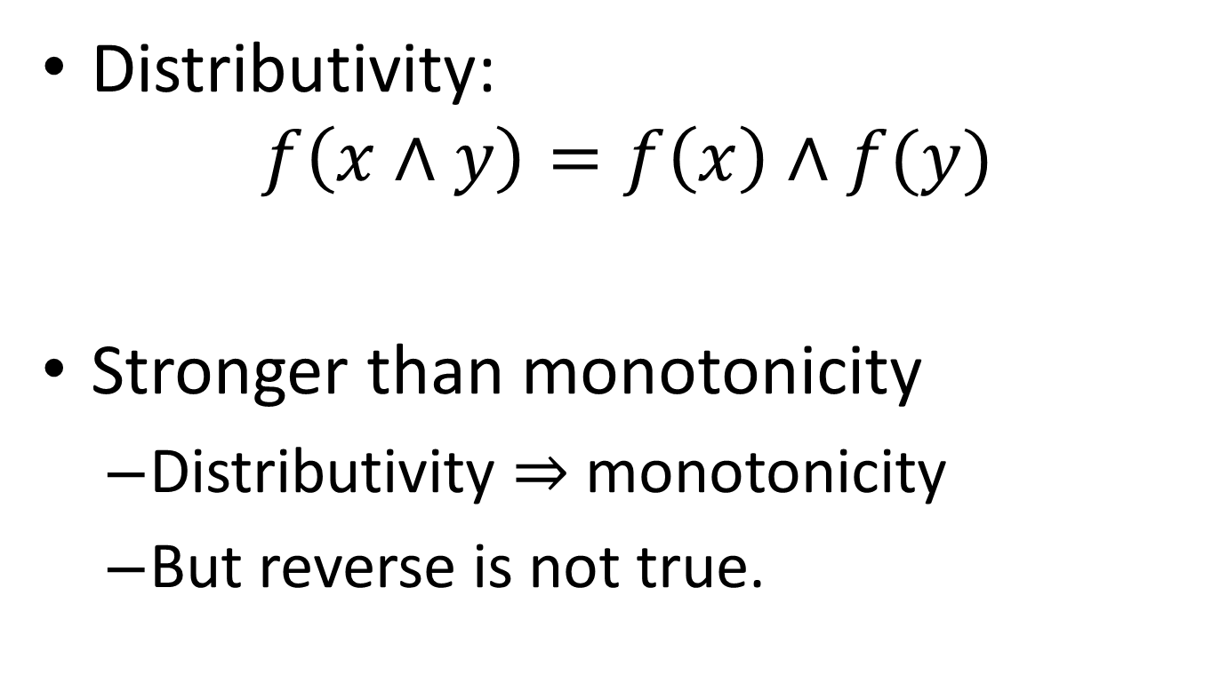
Distributive Frameworks
Distributivity:
$$f\left(x∧y\right)=f\left(x\right)∧f(y)$$
Stronger than monotonicity
Distributivity ⇒ monotonicity
But reverse is not true.

Slide 17
Even More Good News!
The 4 example frameworks are distributive.
If a framework is distributive, then combining paths early doesn’t hurt.
MOP = MFP.
That is, the iterative algorithm computes a solution that takes into account all and only the physical paths.

