Slide 1


Program Analysis https://www.cse.iitb.ac.in/~karkare/cs618/
Static Single Assignment (SSA)
Amey Karkare
Dept of Computer Science and Engg
IIT Kanpur
Visiting IIT Bombay
karkare@cse.iitk.ac.in
karkare@cse.iitb.ac.in

Slide 2
SSA Form
Developed by Ron Cytron, Jeanne Ferrante, Barry K. Rosen, Mark N. Wegman, and F. Kenneth Zadeck,
in 1980s while at IBM.
Static Single Assignment – A variable is assigned only once in program text
May be assigned multiple times if program is executed
<number>

Slide 3
SSA Form
Intermediate representation
Sparse representation
Definitions sites are directly associated with use sites
Advantage
Directly access points where relevant data flow information is avaliable
<number>

Slide 4
SSA Form
In SSA Form
Each variable has exactly one definition
Each use of a variable is reached by exactly one definition
Control flow like traditional programs
Some magic is needed at join nodes
<number>

Slide 5
SSA Form: Examples
i = 0;
…
i = i + 1;
…
j = i * 5;
…
i1 = 0;
…
i2 = i1 + 1;
…
j1 = i2 + 1;
…
<number>

Slide 6
SSA Form: Examples
i = …;
j = …;
if (i < 20)
i = i + j;
else
j = j + 2;
print i,j;
i = …;
j = …;
if (i < 20)
i = i + j
j = j + 2
print i,j
<number>

Slide 7
SSA Form: Examples
i = …;
j = …;
i1 = …;
j1 = …;
if (i < 20)
if (i1 < 20)
i = i + j
j = j + 2
i2=i1+j1
j2=j1+2
print i,j
i3 = ϕ(i2,i1)
j3 = ϕ(j1,j2)
print i3,j3
<number>

Slide 8
SSA Form: Examples
i = …;
j = …;
if (i < 20)
i = i + j;
else
j = j + 2;
print i,j;
i1 = …;
j1 = …;
if (i1 < 20)
i2 = i1 + j1;
else
j2 = j1 + 2;
i3 = ϕ(i2, i1);
j3 = ϕ(j1, j2);
print i3, j3;
<number>

Slide 9
The “magic” : ϕ-function
ϕ is used for selection
One out of multiple values at join nodes
Not every join node needs a ϕ
Needed only if multiple definitions reach the node
<number>

Slide 10
But what does ϕ operation mean in a machine code?
ϕ is a conceptual entity
No direct translation to machine code
typically mimicked using “copy” in predecessors
Inefficient
Practically, the inefficiency is compensated by dead code elimination and register allocation passes
<number>

Slide 11
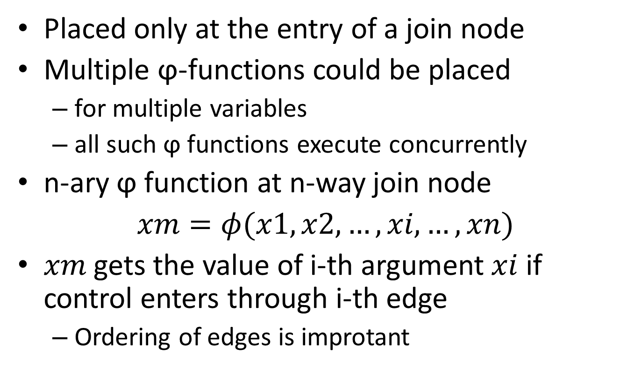
ϕ Properties
Placed only at the entry of a join node
Multiple ϕ-functions could be placed
for multiple variables
all such ϕ functions execute concurrently
n-ary ϕ function at n-way join node
gets the value of i-th argument if control enters through i-th edge
Ordering of edges is improtant
<number>

Slide 12
SSA Form: Example (revisit)
i = …;
j = …;
i1 = …;
j1 = …;
if (i < 20)
if (i1 < 20)
i = i + j
j = j + 2
i2=i1+j1
j2=j1+2
print i,j
i3 = ϕ(i2,i1)
j3 = ϕ(j1,j2)
print i3,j3
<number>

Slide 13
Construction of SSA Form
<number>

Slide 14
Assumptions
Only scalar variables
Structures, pointers, arrays could be handled
Refer to publications
<number>

Slide 15
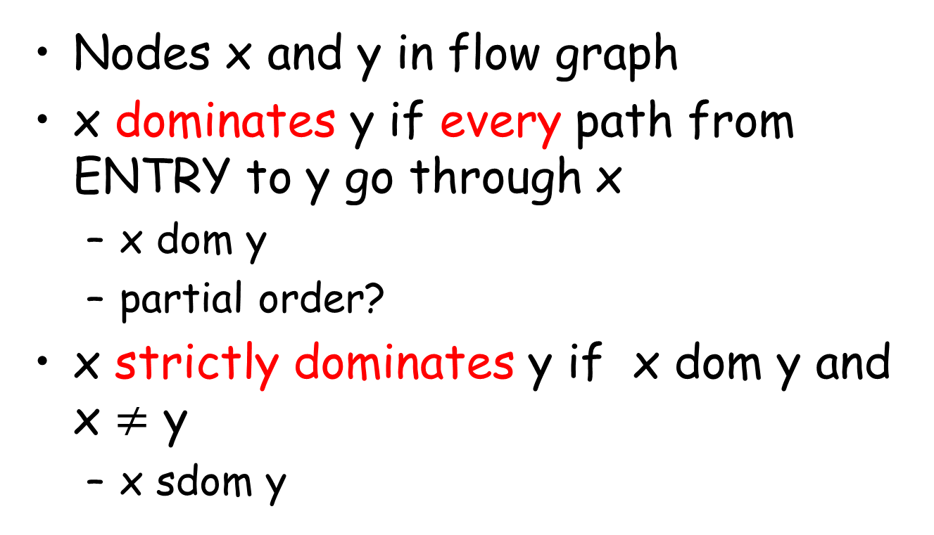
Dominators
Nodes x and y in flow graph
x dominates y if every path from ENTRY to y go through x
x dom y
partial order?
x strictly dominates y if x dom y and x y
x sdom y
<number>

Slide 16
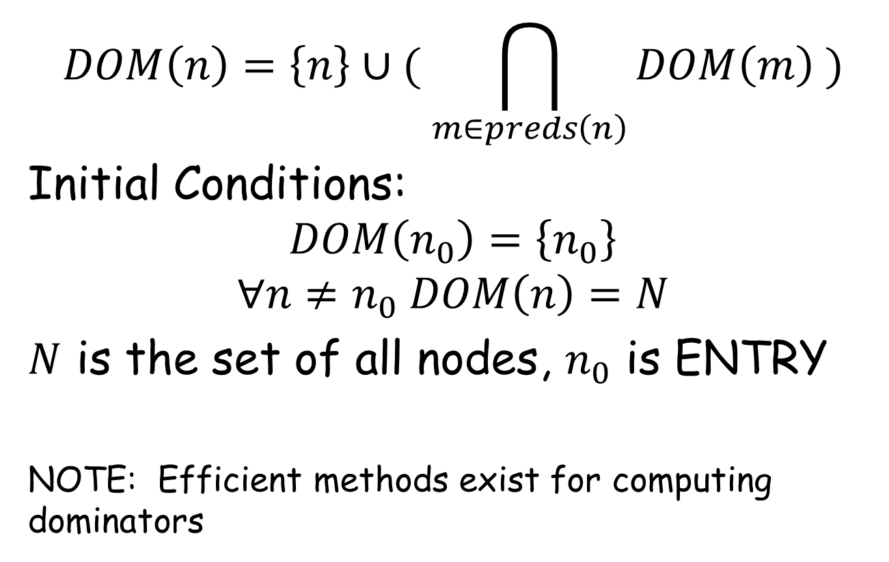
Computing Dominators
Initial Conditions:
is the set of all nodes, is ENTRY
NOTE: Efficient methods exist for computing dominators
<number>

Slide 17
Immediate Dominators and Dominator Tree
x is immediate dominator of y if x is the closest strict dominator of y
unique, if it exists
denoted idom[y]
Dominator Tree
A tree showing all immediate dominator relationships
<number>

Slide 18
Dominator Tree
B0
B0
B1
B1
B2
B3
B2
B3
B4
B5
B4
B5
B6
B6
B7
B7
Control Flow Graph
Dominator Tree
<number>

Slide 19
Dominance Frontier
Dominance Frontier of x is set of all nodes y s.t.
x dominates a predecessor of y AND
x does not strictly dominate y
Denoted DF(x)
Why do you think DF(x) is important for any x?
Think about information originated in x
<number>

Slide 20
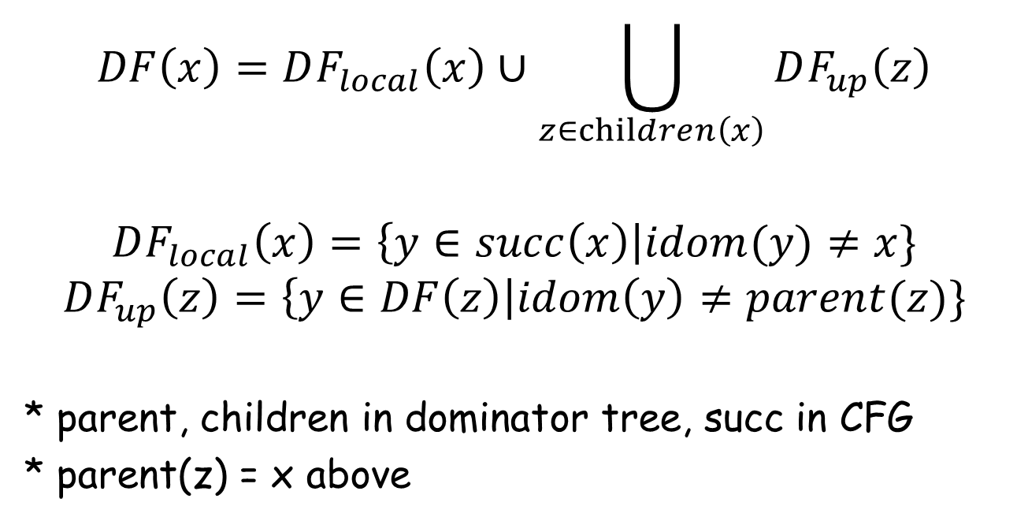
Computing Dominance Frontier
* parent, children in dominator tree, succ in CFG
* parent(z) = x above
<number>

Slide 21
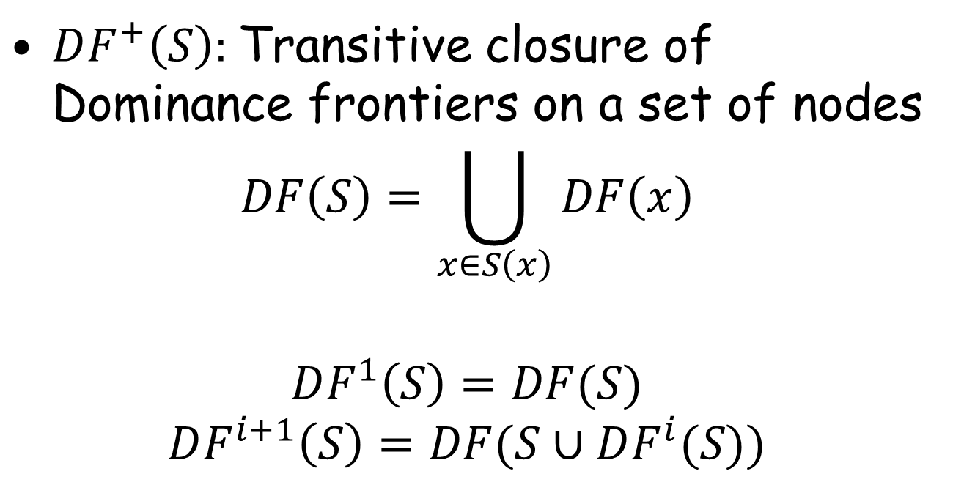
Iterated Dominance Frontier
Transitive closure of Dominance frontiers on a set of nodes
<number>

Slide 22
Minimal SSA Form Construction
Compute DF+ set for each flow graph node
Place trivial ϕ-functions for each variable in the node
Rename variables
Why DF+? Why not only DF?
<number>

Slide 23
Inserting ϕ-functions
foreach variable v {
S = ENTRY ∪ {n | v defined in n}
Compute DF+(S)
foreach n in DF+(S) {
insert ϕ-function for v at start of n
}
}
<number>

Slide 24
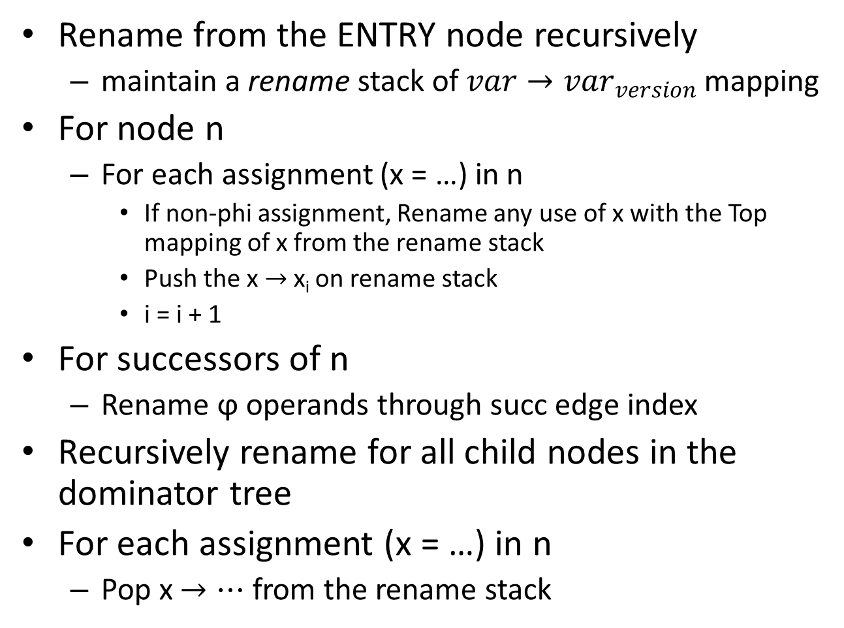
Renaming Variables (Pseudo Code)
Rename from the ENTRY node recursively
maintain a rename stack of mapping
For node n
For each assignment (x = …) in n
If non-phi assignment, Rename any use of x with the Top mapping of x from the rename stack
Push the x x_{i} on rename stack
i = i + 1
For successors of n
Rename ϕ operands through succ edge index
Recursively rename for all child nodes in the dominator tree
For each assignment (x = …) in n
Pop x from the rename stack
<number>

