Slide 1


Program Analysis https://www.cse.iitb.ac.in/~karkare/cs618/
Static Single Assignment (SSA)
(continued)
Amey Karkare
Dept of Computer Science and Engg
IIT Kanpur
Visiting IIT Bombay
karkare@cse.iitk.ac.in
karkare@cse.iitb.ac.in

Slide 2
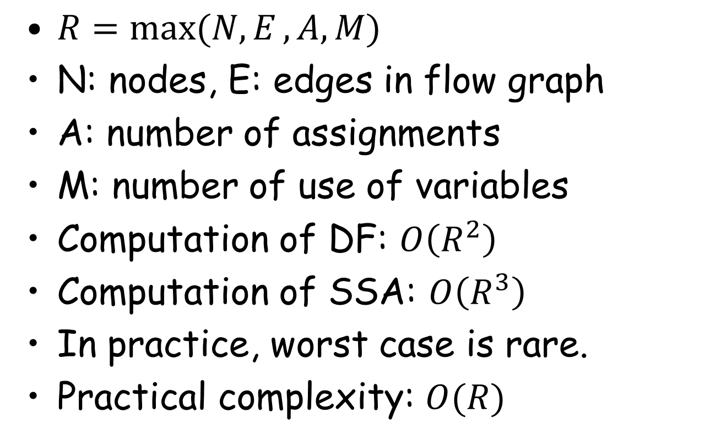
Complexity of Construction
$R=\max{(N, E}, A, M)$
N: nodes, E: edges in flow graph
A: number of assignments
M: number of use of variables
Computation of DF: $O\left(R^{2}\right)$
Computation of SSA: $O\left(R^{3}\right)$
In practice, worst case is rare.
Practical complexity: $O(R)$

Slide 3
Linear Time Algo for ϕ-functions
By Sreedhar and Gao, in POPL’95
Uses a new data structure called DJ-graph
Linear time is achieved by careful ordering of nodes in the DJ-graph
DF for a node is computed only once an reused later if required.

Slide 4
x = …
… = x
y = …
z = …
x = …
… = x
y = …
z = …
… = y
… = y
… = z
Original Program

Slide 5
x1 = …
… = x1
y1 = …
z1 = …
x2 = …
… = x2
y2 = …
z2 = …
… = y1
… = y2
x3=ϕ(x1,x2)
y3 = ϕ(y1,y2)
z3 = ϕ(z1,z2)
… = z3
Minimal SSA form

Slide 6
Variants of SSA Form
Minimal SSA still contains extraneous ϕ-functions
Inserts some ϕ-functions where they are dead
Would like to avoid inserting them
Pruned SSA
Semi-Pruned SSA

Slide 7
Pruned SSA
Only insert ϕ-functions where their value is live
Inserts fewer ϕ-functions
Costs more to do
Requires global Live variable analysis

Slide 8
x1 = …
… = x1
y1 = …
z1 = …
x2 = …
… = x2
y2 = …
z2 = …
… = y1
… = y2
z3 = ϕ(z1,z2)
… = z3
Pruned SSA form

Slide 9
Semi-pruned SSA
Semi-pruned SSA: discard names used in only one block
Total number of ϕ-functions between minimal and pruned SSA
Needs only local Live information
Non-locals can be computed without iteration or elimination

Slide 10
x1 = …
… = x1
y1 = …
z1 = …
x2 = …
… = x2
y2 = …
z2 = …
… = y1
… = y2
y3 = ϕ(y1,y2)
z3 = ϕ(z1,z2)
… = z3
Semi-pruned SSA form

Slide 11
Computing Non Locals
for each block B {
defined = {}
for each instruction v = x op y {
if x not in defined
non_locals = non_locals ∪ {x}
if y not in defined
non_locals = non_locals ∪ {y}
defined = defined ∪ {v}
}
}

Slide 12
SSA to Executable
At some point, we need executable code
Need to fix up the ϕ-function
Basic idea
Insert copies in predecessors to mimick ϕ-function
Simple algorithm
Works in most cases, but not always
Adds lots of copies
Many of them will be optimized by later passes

Slide 13
x0 = …
x1 = …
x2 = ϕ(x0, x1)
... = x2
x0 = …
x2 = x0
x1 = …
x2 = x1
... = x2

Slide 14
Lost Copy Problem
x = 1
x1 = 1
y = x
x = x+1
x2 = ϕ(x1,x3)
x3 = x2 + 1
print y
print x2
Program
SSA from with copy propagation

Slide 15
Lost Copy Problem
x1 = 1
x2 = x1
x3 = x2 + 1
x2 = x3
PROBLEM!!!
print x2
After ϕ-function removal

Slide 16
Lost Copy Problem: Solutions
x1 = 1
x2 = x1
x1 = 1
x2 = x1
x3 = x2 + 1
t = x2
x2 = x3
x3 = x2 + 1
x2 = x3
print t
print x2
Solution 1: Temporary use
Solution 2: Critical Edge Split

Slide 17
Swap Problem
a = 1
b = 2
a1 = 1
b1 = 2
x = a
a = b
b = x
a2 = ϕ(a1,b2)
b2 = ϕ(b1,a2)
print b
print a2
Program
SSA from with copy propagation

Slide 18
Swap Problem
a1 = 1; b1 = 2
a2 = a1; b2 = b1
a2 = b2
b2 = a2
PROBLEM!!!
Fix requires compiler to detect
and break dependency from
output of one ϕ-function to
input of another ϕ-function.
May require temporary if cyclic
dependency exists.
print a2
After ϕ-function removal

Slide 19
SSA Form for Optimizations
SSA form can improve and/or speed up many analyses and optimizations
(Conditional) Constant propagation
Dead code elimination
Value numbering
PRE
Loop Invariant Code Motion
Strength Reduction

