Slide 1


Intelligent Cross-Organizational Process Mining: A Survey and New Perspectives
Yiyuan Yang, Zheshun Wu, Yong Chu, Zhenghua Chen, Zenglin Xu, Qingsong Wen
Presented by: Apurva Karne

Slide 2
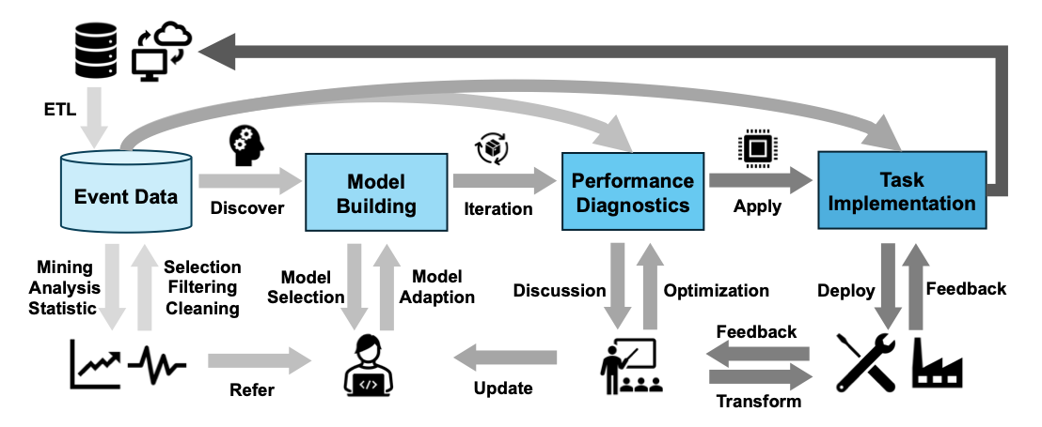
Introduction to Process Mining
Process mining is a high-level field in data mining that plays a crucial role in enhancing operational efficiency and decision-making across organizations.
Core components: discovery, conformance, enhancement, workflow.
Workflow of process mining.
Notes:
How process mining bridges the gap between business processes and data science, extracting insights from event logs to optimize workflows. Highlight the importance of process mining in enhancing operational efficiency and decision-making across organizations.

Slide 3
Latest Advances in Process Mining
Data-centric Process Mining:
Addresses privacy concerns using techniques like federated learning.
Tackles challenges of missing data through imputation and interpolation.
Object-centric Process Mining:
Handles convergence and divergence issues in complex processes.
Introduces specific logging formats to link events to diverse object types.
Customized Metrics and AutoML:
Tailors computing services to specific users or silos.
Automates algorithm selection and hyperparameter tuning for optimal performance.
Efficient Computing Infrastructure:
Utilizes distributed computing for improved reliability and scalability.
Enables processing of massive event log data across multiple organizations.
Notes:
Discuss how these advances address challenges like data privacy, complex relationships, and scalability. Emphasize the role of AI and machine learning in enhancing process mining capabilities.

Slide 4
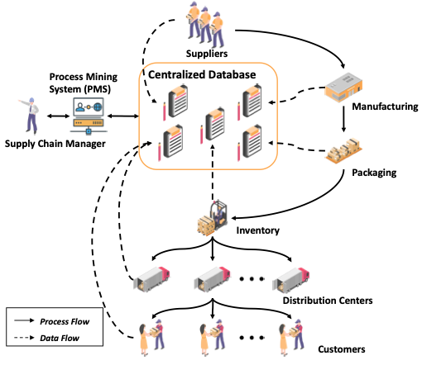
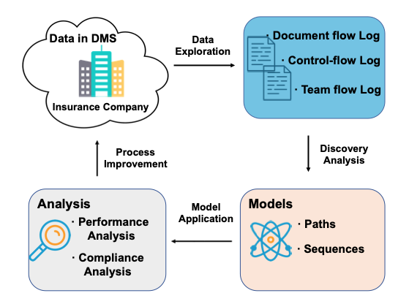
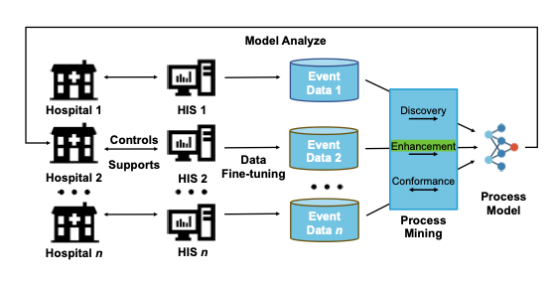
Industrial Applications of Process Mining
Manufacturing and Logistics
Healthcare
Finance
Notes:
Briefly explain how process mining is applied in each industry, using the figures from the paper to illustrate real-world examples.

Slide 5
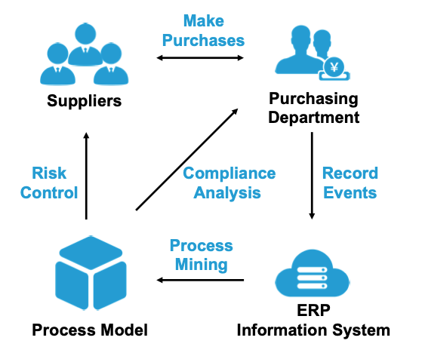
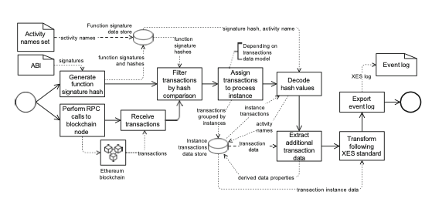
Industrial Applications of Process Mining
ent
Blockchain
Notes:
Briefly explain how process mining is applied in each industry, using the figures from the paper to illustrate real-world examples.

Slide 6
Resources
Datasets and Tools:
Database systems, CSV files or spreadsheets, Transaction logs, ERP systems, Message logs, and Open APIs.
Tools: ProM, Disco, PM4Py.
Metrics and Criteria:
Fitness, Complexity, Precision, Generalization.
Performance: Time, Cost, and Quality.
Conformance checks:
Adaptability.
Generalizability.
Simplicity.
Precision.
Notes:
Discuss how these advances address challenges like data privacy, complex relationships, and scalability. Emphasize the role of AI and machine learning in enhancing process mining capabilities.

Slide 7
Intelligent Cross-Organizational Process Mining(ICPM)
Intelligent Cross-Organizational Process Mining (ICPM) is an advanced approach that leverages artificial intelligence to analyze and optimize business processes across multiple organizations while preserving data privacy and security
Key Features:
AI Integration(AutoML).
Privacy Preservation using Federated Learning.
Customization.
Real-time monitoring and predictive analytics.
Notes:
Explain how ICPM extends traditional process mining to address cross-organizational challenges. Highlight the need for privacy-preserving techniques and customizable computations.

Slide 8
Intelligent Cross-Organizational Process Mining(ICPM)
Challenges:
Data privacy across organizations.
Handling diverse data formats and distributions.
Ensuring explainability for adoption.
Data Quality.
Opportunities:
Federated learning for secure collaboration.
Explainable AI for transparency.
LLMs for domain-specific insights.

Slide 9
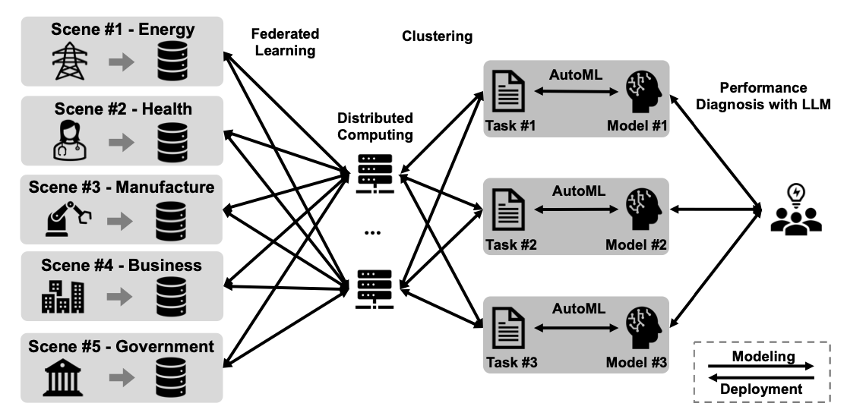
Proposed Solutions for ICPM
Data privacy and Security.
Handling of diverse data modalities.
Collaborative learning.

Slide 10
Future Research Directions
Innovative algorithms for cross-organizational settings
Advanced privacy-preserving methods
Data integration strategies
Ethical considerations and responsible development.
Greater adoption through explainable AI.
Domain-specific customization of LLMs.

Slide 11
Personal Reflection and Conclusion
ICPM redefines process mining by enabling secure collaboration.
It balances privacy, scalability, and innovation.
A step toward a more interconnected, efficient world.
Notes:
Explain how ICPM extends traditional process mining to address cross-organizational challenges. Highlight the need for privacy-preserving techniques and customizable computations.

Slide 12
References
Intelligent Cross-Organizational Process Mining: A Survey and New
Intelligent Cross-Organizational Process Mining: A Survey and New Perspectives
My Medium article.
Notes:
Explain how ICPM extends traditional process mining to address cross-organizational challenges. Highlight the need for privacy-preserving techniques and customizable computations.

Slide 13
Thank You!
Notes:
Explain how ICPM extends traditional process mining to address cross-organizational challenges. Highlight the need for privacy-preserving techniques and customizable computations.

