Slide 1


- Apurva SAWANT - Nisarg Patel

Slide 2
Dataset
Dataset : Boston Airbnb Open Data https://www.kaggle.com/airbnb/boston/data
Details about listings, reviews, calendar.
Listing.csv – details of the listing like price, location, no of rooms, amenities, host details, etc.
Reviews.csv – details of the reviews given by users to different listings including the date and details of the reviewer.
Calendar.csv – details of price according to the availability dates.

Slide 3
Problem Statement
To get different insights from the Airbnb dataset.
To recommend listing to the users on basis of their reviews.
To perform price prediction for a new listing to help user gain maximum profit.
To perform analysis over the data to help the host to decide where to invest.

Slide 4
Overview
Data cleaning
Analysis
Sentimental analysis
Recommendations
Prediction

Slide 5
Technologies
Hive
Pig
Mahout
MapReduce
Microsoft Azure Machine Learning Studio
Python
Power BI
AWS

Slide 6
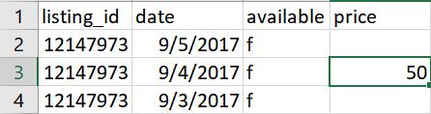

Data Cleaning
Missing data
Data in different languages
Modified the numeric values

Slide 7

Analysis
Which area of Boston is most Profitable for hosting a property?

Slide 8
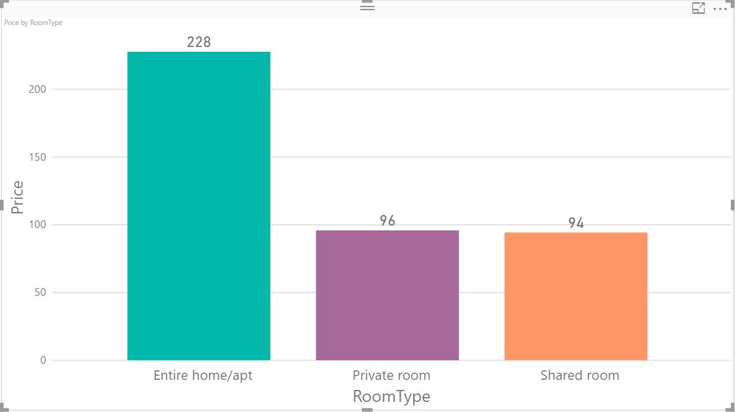
To backup the profitability, First we need to check which Room Type gets good return.

Slide 9
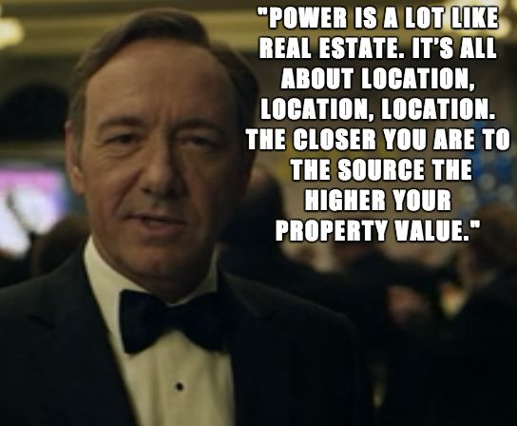
Importance of Location for Investments

Slide 10
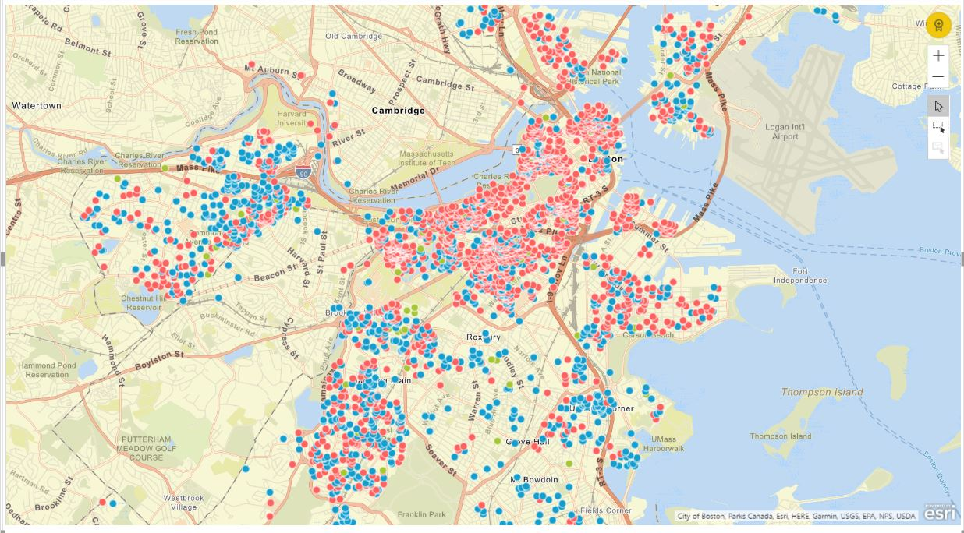
Once we have decided which type of room to buy, then we need the select in which general area of Boston this has to be
Red Spot is Entire Home/Apt
Blue Spot is Private Room
Green Spot is Shared Room

Slide 11
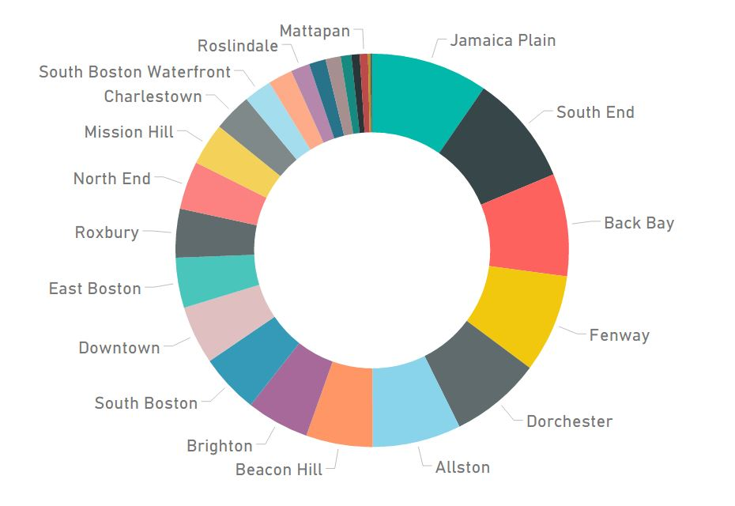
Now we need to have a look which area has maximum listings

Slide 12
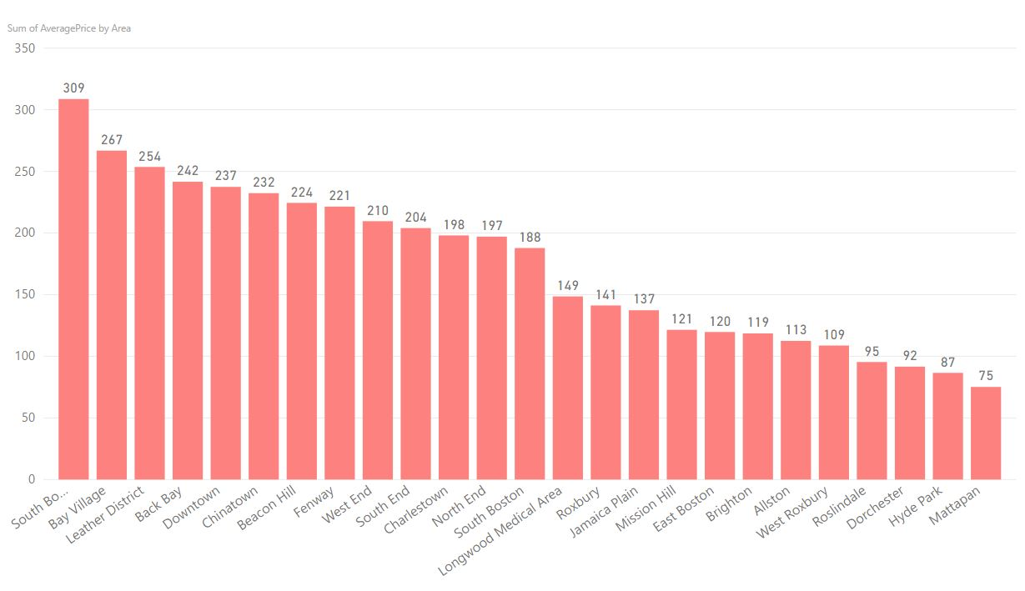
Area Vs Price

Slide 13
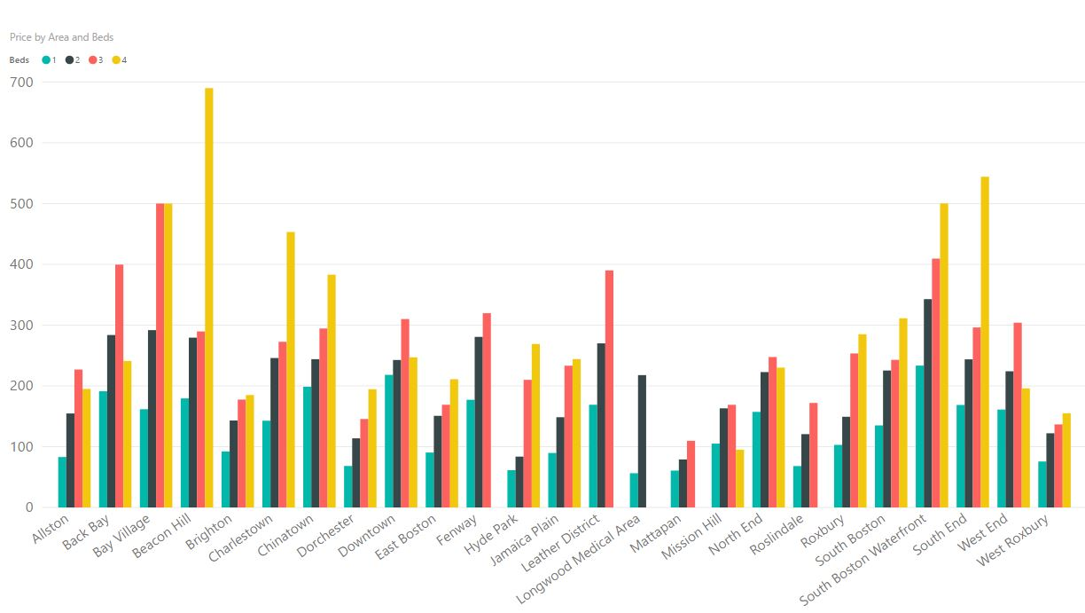
After the location is finalized, We can check how many beds listing could be in our favor

Slide 14

Does being strict or flexible for the cancellation policy affects the booking of your property ?

Slide 15
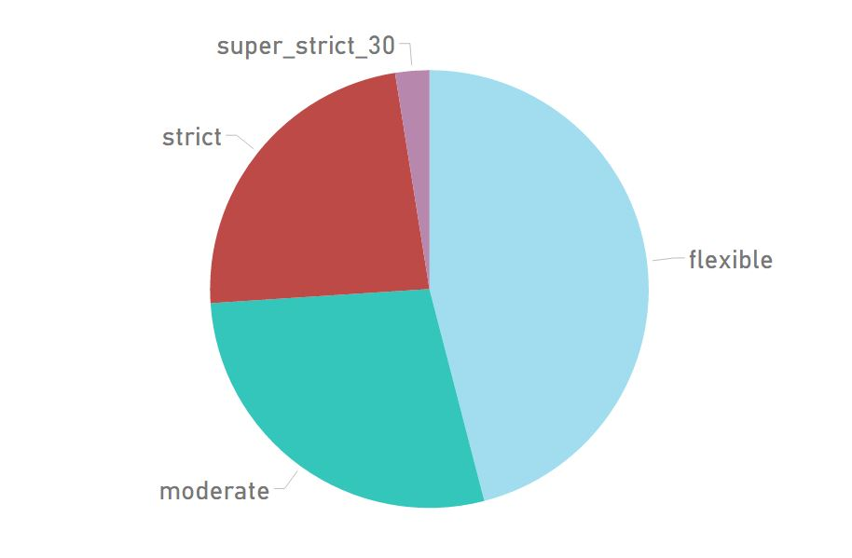
Cancellation Policy Vs Booking

Slide 16
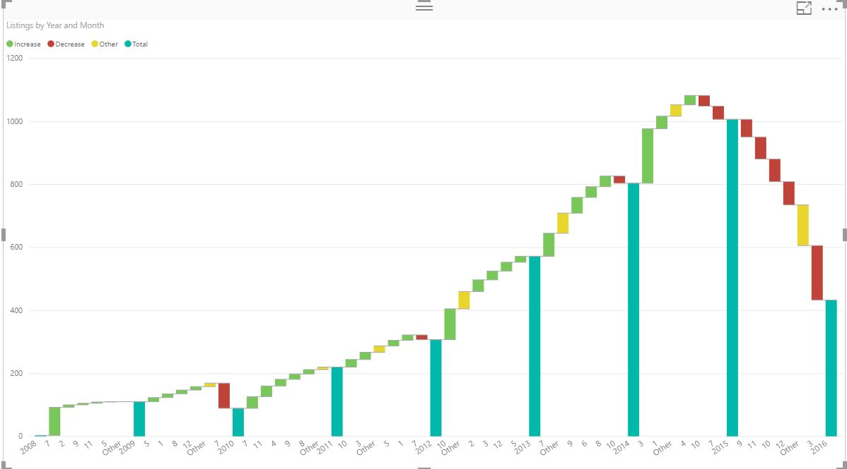
Performance of Airbnb Until Now in Boston

Slide 17
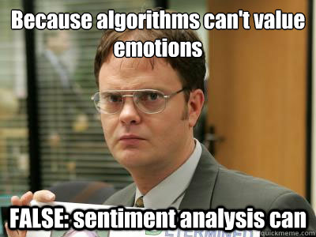
Sentimental Analysis
It is a way to evaluate written or spoken language to determine if the expression is favourable, unfavourable, or neutral, and to what degree.

Slide 18

Why Hive?
Join functionality is difficult to implement and time consuming using MapReduce.
MapReduce provides more control for writing complex business logic when compared to Pig and Hive.
At times, the job might require several hive queries for instance 12 levels of nested FROM clauses then it becomes difficult for Hadoop developers to write using MapReduce coding approach.

Slide 19
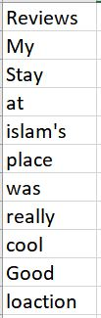
Process
Extracted the review column from the data
Split the data into arrays
Tokenized all the arrays

Slide 20
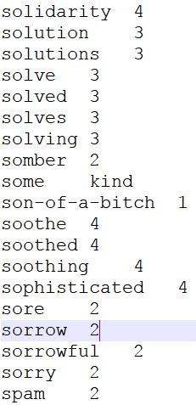
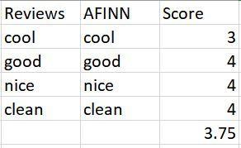
AFINN file
Inner join on our data and AFINN file
Perform Group by operation and calculate average rating of every review.

Slide 21
Complications
The scale of AFINN file usually ranges from -5 to +5 so there were discrepancies in the resultant score
Input file given to Mahout should have the score in the range of 1 to 5
Modified the AFINN file to change it’s range to 1 to 5 using MapReduce

Slide 22
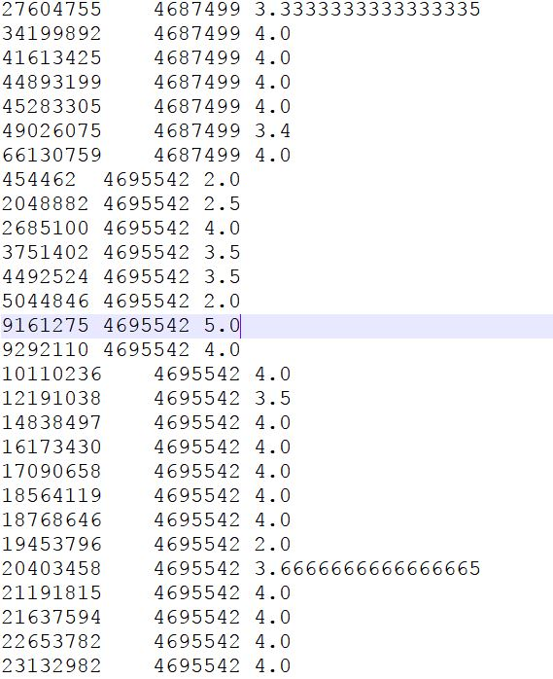
Output

Slide 23
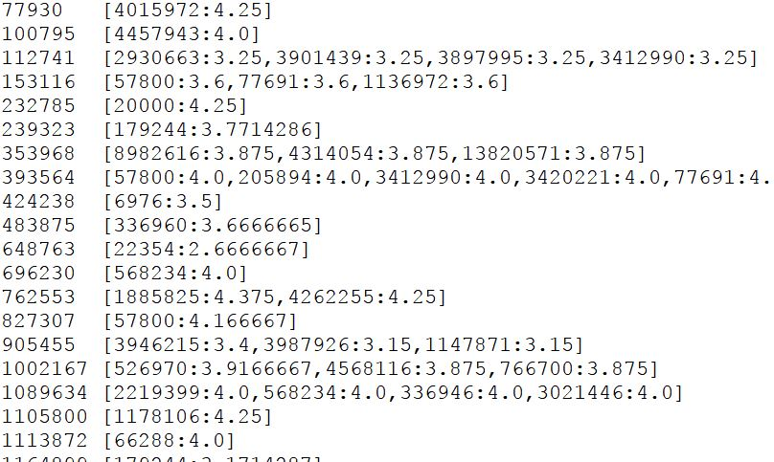
Recommendation
Performed recommendation using Mahout
Output of sentimental analysis is used as input for recommendation

Slide 24

Prediction

Slide 25

What have we predicted and Why ?
Attempted to predict price of a listing
Studied the influence of different parameters on the prediction
It is difficult for a first time user to decide the price of his listing
The prediction feature can be used to help a new user to maximize his profit.
This feature is not provided by airbnb as of now

Slide 26
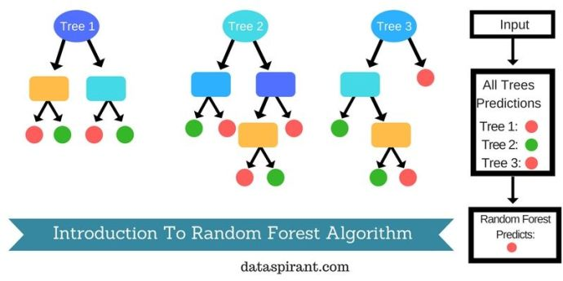
Algorithm
Random Forest algorithm is a supervised classification algorithm used for prediction
Non-linear data
Reduction in over fitting

Slide 27
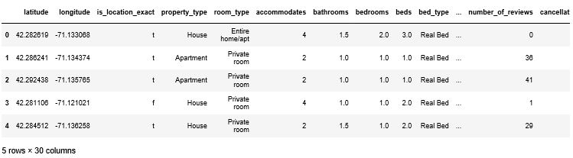
Steps
Selected the parameters
Modified the prices to it’s logarithmic scale
logn(250) = 5.521461

Slide 28
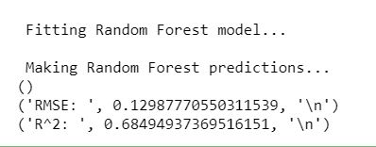
Created dummies for certain parameters
Split the data
Training data: 67% Test data: 33%
Applied RandomForestRegressor to the training data

Slide 29
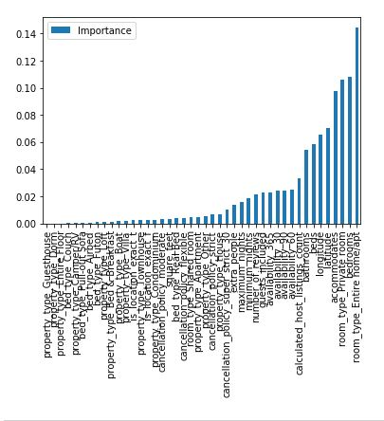
Output
Studied the influence of different parameters on the prediction

Slide 30
Comparison of regression models
Linear Regression
Decision Tree Regression
Random Forests Regression

Slide 31
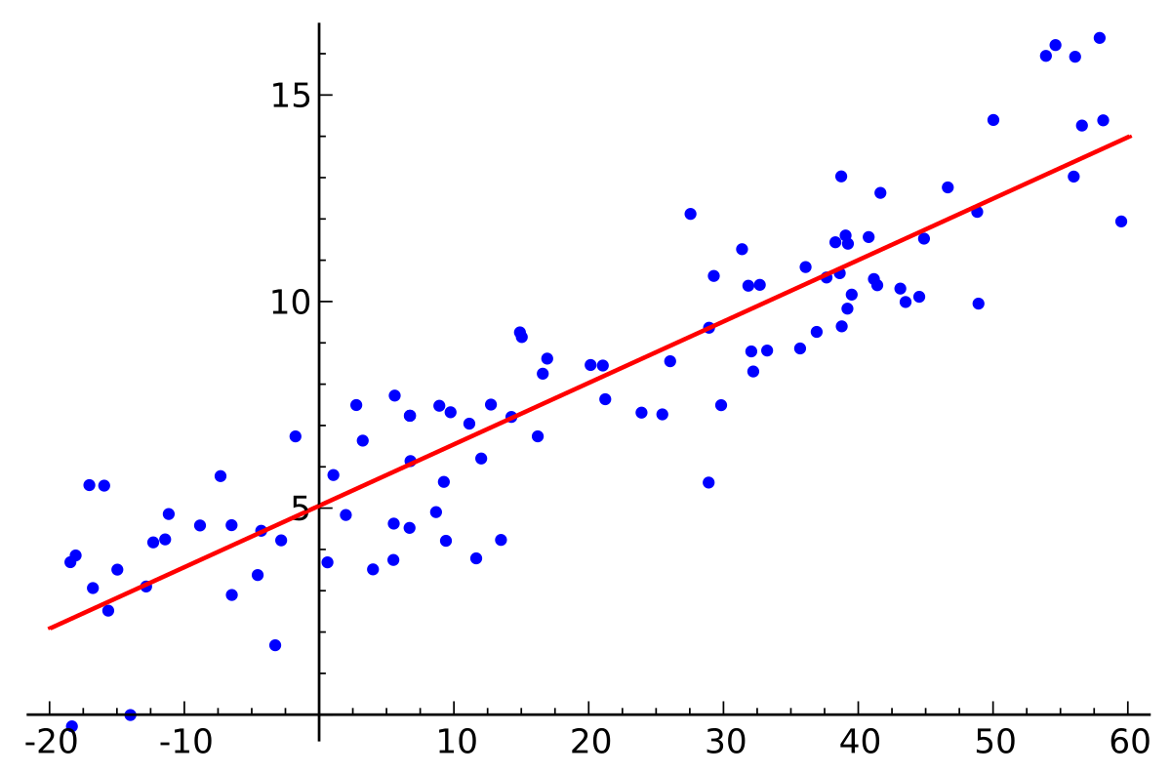
Linear Regression

Slide 32
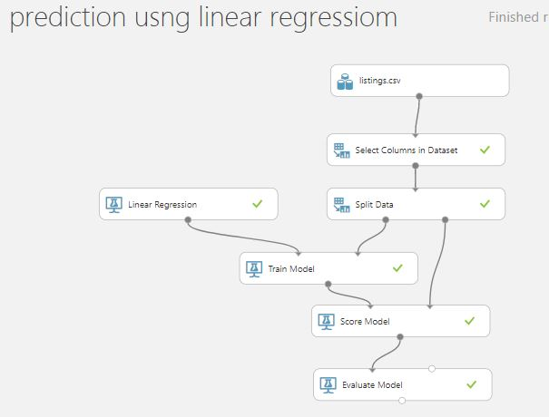
Linear Regression

Slide 33
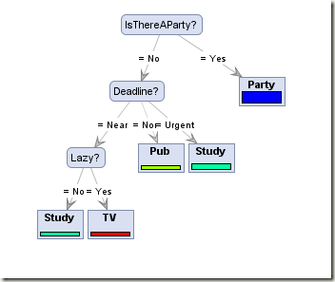
Decision Tree Regression

Slide 34
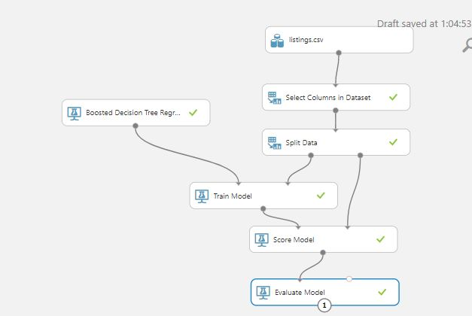
Decision Tree Regression

Slide 35
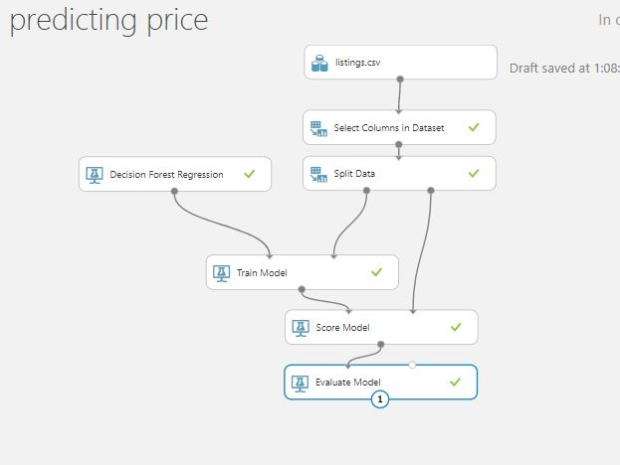
Random Forest Regression

Slide 36
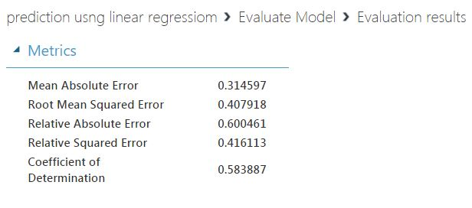
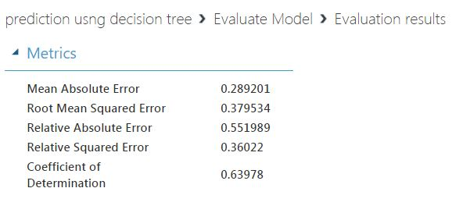
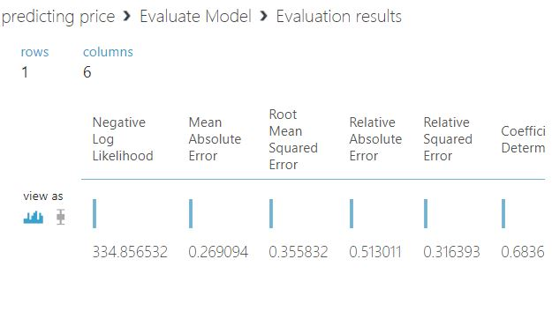

Slide 37
Thank You!

