Slide 1
LoanBoard
End-to-End Production DevOps Capstone
Session 21 Final Capstone | Apurv | Scaler School of Technology
github.com/apurvdugar/devops-project
Notes:
Introduce yourself and the project: a fintech loan application manager with a full DevOps lifecycle around it.

Slide 2
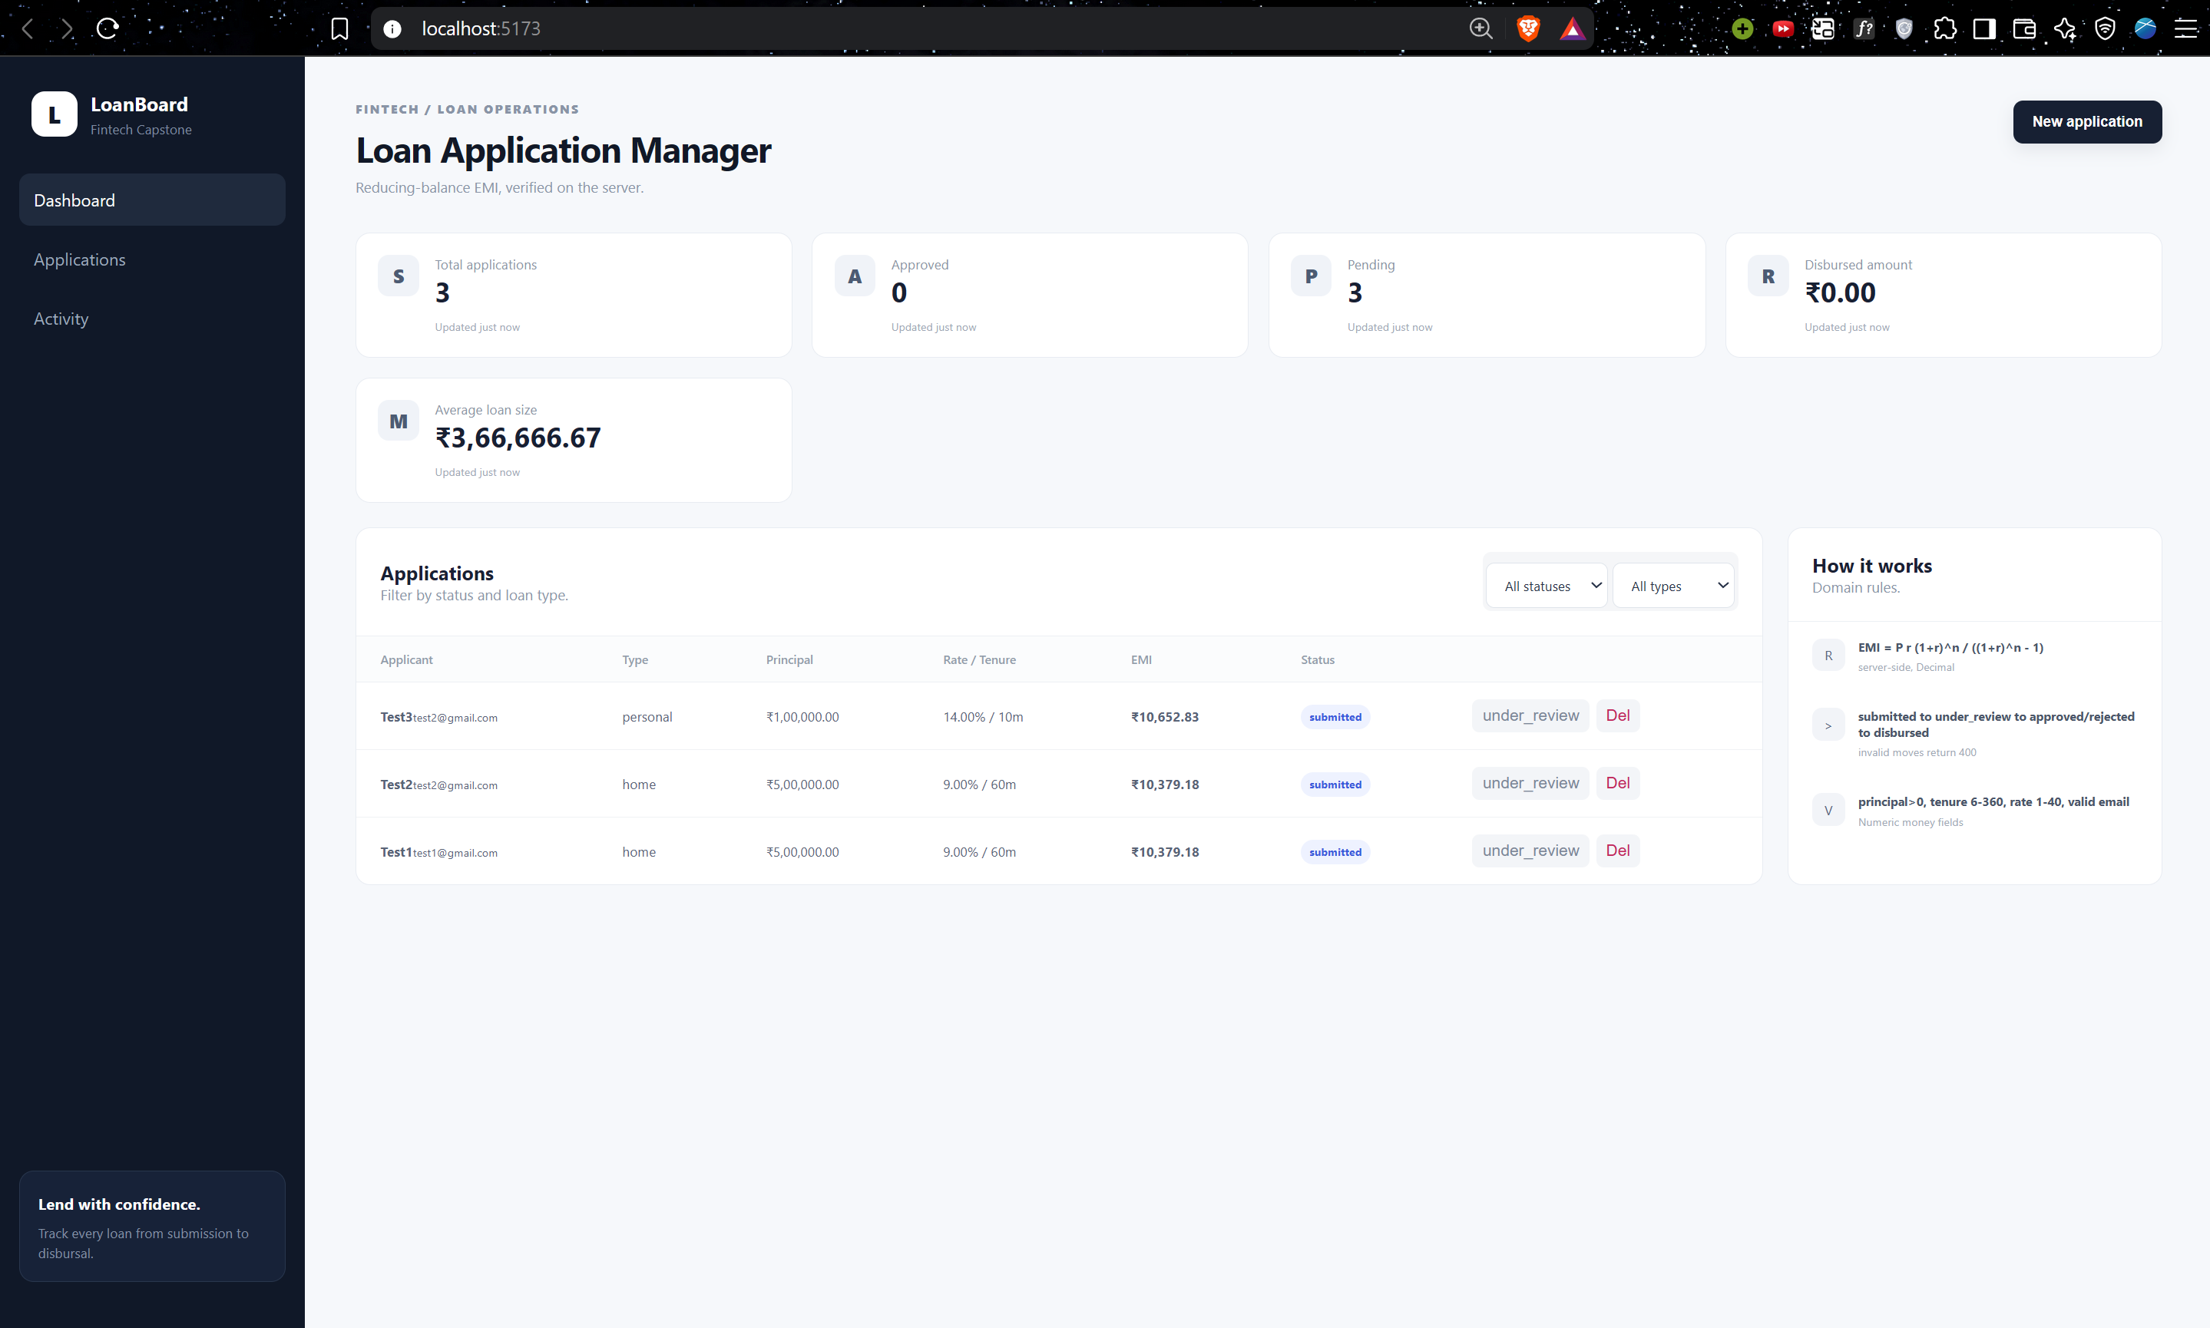
What is LoanBoard?
Loan application manager: create loans, track status, EMI calculated server-side
Status flow: submitted > under review > approved / rejected > disbursed
Backend: FastAPI + SQLAlchemy + Alembic, PostgreSQL 16
Frontend: React + Vite, served by Nginx
Full DevOps layer: Docker, CI/CD, Trivy, Terraform, Kubernetes, Helm, Prometheus, Grafana, Argo CD
LoanBoard dashboard (React frontend)
Notes:
Domain is my own (fintech loans), DevOps layer follows the TaskBoard architecture.

Slide 3
Architecture
Developer
git push
GitHub Actions
test, scan, build
GHCR
SHA-tagged images
EKS on AWS
(Terraform)
>
>
>
Inside the cluster
Observability
GitOps
Ingress routes / to frontend and /api to backend.
Backend and frontend: 2 replicas each, ClusterIP services.
PostgreSQL with a 5Gi persistent volume.
Backend exposes /metrics.
Prometheus scrapes via ServiceMonitor.
Grafana shows requests, errors, latency.
Argo CD watches helm/loanboard in Git.
Detects drift and self-heals the cluster.
Notes:
Walk left to right: code -> pipeline -> registry -> cluster on AWS, with monitoring and GitOps.

Slide 4
M1 + M2: Application and Testing
Application (M1)
Testing (M2)
7 REST endpoints: GET, POST, PUT, PATCH, DELETE on /api/loans
/health, /ready and /metrics endpoints
PostgreSQL table managed by Alembic migrations
Money stored as Decimal, never float
Validation: tenure 6-360 months, rate 1-40%
12 pytest tests (unit + integration)
Covers EMI math, status transitions, CRUD endpoints
Uses a test database, not production
Known check: 1,00,000 at 12% for 12 months = Rs 8,884.88
Tests run first in CI and fail the build on error

Slide 5
M3 + M4: Git and Docker
Git and GitHub (M3)
Docker (M4)
Public repo: apurvdugar/devops-project
31+ commits with meaningful messages
.gitignore excludes .env, __pycache__, node_modules, .venv
No secrets committed (Gitleaks scans every push)
Backend Dockerfile on Python 3.12 slim
Frontend: multi-stage build (Node build, Nginx runtime)
Both images run as non-root users
docker compose up --build starts frontend, backend and postgres

Slide 6
M5 + M6: CI/CD and DevSecOps
Test
pytest + npm build
Secure
Gitleaks + Bandit
Build + Scan
Docker + Trivy
Push
GHCR, SHA tag
>
>
>
GitHub Actions runs on every push to main
A failing test stops the pipeline
Trivy scans both images and fails on HIGH or CRITICAL CVEs
Images are tagged with the Git commit SHA, not latest
Trivy result
Trivy scanned OS layers and pip/npm packages. It first flagged starlette, urllib3, msgpack and setuptools. I pinned patched versions, and the final run shows 0 HIGH or CRITICAL findings.
Notes:
Mention the Loom demo link in the README for the live pipeline run.

Slide 7
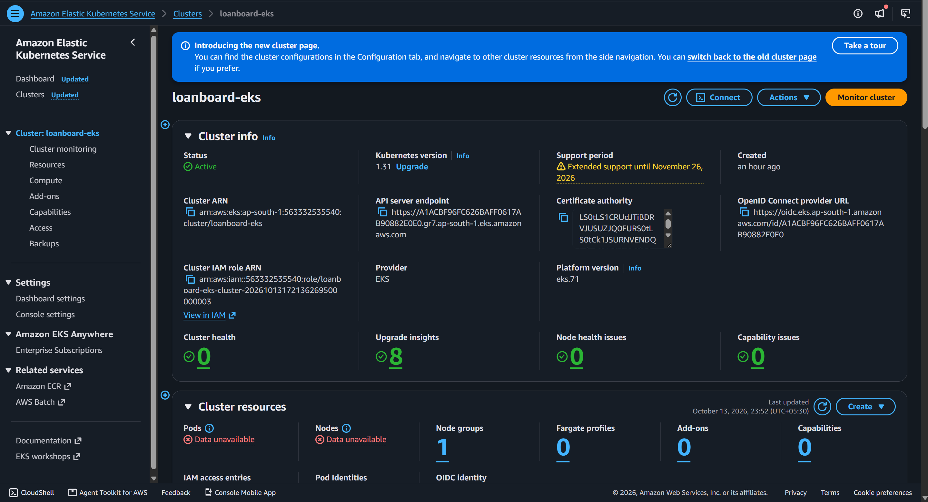
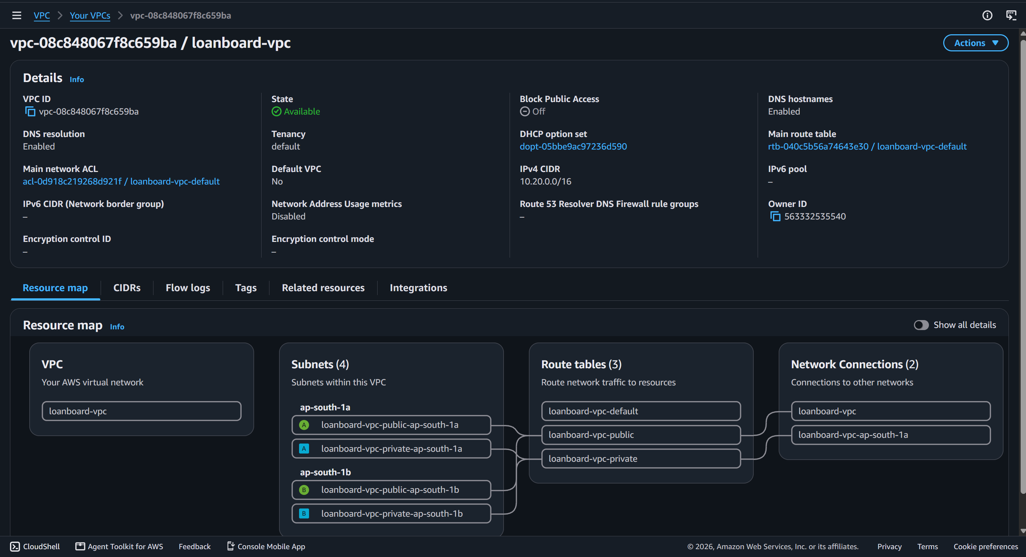
M7: Terraform on AWS
Custom VPC 10.20.0.0/16 across 2 availability zones
Public and private subnets, Internet and NAT gateways
EKS cluster v1.31 with managed node group (t3.medium, min 2, max 4)
Commands: init, validate, plan, apply, destroy
No credentials committed; tfvars example only
EKS cluster in AWS Console
VPC provisioned by Terraform
Notes:
Remind: terraform destroy was run after evaluation to avoid costs.

Slide 8
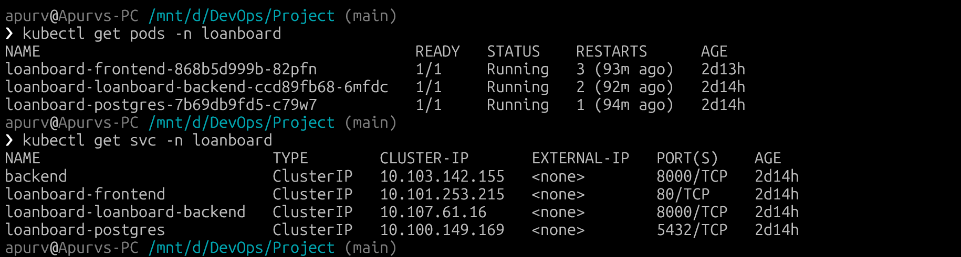
M8: Kubernetes and Helm
Namespace loanboard with ConfigMap, Secret and 5Gi PVC
Backend and frontend: 2 replicas each, with health probes
ClusterIP services; Ingress: / to frontend, /api to backend
HPA scales pods from 2 to 5 on CPU and memory
Helm chart with values-dev.yaml and values-prod.yaml
Deploy: helm upgrade --install loanboard helm/loanboard
kubectl get pods and services, all Running

Slide 9
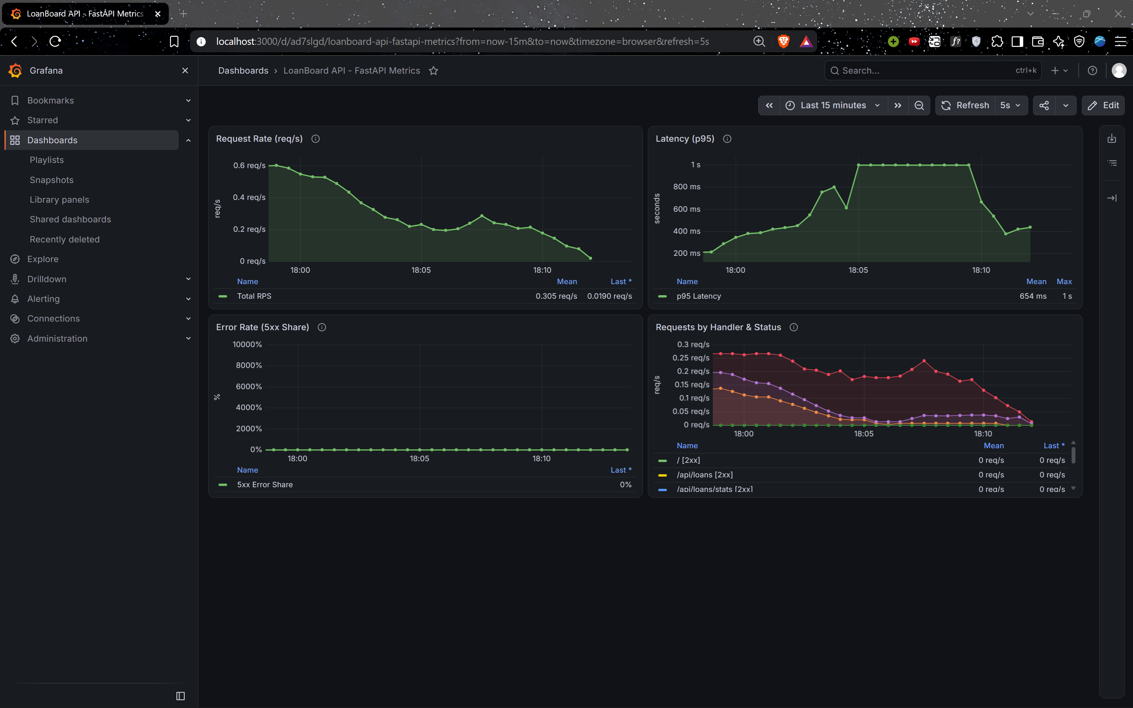
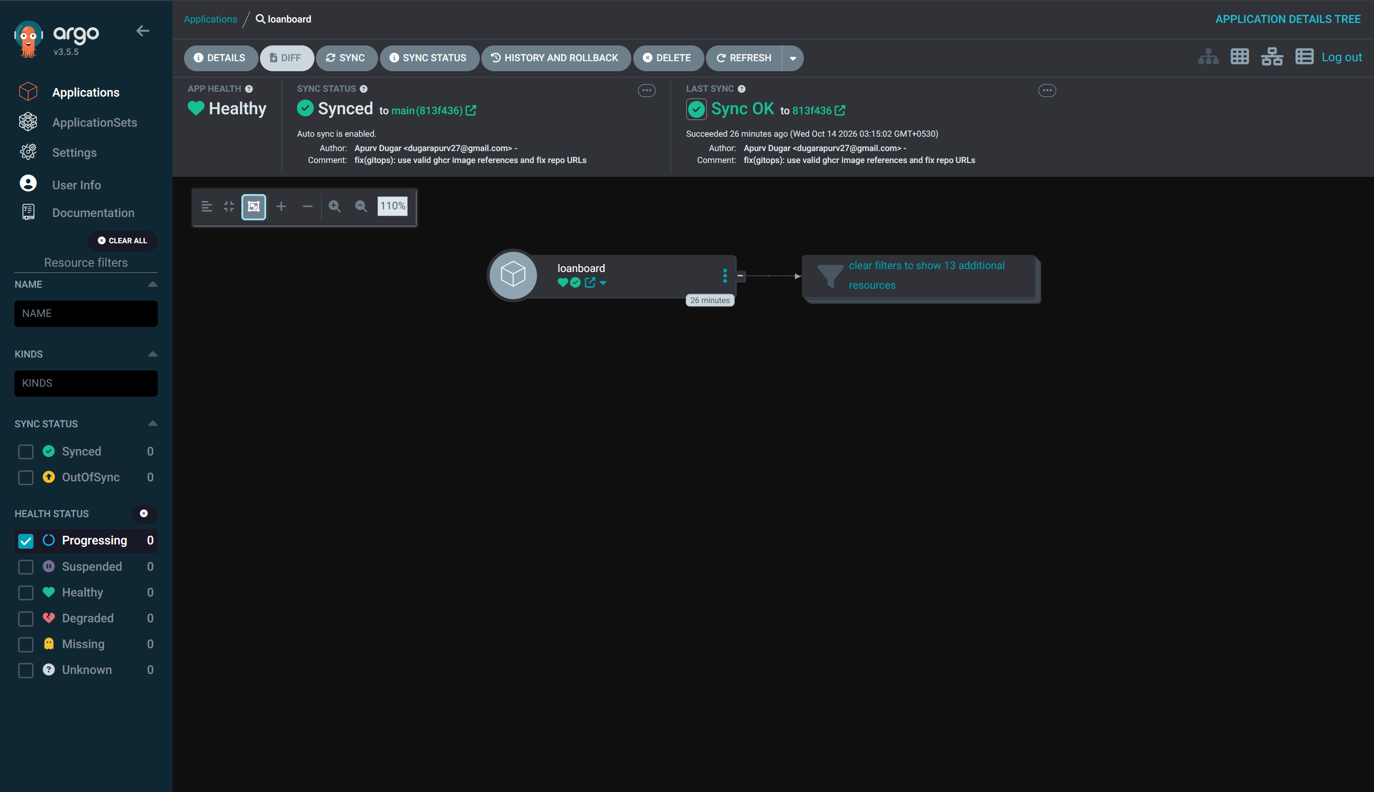
M9: Observability and GitOps
/metrics endpoint exposed by FastAPI
kube-prometheus-stack in the monitoring namespace
ServiceMonitor scrapes the backend every 15s
Grafana dashboard: request rate, errors, p50/p95/p99 latency
Argo CD keeps the cluster in sync with Git and self-heals
Grafana dashboard with live metrics
Argo CD application

Slide 10
Lessons Learned and Live Demo
Security scans in CI catch problems before images reach the registry
GitOps removes configuration drift: Git is the source of truth
One Helm chart with dev and prod values avoids duplicate manifests
Probes plus autoscaling keep the app reliable under load
Troubleshooting routine: get, describe, logs, fix, verify
Live demo
1. Commit a change
2. Watch the pipeline run
3. See the deployment update
Thank you!
Notes:
Live demo: commit a small change, show the Actions run go green, then show the pods update.

