Slide 1
Problem Statement
Study and implement van Emde Boas tree with application to Kruskal and compare wrt Union Find and Fibonacci heap
Team Member:
Apurvi Mansinghka(2019201093)
Himanshu Kumar(2019201094)

Slide 2
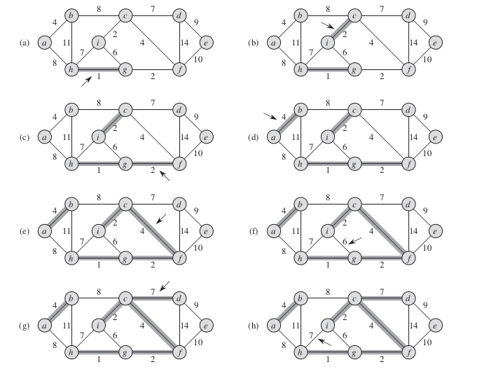
Kruskal Algorithm
Minimum Spanning tree algoithm
Find minimum weighted edge and detect cycles using union find.
An example of Kruskal Implementation

Slide 3
Data Structures : Unsorted and Sorted Array
Unsorted Array
To perform extract minimum operation of kruskal’s algorithm,finding and deleting minimum in unsorted array can take O(E). Therefore,
Worst and Average case : O(E²)
Sorted Array
Insertion of elements and sorting the array can result in O(E+ElogE) overall time complexity for implementing kruskal’s algorithm

Slide 4
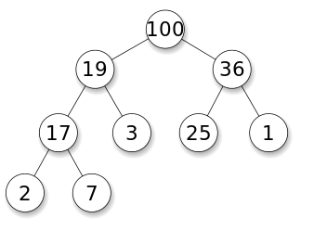
Data Strucutres : Binary Heap
Shape property: a complete binary tree where all levels need to be completely filled except for the rightmost last level
Heap property : the key stored in each node is either (≥) or (≤) the keys in the node's children.
Time Complexity
Insertion : O(logE)
Deletion : O(logE)
Overall complexity for Kruskal :
Best Case : O(E+VlogE)
Worst and Average Case : O(E+ElogE)

Slide 5
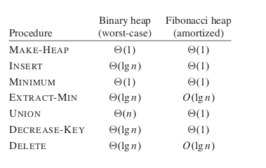
Fibonacci Heaps
Collection of rooted trees that are min-heap ordered.
Children of a node are linked together in a Circular,doubly linked List.
Support Mergeable heap operations.
Similar to binomial heaps but have a less rigid structure.
Binomial heaps merge heaps immediately but Fibonacci heaps wait to merge until the extract-min function is called.
Time Complexity Comparison:

Slide 6
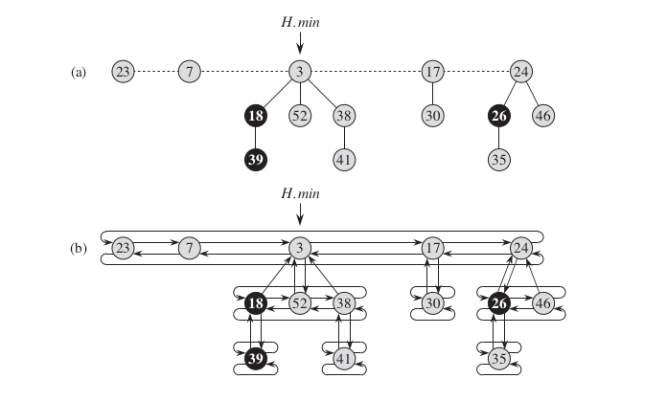
Memory Representation of Fibonacci Heap
A Fibonacci heap node has following attributes :
X.degree : Number of children.
X.key : actual value.
X.left & X.right : Pointers to the sibling nodes.
X.parent : Pointer to the parent node.
X.child : any one child node of itself.
X.mark : Indicates whether node x has lost a child since the last time x was made the child of another node.

Slide 7
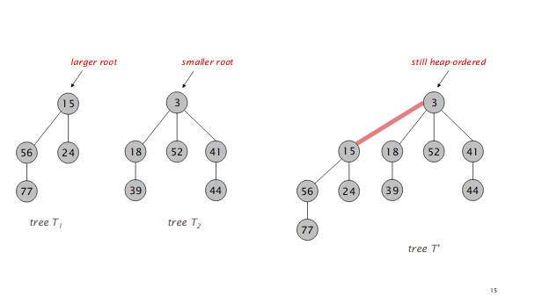
Operations Of Fibonacci Heap
Insertion
Create a new singleton tree. Add to root list; update min pointer (if necessary).
Linking
Make larger root be a child of smaller root.

Slide 8
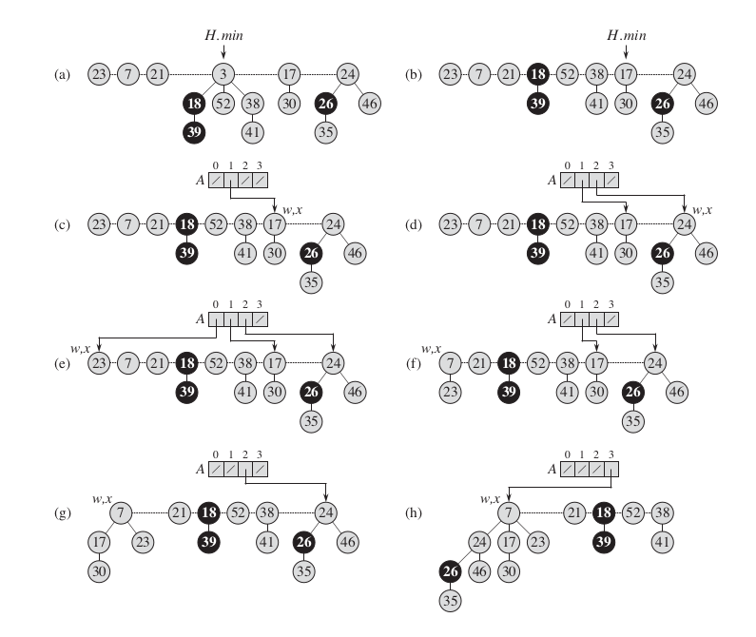
Delete Minimum
Meld the child nodes of min pointer node to root list.
Delete node referred by H.min.
Update H.min pointer to point to next node.
Consolidate trees so that no two trees have the same rank.

Slide 9
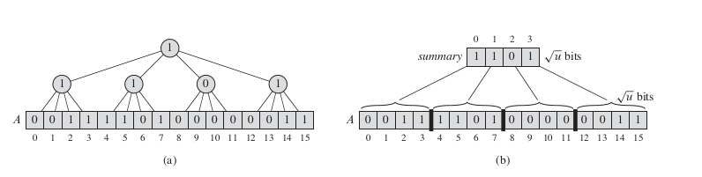
Van Emde Boas
Before going to VEB let us analyse different approaches to store dynamic data set and the complexity of implementing dictionary using these approaches
Superimposing a tree of constant height on bit Vector
Let us assume that the size of the universe is u= 2 2 for some integer k, so that u is an integer. We will superimpose a tree of degree u 1/2 , so that the height of the tree will always remains 2

Slide 10
Bitvectors
A bitvector is an array of bits of length U.
Represents a set of elements with insertions, deletions, and lookups each taking time O(1):
To insert x, set the bit for x to 1.
To delete x, set the bit for x to 0.
To lookup x, check whether the bit for x is 1.
Space usage is Θ(U).
1101110010111011110001001101010111100110111101111

Slide 11
Recursive Approach
Now, we make the structure recursive, shrinking the universe size by the square root at each level of recursion
T (u) = T ( √ u ) + O (1)
T (u) = O (loglog(u))
The cluster number in which x value resides will be given by f loor(x/ √ u )
high(x) = f loor(x/ √ u )
low(x) = x mod √ u
index(x, y ) = x √ u + y
The function high(x) gives the most significant bits of x, producing the number of x’s cluster.
The function low(x) gives the least significant bits of x and provides x’s position within its cluster

Slide 12
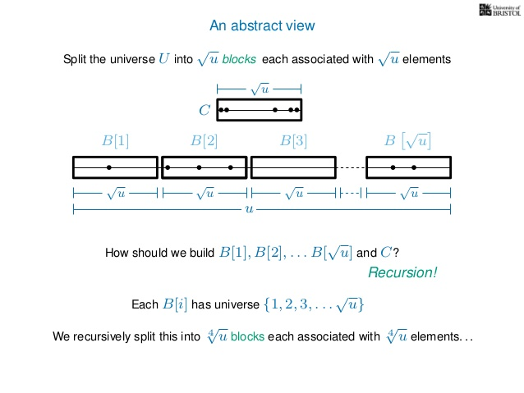

Slide 13
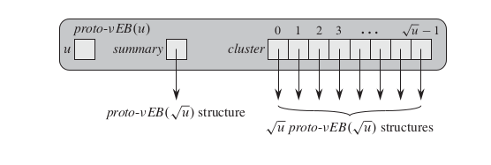
Proto-vEB Tree
Using the above recursive approach we discuss our recursive data structure Proto Veb which will fail to achieve our goal of O(loglog(u)) time but serves as a basis for the vEB structure.
Attributes of the structure:
● u ​ is the universe size of the bit vector. If u=2 then it is the base size which contains
an array A[0..1] of two bits .
● A pointer name summary to a proto-vEB( √ u ) structure.
● An array cluster [0.... √ u -1] of √ u pointers each pointing to some other proto-vEB(
√ u ) structure.

Slide 14
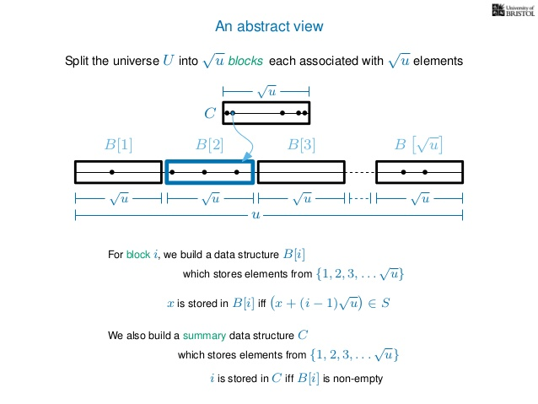

Slide 15
Complexity analysis on proto-vEB structure:
Insertion
It involves two recursive insertion into summary and cluster which leads to the following recurrence relation.
T(u)=2T(√ u )+O(1))
Overall Insertion time becomes: O(logu))
Finding Minimum
Finding minimum also requires two recursive calls ,first to find minimum in summary and then in respective cluster.
T(u)=2T(√ u )+O(1)
Overall Insertion time becomes: O(logu)
Deletion
We need to determine whether any bit in the appropriate cluster is 1. As we have defined proto-vEB structures, we would have to examine all u bits within a cluster to determine whether any of them are 1.
T(n)=2T(√ u )+O(√ u )

Slide 16
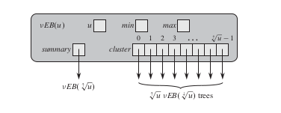
vEB Tree
In case of proto-vEB we have to recurse multiple times to implement many operations due to which we fail to achieve O(loglog(u)) complexity . To reduce the need of some recursion, we store a little more information using vEB-structure.

Slide 17
Min and max attributes will help to reduce time in the following way:
For finding the min and max element we need not to recurse down in cluster or summary, hence constant time will be required.
For determining the no. of elements in the vEB tree we can use the min and max values.
If min and max both NIL then vEB Tree is empty. If min and max are equal to each other and not NIL then vEB Tree has only one element otherwise the tree has two or more elements.
The above determination can be done in constant time providing help in insert and delete operation.
If vEB tree is empty we can insert an element by just updating the min and max values in constant time.
Similarly deletion of single element can be done in constant time by setting the min and max to null.

Slide 18
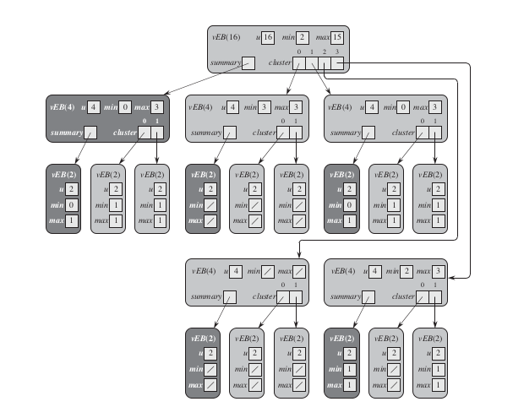
An example of vEB(16) that stores the set {2, 3, 4, 5, 7, 14, 15}.The value stored in the min attribute of a vEB tree does not appear in any of its clusters.

Slide 19
Operations in vEB :
Insert
vEB structure reduces two recursive calls to one .If cluster already has some element then no need to update summary otherwise update summary also.
Time Complexity :
T(u)=T(u)+O(1)
T(u)=O(loglogu)
Finding Minimum
root vEB contains min value so O(1) time.
Deletion
1. If max==min then set max=min=nil and delete entry from summary
2. If element to be deleted(x) is equal to min then retrieve min from the node pointed by the cluster array of current node and recursively update the min of all the nodes with the min value retrieved from cluster array.
3.Similarly if element to be deleted is max then we will update it recursively .

Slide 20
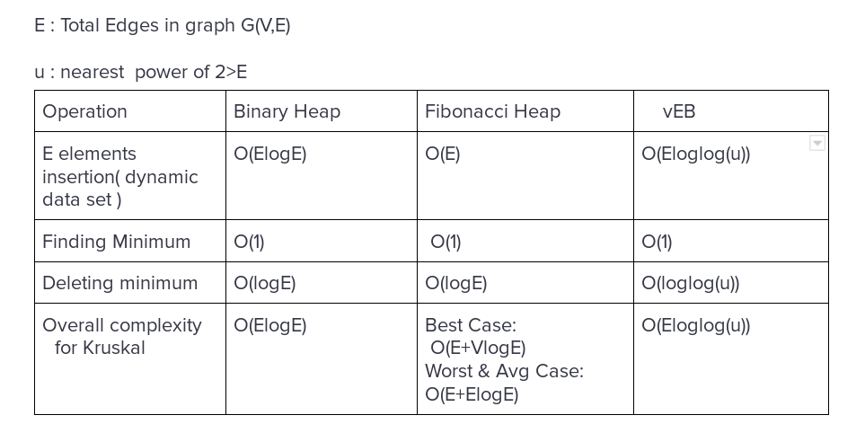
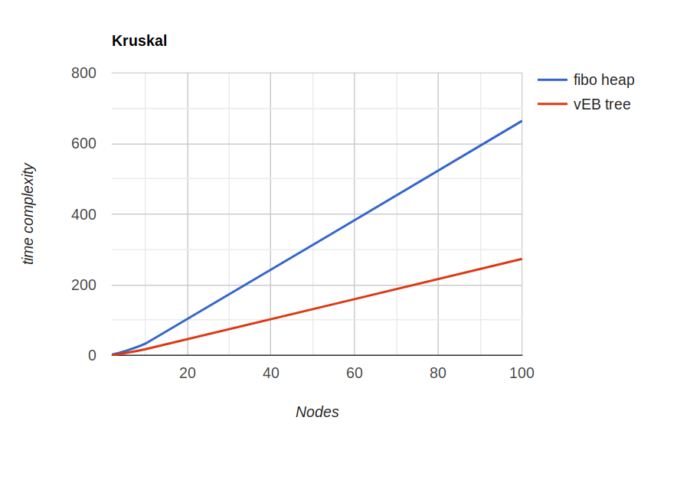
RESULTS

Slide 21
THANK YOU

