Slide 1


Online Shopping Site
Submitted To:
Mr. Mayank Jain
IIIT Kota
Submitted By:
Sudeep Singh Gill (2017KUCP1003)
Krishna Sharma (2017KUCP1005)
Apurv Jain (2017KUCP1016)

Slide 2


Grocery Mania

Slide 3
Project Background
Our project- “Online Shopping Site”, comes under the course, IT Workshop -3 (Python Lab), (Course Code: CSP 211).
The project gives real life understanding of Online Shopping.
We have named our project as: “Grocery Mania”.

Slide 4

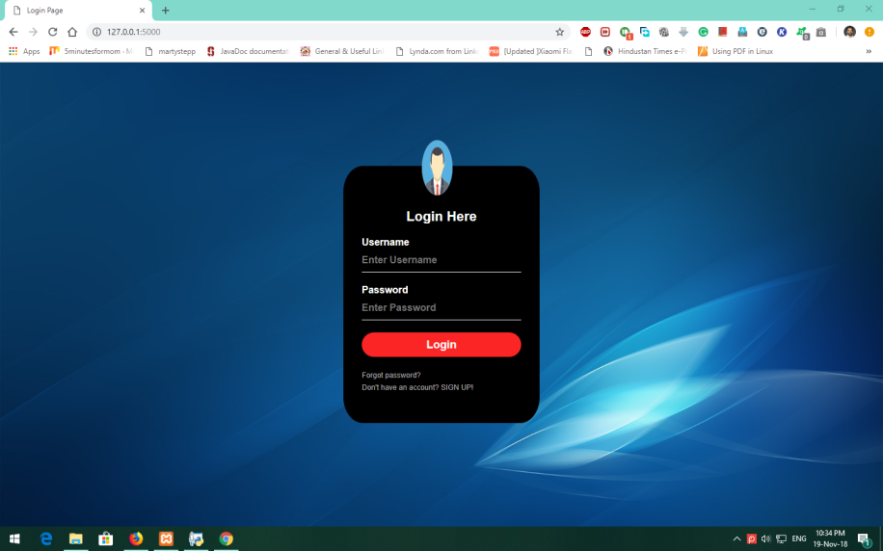
LOGIN
Any user can Login to the website through this page.

Slide 5
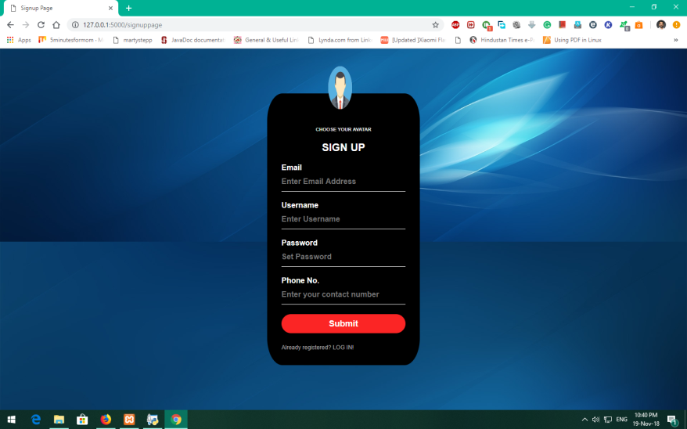
Sign Up
This is the Sign Up page.
Any new User can Register and make his/her Login Account.

Slide 6
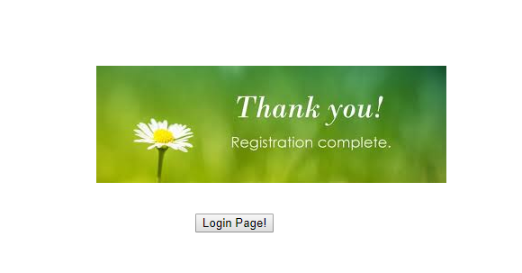
Successful Registration Acknowledgement

Slide 7
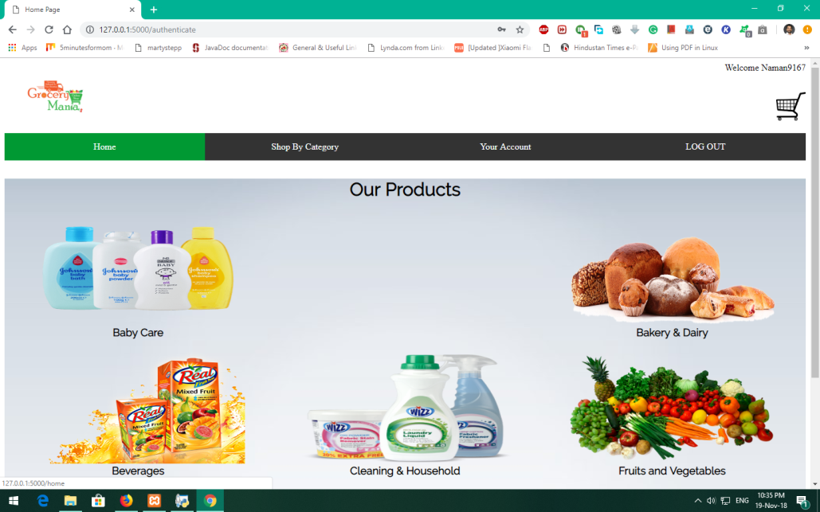
Home Page
This is the Home Page for the User.
The Home Page contains various options, such as: View Account, View Cart, Shop by Category etc.

Slide 8
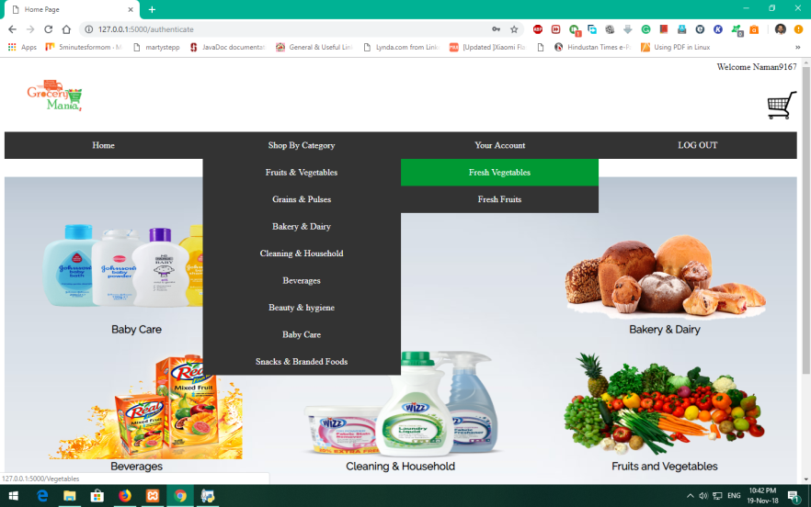
Shop By Category
The ‘Shop By Category’ tab contains various Product Categories like:
1. Fruits & Vegetables
2. Bakery & Dairy
etc.

Slide 9
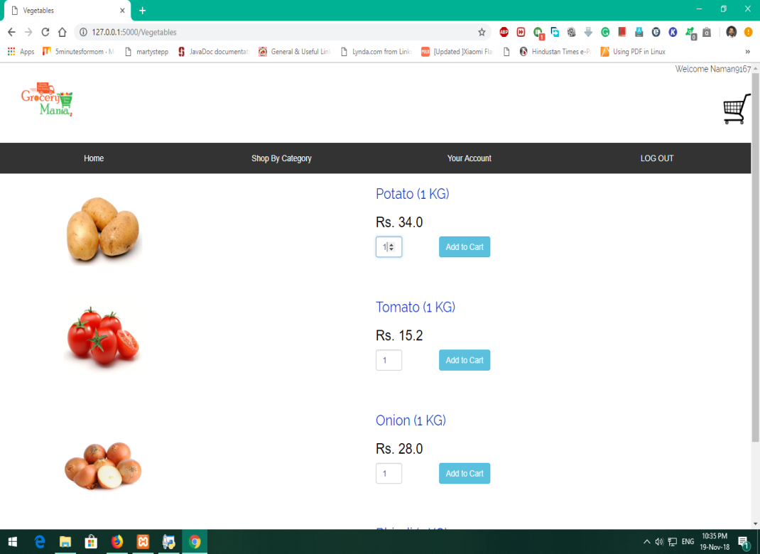

Product Page
As soon as the User selects one of the categories, the ‘Product Page’ of that category will open up.
This page will contain the Quantity & Price of the individual product.
The User can select the how much he/she wants to buy each product & can add it to cart.

Slide 10
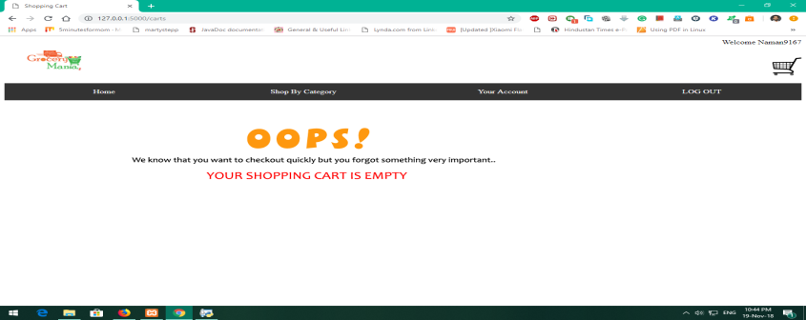

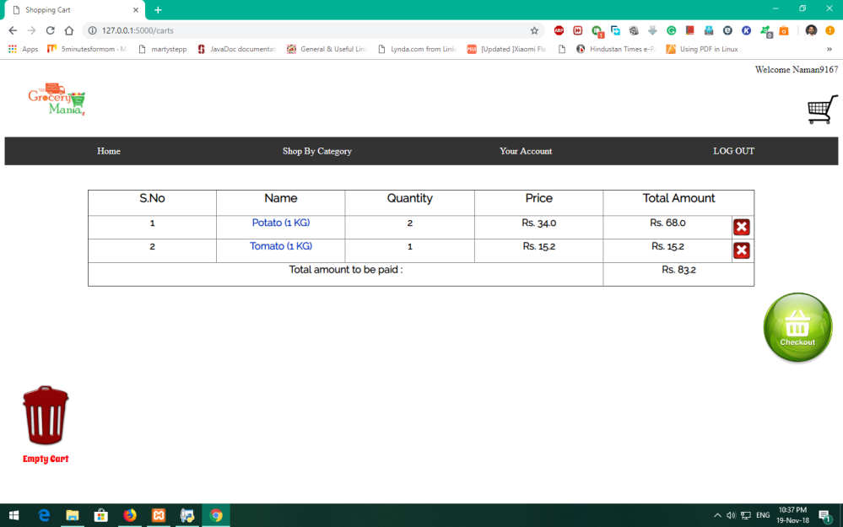


Cart
The User can view his/her “Cart” by clicking on the Cart icon.
If the Cart is empty, it will print a message about it.
Otherwise, the Product that have been added so far would be seen along with their Quantity demanded, Price, Total Amount of each Product & the Final price (or the Total Amount to be paid).
The user will have three options:
1. To cross out an item by clicking on the
cross button.
2. To Checkout the Cart & proceed
for next step.
3. To Empty Cart or delete all items added
so far.

Slide 11
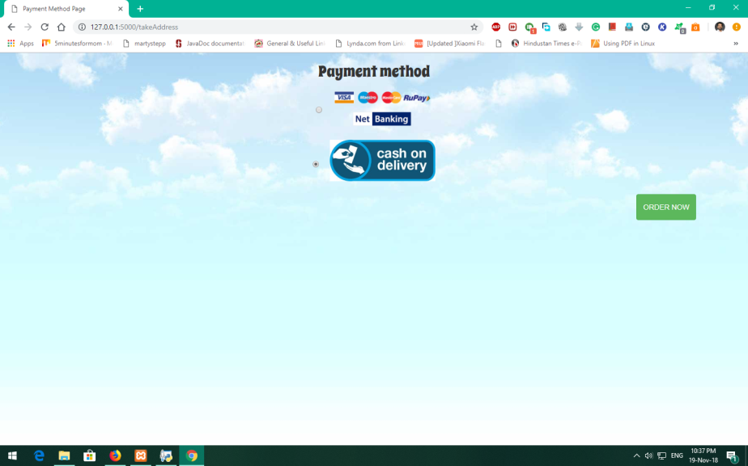

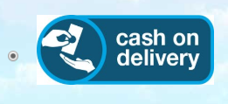

Payment Method
The user will have two options for Payment:
1. To pay through Net Banking
(Visa, Mastero, Master
Card or RuPay Debit/Credit/
ATM Card).
2. Cash On Delivery.
The user can Order or proceed
to next step through the
“ORDER NOW” button.

Slide 12
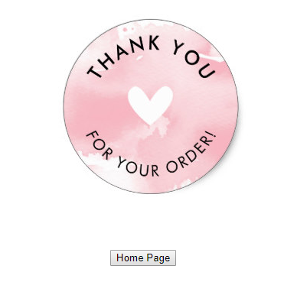
Successful Order Confirmation

Slide 13
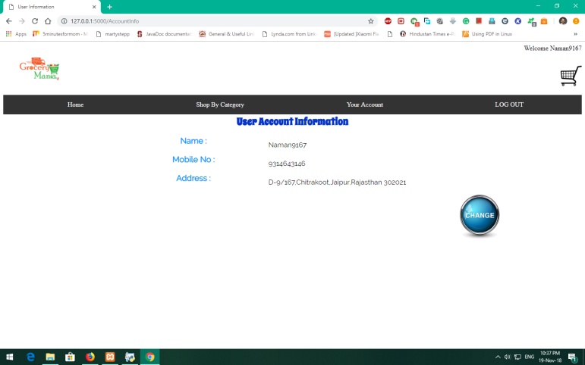

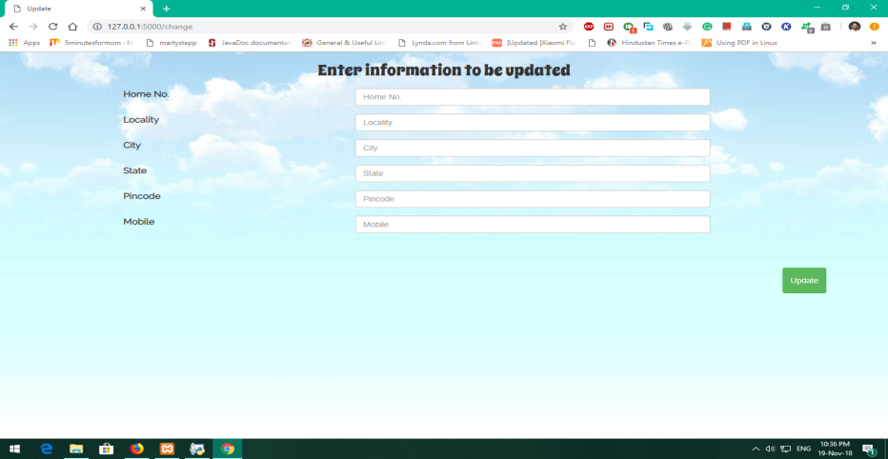
User Details
The User can view his/her Account Details through the “View Account” tab on the Home Page.
The User can view his/her details,
such as: Name (Login ID), Mobile
No. and Address.
He/she can also edit it through the
“Change” Button.
The User can update his/her Address & Mobile No.

Slide 14
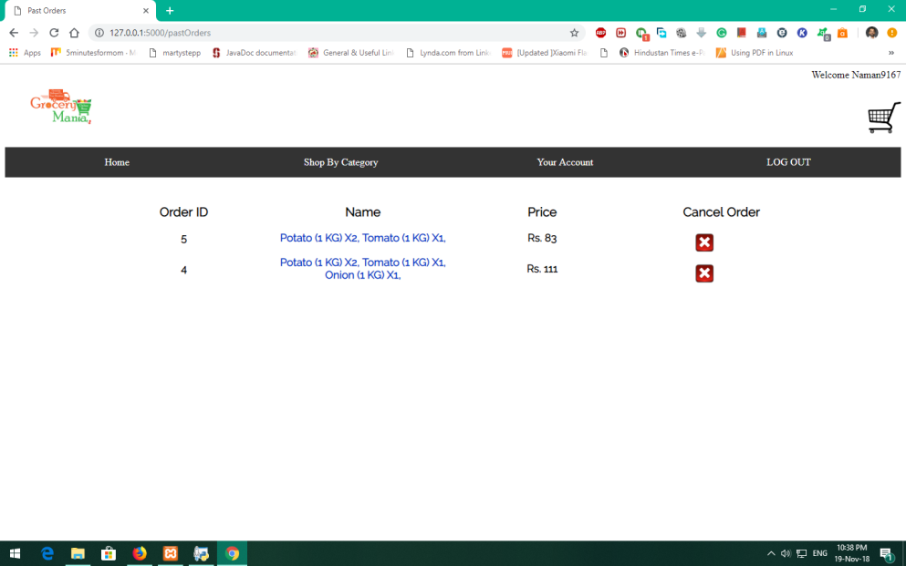
Past Orders
The User can view his/her Past Orders .
The User can also Cancel respective orders, if not delivered till now.

Slide 15
Project Timeline
13 NOV
20 NOV
PHASE 1
PHASE 2
Initial Progress & Synopsis
Final Project

Slide 16
Frontend Portion
DESIGNING
HTML
JavaScript
CSS

Slide 17
Backend Portion
DEVELOPING
SQL
Python
(Flask)

Slide 18
References
W3Schools Online Web Tutorials [Online]. Available: https://www.w3schools.com/
[Accessed : Nov. 18, 2018]
Flask Tutorial [Online]. Available: https://www.tutorialspoint.com/flask
[Accessed : Nov. 18, 2018]

Slide 19
Thank you

