Slide 1
CML: Control, Machine Learning and Numerics

Slide 2
Vision Transformer – A Deep Learning model for Image Analysis and Understanding CML: Control, Machine Learning and Numerics

Slide 3



Group Members
Friedrich-Alexander-Universität Technische Fakultät
Apurwa Agrawal
Kshitij Dua
Sneha Kumari
Amit Jadhav
Rajesh Madhipati
Masters in Data Science FAU Erlangen-Nuremberg
Masters in Data Science FAU Erlangen-Nuremberg
Masters in Data Science FAU Erlangen-Nuremberg
Masters in Data Science FAU Erlangen-Nuremberg
Masters in Data Science FAU Erlangen-Nuremberg
Vision Transformer – A deep learning model for image analysis and understanding

Slide 4


Course Advisors
Friedrich-Alexander-Universität Technische Fakultät
Prof. Dr. Enrique Zuazua Iriondo
Dr. Yongcun Song
Vision Transformer – A deep learning model for image analysis and understanding

Slide 5
Table of Content
01
Introduction
07
Limitations and Future directions
02
Motivation of Vision Transformers
08
Conclusion
03
Evolution of Transformers
09
References
04
Vision Transformer architecture
05
Training Vision Transformers
06
Performance and Applications
Vision Transformer – A deep learning model for image analysis and understanding
Technische Fakultät
5

Slide 6
Introduction
Vision Transformer – A deep learning model for image analysis and understanding

Slide 7
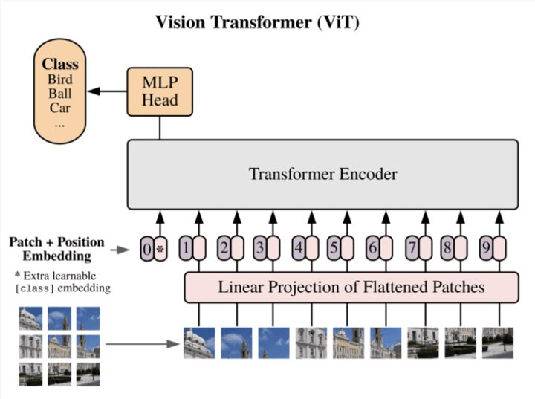
Introduction
The Transformer model was initially introduced for natural language processing tasks, such as machine translation and text generation. It is a sequence-to-sequence model that uses self-attention mechanisms to capture dependencies between words in a sequence.
The Vision Transformer (ViT) extends the Transformer architecture for computer vision tasks. While traditional convolutional neural networks (CNNs) have been the dominant approach for image classification and other vision tasks, the ViT explores the potential of self-attention mechanisms in processing images directly.
Vision Transformer – A deep learning model for image analysis and understanding
Technische Fakultät
7

Slide 8
Motivation
Vision Transformer – A deep learning model for image analysis and understanding

Slide 9

Motivation
Unlike RNN which process sequence step by step, transformers utilize a self-attention mechanism
Self-attention mechanism allows to attend all positions in the sequence at once
They are based on seq2seq method, i.e., transforming sequence into other sequences
Transformers have achieved the state-of-the-art performance in numerous natural language processing (NLP) tasks.
Vision Transformer – A deep learning model for image analysis and understanding
Technische Fakultät
9

Slide 10
Evolution of Transformers
Vision Transformer – A deep learning model for image analysis and understanding

Slide 11
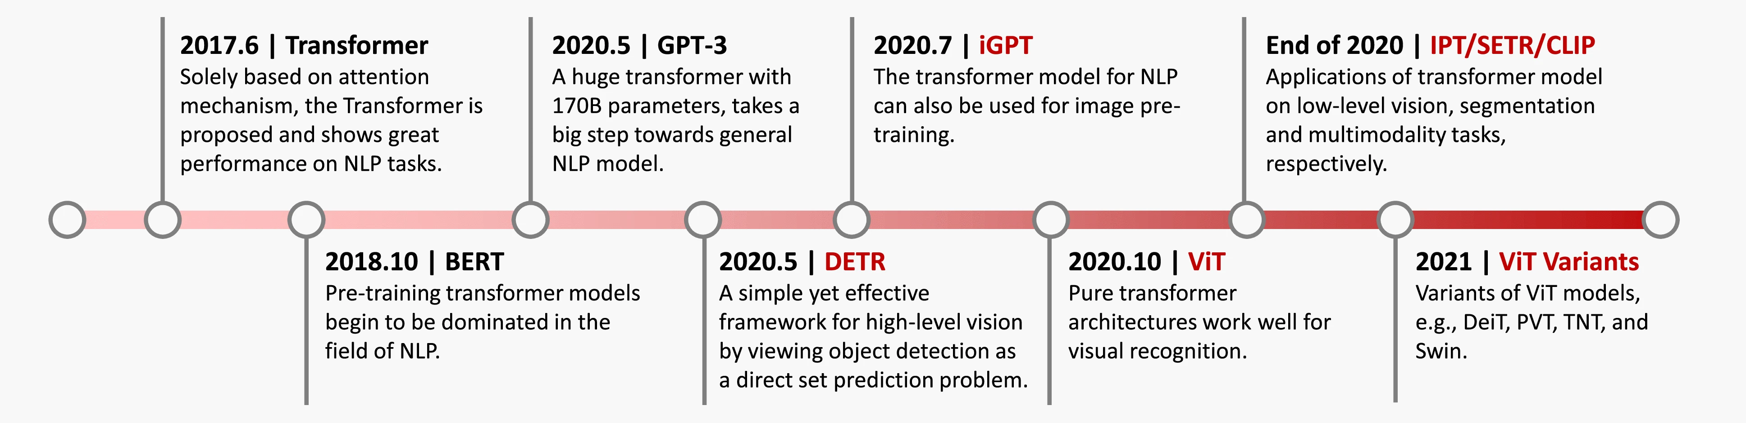
Evolution of Transformers
Vision Transformer – A deep learning model for image analysis and understanding

Slide 12
Core idea:
Images are also just “sequences” •
Separate images into patches •
Transform patches to tokens •
Encode patch-tokens using Transformer
Vision Transformer – A deep learning model for image analysis and understanding
Technische Fakultät
12

Slide 13
Evolution of Transformers
Transformers were introduced to address limitations of traditional approaches like CNN and RNN.
Capturing Long Distance Dependencies of RNN: Traditional models like recurrent neural networks (RNNs) suffer from difficulties in capturing long-range dependencies in sequences.
Difficulties with long sequences:
Large memory Usage
Difficult to train(vanishing/exploding gradients)
RNNs process sequences sequentially, which makes it challenging to capture relationships between distant elements. This is when the self-attention mechanism was introduced.
Vision Transformer – A deep learning model for image analysis and understanding
Technische Fakultät
13

Slide 14
Evolution of Transformers
The original Transformer model, proposed in the paper "Attention Is All You Need" by Vaswani et al. in 2017, introduced the concept of self-attention and positional encoding, which revolutionized the field of NLP.
Self-Attention mechanism also addressed below limitations of RNN:
Flexibility and Expressiveness
Information Flow and Contextual Modeling
Parallelization and Efficiency
Scalability
Vision Transformer – A deep learning model for image analysis and understanding
Technische Fakultät
14

Slide 15
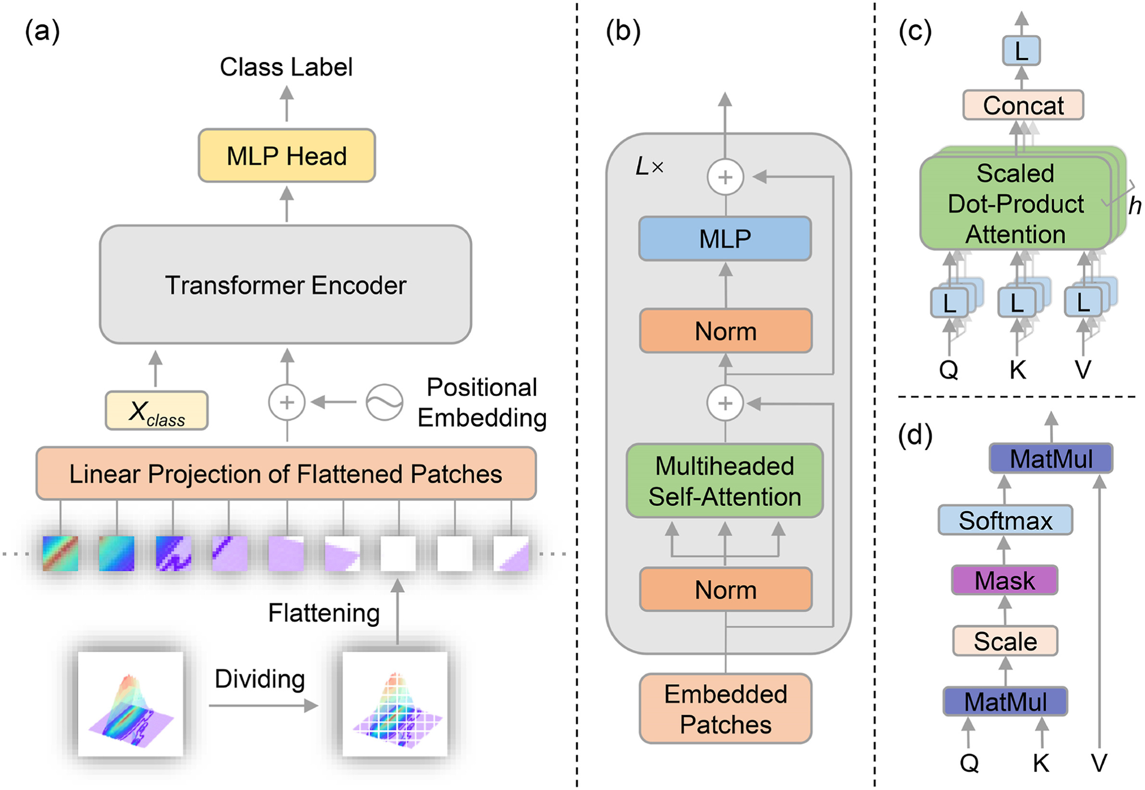
Vision Transformer Architecture
Vision Transformer – A deep learning model for image analysis and understanding

Slide 16
Vision Transformer Architecture
Vision Transformer – A deep learning model for image analysis and understanding
Technische Fakultät

Slide 17
3 Parts of Architecture
3. The classification head.
2. Feature extraction via stacked transformer encoders.
1. Patch embedding.
Vision Transformer – A deep learning model for image analysis and understanding
Technische Fakultät
17

Slide 18
1. Patch Embedding
Vision Transformer – A deep learning model for image analysis and understanding
Technische Fakultät
18

Slide 19


1. Patch Embedding
Batch of images b
Vision Transformer – A deep learning model for image analysis and understanding
Technische Fakultät
19

Slide 20
1. Patch Embedding
One of the images
(b, h, w, c)
Batch of images b
b = batch h = height
w = width
c = channel
Vision Transformer – A deep learning model for image analysis and understanding
Technische Fakultät
20

Slide 21









1. Patch Embedding
2
1
3
n patches of the image
4
5
6
7
8
9
One of the images
(b, h, w, c)
Batch of images b
Vision Transformer – A deep learning model for image analysis and understanding
Technische Fakultät
21

Slide 22
1. Patch Embedding
2
1
3
n patches of the image
4
5
6
7
8
9
One of the images
(b, h, w, c)
Batch of images b
p = pre-defined parameter
2
4
5
6
7
8
9
1
3
The image is split into n square patches of shape (p,p,c),
Vision Transformer – A deep learning model for image analysis and understanding
Technische Fakultät
22

Slide 23
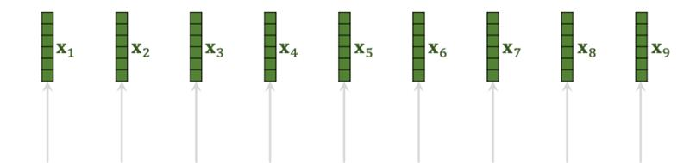
1. Patch Embedding
Flat patches (b, n, (p^2*c))
Flatten the patches
2
4
5
6
7
8
9
1
3
Every patch has a feature vector of dimesion (1, p^2*c)
Vision Transformer – A deep learning model for image analysis and understanding
Technische Fakultät
23

Slide 24
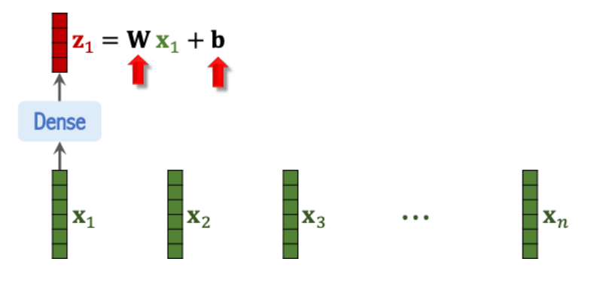
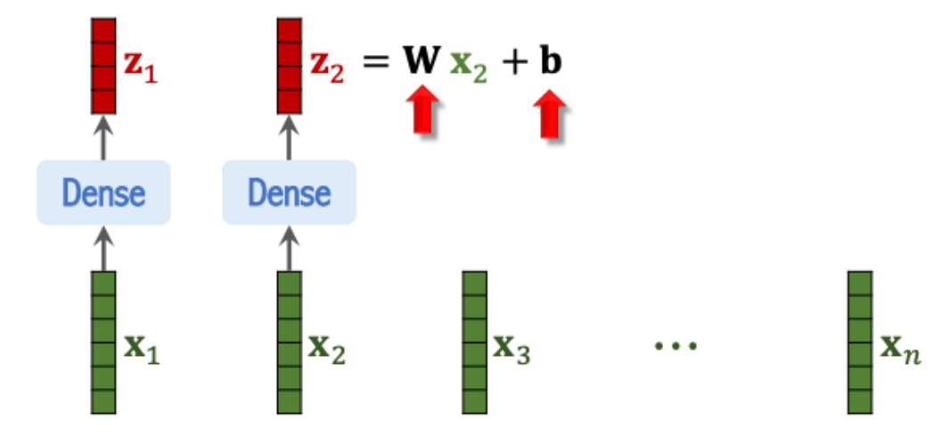
1. Patch Embedding
Embeddings ((p^2 * c), d)
The flattened patches are multiplied with a trainable embedding tensor of shape (p²*c, d), which learns to linearly project each flat patch to dimension d.
Vision Transformer – A deep learning model for image analysis and understanding
Technische Fakultät
24

Slide 25
1. Patch Embedding
(b,n+1,d)
Embeddings ((p^2 * c), d)
Vision Transformer – A deep learning model for image analysis and understanding
Technische Fakultät
25

Slide 26
1. Patch Embedding
(CLS)Token
(1,d)
(b,n+1,d)
A learnable (CLS) token of shape (1, d) is prepended to the sequence of patch embeddings.
n embedded patches of shape (1,d)
(b, n+1, d)
(n+1,d)
Patched embeddings
Positional embeddings E_{pos} This tensor learns 1D positional information for each of the patches, in order to add a spatial representation of each patch within the sequence.
Vision Transformer – A deep learning model for image analysis and understanding
Technische Fakultät
26

Slide 27
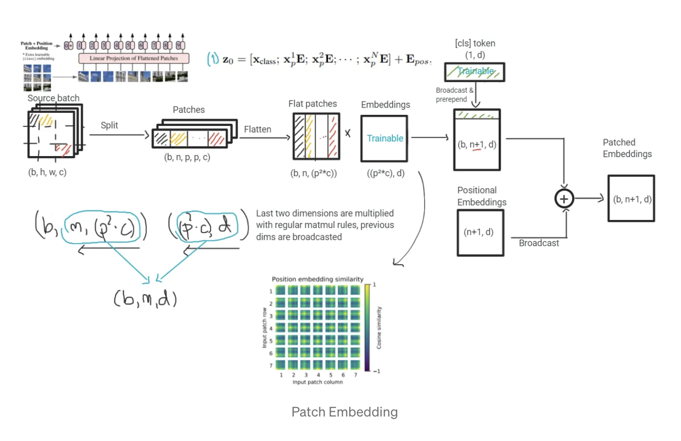
1. Patch Embedding
In the first step, an input image of shape (height, width, channels) is embedded into a feature vector of shape (n+1, d), following a sequence of transformations. This corresponds to equation (1) :
Vision Transformer – A deep learning model for image analysis and understanding
Technische Fakultät
27

Slide 28
2. Transformer Encoding
Vision Transformer – A deep learning model for image analysis and understanding
Technische Fakultät
28

Slide 29
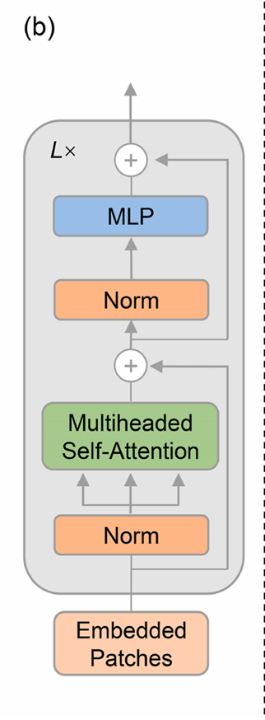
2. Transformer Encoding
In the second step, the network learns more abstract features from the embedded patches, using a stack of E transformer encoders.
The encoder components contains
a multi-head attention(MHA) mechanism
a 2-layer MLP with with
Layer normalization
Residual connections
Vision Transformer – A deep learning model for image analysis and understanding
Technische Fakultät
29

Slide 30
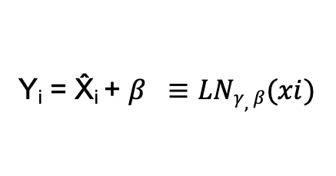
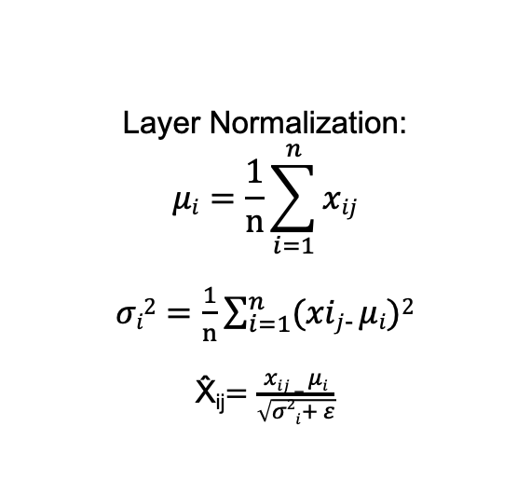
2.1 Layer Normalization
2. Transformer Encoding
Residual connection
(b,n,d)
(b,n,d)
(b,n,d)
(b,n,d)
Layer Norm
MSA
Z_{e-1}
LN(Z_{e-1})
MSA(LN(Z_{e-1}))
Z’_{e}
Z’_{e} = MSA(LN(Z_{e-1})) + Z_{e-1 ,} where e = 1 … L (2)
Layer Normalization:
$$μi=\frac{1}{n}\sum_{i=1}^{n}{xij}$$
$σi2=\frac{1}{n}\sum_{i=1}^{n}{(xij}$₋ $μi)2$
X̂_{ij}$=\frac{xij − μi}{\sqrt{σ2i+ ε}}$
Y_{i} = X̂_{i} + $β ≡LNγ,β(xi)$
Layer normalization helps to stabilize hidden state dynamics and to reduce the training time.
MSA = Multi sequence alignment
Residual connections offer gradients alternative paths, to solve the vanishing gradients problem
Vision Transformer – A deep learning model for image analysis and understanding
Technische Fakultät

Slide 31
2.1 Layer Normalization
2. Transformer Encoding
Layer Normalization
Batch Normalization
batch
batch
mean
std
1
2
0
4
5
1
3
2
1
6
2
0
6
2
5
1
3
1
1
2
0
4
5
1
3
2
1
6
2
0
6
2
5
1
3
1
3
2
3
4
3
1
3
0
3
3
2
1
Same for all features dimensions
mean
2
3
3
Sample for all training examples
std
2
2
2
Vision Transformer – A deep learning model for image analysis and understanding
Technische Fakultät

Slide 32
2.1 Layer Normalization
2. Transformer Encoding
Features multiplied with
scaling factor and added to shifting factor both learnable during training
d_{MLP}
d
d
Residual connection
(b,n,d)
(b,n,d)
(b,n,d)
(b,n,d)
Layer Norm
MSA
Layer Norm
Z_{e-1}
LN(Z_{e-1})
MSA(LN(Z_{e-1}))
Z’_{e}
Trainable
Next encoder
(b,n,d)
(b,n,d)
Since the input through output the dimension is same, hence it is stackable
Residual connection
Z_{e}
MLP(LN(Z’_{e}))
Z_{e} = MLP(LN(Z’_{e})) + Z’_{e.} e = 1 … L. (3)
Vision Transformer – A deep learning model for image analysis and understanding
Technische Fakultät

Slide 33
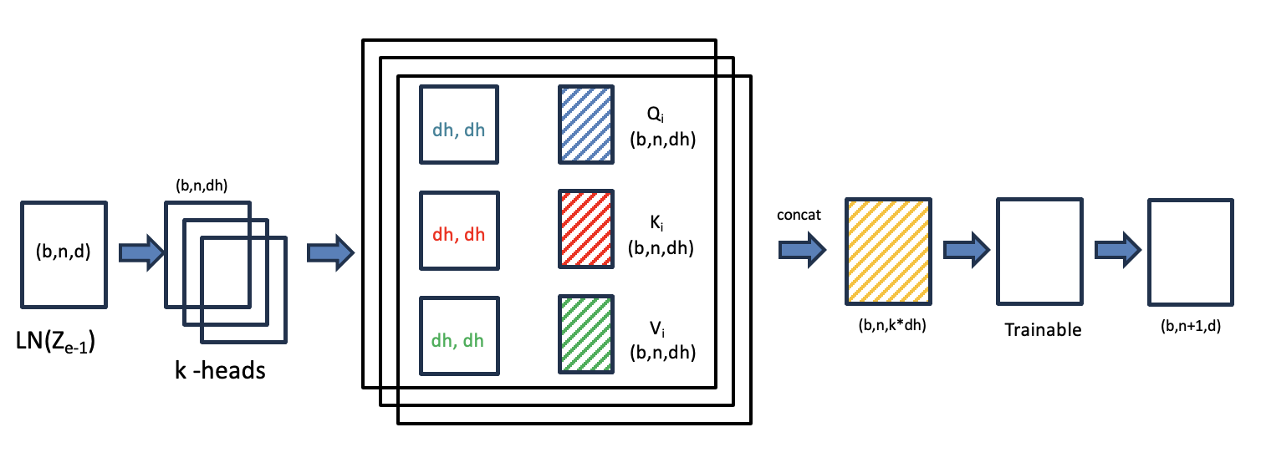
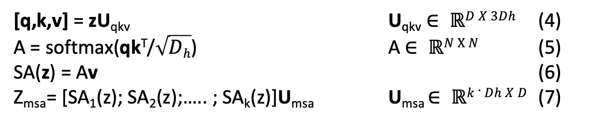
2.2 Multi-head Attention
2. Transformer Encoding
The multi-head attention(MHA) step, included in each L stacked transformers, corresponds to equations (4), (5), (6) and (7)
[q,k,v] = zU_{qkv} U_{qkv} $∈ ℝD X 3Dh$ (4)
A = softmax(qk^{T}/$\sqrt{Dh}$) A $∈ ℝN Χ N$ (5)
SA(z) = Av (6)
Z_{msa}= [SA₁(z); SA₂(z);….. ; SA_{k}(z)]U_{msa} U_{msa} $∈ ℝk . Dh X D$ (7)
Vision Transformer – A deep learning model for image analysis and understanding
Technische Fakultät

Slide 34

2.2 Multi-head Attention
2. Transformer Encoding
Ki, Qi , Vi = projection of input in 3 sub-spaces(matrix)
Q_{i}
d_{h}, d_{h}
(b,n,d_{h})
(b,n,d_{h})
K_{i}
concat
d_{h}, d_{h}
(b,n,d_{h})
(b,n,d)
(b,n,k*d_{h})
(d,d)
(b,n+1,d)
LN(Z_{e-1})
d_{h}, d_{h}
V_{i}
SA(Z)
Trainable
MSA(Z)
(b,n,d_{h})
Hidden state from previous encoder split into k-heads
Feature tensor(Z)
Each feature tensor is multiplied with Q_{i}, K_{i}, V_{i}
[q,k,v] = ZU_{qkv} U_{qkv} $∈ ℝD X 3Dh$ (4)
Vision Transformer – A deep learning model for image analysis and understanding
Technische Fakultät

Slide 35
2.2 Multi-head Attention
2. Transformer Encoding
Vision Transformer – A deep learning model for image analysis and understanding
Technische Fakultät
35

Slide 36
2.2 Multi-head Attention
2. Transformer Encoding
Following on each head, the scaled dot-product attention tensor (A) is computed as :
A = softmax(qk^{T}/$\sqrt{Dh}$) A $∈ ℝN Χ N$ (5)
Self Attention: SA(z) = Av (6)
Self attention matrices are concatenated on the second dimension, resulting in (n+1 , d) tensor
Vision Transformer – A deep learning model for image analysis and understanding
Technische Fakultät
36

Slide 37
2.2 Multi-head Attention
2. Transformer Encoding
Vision Transformer – A deep learning model for image analysis and understanding
Technische Fakultät
37

Slide 38
2.2 Multi-head Attention
2. Transformer Encoding
The tensor in the above step is then run through a single linear layer, by effectively multiplying it with a (d,d) trainable tensor.
This linear layer is very important, as it allows features to be learned as aggregates from all the heads
Z_{msa}= [SA₁(z); SA₂(z);….. ; SA_{k}(z)]U_{msa} U_{msa} $∈ ℝk . Dh X D$ (7)
Vision Transformer – A deep learning model for image analysis and understanding
Technische Fakultät
38

Slide 39
3. Classification Head
Vision Transformer – A deep learning model for image analysis and understanding
Technische Fakultät
39

Slide 40
3. Classification Head
[cls] token is used in the classification head.
The trainable weights lie inside MHA & MLP weights
Pre-training - 2 layer of MLP used, hence 2 weight matrices
W_{h} [d, d_{mlp}]
W_{o} [d_{mlp}, d]
Output [1, n_cls]
Fine-tuning – single layer used, hence only 1 tensor [d, n_cls]
Output [1, n_cls]
Output: Probability associated with each of n_{cls} classes [1, n_{cls}]
y = MLP(LN(Z_{i}))
y = Linear(LN(Z_{i}))
Pre-training
Fine-tuning
Z_{i}
Output layer (d_{mlp}, n_{cls})
+ softmax
Z_{i}
Output layer (d, n_{cls})
+ softmax
(b,1, n_{cls})
(d, d_{mlp})
(b,1, n_{cls})
(b,1,d)
Hidden layer
(b,1,d)
Vision Transformer – A deep learning model for image analysis and understanding
Technische Fakultät
40

Slide 41
Trainable Parameters
Model | Layers | Hidden size D | MLP size | Heads | Params
ViT-Base | 12 | 768 | 3072 | 12 | 86M
ViT-Large | 24 | 1024 | 4096 | 16 | 307M
ViT-Huge | 32 | 1280 | 5120 | 16 | 632M
Taking an example of ViT-Base architecture and calculate the no of parameters in the architecture
Vision Transformer – A deep learning model for image analysis and understanding
Technische Fakultät
41

Slide 42
Trainable Parameters
For patch embedding(assuming 256 patches each of 16*16 pixels):
(p²*c*d) + ((n+1)*d
= 256*3*768 + 256*768
= 786432
Therefore, 2 embedded matrices account for 786432 parameters
Model | Layers | Hidden size d | MLP size | Heads | Params
ViT-Base | 12 | 768 | 3072 | 12 | 86M
ViT-Large | 24 | 1024 | 4096 | 16 | 307M
ViT-Huge | 32 | 1280 | 5120 | 16 | 632M
Vision Transformer – A deep learning model for image analysis and understanding
Technische Fakultät
42

Slide 43
Trainable Parameters
Model | Layers L | Hidden size d | MLP size | Heads k | Params
ViT-Base | 12 | 768 | 3072 | 12 | 86M
ViT-Large | 24 | 1024 | 4096 | 16 | 307M
ViT-Huge | 32 | 1280 | 5120 | 16 | 632M
Encoder stack:
L*(k*d*3*d_{h} + d*d + d*d_{mlp} + d_{mlp} *d)
= 12*(12*768*3*64 + 768*768 + 2 *768*3072)
= 12*(1769472 + 589824 + 718592)
= 12*589824*(12)
= 84934656
Therefore approx 85 million parameters
Lx
L = 12
k = 12
d = 768
d_{h} = 768/12 = 64
D_{mlp} = 3072
Vision Transformer – A deep learning model for image analysis and understanding
Technische Fakultät
43

Slide 44
Trainable Parameters
Model | Layers | Hidden size D | MLP size | Heads | Params
ViT-Base | 12 | 768 | 3072 | 12 | 86M
ViT-Large | 24 | 1024 | 4096 | 16 | 307M
ViT-Huge | 32 | 1280 | 5120 | 16 | 632M
y = Linear(LN(Z_{i}))
Fine Tuning(Ex- on ImageNet):
d*n_{cls}
= 768*1000
= 768000
Therefore approx 768000 parameters
Hence in total we obtain around 86 million parameters
Fine-tuning
Z_{i}
Output layer (d, n_{cls})
+ softmax
(b,1, n_{cls})
(b,1,d)
Vision Transformer – A deep learning model for image analysis and understanding
Technische Fakultät
44

Slide 45
Performance, Limitations and Future Improvements
Vision Transformer – A deep learning model for image analysis and understanding

Slide 46
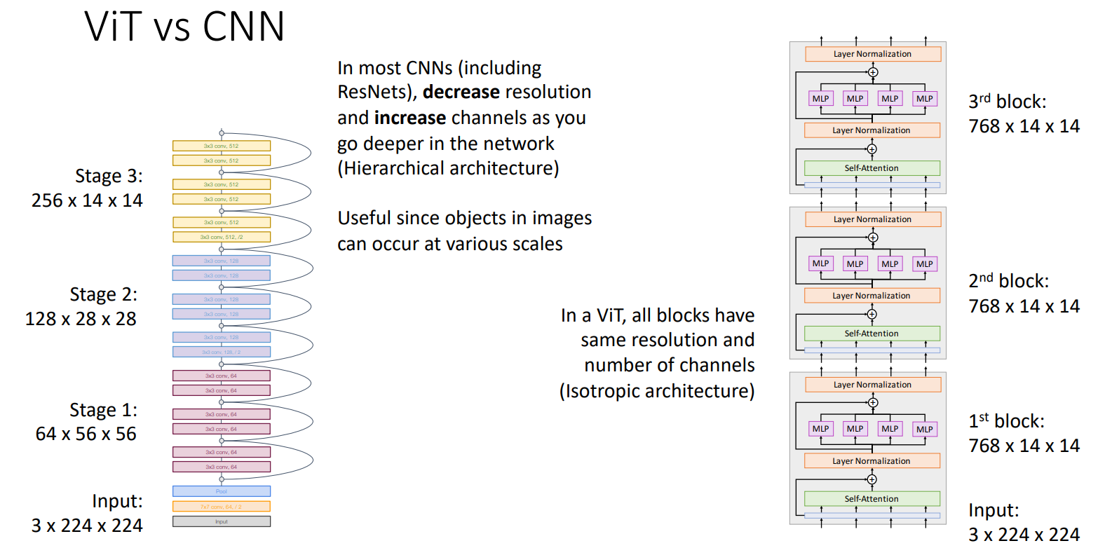
Performance Measure
Vision Transformer – A deep learning model for image analysis and understanding
Technische Fakultät
46

Slide 47
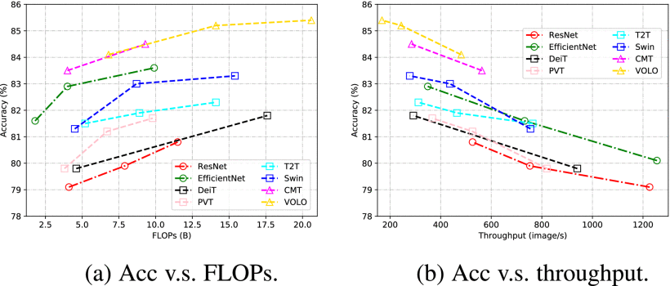
Performance Measure
Vision Transformer – A deep learning model for image analysis and understanding
Technische Fakultät
47

Slide 48
Limitations of ViT
Limited Spatial Information
Computational Complexity
Data Requirements
Generalization to Diverse Data
Interpretability and Explainability
Memory and Computational Efficiency
Continual Learning and Adaptability
Robustness to Variations
Vision Transformer – A deep learning model for image analysis and understanding
Technische Fakultät
48

Slide 49
Discussion and Conclusion
Superior Performance:
Demonstrated exceptional performance, surpassing traditional CNNs in various image analysis tasks..
Global Context Modelling:
capture global contextual information, enabling modeling of long-range dependencies and interactions between image elements.
Scalability and Adaptability:
Scalability and Adaptability: ViTs are highly scalable and adaptable, making them suitable for diverse applications and datasets.
Vision Transformer – A deep learning model for image analysis and understanding
Technische Fakultät
49

Slide 50
Future Improvements
Enhanced attention mechanism for better long-range dependency modeling.
Improved model efficiency with reduced computational complexity.
Advancements in interpretability for better understanding of attention maps.
Integration of multimodal information for enhanced performance.
Lifelong learning capabilities for continuous adaptation and knowledge retention.
Vision Transformer – A deep learning model for image analysis and understanding
Technische Fakultät
50

Slide 51
References
Han, Kai & Wang, Yunhe & Chen, Hanting & Chen, Xinghao & Guo, Jianyuan & Liu, Zhenhua & Tang, Yehui & Xiao, An & Xu, Chunjing & Xu, Yixing & Yang, Zhaohui & Zhang, Yiman & Tao, Dacheng. (2022). A Survey on Vision Transformer. IEEE Transactions on Pattern Analysis and Machine Intelligence. PP. 1-1. 10.1109/TPAMI.2022.3152247.
C. Subakan, M. Ravanelli, S. Cornell, M. Bronzi and J. Zhong, "Attention Is All You Need In Speech Separation," ICASSP 2021 - 2021 IEEE International Conference on Acoustics, Speech and Signal Processing (ICASSP), Toronto, ON, Canada, 2021, pp. 21-25, doi: 10.1109/ICASSP39728.2021.9413901.
Dosovitskiy, Alexey & Beyer, Lucas & Kolesnikov, Alexander & Weissenborn, Dirk & Zhai, Xiaohua & Unterthiner, Thomas & Dehghani, Mostafa & Minderer, Matthias & Heigold, Georg & Gelly, Sylvain & Uszkoreit, Jakob & Houlsby, Neil. (2020). An Image is Worth 16x16 Words: Transformers for Image Recognition at Scale.
Vision Transformer – A deep learning model for image analysis and understanding
Technische Fakultät
51

Slide 52
Thankyou
Vision Transformer – A deep learning model for image analysis and understanding

