Slide 1


Road Scene Understanding for the Visually Impaired
(RSU-VI)
Team 1

Slide 2



Course advisors
Hakan Calim
Badhan Kumar Das

Slide 3
Group Members
Apurwa Agrawal
Priyanka Muddarla
Nuren Samia
Shaun Dsilva
Sahana Byregowda
Srusti Ujjini Math

Slide 4
Outline
Introduction to the Voice Assistance System
Overview of Speech Recognition
Speech to Text and Text to Speech
Challenges
FINALLY, WE FIGURED IT!!!
Text To Speech
Conclusion
Future Works
Demo

Slide 5
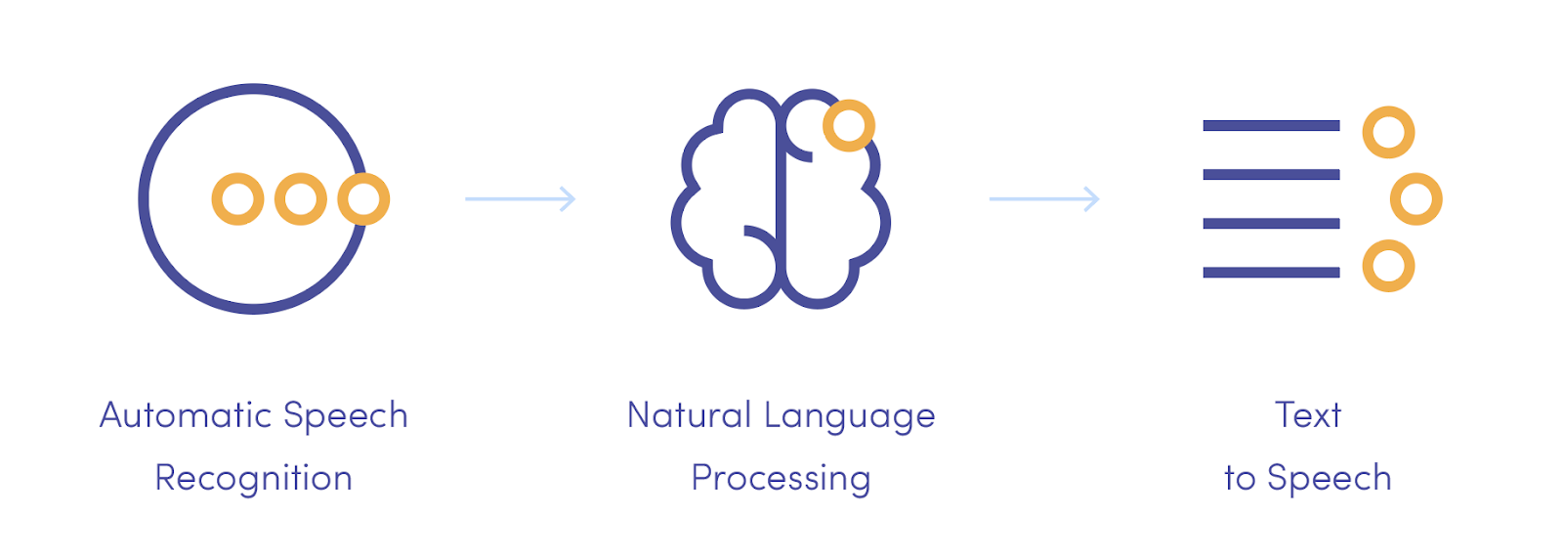
Introduction
What is a voice assistant?
Examples: Siri, Alexa
What is Voice Assistant doing in our project :
In earlier Implementation
Enhancing Natural Language Processing (NLP)
Notes:
What is VA doing in our project
Since we hv prior implimentation it used be stARETED manuly this one can be swtchd to speech inpts
Intro NLP more Accurate to recognice different accent dlcts

Slide 6

Advantages of Voice Assistance in BVIP(Blind or Visually impaired person)
Voice-Activated Commands
Real-Time Guidance
Points of Interest Identification
Accessibility and Safety
Customization and Personalization
Integration with Other Accessibility Features

Slide 7
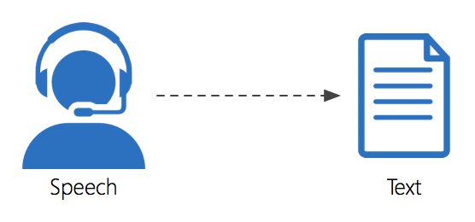
Speech to Text
Numerous technologies for STT.
How does it function ?
Where do we have its uses.
What will this help us in.
Notes:
There are lot of technologies that converts spoken language into written text.
It takes audio input, such as recorded speech or live speech, and transcribes it into written form.
The commonly used applications are Voice Assistants, Transcription services, Voice recognition services etc.
This will enable us to dictate text, convert the audio into written format and interact using voice commands.

Slide 8
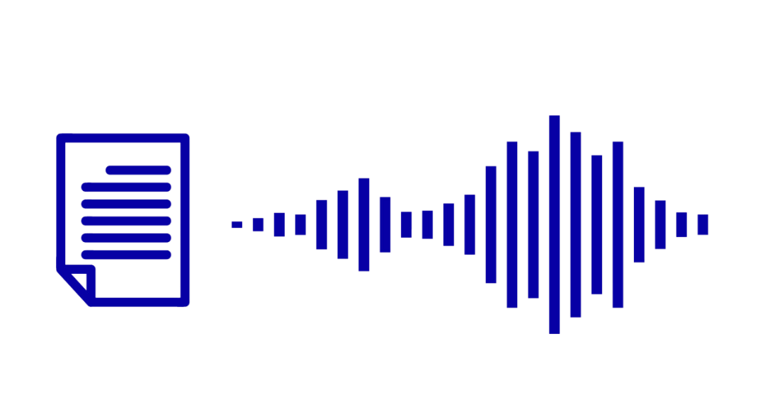
Text to Speech
TTS converts written text into spoken words
It uses natural language processing to understand the text and generate natural-sounding speech.
TTS systems employ voice synthesis techniques to produce the spoken output.
TTS has applications in accessibility, navigation systems, virtual assistants, and more.
Notes:
There are lot of technologies that converts spoken language into written text.
It takes audio input, such as recorded speech or live speech, and transcribes it into written form.
The commonly used applications are Voice Assistants, Transcription services, Voice recognition services etc.
This will enable us to dictate text, convert the audio into written format and interact using voice commands.

Slide 9
Challenges
Operating Systems
Needed VM setup as none of our systems were Linux and CIP pools gives only 2GB data limit
MacOS:
Silicon Processor of MacOS
VM – Qemu with UTM
Windows:
Dependencies for different ASR tools were not same as linux.
VM setup and Microphone issue resolved

Slide 10
ASR Tools
Kaldi:
One of the important dependencies – Python 2.7
About 40 GB of space is required
Huge setup time
Not accurate speech recognition
Speech recognition:
Background noise
Performance based on accent, dialect and speaking speed
Homophones - ‘two’ and ‘to’

Slide 11
ASR Tools
Sphinx:
Reduced accuracy in complex acoustic environment, noisy recordings, accents etc
Adaptation to speaker variability
Difficult to handle complex sentences
Complex Fine-tuning
Bad output speech quality
HuggingFace :
Limited language selection
The data capturing was not accurate
Download different dataset
Notes:
leon Espnet

Slide 12
When ASR became a battle of giants

Slide 13


Finally, we figured it out !!
Whisper
PYTTSX3

Slide 14
Open AI Whisper – an Overview
According to OpenAI, Whisper is a general-purpose speech(automatic voice recognition system) recognition model
It is trained on a large dataset of diverse audio
It is also a multitasking model that can perform multilingual speech recognition, speech translation, and language identification
OpenAI Whisper is very fast.

Slide 15
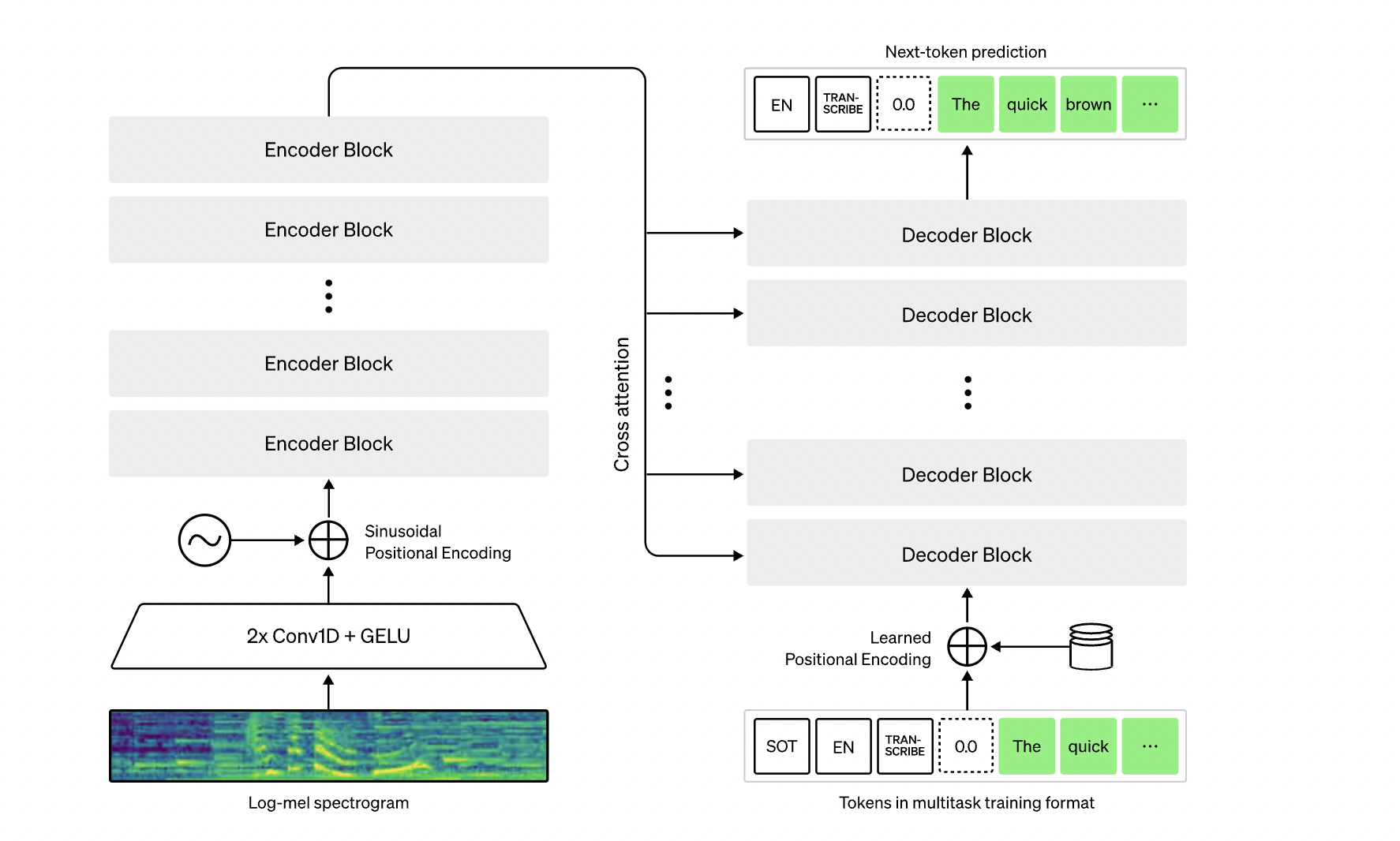
Architecture of Whisper
Source: https://openai.com/research/whisper
Notes:
- Open Ai whisper works on the transformer model ()
- It has encoder and decoder layers
- The input to the transformer model is usually tokenized into smaller units, such as words or subwords
- eg
-pretraining and fine tuning
OpenAI models are based on a deep learning technique called a transformer.
Transformers are a type of neural network architecture that has been highly successful in natural language processing tasks.
The key idea behind transformers is self-attention, which allows the model to focus on different parts of the input sequence when generating an output.
The architecture of a transformer consists of multiple layers, typically called encoder and decoder layers.
The encoder processes the input sequence,
while the decoder generates the output sequence.
Each layer within the encoder or decoder is composed of multiple attention heads, which enable the model to capture different types of relationships and dependencies in the data.
The input to the transformer model is usually tokenized into smaller units, such as words or subwords, Once trained, the models can be fine-tuned on specific tasks or domains to further improve their performance. Overall, OpenAI's architecture, based on transformers, enables their models to understand and generate human-like text, making them powerful tools for a wide range of natural language processing tasks.

Slide 16
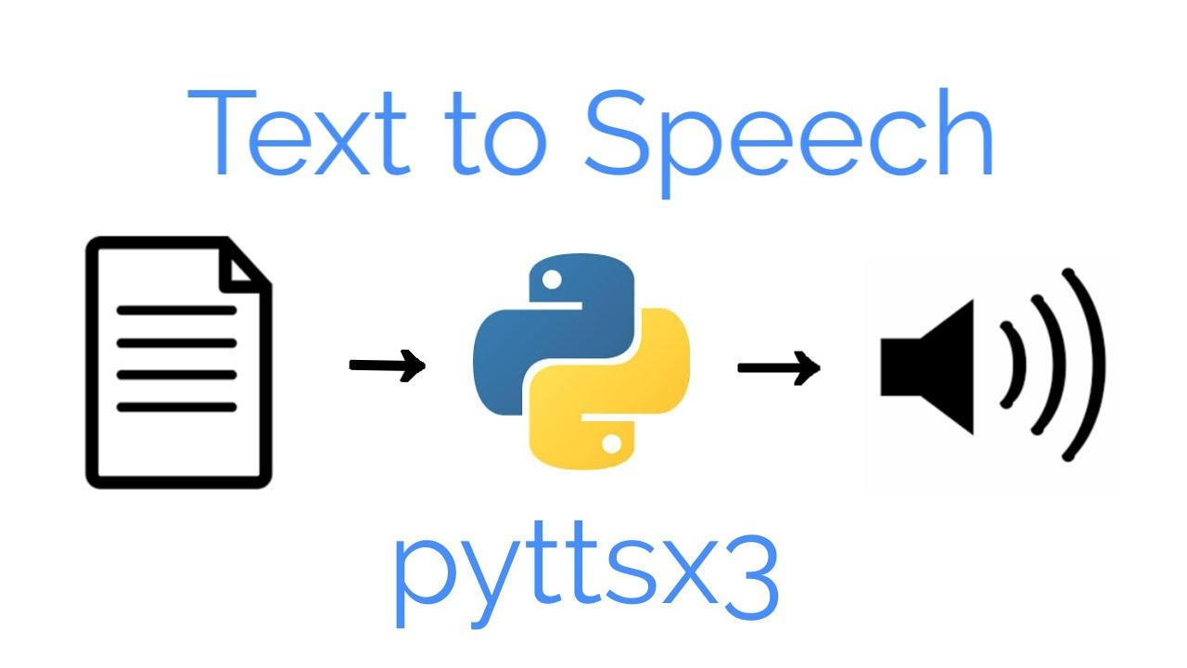
Pyttsx3
Pyttsx3 is a Python library that provides a simple yet powerful interface for performing text-to-speech conversion.
Here's an overview of pyttsx3's key features:
Easy installation
Platform independence
Multiple speech engines
Voice customization
Compatibility with Python versions
Notes:
Pyttsx3 is a Python library that provides a simple yet powerful interface for performing text-to-speech conversion. It allows you to generate spoken output from text, making it useful in various applications, including presentations. Here's an overview of pyttsx3's key features:
1.Easy installation and usage: Pyttsx3 can be easily installed using the pip package manager, making it accessible to Python developers. Its intuitive API allows you to convert text to speech with just a few lines of code.
2.Platform independence: Pyttsx3 is platform-independent, which means it can be used on different operating systems such as Windows, macOS, and Linux without any modifications.
3. multiple search engines: It supports multiple search engines ,including Microsoft speech platform ,espeak .This flexibility allows us to chose the engine that best suits our needs or that is compatabile with our system.
4.Customizable voice settings: You have control over various voice parameters, including speech rate (speed), volume, and voice type. This allows you to fine-tune the generated speech to suit your requirement.
5 . Compatibility with Python versions: Pyttsx3 is compatible with both Python 2.x and 3.x versions, making it accessible to a wide range of developers and projects.

Slide 17
Conclusion
Improved usability and functionality of the system for blind or visually impaired persons (BVIPs).
Hands-free interaction to start , stop or shutdown the system using speech input
Can be integrated with Jetson Nano as this is supported in all 3 OS – Windows, MacOS, Linux
Space required is around 30 MB which is very less compared to Kaldi which required about 40 GB
Notes:
1. In conclusion, the implementation of a voice assistant system for the SENSATION system represents a significant advancement in improving the usability and functionality of the system for blind or visually impaired persons (BVIPs).
2.This sensation system provides Hands-free interaction to start , stop or shutdown the system using speech input
5. The voice assistant system leverages voice recognition technology, allowing BVIPs to interact with the SENSATION system hands-free. This feature is particularly valuable in situations where manual input may be challenging or impossible for BVIPs, enhancing their independence and freedom of movement.
6.By integrating voice commands into the SENSATION system, we aim to improve the overall user experience for BVIPs, promoting increased adoption and user satisfaction. The voice assistant system enhances the usability and convenience of the system, making it more accessible and efficient for BVIPs to navigate and walk on sidewalks.

Slide 18
Future scope
Future work in Sensation
Integration with sensation/ chest box.
b. Further implementation of code to handle different def according to requirement.
c. Training the system to understand natural language - few things are hard coded right now.
2. Fine tuning.
3. Auto –detection of language.
4. Multi model implementation of Whisper.
Notes:
Fine tuning- We can do fine tuning to our system, means we can add more datasets, train the system more according to the datasets. Multi model implementation- we can add multiple types of inputs to our system according to system efficiency like putting pictures, videos etc. Auto detection of language- We are working here with English language. If we give input in other language the system will not take it. So in future we can work on our system to detect multiple languages. Training the system to understand natural language- the system should understand natural languages, the commands and can able to automatically detect it and work according to it. We can work on that in future.

Slide 19
DEMO
Team 1

Slide 20
Thank You
Team 1

