Slide 1


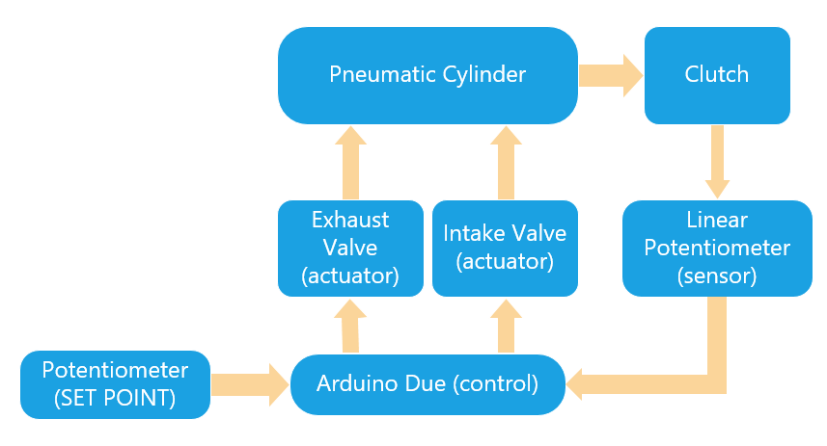
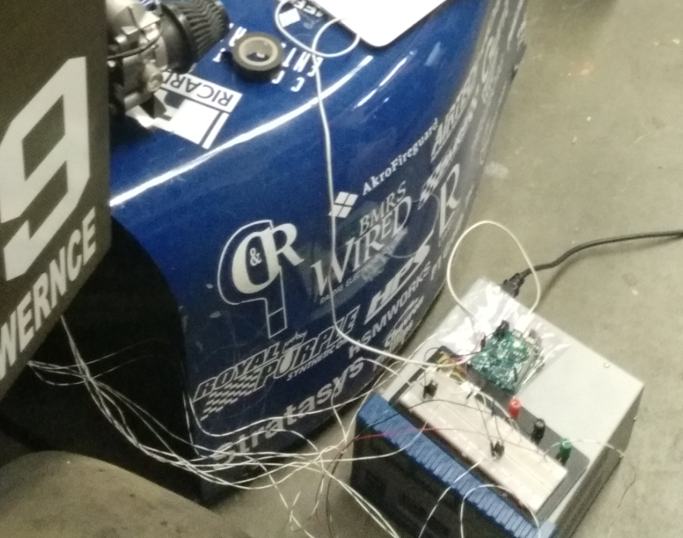
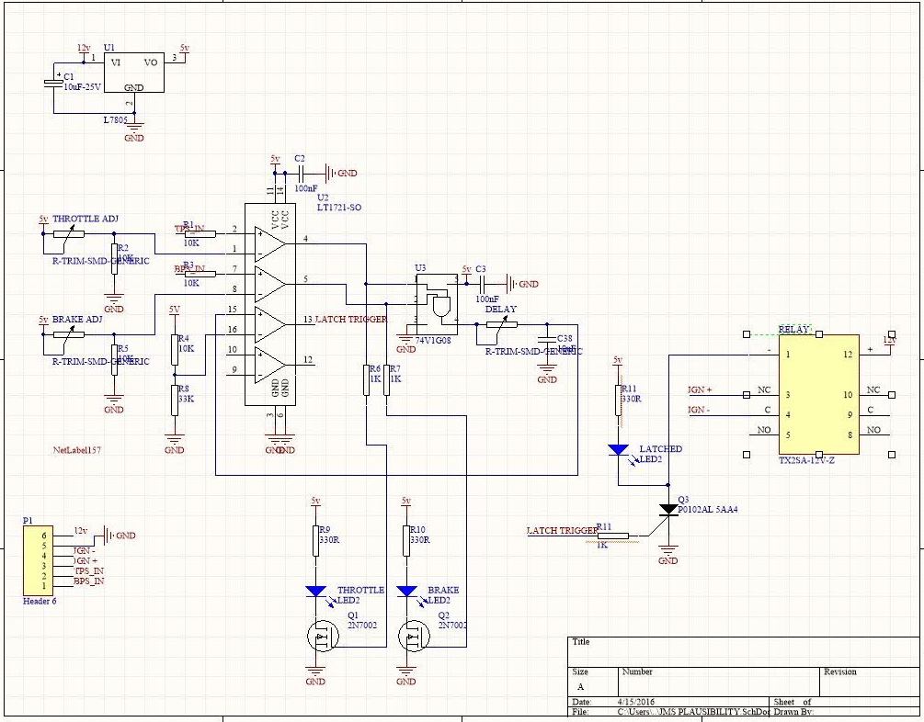
Computer Systems Design Laboratory
University of Kansas
Design and implementation of an affordable Wind Turbine monitoring system
By: Luis Chachayma
PROJECT OVERVIEW
asdsa
HARDWARE DESIGN PROGRESS
Resolver Schematic Resolver Board
Block Diagram Clutch Control
Implementation and testing
BSPD:
For this safety system we are using a comparator, timer and a relay in order to send the command to turn of the car.
IMPLEMENTATION
Clutch Control system:
For this control system we used a arduino Due (84MHz, 1MSPS). This controller allowed us to sample the position of the clutch up to 1 Mega sample per second allowing the sensing of the clutch position precisely. We used a linear potentiometer to sense the position.
To control the pneumatic valves we used a pneumatic valves (intake, exhaust) with a response time of 10 milliseconds.
For the control we used a PID control library created for the arduino Due.
BSPD schematic
Notes:
1

