Slide 1


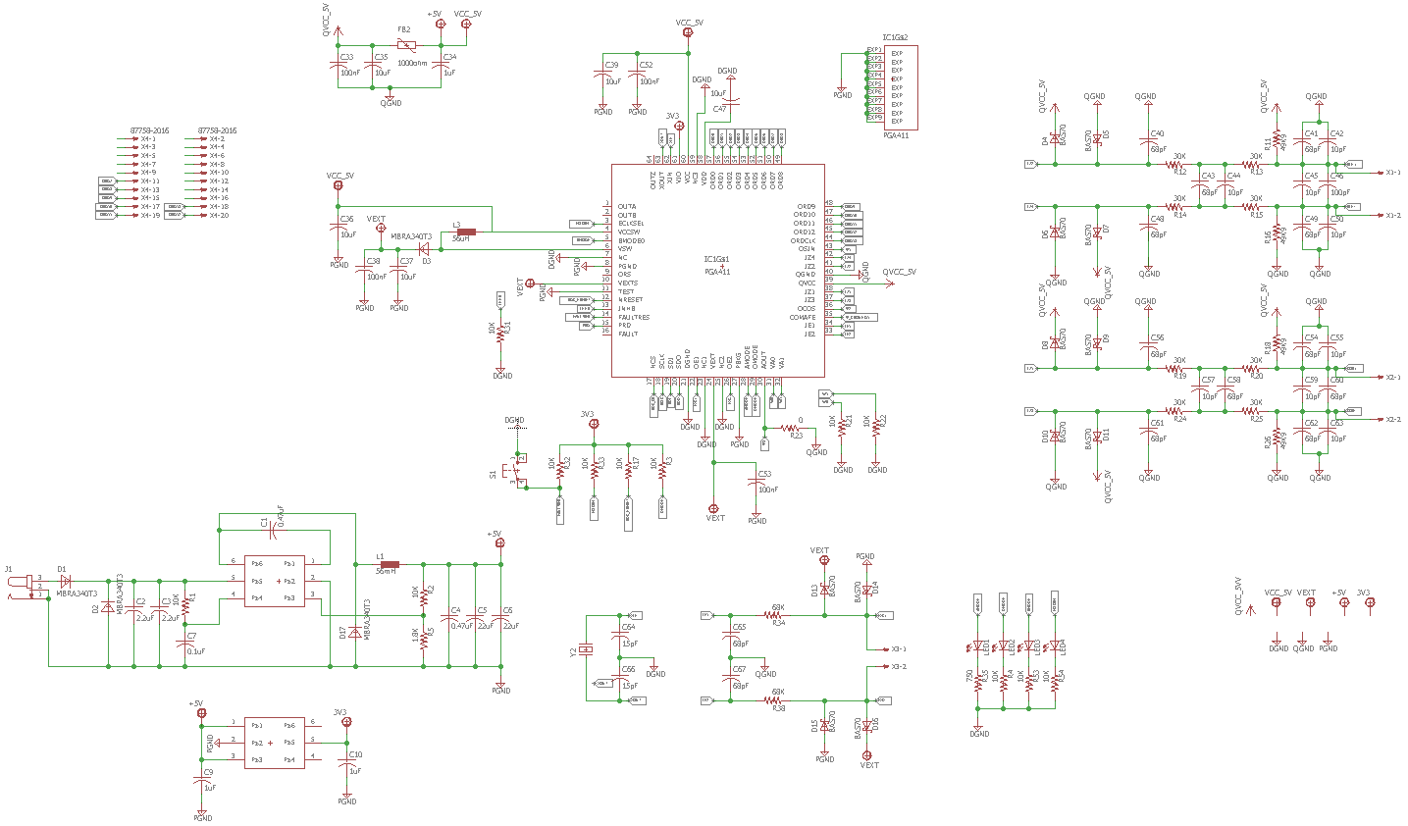
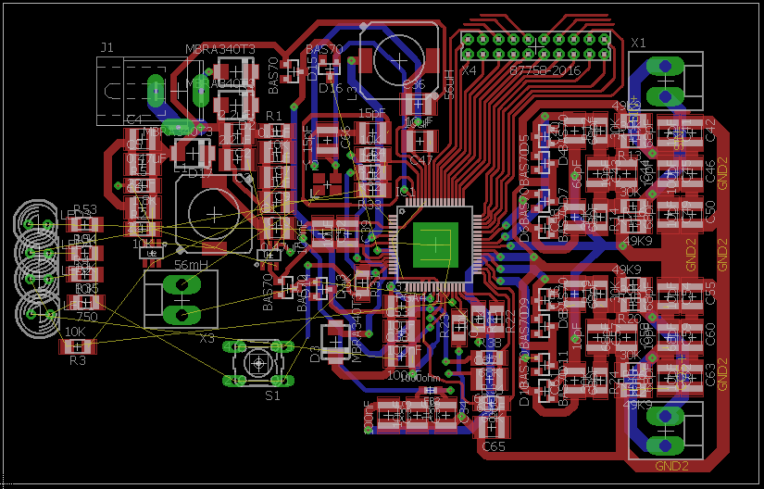
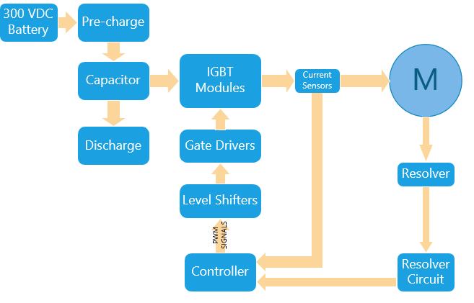
Computer Systems Design Laboratory
University of Kansas
Electric car power train control (in development)
By: Luis Chachayma, Sai Charan
PROJECT OVERVIEW
Proper control of the electrical systems in an electric vehicle is necessary in order to have the best performance of the vehicle, saving the battery life.
On the side of the Motor we need to sense the rotation angle sensor, so we can efficiently control the motor.
For the peaks of power consumption from the motor we need to supply that power by using a capacitor. Which makes necessary the use of a pre-charge and discharge circuit. The capacitor also behaves as a filter preventing the harmonic (ripple) currents of the switching frequency to reach the battery.
HARDWARE DESIGN PROGRESS
Resolver Schematic Resolver Board
IMPLEMENTATION
Resolver circuit: The circuit is being designed using the PGA411-Q1 from Texas Instruments. This circuit will allow to sense the functioning parameters of the motor precisely.
Pre-charge and discharge circuit: This circuits will allow to charge the capacitor when the car is started and discharge it when the car is stopped manually or by a fault.
PWM level shifter: Allows to shift the 0-5 volts logic of the microcontroller to 0-15volts logical level to be able to control the inverter.
All the circuits are being designed using two layer PCBs with Eagle.
Block Diagram Motor Control
Notes:
1

