Slide 1


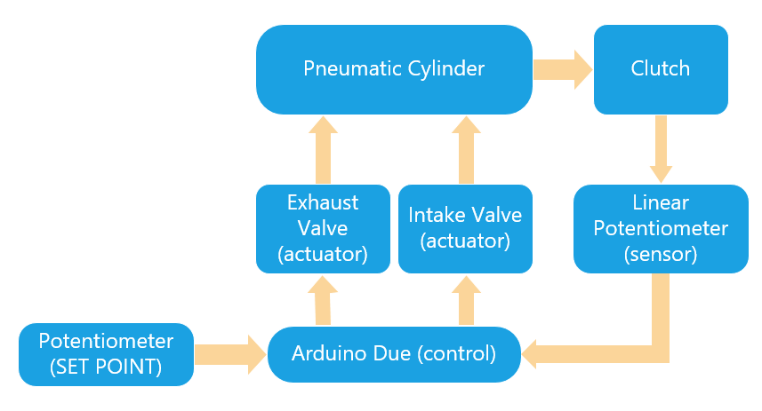
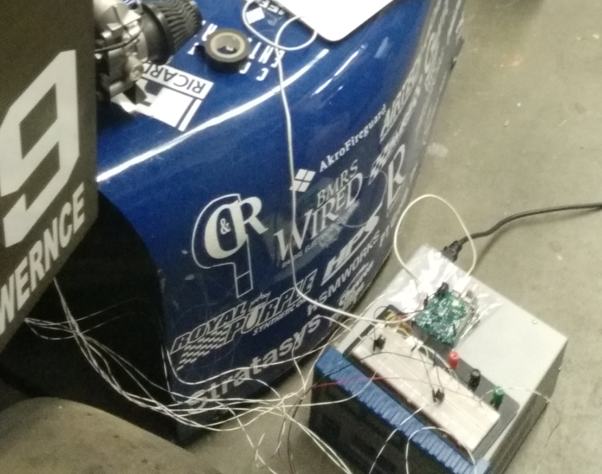
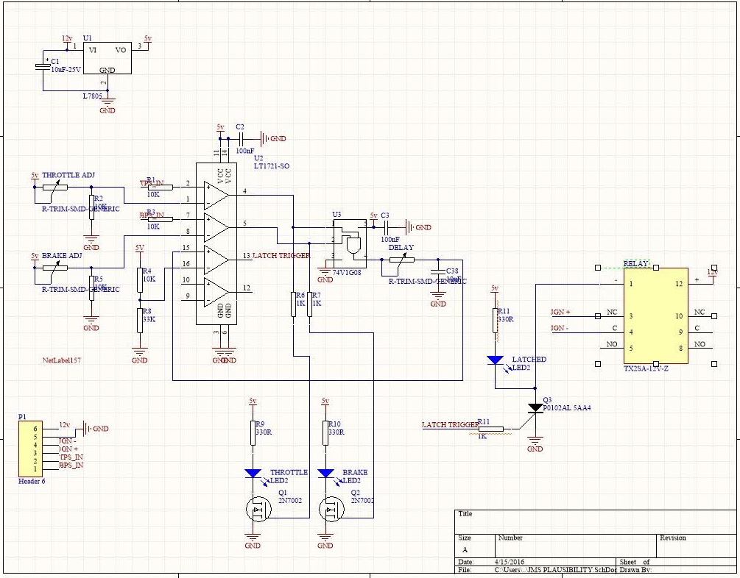
Computer Systems Design Laboratory
University of Kansas
Combustion car clutch control, BSPD design
By: Luis Chachayma, Kelly O’Neill
PROJECT OVERVIEW
Clutch Control System: The ECU control unit of the vehicle plays the most important role in a combustion vehicle. One of the functions is to manage the shifting, so the driver does not need to control the shifting manually.
For our formula SAE car we are using pneumatic cylinders and valves to control the position of the clutch. An inconvenient with this system is that the shifting is done by the ECU, so the movement of the clutch is extremely fast. This is not a problem for competitions, but the problem is that we cannot move the car slowly with out generating unnecessary wear down of the wheels and noise when we are out of a competition scenario.
BSPD (Brake System Plausibility Device): This system is necessary in order to detect faults during the driving. The fault should be activated if the driver presses the clutch and the accelerator at the same time from more than 0.5 seconds. This is required by formula SAE.
Block Diagram Clutch Control
Implementation and testing
BSPD:
For this safety system we are using a comparator, timer and a relay in order to send the command to turn of the car.
IMPLEMENTATION
Clutch Control system:
For this control system we used a arduino Due (84MHz, 1MSPS). This controller allowed us to sample the position of the clutch up to 1 Mega sample per second allowing the sensing of the clutch position precisely. We used a linear potentiometer to sense the position.
To control the pneumatic valves we used a pneumatic valves (intake, exhaust) with a response time of 10 milliseconds.
For the control we used a PID control library created for the arduino Due.
BSPD schematic
Notes:
1

