Slide 1
GAN Applications

Slide 2
Recap

Slide 3

Two player game
z
G
x
D
y = D(G(z))
G tries to make D(G(z)) near 1
-- “I am not fake”
D tries to make D(G(z)) near 0
-- “You are fake”
x
D
y = D(x)
𝓓𝓪𝓽𝓪
D tries to output 1
-- “You are real”

Slide 4
Update generator
z
G
D
y = D(G(z))
Cost
G
D
Calculate gradients (backprop) and update parameters
Calculate gradients (backprop) and do not update parameters

Slide 5
Update discriminator
z
G
D
y = D(G(z))
Cost 1
x
D
y = D(x)
𝓓𝓪𝓽𝓪
Cost 2
D
Add
Calculate gradients (backprop) and update parameters

Slide 6
Conditional GAN
random vector
z
G
x = G(z | y)
auxiliary input
y
input
x
D
y = D(x | y)
auxiliary input
y

Slide 7
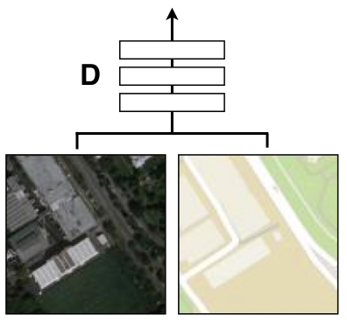
Image to image translation (transformation)
Input
Output
GOAL
𝓓𝓪𝓽𝓪
Aerial map
Aerial image
From Google Maps
Image-to-Image Translation with Conditional Adversarial Networks, Phillip Isola, Jun-Yan Zhu, Tinghui Zhou, and Alexei A. Efros,
Berkeley AI Research (BAIR) Laboratory, CVPR 2017

Slide 8
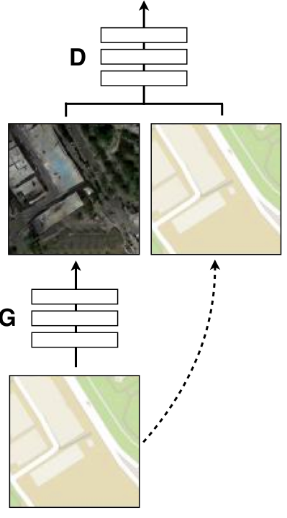
Training Generator
Auxiliary / conditional input
y
G
x
D
Noise z

Slide 9
Training Generator
Auxiliary / conditional input
y
G
x
D

Slide 10
Training Generator
Auxiliary / conditional input
y
G
x
D
Real or fake?

Slide 11
Training Generator
Auxiliary / conditional input
y
G
x i.e. G(y)
D
Backprop D and update G
considering this pair to be real.
min
Auxiliary / conditional input y

Slide 12
Discriminator update
x from G i.e. G(y)
D
Consider this pair to be fake.
max
Auxiliary / conditional input y

Slide 13
Discriminator update
x from G i.e. G(y)
x from data
D
D
Consider this pair to be fake.
Consider this pair to be real.
max
max
Auxiliary / conditional input y
Auxiliary / conditional input y

Slide 14
Training Generator
Auxiliary / conditional input
y
G
x i.e. G(y)
D
Backprop D and update G
considering this pair to be real.
min
y

Slide 15
Training Generator
Auxiliary / conditional input
y
G
x i.e. G(y)
D
Backprop D and update G
considering this pair to be real.
G(y)
x from data
L1( , )
min
λ
y
The generator is tasked to not only fool the discriminator, but also to be near the ground truth
Traditional image loss

Slide 16
Generator Architecture
y
G
x
D
Aerial map
Aerial image

Slide 17
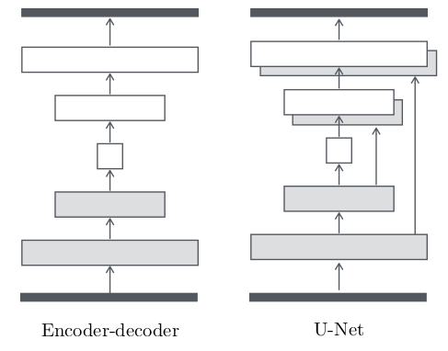
Generator Architecture
G
encode
decode
Essential features
Aerial map
Aerial image
Encoder-decoder architecture

Slide 18
Generator Architecture
G
G
Essential features
Skip connections
Aerial map
Aerial image
U-net
Encoder-decoder architecture with skip connections
Encoder-decoder architecture
O. Ronneberger, P. Fischer, and T. Brox. U-net: Convolutional networks for biomedical image segmentation, 2015.

Slide 19
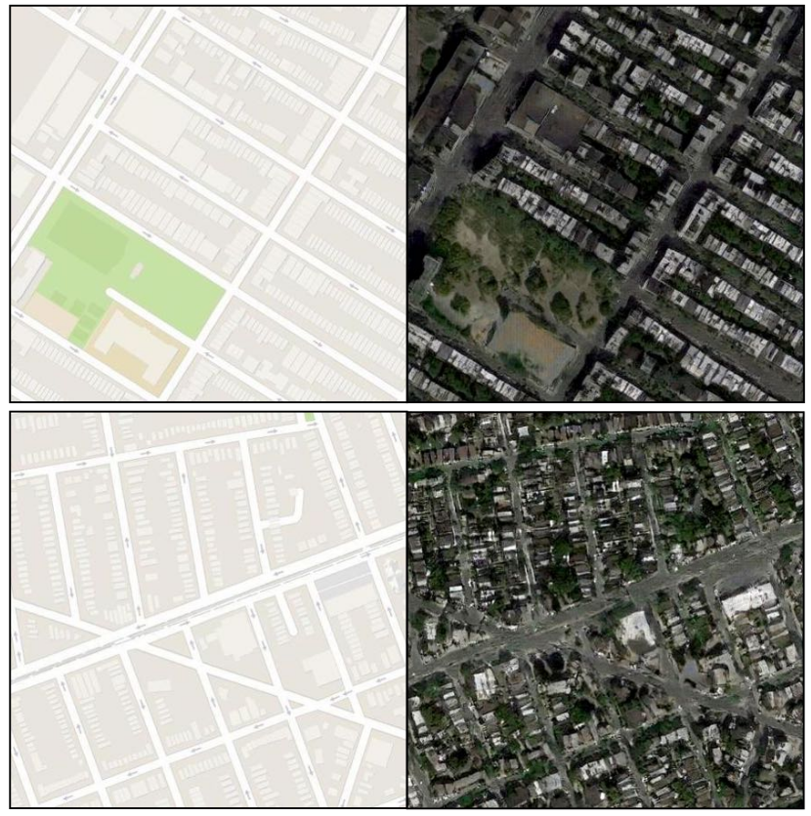
Input
Output
Input
Output
Image-to-Image Translation with Conditional Adversarial Networks, Phillip Isola, Jun-Yan Zhu, Tinghui Zhou, and Alexei A. Efros,
CVPR 2017

Slide 20
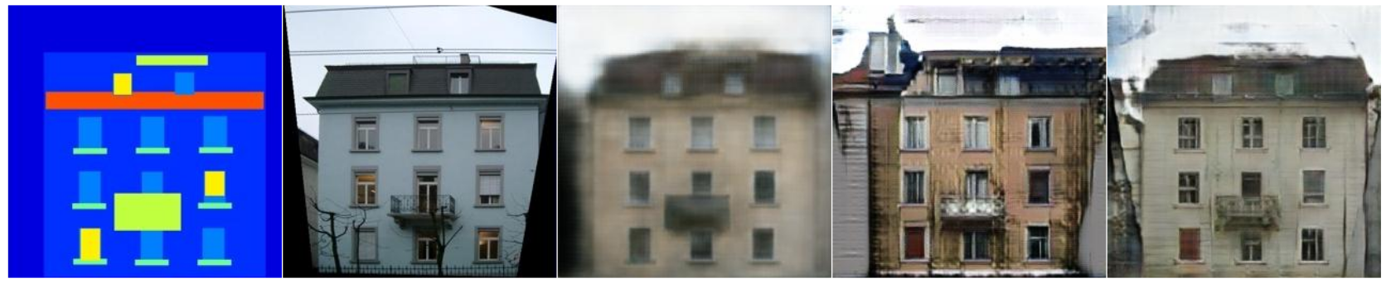
Image-to-Image Translation with Conditional Adversarial Networks, Phillip Isola, Jun-Yan Zhu, Tinghui Zhou, and Alexei A. Efros,
CVPR 2017

Slide 21
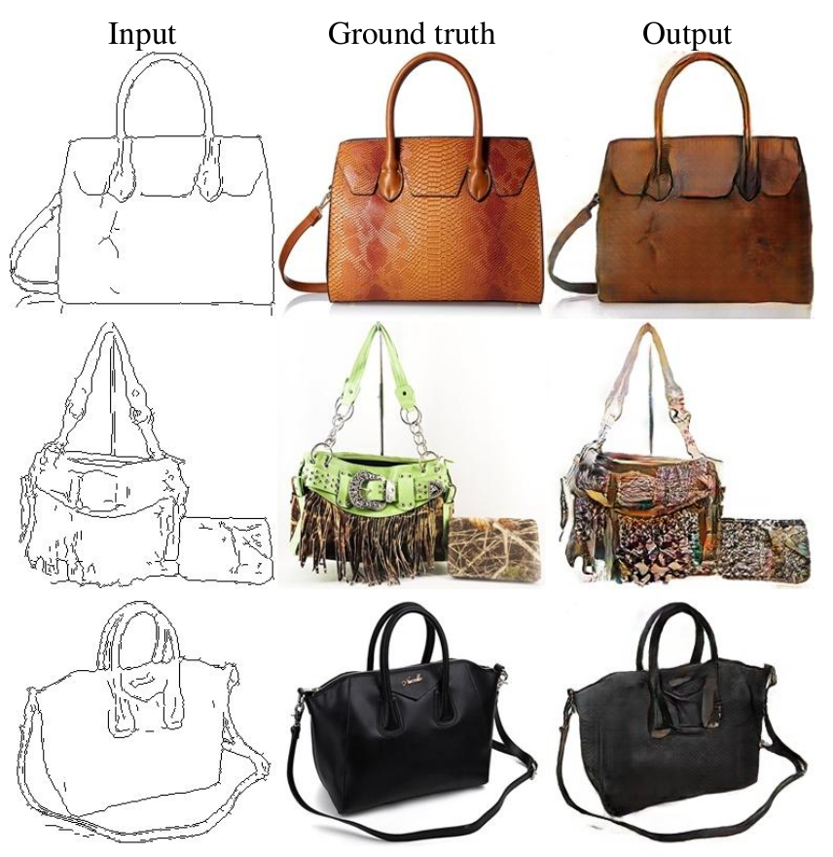
Image-to-Image Translation with Conditional Adversarial Networks, Phillip Isola, Jun-Yan Zhu, Tinghui Zhou, and Alexei A. Efros,
CVPR 2017

