Slide 1
Non-local Means Filtering
EE5175 Image Signal Processing

Slide 2
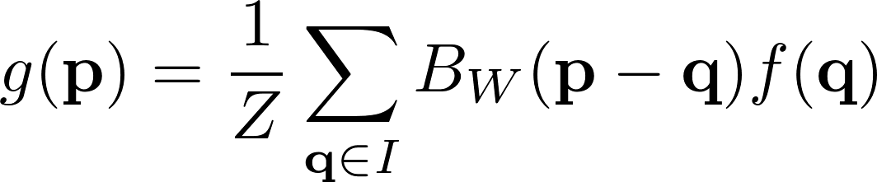
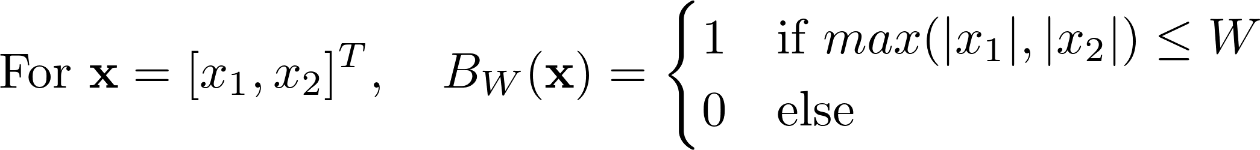
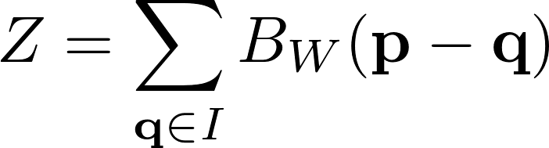
Mean filtering
Each output pixel is the average of intensities present in a neighbourhood around the corresponding input pixel
Box function
Normalization
acts as averaging here

Slide 3

Mean filtering
depends only on the pixel location
Takes into account all pixels q which are inside a box radius with p as centre
Choose q only within W-box radius around p

Slide 4
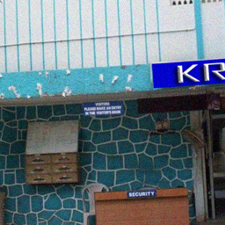

Mean filtering
Box radius
Box dimensions
All ones filter (before normalizing)

Slide 5
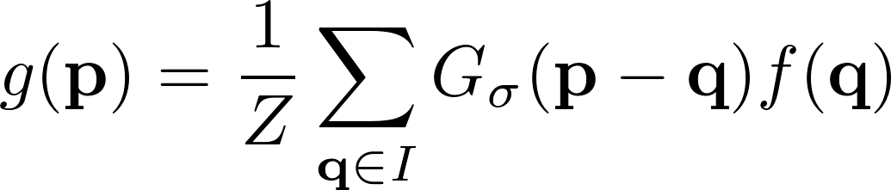
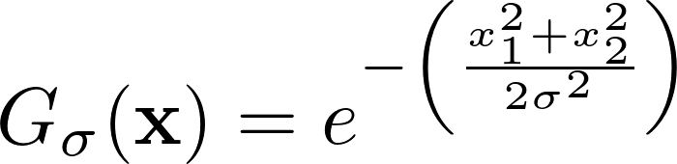
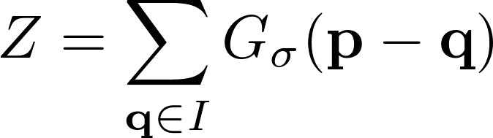
Gaussian filtering
Each output pixel is the Gaussian weighted average of intensities centred around the corresponding input pixel
Gaussian weighting
Normalization

Slide 6
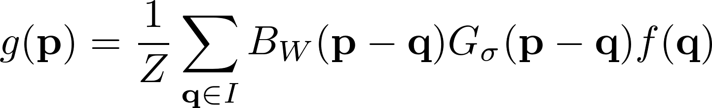
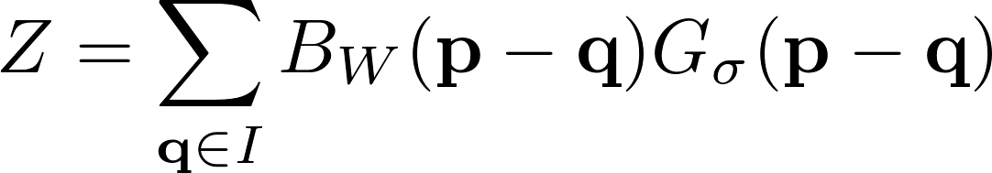
Gaussian filtering
Each output pixel is the Gaussian weighted average of intensities present in a neighbourhood around the corresponding input pixel
Weight based on spatial distance between p and q
Choose q only within W-box radius around p

Slide 7
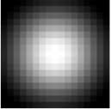
Gaussian filtering
Box radius
Box dimensions
Gaussian filter

Slide 8
Mean and Gaussian filters
Operate in the same manner irrespective of image intensities
Only depend on spatial locations around a pixel
Cause space invariant blur
Useful to model optical lens blur (defocus blur)
Bad for applications such as denoising
Do not care about edges

Slide 9
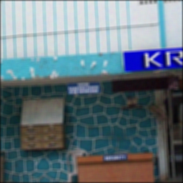
Denoising additive Gaussian noise
Noisy image
Mean filter
Gaussian filter

Slide 10
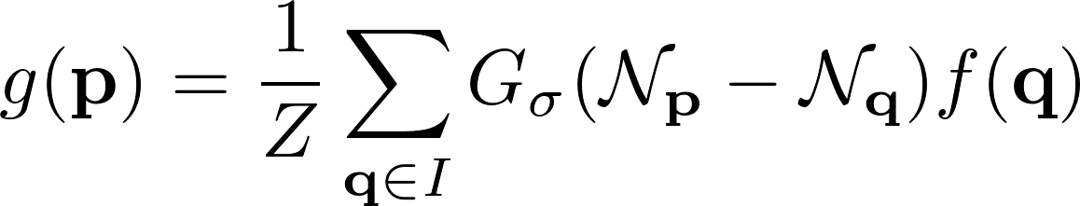
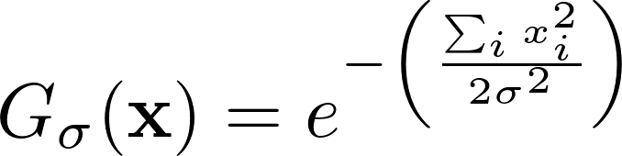
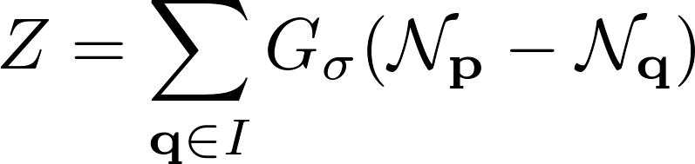
Non-local means (NLM) filter
Averages pixels that have similar neighbourhoods
If neighbourhood of p looks similar to neighbourhood of q, give higher weight
The weight depends on image intensities
Gaussian weighting based on difference in image intensities
Normalization

Slide 11
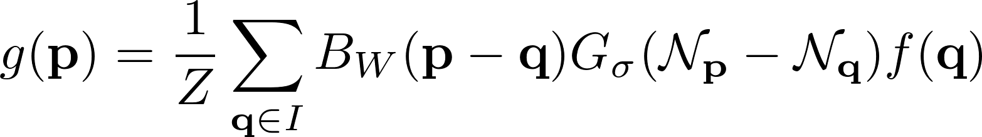
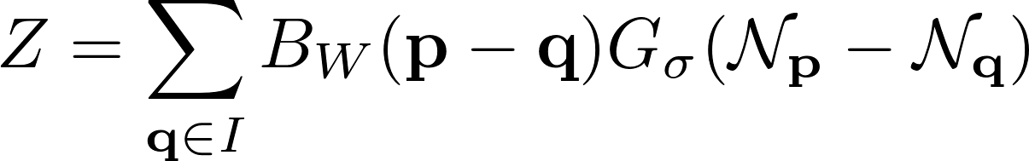
Non-local means (NLM) filter
Weighs neighbour pixels that have similar neighbourhoods
Similarity weight based on intensities of neighbourhood around p and q
Choose q only within W-box radius around p

Slide 12
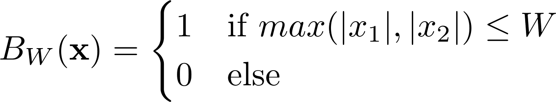




Non-local means (NLM) filter
Search neighbourhood
If W covers the whole image, then each output pixel depends on input pixels at any location “non-local”
Higher weight
looks similar to p
Similarity neighbourhood
Lower weight

Slide 13
Non-local means (NLM) filter
A
A
B
B
Mean and Gaussian filtering
Filters (kernels) at A and B are same
Convolution can be used
Non local means filtering
Filters (kernels) at A and B are different
Convolution cannot be used

Slide 14
Non-local means (NLM) filter
Operates based on image intensities
Specifically, based on image neighbourhood around a pixel
Causes space variant blur
Good for applications such as denoising
Preserves edges

Slide 15
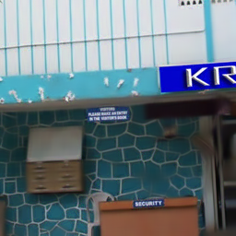
Denoising
Noisy image
Mean filter
Gaussian filter
Non local means filter

