Slide 1
Concurrency

Slide 2
Process
A computer program is a passive collection of instructions and a process is the actual execution of a computer program.
Several processes may be associated with the same program.
A process may be made up of multiple threads of execution that execute instructions concurrently.

Slide 3
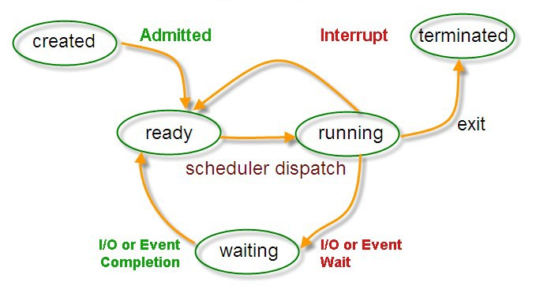
Process state

Slide 4
Multitasking
Multitasking is a method to allow multiple processes to share processors and other system resources.
Each CPU executes a single task at a time. However, multitasking allows each processor to switch between tasks that are being executed without having to wait for each task to finish.

Slide 5
Thread
a thread of execution is the smallest sequence of programmed instructions.
Multiple threads can exist within one process, executing concurrently and sharing resources such as memory, while different processes do not share these resources.

Slide 6
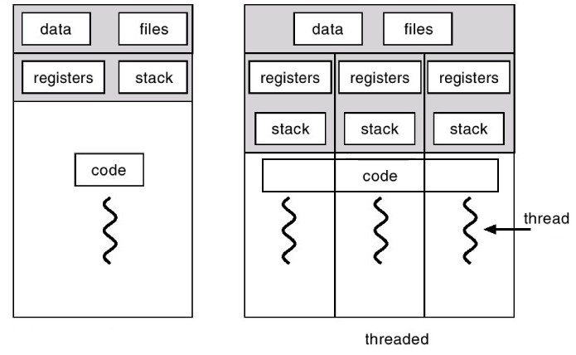
Thread

Slide 7
Threads vs Processes
processes are typically independent, while threads exist as subsets of a process
processes carry considerably more state information than threads, whereas multiple threads within a process share process state as well as memory and other resources
processes have separate address spaces, whereas threads share their address space
context switching between threads in the same process typically occurs faster than context switching between processes

Slide 8
Multithreading Advantage
Responsiveness: By moving long-running tasks to a worker thread that runs concurrently with the main execution thread. executing tasks in the background.
Better system utilization: as an example, a file system using multiple threads can achieve higher throughput and lower latency since data in a faster medium (such as cache memory) can be retrieved by one thread while another thread retrieves data from a slower medium (such as external storage) with neither thread waiting for the other to finish.
Simplified sharing and communication: unlike processes, which require a message passing or shared memory mechanism to perform inter-process communication (IPC), threads can communicate through data, code and files they already share.
Faster execution, Parallelization: applications looking to use multicore or multi-CPU systems can use multithreading to split data and tasks into parallel subtasks and let the underlying architecture manage how the threads run, either concurrently on one core or in parallel on multiple cores. GPU computing environments like CUDA and OpenCL use the multithreading model where dozens to hundreds of threads run in parallel across data on a large number of cores.

Slide 9
Multithreading Disadvantage
Synchronization: since threads share the same address space, the programmer must be careful to avoid race conditions. In order for data to be correctly manipulated, threads will often need to rendezvous in time in order to process the data in the correct order. Threads may also require mutually exclusive operations to prevent common data from being read or overwritten in one thread while being modified by another. Careless use of such primitives can lead to deadlocks, livelocks or starvation.
Thread crashes a process: an illegal operation performed by a thread crashes the entire process.

Slide 10
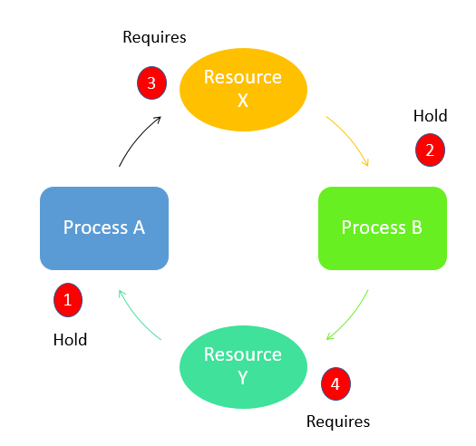
Multithreading Disadvantage

