Slide 1
ShopAddict
By Rob, Anton, Ivelina and Ramaz

Slide 2
Pitch
Target audience
Variety of products
Time saving
Convenient
Adaptability

Slide 3
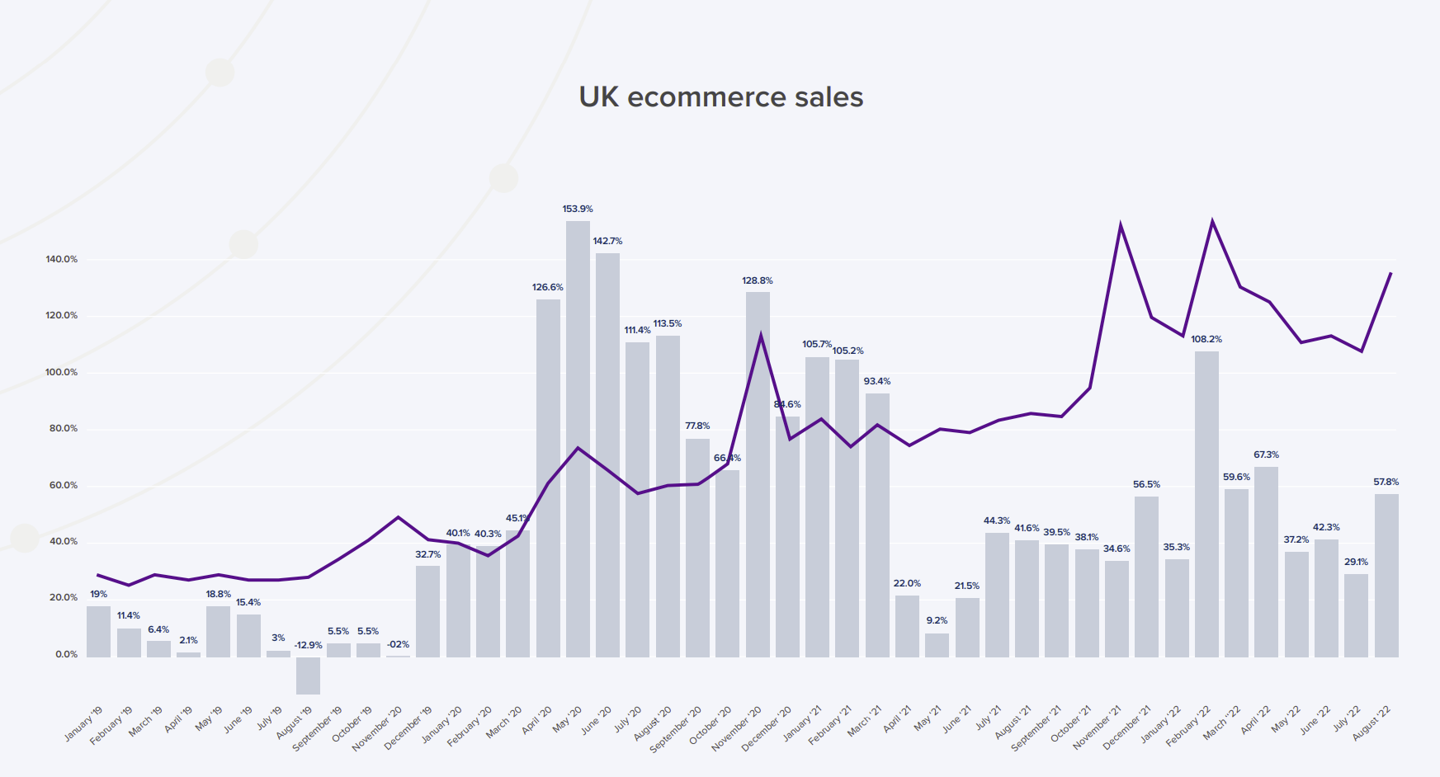
Motivation
We like to follow the trend!
Since 2001, online sales have grown by 300% while departments store sales have dropped by 50%
In 2040, its estimated 95% of all purchase transactions will be facilitated by e-commerce.
UK online sales growing throughout 2022, including finishing up August nearly 58% above the same month in 2021.

Slide 4
Why?
There is a demand for convenient online shopping.
During the covid period. Most companies had to resort to online selling to stay afloat, during such circumstances, the market had evolved to be more online orientated.
For every household, this became an ordinary habit, to shop online.
Because of this demand, we wanted to create a shopping experience that will bring: Target audience.
Variety of products
Time saving
Convenient
Adaptability

Slide 5
Technologies
React
Node.js
API - DummyJSON
Tailwind
Hero Icons/React Icons
Alice-Carousel
React router
Confetti
Github
Netlify

Slide 6
Process
Breakdown of tasks and roles
We had a dynamic role distribution, in which we had kept each other on a level, without a particular task being underdeveloped, we helped each other for more difficult tasks.
Challenges
Tailwind was an issue due to unfamiliarity.
We had particular issues including JS orientated, such as the cart, and its functionality.
Certain GitHub issues affecting production and causing delays.
Successes
Team communication
Running App

Slide 7
DEMO

Slide 8
Direction for future development
Customer Logins
Payment systems
Dynamic menu - Adding more distinct item choices i.e. shoes, hats etc instead of just men and women
Develop Apps Saleable Package

Slide 9
Links
Deployment: https://transcendent-kringle-16abc9.netlify.app/
GitHub: https://github.com/apyosi/ecommerce-shop

