Slide 1
Chapter 6. Binary Trees
Part 1

Slide 2
Objectives
Trees, Binary Trees, and Binary Search Trees
Implementing Binary Trees
Binary Search Tree
Tree Traversal
Insertion
Deletion

Slide 3
What is a Tree?
Trees, Binary Trees, and Binary Search Trees
In computer science, a tree is an abstract model of a hierarchical structure
A tree consists of nodes with a parent-child relation
Inspiration: family trees
Applications:
  Organization charts
  File systems
  Programming environments
Every node except one (a root) has a unique parent.
Computers”R”Us
Sales
Manufacturing
R&D
US
International
Laptops
Desktops
Europe
Asia
Canada
Empty structure is an empty tree.
Non-empty tree consists of a root and its children, where these children are also trees.
Exact definition

Slide 4
Tree Terminology
Root: unique node without a parent
Internal node: node with at least one child (A, B, C, F)
Leaf: node without children (E, I, J, K, G, H, D)
Ancestors of a node: parent, grandparent, great-grandparent, …
Descendants of a node: child, grandchild, great-grandchild, etc.
Level of a node: a root is said to be at level 1 (in some literatures a root is said to be at level 0). If a father is at level i then its children are at level i+1.
Height of a tree: maximum level in a tree (The empty tree is a legitimate tree of height 0 (by definition) and a single node is a tree of height 1.
Degree (order) of a node: number of its children.
A
subtree
B
C
D
E
F
G
H
I
J
K
Subtree: tree consisting of a node and its descendants
Each node has to be reachable from the root through a unique sequence of arcs, called a path
The number of arcs in a path is called the length of the path

Slide 5
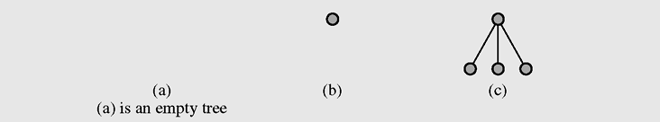
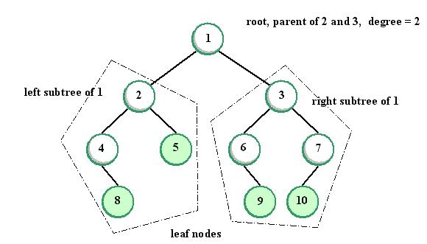
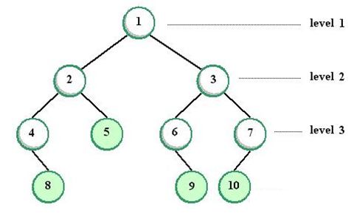
Tree examples - 1
Image Source: JEDI
Notes:
Image Source: JED
Some books say: level of root = 0

Slide 6
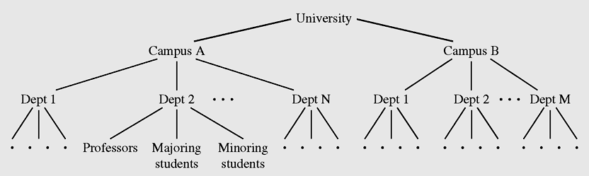
Tree examples - 2
Hierarchical structure of a university shown as a tree

Slide 7
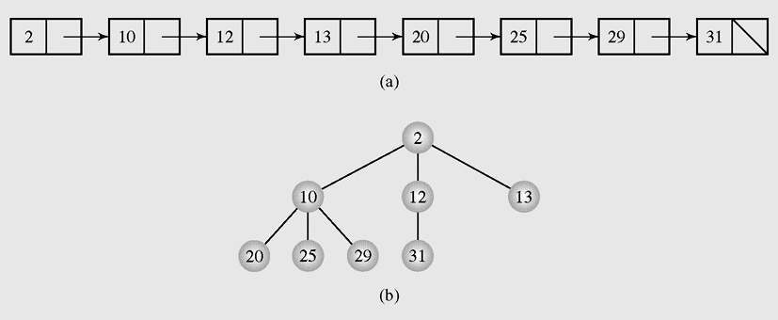
How to convert a linked list into a tree?
Linked list can be transformed into an orderly tree (a tree where all elements are stored according to some predetermined criterion of ordering) as shown in the example below, however from searching point of view this tree is not better than a linked list.
Transforming (a) a linked list into (b) a tree

Slide 8
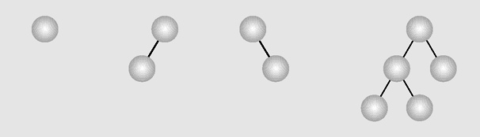
Binary Trees
A binary tree is a tree in which each node has at most two children. (Thus an empty tree is an binary tree). Each child may be empty and designated as either a left child or a right child
Examples of binary trees

Slide 9
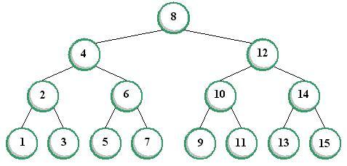
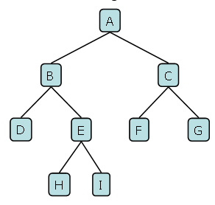
Types of Binary Trees
(Drozdek’s book)
In a full binary tree (sometimes proper binary tree or 2-tree), every node other than the leaves has two children.
In a complete binary tree, all non-terminal nodes have both their children, and all leaves are at the same level.
A Full Binary Tree
A Complete Binary Tree
Notes:
Image source: JEDI (https://jedi.dev.java.net/)

Slide 10
Tree Traversal
Tree traversal is the process of visiting each node in the tree exactly one time
Breadth-first traversal is visiting each node starting from the lowest (or highest) level and moving down (or up) level by level, visiting nodes on each level from left to right (or from right to left)
Breadth-first traversal:
A, B, C, D, E, F, G, H, I

Slide 11
Depth-First Traversal
Depth-first traversal proceeds as far as possible to the left (or right), then backs up until the first crossroad, goes one step to the right (or left), and again as far as possible to the left (or right). There are 3 tasks to be done in this type of traversal:
    V — Visiting a node
    L — Traversing the left subtree
    R — Traversing the right subtree
The 3 tasks can themselves be ordered in 3! = 6 ways, so there are 6 possible ordered depth-first traversals. It can be reduced to 3 traversals where the move is always from left to right and attention is focused on the first column. The 3 traversals are given these standard names:
    VLR: Preorder traversal (or NLR)
    LVR: Inorder traversal (or LNR)
    LRV: Postorder (or LRN)

Slide 12
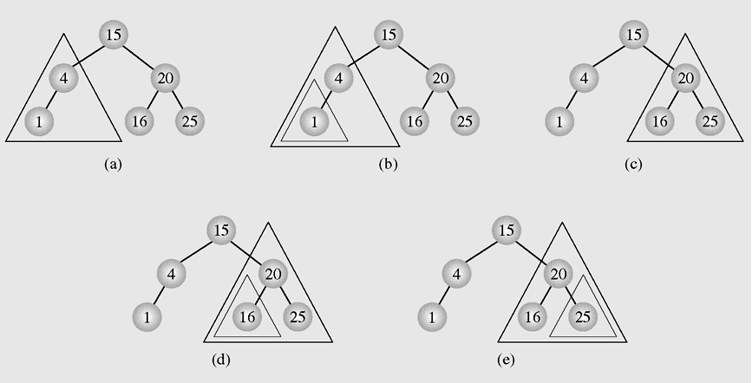
Inorder Traversal explanation
Inorder tree traversal

Slide 13
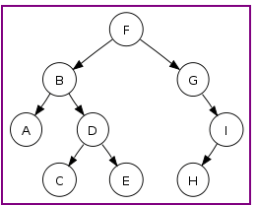
Tree Traversal example
Preorder traversal: F, B, A, D, C, E, G, I, H (root, left, right)
Inorder traversal: A, B, C, D, E, F, G, H, I (left, root, right)
Postorder traversal: A, C, E, D, B, H, I, G, F (left, right, root)
Level-order traversal (breadth first): F, B, G, A, D, I, C, E, H

Slide 14
Implementing Binary Trees - 1
Binary trees can be implemented in at least two ways:
  As arrays
  As linked structures
To implement a tree as an array, a node is declared as an object with an information field and two “reference” fields. These reference fields contain the indexes of the array cells in which the left and right children are stored, if there are any.
However, it is hard to predict how many nodes will be created during a program execution. (Therefore, how many spaces should be reserved for the array?)

Slide 15
Implementing Binary Trees - 2
To implement a tree as a linked structure, a node is declared as an object with an information field and two “reference” fields.
Key (data)
left child right child
class Node
{int info;
Node left,right;
Node(int x)
{info=x;left=right=null;
}
}
class Node
{int info;
Node left,right;
Node(int x) { }
Node(int x, Node p, Node q)
{info=x;left=p; right=q;
}
Node(int x)
{this(x,null,null);
}
}
Different types of implementations of Binary tree node

Slide 16
Breadth-First Traversal code
void breadth()
{ if(root==null) return;
MyQueue q = new MyQueue();
q.enqueue(root);
Node p;
while(!q.isEmpty())
{ p = (Node) q.dequeue();
if(p.left !=null)
q.enqueue(p.left);
if(p.right !=null)
q.enqueue(p.right);
visit(p);
}
}
Top-down, left-to-right, breadth-first traversal implementation

Slide 17
Depth-First Traversal code
void preOrder(Node p)
{ if(p==null) return;
visit(p);
preOrder(p.left);
preOrder(p.right);
}
void inOrder(Node p)
{ if(p==null) return;
inOrder(p.left);
visit(p);
inOrder(p.right);
}
void postOrder(Node p)
{ if(p==null) return;
postOrder(p.left);
postOrder(p.right);
visit(p);
}

Slide 18
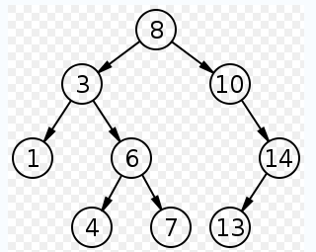
Binary Search Trees
In computer science, a binary search tree (BST) is a node based binary tree data structure which has the following properties:
The left subtree of a node contains only nodes with keys less than the node's key.
The right subtree of a node contains only nodes with keys greater than the node's key.
Both the left and right subtrees must also be binary search trees.
From the above properties it naturally follows that:
Each node (item in the tree) has a distinct key.
An inorder traversal of a binary search trees visits the keys in increasing order

Slide 19
Implementing Binary Search Trees
class BSTree
{Node root;
BSTree() {root=null;}
void insert(int x) {... }
void visit(Node p) {...}
void preOrder(Node p) {...}
void inOrder(Node p) {...}
void postOrder(Node p) {...}
Node search(int x) {...}
void deleteByMerging(int x) {...}
void deleteByCopying(int x) {...}
}
class Node
{int info;
Node left,right;
Node(int x)
{info=x;left=right=null;
}
}

Slide 20
Searching on Binary Search Trees
Node search(Node p, int x)
{ if(p==null) return(null);
if(p.info==x) return(p);
if(x<p.info)
return(search(p.left,x));
else
return(search(p.right,x));
}

Slide 21
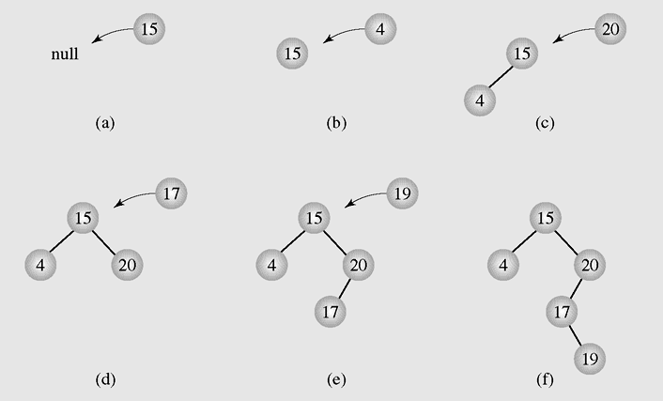
Insertion - 1
Inserting nodes into binary search trees

Slide 22
Insertion - 2
void insert(int x)
{if(root==null)
{root = new Node(x);
return;
}
Node f,p;
p=root;f=null;
while(p!=null)
{if(p.info==x)
{System.out.println(" The key " + x + " already exists, no insertion");
return;
}
f=p;
if(x<p.info)
p=p.left;
else
p=p.right;
}
if(x<f.info)
f.left=new Node(x);
else
f.right=new Node(x);
}

Slide 23
Deletion - 1
There are three cases of deleting a node from the binary search tree:
  The node is a leaf; it has no children
  The node has one child
  The node has two children

Slide 24
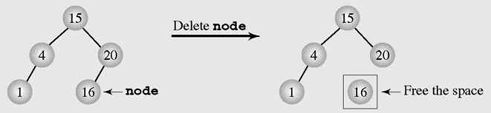
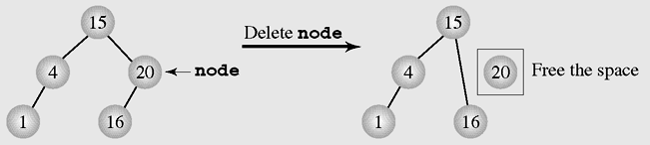
Deletion - 2
Deleting a leaf
Deleting a node with one child

Slide 25
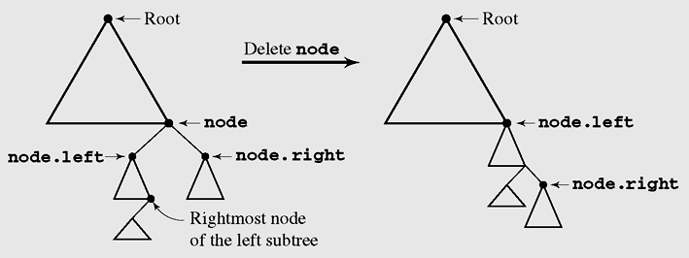
Deletion by Merging - 1
Making one tree out of the two subtrees of the node and then attaching it to the node’s parent is called deleting by merging
Summary of deleting by merging

Slide 26
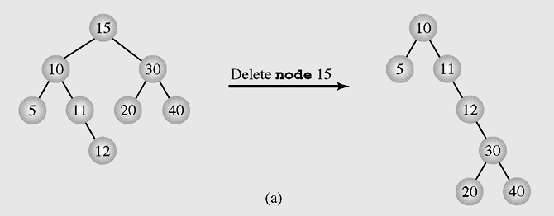
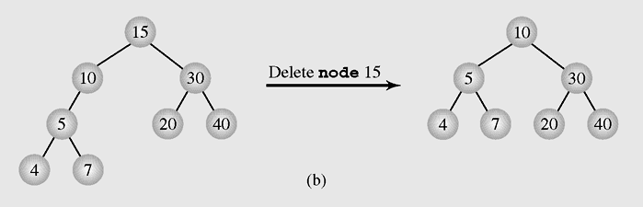
Deletion by Merging - 2
The height of a tree can be (a) extended or
(b) reduced after deleting by merging

Slide 27
Deletion by Copying - 1
If the node has two children, the problem can be reduced to:
  The node is a leaf
  The node has only one nonempty child
Solution: replace the key being deleted with its immediate predecessor (or successor)
A key’s predecessor is the key in the rightmost node in the left subtree

Slide 28
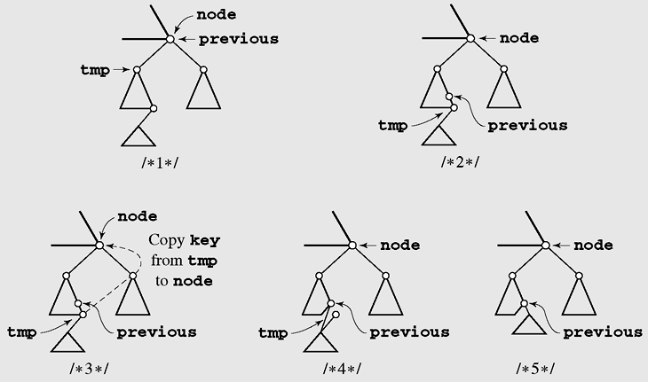
Deletion by Copying - 2
Deleting by copying

Slide 29
Summary
Discussed topics:
Trees, Binary Trees, and Binary Search Trees
Implementing Binary Trees
Searching a Binary Search Tree
Tree Traversal
Insertion
Deletion

Slide 30
Reading at home
Text book: Data Structures and Algorithms in Java, Second Edition by Adam Drozdek
6.1 Trees, Binary Trees, and Binary Search Trees 214
6.2 Implementing Binary Trees 219
6.3 Searching a Binary Search Tree 221
6.4 Tree Traversal 223
6.5 Insertion 239
6.6 Deletion 242
  6.6.1 Deletion by Merging 243
  6.6.2 Deletion by Copying 246

Slide 31
Preorder Traversal of non-binary tree
A traversal visits the nodes of a tree in a systematic manner
In a preorder traversal, a node is visited before its descendants
Application: print a structured document
Algorithm preOrder(v)
  visit(v)
  for each child w of v
  preorder (w)
1
Make Money Fast!
2
5
9
1. Motivations
2. Methods
References
3
4
6
7
8
1.1 Greed
1.2 Avidity
2.1 Stock
Fraud
2.2 Ponzi
Scheme
2.3 Bank
Robbery

Slide 32
Postorder Traversal of non-binary tree
In a postorder traversal, a node is visited after its descendants
Application: compute space used by files in a directory and its subdirectories
Algorithm postOrder(v)
  for each child w of v
  postOrder (w)
  visit(v)
9
cs16/
8
3
7
homeworks/
programs/
todo.txt
1K
1
2
4
5
6
h1c.doc
3K
h1nc.doc
2K
DDR.java
10K
Stocks.java
25K
Robot.java
20K

Slide 33
Inorder Traversal of non-binary tree
A traversal visits the nodes of a tree in a systematic manner
In a inorder traversal, a node is visited just after its the first descendant and before its other descendants
Algorithm preOrder(v)
  visit(v)
  for each child w of v
  preorder (w)
4
Make Money Fast!
2
6
9
1. Motivations
2. Methods
References
1
3
5
7
8
1.1 Greed
1.2 Avidity
2.1 Stock
Fraud
2.2 Ponzi
Scheme
2.3 Bank
Robbery

Slide 34
Reading at home
Text book: Data Structures and Algorithms in Java, Second Edition by Adam Drozdek
6.1 Trees, Binary Trees, and Binary Search Trees 214
6.2 Implementing Binary Trees 219
6.3 Binary Search Tree 221
6.4 Tree Traversal 223
6.5 Insertion 239
6.6 Deletion 242

