Slide 1
Chapter 10. Hashing

Slide 2
Objectives
Why Hashing?
Hash Functions
Collision Resolution
Deletion
Perfect Hash Functions (*)
Hash Functions for Extendable files (*)
Hashing in java.util
(*) Students are required to understand essential features only (the problem explaination, definitions, the outline of algorithms…), not in details.

Slide 3
Why hashing?
Hash tables are one of the most efficient means of searching for data. A hash table establishes a mapping between all of the possible keys and the position where the data associated with those keys is stored. The expected complexity of searching using a hash table is O(1).
Hash function h(x) is a function which transforms a particular key x, be it a string, number, record, or the like, into an index i = h(x) in the table T, where T[i] is used for storing an item having key x or its address.
If h(x) transforms different keys into diffenrent values (most of case are integral numbers), it is called a perfect hash function. (In this case the hash table contains at least the same number of positions as the number of elements being hashed).
The situation, that h(x) = h(y) for some x # y, is called the collision of the hash function h(x).

Slide 4
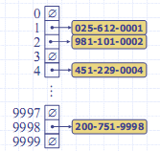
Hash table example
We design a hash table for a map storing entries as (ID, Name), where ID is a nine-digit positive integer
Our hash table uses an array of size N = 10,000 and the hash function h(x) = last four digits of x
Notes:
Example: Goodrich’s

Slide 5
How to select Hash Functions?
We want a hash function that is easy to compute and that minimizes the number of collisions.
Hashing functions should be unbiased.
  That is, if we randomly choose a key, x, from the key space, the probability that f(x) = i is 1/M, where M is the size of the hash table.
  We call a hash function that satisfies unbiased property a uniform hash function.

Slide 6
Division Hash Functions
Division h_{D}(x) = x % M :
  Using the modulus (%) operator.
  We divide the key x by some number M and use the remainder as the hash index for x.
    This gives indexes that range from 0 to M - 1,
    where M = that table size (hash table).
The choice of M is critical.
  If M is divisible by 2, then odd keys to odd indexes and even keys to even ones. (biased!!)
  A good choice for M would be : M a prime number such that M does not divide r^{k}±a for small k and a.

Slide 7
Folding Hash Functions
Folding
  Partition key x into several parts.
  All parts except for the last one have the same length.
  Add the parts together to obtain the value y, the hash index then is h(x) = y % M.
Two possibilities (divide x into several parts)
  Shift folding:
  Shift all parts except for the last one, so that the least significant bit of each part lines up with corresponding bit of the last part. Suppose x = 72320354121324
    x₁=723, x₂=203, x₃=541, x₄=213, x₅=24,
    index= (x₁ + x₂ + x₃ + x₄ + x₅) % 1000 = 1704%1000 = 704
  Boundary folding (folding at the boundaries):
  reverses every other partition before adding
    x₁=723, x₂=302, x₃=541, x₄=312, x₅=24, index=1902%1000 = 902

Slide 8
Folding Hash Functions - example
Folding example:
723 203 541 213 24
P1
P2
P3
P4
P5
shift folding
723
203
541
213
24
1704
folding at the
boundaries
723 203 541 213 24
MSD ---> LSD
LSD <--- MSD
If the target relative address has k digits then the key value is partitioned into k digit chunks (from left to right). E.g. if Tsize=1000 then k = 3
MSD = Most Significant Digit
LSD = Least Significant Digit

Slide 9
Other Hash Functions
In the mid-square method, the key is squared and the middle or mid part of the result is used as the address
Exp: key = 3121² = 9 740 641 ->index = 406 mod Tsize
Since the middle bits of the square usually depend upon all the characters in a key, there is high probability that different keys will produce different hash indexes.
In the extraction method, only a part of the key is used to compute the address
Exp: 123-45-6789->1234-5-6789 -> index = 1289 mod TSize
Using the radix transformation, the key K is transformed into another number base; K is expressed in a numerical system using a different radix.
Exp: 345₁₀ = 423₉ -> index = 423 mod TSize

Slide 10
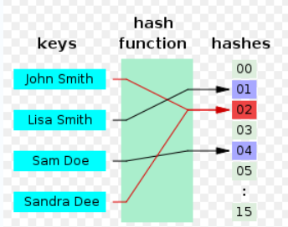
Collision
Collisions occur when different elements are mapped to the same cell
Notes:
Image source:http://en.wikipedia.org/wiki/File:Hash_table_4_1_1_0_0_1_0_LL.svg

Slide 11
Collision Resolution
Open addressing method
In the open addressing method, when a key collides with another key, the collision is resolved by finding an available table entry other than the position (address) to which the colliding key is originally hashed.
  The simplest method is linear probing, for which p(i) = i, and for the i^{th} probe, the position to be tried is (h(K) + i) mod Tsize, i = 1,2,…
  Quadratic: h(K) ± i² (mod M) provided M is prime,
  M Ξ 3 (mod 4); again to guarantee permutation.
Notes:
Linear probing = thăm dò tuyến tính

Slide 12
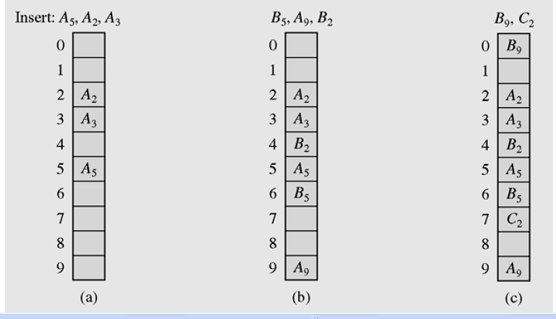
Linear Probing example - 1
Notes:
Linear probing handles collisions by placing the colliding item in the next (circularly) available table cell

Slide 13

Linear Probing example - 2
h(x) = x mod 13
Insert keys 18, 41, 22, 44, 59, 32, 31, 73, in this order
( h(x) -> 5, 2, 9, 5, 7, 6, 5, 8 )
Notes:
Linear probing handles collisions by placing the colliding item in the next (circularly) available table cell

Slide 14
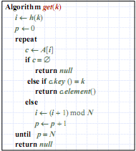
Search an item in hash tables using linear Probing
Consider a hash table A that uses linear probing
get(k)
  We start at cell h(k)
  We probe consecutive locations until one of the following occurs
  An item with key k is found, or
  An empty cell is found, or
  N cells have been unsuccessfully probed
Notes:
Reference: Goodrich’s
consecutive = seqential

Slide 15
Factors affecting Search perfomance
Quality of hash function
  how uniform?
  depends on actual data
Collision resolution strategy used
Load factor of the HashTable
  N/Tsize
  the lower the load factor the better the search performance
Notes:
Reference: Goodrich’s
consecutive = seqential

Slide 16
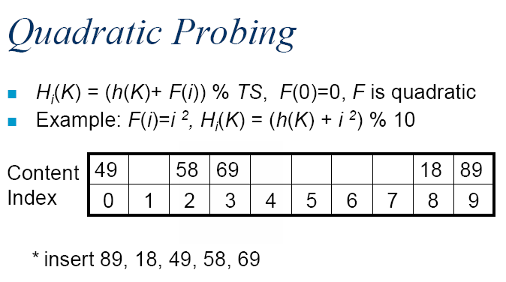
Quadratic Probing example
Notes:
Linear probing handles collisions by placing the colliding item in the next (circularly) available table cell

Slide 17
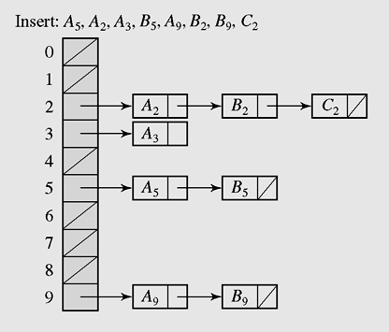
Collision Resolution
Chaining method
Keys do not have to be stored in the table itself. In chaining, each position of the table is associated with a linked list or chain of structures whose info fields store keys or references to keys.
This method is called separate chaining, and a table of references (pointers) is called a scatter table. In this method, the table can never overflow, because the linked list is extendible.
In chaining, colliding keys are put on the same linked list
Notes:
Scatter : to cause to separate widely

Slide 18
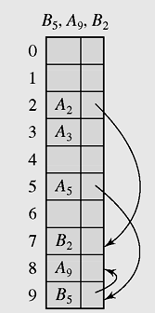
Collision Resolution
Coalesced hashing or coalesced chaining method
A version of chaining called coalesced hashing (or coalesced chaining) combines linear probing with chaining. Each position pos in the table contains 2 fields: info and next. The next field contains the index of the next key that is hashed to pos. By this way, a sequential search down the table can be avoided by directly accessing the next element on the linked list.
An overflow area known as a cellar can be allocated to store keys for which there is no room in the table
Coalesced hashing puts a colliding key in the last available position of the table
Notes:
Coalesce = to grow\mix together

Slide 19
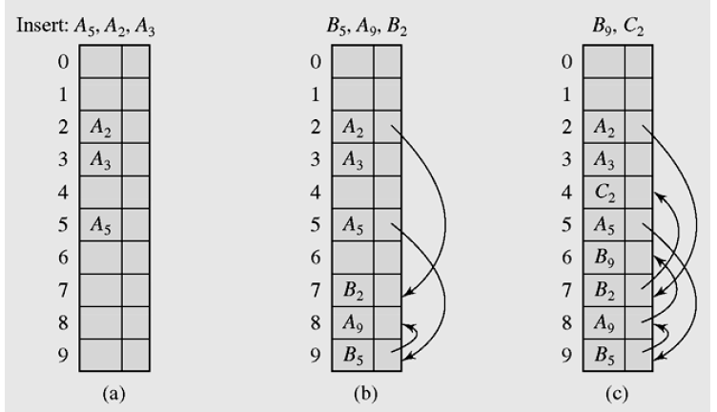
Coalesced hashing example
Coalesced hashing puts a colliding key in the last available position of the table
Notes:
Coalesce = to grow\mix together

Slide 20
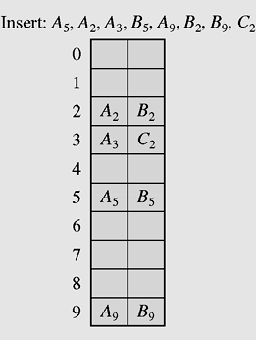
Bucket Addressing
To store colliding elements in the same position in the table can be achieved by associating a bucket with each address.
A bucket is a block of space large enough to store multiple items (a block consists of slots, each slot contains one item).
By using buckets, the problem of collisons is not totally avoided. By incorporating the open addressing approach, the colliding item can be stored in the next bucket is it has an available slot when using linear probing, or it can be stored in some other bucket when, say, quadratic probing is used. The colliding items can also be stored in an overflow area. In this case, each bucket includes a field that indicates whether the search should be continued in this area or not.
Collision resolution with buckets and linear probing method.

Slide 21
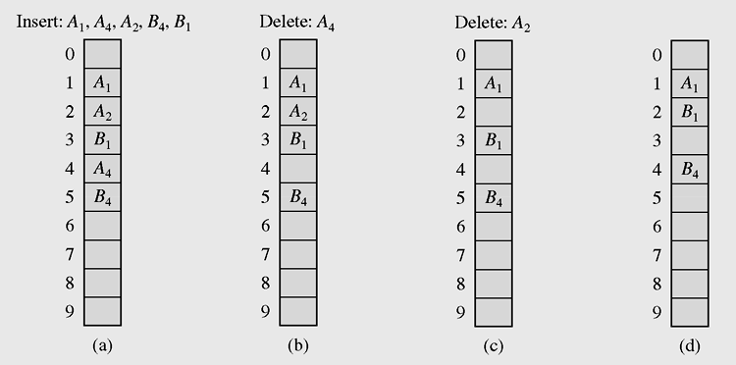
Deletion
Consider the table in which the keys are stored using linear probing. Suppose we delete A₄ and then then try to find B₄. Because when searching B we hash it to position 4 and see that this position is empty and conclude that B4 is not found (which is not true).
Linear search in the situation where both insertion
and deletion of keys are permitted
To avoid this situation, we mark the deleted positions only. When inserting new element to this position, we update information for new element. When there too many marked deleted elements in the table, the table is refresh (d).

Slide 22
Perfect Hash Functions
If hash function h transforms different keys into different numbers, it is called a perfect hash function.
If a function requires only as many cells in the table as the number of data so that no empty cell remains after hashing is completed, it is called a minimal perfect hash function
Cichelli’s method is an algorithm to construct a minimal perfect hash function

Slide 23
A Perfect Hash Function for strings
R. J. Cichelli gave an algorithm for finding perfect hash functions for a given fixed collection of words.
He proposes the hash function for each word s:
h(word) = (length(word) + g(firstletter(word)) +
g(lastletter(word))) mod TSize
The function g is to be constructed so that h(s) is unique for each string s.
For this to be a perfect hash function, the proper mapping of letters to integers is needed.

Slide 24
Perfect Hashing: Outline of Cichelli's Algorithm
Given a fixed collection of words, the Cichelli's algorithm proceeds thus:
1. Find the frequency of the first and the last letter of each word;
2.Then find the sum of the frequencies of the first and the last letter of each word;
3. Sort the words in descending order of frequency;
4. Go to the next word (select the next word from step 3);
5. Choose g-values for any unassigned first/last letters for the current word. If a conflict occurs, backtrack and choose again.
6. If there are more words to process, go to Step 4.

Slide 25
Example 1: Illustrating Perfect Hashing
Use Cichelli's algorithm to build a minimal perfect hash
function for the following nine strings:
DO DOWNTO ELSE
END IF IN
TYPE VAR WITH

Slide 26
Example 1: Solution
For Step 1 in the algorithm, we find the frequencies of the
first and last letter of each word to find:
D O E I F N T V R W H
3 2 4 2 1 1 1 1 1 1 1
Next we find the sum of the first and last letter of each word:
DO=5(D+0=3+2), DOWNTO=5, ELSE = 8, END=7,
IF=3, IN=3, TYPE=5, VAR=2,WITH=2
Sorting the keywords in decreasing frequency yields:
ELSE END DOWNTO DO TYPE IN IF VAR WITH
We are now at step 5 of the algorithm, the heart of the algorithm. We try the words in frequency order:
DO DOWNTO ELSE END IF IN TYPE VAR WITH

Slide 27
Example 1: Cichelli's Method (cont'd)
s = ELSE g(E)=0 h(s) = s.length()+g(E)+g(E)=4 {4}
s = END g(D) = 0 h(s) = s.length()+g(E)+g(D)=3 {34}
s = DOWNTO g(O) = 0 h(s)= 6 {346}
s = DO h(s) = s.length()+g(D)+g(O) = 2 {2346}
s = TYPE g(T) = 0 h(s)= 4* {2346}
s = TYPE g(T)=1 h(s) = s.length()+g(T)+g(E) =5 {23456}

Slide 28
Example 1: Cichelli's Method (cont'd)
s=IN g(I)=0,g(N)=0 h(s)= s.length()+g(I)+g(N)=2*{23456}
s=IN g(I)=1,g(N)=0 h(s)=s.length()+g(I)+g(N)=3* {23456}
s=IN g(I)=2,g(N)=0 h(s)=s.length()+g(I)+g(N)=4* {23456}
s=IN g(I)=3,g(N)=0 h(s)=s.length()+g(I)+g(N)=5* {23456}
s=IN g(I)=3,g(N)=1 h(s)=s.length()+g(I)+g(N)=6* {23456}
s=IN g(I)=3,g(N)=2 h(s)=s.length()+g(I)+g(N)=7 {234567}

Slide 29
Example 1: Cichelli's Method (cont'd)
s=IF g(F)=0 h(s)=s.length()+g(I)+g(F)=5* {234567}
s=IF g(F)=1 h(s)=s.length()+g(I)+g(F)=6* {234567}
s=IF g(F)=2 hash(s)=s.length()+g(I)+g(F)=7* {234567}
s=IF g(F)=3 h(s)=s.length()+g(I)+g(F)=8 {2345678}
The steps for VAR and WITH are left as an exercise.
You should get V=R=W=H=3, h(VAR)=0 and h(WITH)=1.

Slide 30
Example 1: Cichelli's Algorithm (cont'd)
With the g-values
E = D = O = 0,T = 1,N = 2,I = F = V = R = W = H = 3, h
is minimal perfect.
Based on these g-values the strings will be stored as shown below:
0 1 2 3 4 5 6 7 8
ELSE
DOWNTO
VAR
WITH
DO
END
DO
IN
IF
The hash table above is fully occupied with empty slots.
Note that if there are empty slots or there is a collision, then the g-value assignments are in error.

Slide 31
Cichelli's Algorithm: Comments
The search process in this algorithm is exponential.
The algorithm is applicable to small sets of strings.
It does not guarantee that a perfect hash function can be found.
Program usually run only once and result incorporated into another program.
There are extensions to this technique that avoid its limitations.
For our purpose in this course, the Cichelli's algorithm is sufficient.

Slide 32
Hash Functions for Extendible Files
There are two categories of hashing: Static hashing (the hash table is fixed-sized), and Dynamic/Extendible hashing.
Dynamic/Extendible hashing: splits and coalesces buckets appropriately with the database size.
  i.e. buckets are added and deleted on demand.
  The hash function typically produces a large number of values, uniformly and randomly.
  Only part of the value is used depending on the size of the database.
  Hash indices are typically a prefix of the entire hash value.
  More than one consecutive index can point to the same bucket.

Slide 33
Extendible Hashing
Extendible hashing is a type of hash system which treats a hash as a bit string, and uses a trie for bucket lookup
Extendible hashing accesses the data stored in buckets indirectly through an index that is dynamically adjusted to reflect changes in the file
Extendible hashing allows the file to expand without reorganizing it, but requires storage space for an index
Values returned by such a hash function are called pseudokeys

Slide 34
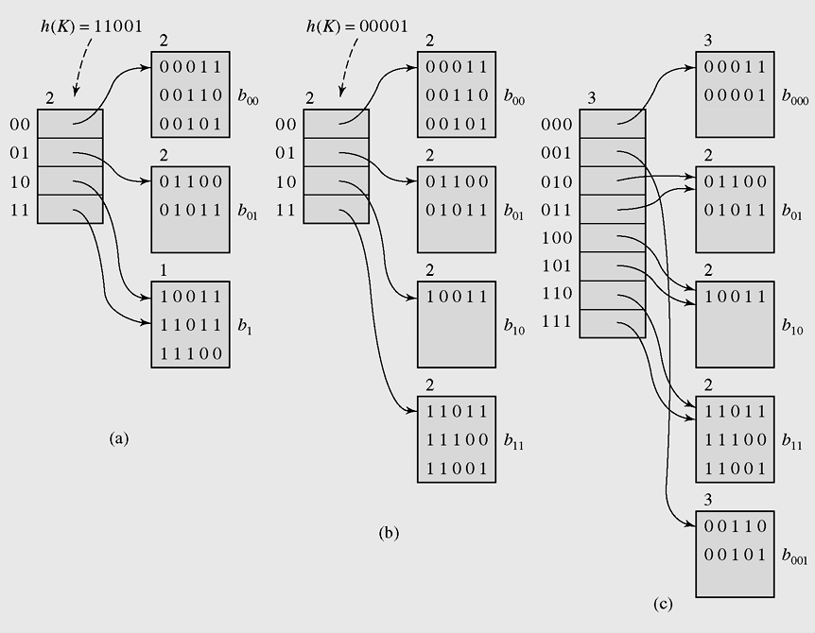
Extendible Hashing (continued)
An example of extendible hashing

Slide 35
Applications of Hashing
There are many areas where hashing is applicable.Here are common ones:
Databases: Efficient retrieval of records.
Compilers: Symbol tables.
Games: Lookup board configuration to find the move that goes with it.
UNIX shell: Quick command lookup.
IP Routing: Fast IP address lookup.

Slide 36
Hashing in java.util - HashSet and HashMap classes
HashSets store objects
  supports adding and removing in constant time
HashMaps store a pair (key,object)
  this is an implementation of a Map
  HashMap is more useful and standard
  HashMap’s main methods are:
    put(Object key, Object value)
    get(Object key)
    remove(Object key)
  All done in expected O(1) time.
  The HashMap class is roughly equivalent to Hashtable, except that it is unsynchronized and permits nulls.
  An instance of HashMap has two parameters that affect its performance: initial capacity and load factor. The capacity is the number of buckets in the hash table. The load factor is a measure of how full the hash table is allowed to get before its capacity is automatically increased.
A hash map is a collection of singly linked lists (buckets); that is, chaining is used as a collision resolution technique

Slide 37
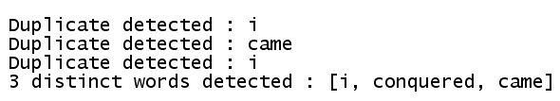
HashSet example
import java.util.*;
public class Main
{ public static void main(String args[])
{ Set s = new HashSet();
String [] a = {"i", "came", "i", "came", "i", "conquered"};
for(int i=0; i<a.length;i++)
{ if(!s.add(a[i]))
System.out.println("Duplicate detected : " + a[i]);
}
System.out.println(s.size() + " distinct words detected : " + s );
}
}

Slide 38
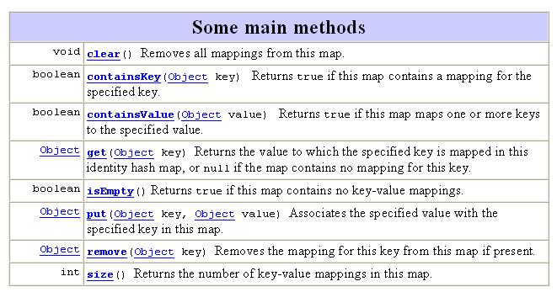
HashMap class
Hash table based implementation of the Map interface. This implementation provides all of the optional map operations, and permits null values and the null key. (The HashMap class is roughly equivalent to Hashtable, except that it is unsynchronized and permits nulls.)

Slide 39
HashMap class example
import java.util.*;
public class Main
{ public static void main(String args[])
{ HashMap hMap = new HashMap();
hMap.put("One", new Integer(1));
hMap.put("Two", new Integer(2));
Object obj = hMap.get("One");
System.out.println(obj);
}
}
Output is: 1

Slide 40
Summary - 1
Hash functions include the division, folding,
mid-square, extraction and radix
transformation methods
Collision resolution includes the open addressing, chaining, and bucket addressing methods
Cichelli’s method is an algorithm to construct a minimal perfect hash function

Slide 41
Summary - 2
In expandable hashing and dynamic hashing, a binary tree is used as an index of buckets
In extendible hashing, a directory of records is kept in a table
A hash map is a collection of singly linked lists (buckets); that is, chaining is used as a collision resolution technique
HashSet is another implementation of a set
(an object that stores unique elements)
A Hashtable is roughly equivalent to a HashMap except that it is synchronized and does not permit null values with methods to operate on hash tables

Slide 42
Reading at home
Text book: Data Structures and Algorithms in Java, Second Edition by Adam Drozdek
Why Hashing?
Hash Functions 520
Collision Resolution 522
Deletion 531
Perfect Hash Functions (*) 532
Hash Functions for Extendable files (*) 538
Hashing in java.util 544
(*) Students are required to understand essential features only (the problem explaination, definitions, the outline of algorithms…), not in details.

Slide 43
Notes about HashSet class
HashSet class is a concrete implementation of Set interface. It creates a collection that uses a hash table for storage. Hash table stores information by using a mechanism called hashing. In hashing, the informational content of a key is used to determine a unique value, called its hash code. The hash code is then used as an index at which the data associated with the key is stored. The transformation of key into its hash code is performed automatically. You never see the hash code itself. The advantage of hashing is that it allows the execution time of basic operation, such as add(), contains(), remove(), and size() to remain constant even for large sets.
HashSet is not synchronized. If more than one thread wants to access it at the same time then it must be synchronized externally.

