Slide 1


Salt Lake City, UT 14 November 2019 – Salt Lake City, UT
airU Google Cloud Platform Solution
Scott Gale – MS Computer Science Project
Department of Computer Science – University of Utah
**Please Hold All Questions Until the End**
Notes:
Bring an airU sensor (in a case / exposed)
Packet inventory
Slide deck
Google Data Studio Sample Report
Technical documentation
Proposal

Slide 2
Agenda
Overview
Google Cloud Platform (GCP) Services
IoT Core
Cloud Functions
Database (BigQuery and Firebase)
Firmware
Web Interface
Cost Analysis
Way Forward
Questions

Slide 3
Acknowledgements
Guidance from Professor Gaillardon
Tom Becnel (Student lead)
Quang Nguyen (MS)
Henry Gilbert (BS Senior Project)
Pascal Goffin (Post Doc)
Senior project team (Spring 2019)
Notes:
1. Highlight the benefits received through collaboraton

Slide 4
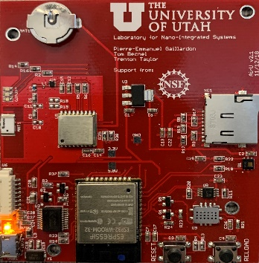

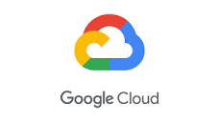


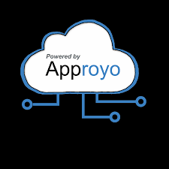

Project Setup and Scope
CADE LAB
SERVER
CLOUD SOLUTION
Why?
Portable
Scalable
Ease of administration
Integration
Notes:
To frame the context of my project
Discuss what the sensor do.

Slide 5
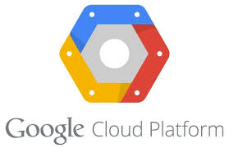

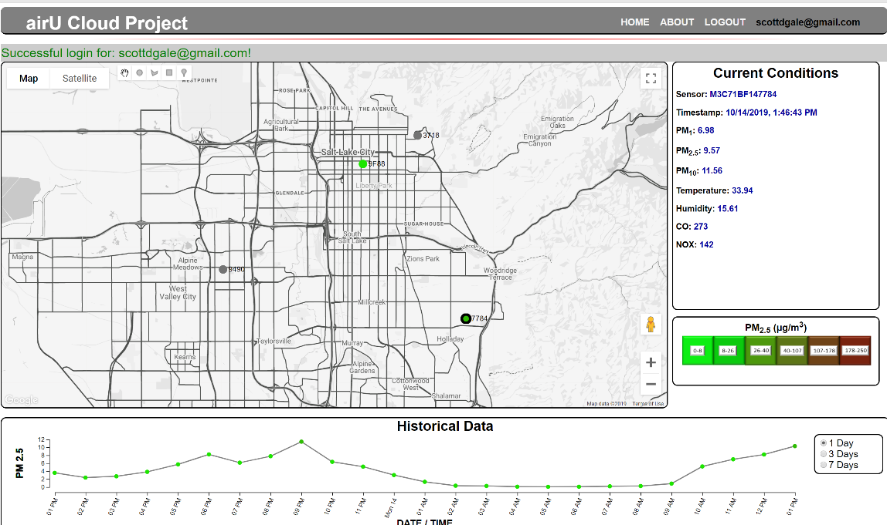
Overview
Device / Sensor
Databases
GCP
BigQuery
GCP
Storage
Bucket
Cloud
Function
MQTT
*Publish
*Subscribe
Web Interface
GCP
IoT Core
Sensor Data
Data Communication
Notes:
Highlight that green is sensor data pathway
Orange is other data communication (firmware, configuration, authentication, and user data)
Briefly discuss each component and the changes required to transform this to a cloud based system
Start with IoT, Cloud Function, Databases

Slide 6
GCP Services (1 of 3)
Registry
IoT Core
Device Registry
Connection configuration
MQTT Broker
Device Configuration / Device State
Configuration: Set firmware version
State: Firmware, reconnect time, publish meta data
Device Commands
Useful to send information to device
Currently used for “reset” functionality
Robust debug logging
Maximum of 10,000 simultaneous MQTT connections
Device_1
Define protocol
Publication topics
Subscription topics
Encryption keys
Device_2
Device_3
Device_n
Notes:
Portal or gateway for IoT, embedded device to connect with Google Cloud Platform services.
Briefly explain MQTT broker – publication / subscription message service
Goolge provides 3 mechanisms to remotely manage devices within the registry
Configuration, State, and Commands
Debug logging feature critical in understanding what is going on with a remote device.

Slide 7
GCP Services (2 of 3)
Cloud Function
Standalone event driven function (node.js)
Triggered by publication to MQTT data topic
Parse packet (JSON)
Forwards and stores data in BigQuery DB
GCP
BigQuery
Cloud
Function
GCP
IoT Core

Slide 8
GCP Services (3 of 3)
Databases
BigQuery (sensor data storage)
Relational style SQL database (serverless)
Automatic data replication and backup features
Designed to ingest / query high amounts of data (IoT)
CANNOT edit records . . . Copy, modify, and delete
Storage for all sensor data – automatic growth
Firebase (user information / authentication)
User information stored in a NoSQL (non-relational) DB
Convenient API to create, edit, or delete information
Firebase Authentication provides “hands off” password handling and maintenance
Can use Google, Yahoo, FaceBook, etc credentials
Notes:
Scalability! Databases scale automatically, no management
Ease of administration (hands off credential management)

Slide 9
Firmware (1 of 2)
Connection to IoT Core
Uses JSON Web Token (JWT) to manage connection
Maximum connection = 24 hours
Idle termination > 20 minutes
Device must exist on the Cloud Platform prior to connection
Over the Air (OTA) updates
Subscription to “Configuration” provided by IoT broker
Filename of the .bin that processor should run
Always receives a Configuration publication upon startup
Notes:
1. Highlight that I did not write all the firmware – updated the firmware for connections and optimization.

Slide 10
Firmware (2 of 2)
Algorithm sending data (packet = 256 bytes)
Send data when data changes
Minimum: At least 1 packet per hour
Maximum: 1 packet per 5 minutes (12 packets per hour)
Define threshold for change
Particulate (PM₁, PM_{2.5}, PM₁₀): 0.25
Temperature, Humidity, NOX: 1.0
CO: 30.0
GPS coordinates: 0.05
30 days – Total data stored in DB Minimum 80% reduction
# Devices | Local System | airU Cloud
100 | 1.1 GB | <= 221 MB
1000 | 11 GB | <= 2.2 GB
Notes:
v1 to v2 we OPTIMIZED the amount of data exchanged from the devices to the database.
v1 sends data packets every minute – Scalability issues especially from a cloud service where we know pay for data storage.
80% reduction from v1 to v2 (1 minute to 5 minute)
Additional threshold parameters in place to avoid sending repetitive data packets
IF DATA doesn’t change then don’t send the data.

Slide 11
Web Interface
Provides:
Account registration / login
Request sensor
View general air quality information (all users)
View specific sensor information to include history (verified owners of sensors)
Version 2 currently deployed (testing)
https://scottgale.appspot.com
Notes:
1. Briefly explain then show live page.
2. Login – show clicking on sensor for historical data.
3. Framework is established for detailed / custom visualizations

Slide 12
Cost Analysis and Scalability
GCP Function | 100 Sensors | 1,000 Sensors | 5,000 Sensors | 10,000 Sensors
IoT Core | $0.00 | $9.16 | $50.30 | $101.73
Cloud Function | $0.00 | $2.77 | $17.06 | $34.91
BigQuery DB Storage | $0.00 | $0.00 | $0.03 | $0.26
BigQuery Query | $2.09 | $403.11 | $2,035.56 | $4,076.11
Web Hosting | $15.00 | $15.00 | $15.00 | $15.00
Monthly Cost | $17.09 | $430.04 | $2,117.94 | $4,228.00
Annual Cost | $205.02 | $5,160.51 | $25,415.28 | $50,736.06
Notes:
IoT: First 250MB data exchanged free / month; $0.0045 per MB thereafter
Cloud Function: First 2 million invocations free / month; $0.40 per million thereafter
BigQuery Storarge: First 10GB free / month; $.020 per GB after
BigQuery Query: First 1TB free / month; $5.00 per TB thereafter
* Price tag for 10,000 sensors may seem high . . . < $0.50 per sensor per month

Slide 13
Way Forward
v1 sensors to web app
Jupyter Notebook variant for researchers
Expand functionality of web app / visualization
Data Studios reports – template in place
https://datastudio.google.com/s/u0IFoAhnMdM
Machine learning
Notes:
Show printout of Data Studios report (included in slide packet)
Number of jumping off points from base solution . . .
Provide researchers with a JN with template queries in place
Show example with 9F88 from 1 November to Present
Data studios highlights the power that can come from a cloud computing framework and the integrated tools that are available.

Slide 14
Conclusion
Databases
Device / Sensor
GCP
BigQuery
GCP
Storage
Bucket
Cloud
Function
MQTT
*Publish
*Subscribe
Web Interface
GCP
IoT Core
Sensor Data
Data Communication

Slide 15
Lessons Learned
Complexity of end to end solution – very little exposure beyond discrete pieces
Complexity of real environment – power, connectivity, weather, users, etc
Solidifies the need for robust engineering
3. Documentation preserves momentum
Code
Design decisions
Interaction of functional blocks
4. Value of team collaboration in design / problem solving
Notes:
Challenge of academics – hard to replicate end to end solution. Nothing in this is overly difficult – discovering, connecting functional blocks into a coherent, working system
Highlight documentation – hard copy back of your packets

Slide 16


Laboratory for NanoIntegrated Systems Department of Electrical and Computer Engineering MEB building – University of Utah – Salt Lake City – UT – USA
Questions
Notes:
Lessons learned:

